Slide 1

A UNIFYING MEASUREMENT FRAMEWORK
Stimulating improvement through measurement
An overview and commentary on New Zealand’s journey on the Integrated Performance and Incentive Framework
Andrew Terris
EPSO Conference September 2015, Helsinki

Slide 2
Presentation coverage
Context
  New Zealand and its health system
  Structures and monitoring frameworks
Current drivers
Desired outcomes and focus for the health system in NZ
The role of measurement – monitor, aid or catalyst
Whole (of) system measurement framework - approach
Progress on the journey (a work in progress)
Observations
The role of monitoring groups in such a framework

Slide 3
Or…
If:
“Every system is perfectly designed to get the results it gets.” (prof Don Berwick)
then:
What is the role of measurement in the complex adaptive system of healthcare?
And
What is the role of monitoring agencies in such a framework?

Slide 4
New Zealand – Context Setting
South-west pacific
Island country
Population 4.59 million
268,680 sq. km (similar UK)
15% Maori (indigenous)
Temperate climate
GDP US$186 billion
Dairy, meat, forestry
Small and geographically dispersed population

Slide 5

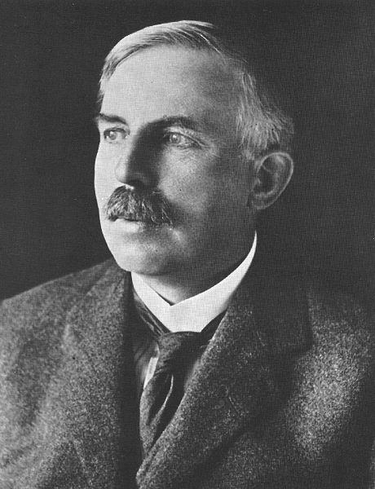



Famous New Zealanders
Sir Edmund Hilary
Lord Rutherford
Sir Peter Jackson
Weta Studios
Lord of the Rings
King Kong
The Hobbit
The All Blacks

Slide 6
New Zealand – Health Context
Public health system (30% with some private insurance)
Funded from general taxation
Hospital level care fully funded
Primary care partially subsidised (50 – 80%), free for U13’s from 2015
20 District Health Boards
33 Primary Health Organisations
capitated /enrolled population – 95% NZ’ers are enrolled in a General Practice.
1,200 general practices (average “capitated” register of 1,500 patients per GP)
GPs and Pharmacies operate as private business funded primarily through Government or DHB contracts with patient co-payment
Population based funding formula (PBFF)
ACC and PHARMAC

Slide 7
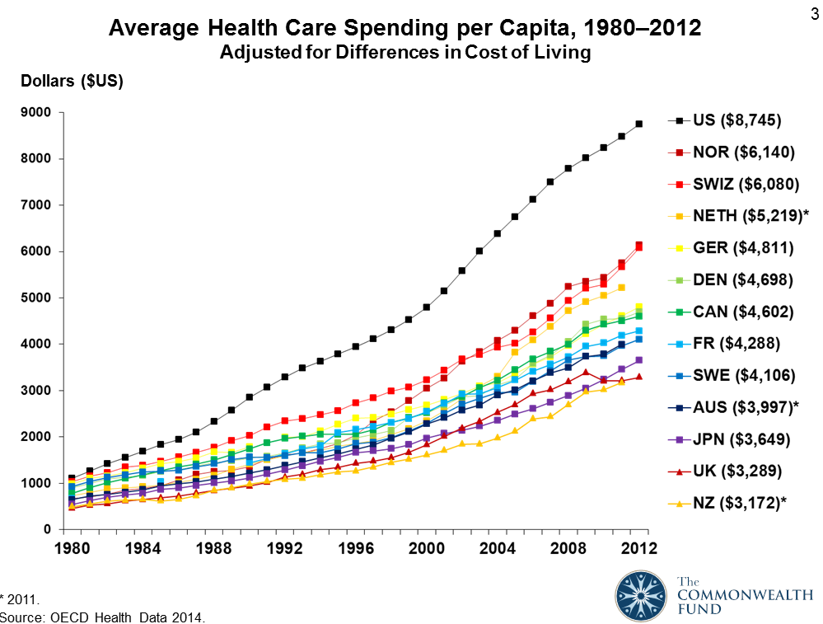
NZ Heath - International context
NZ – low $ but 10% x GDP and growing

Slide 8
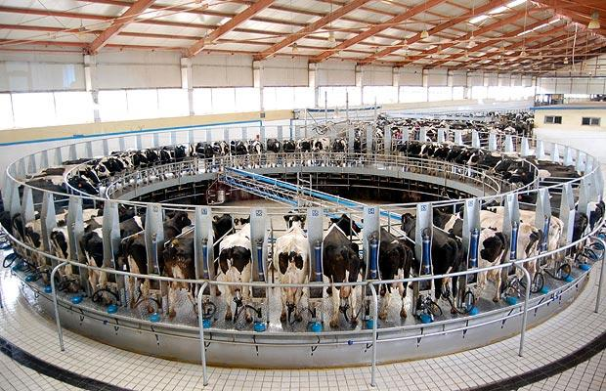

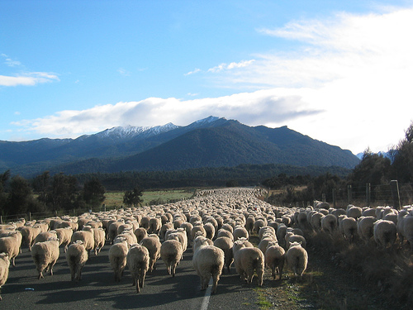

NZ is sustained by…

Slide 9
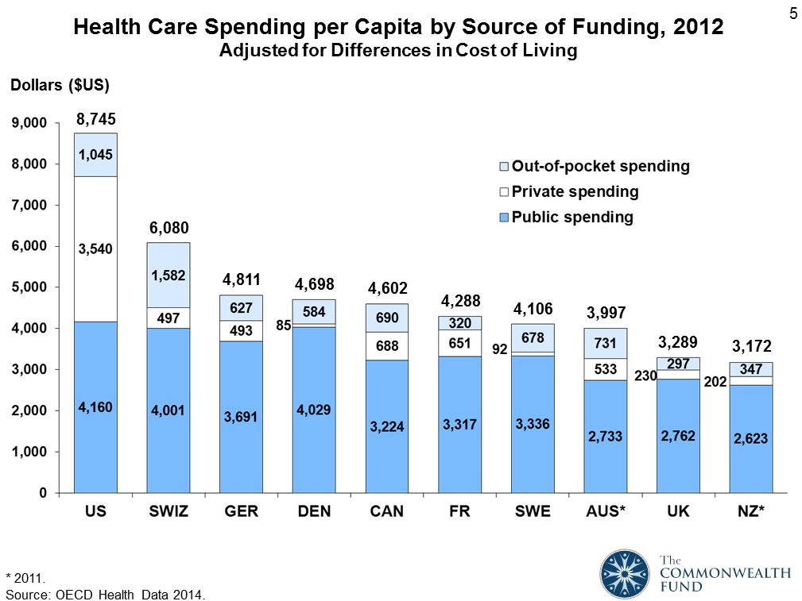
NZ Heath - International context

Slide 10
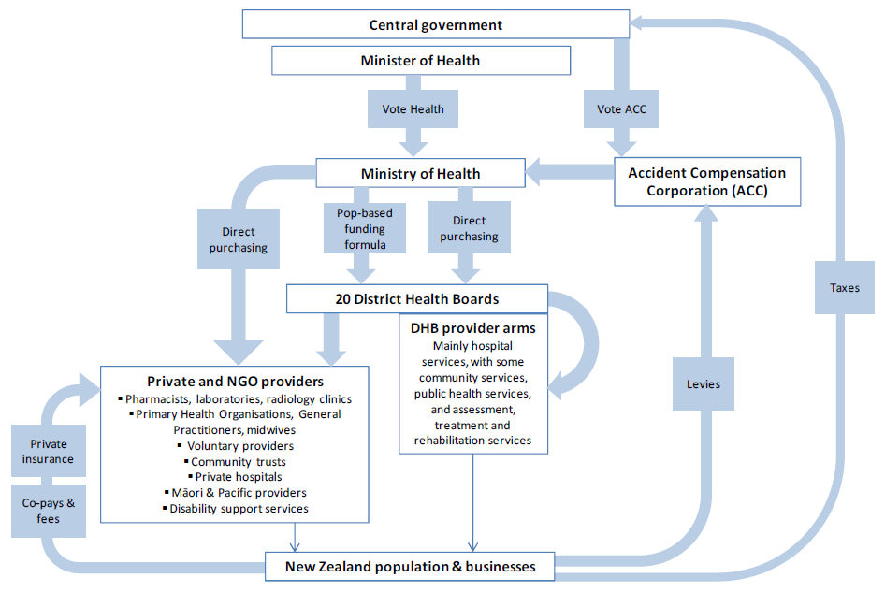
NZ Health Context- funding

Slide 11
Drivers
THE DEMAND SIDE
growing population (110 per day)
increase in ethnic groups, largest growth in Asian ethnic group
The population is ageing. >=65 y.o. will double by 2031
NZ’ers living longer - extra years of life spent in poor health
Disease patterns changing. Cancers are becoming more prominent.
Comorbidity - half of adults aged >=65 y.o. have >=2 LTCs
Disability rates are increasing in all age groups.
THE SUPPLY SIDE
Increasing financial constraints
Increasing technology
An ageing work force
A move to integration and care closer to home
Increased demand for integration of health and social services
Many hospitals reaching end of (asset) life
Projected costs and resources at the current trajectory are not sustainable

Slide 12
Measurement Frameworks
Monitoring (legislative Compliance)
Performance
Quality
Continuum: command and control v devolution /innovation
Removing unwarranted variation

Slide 13
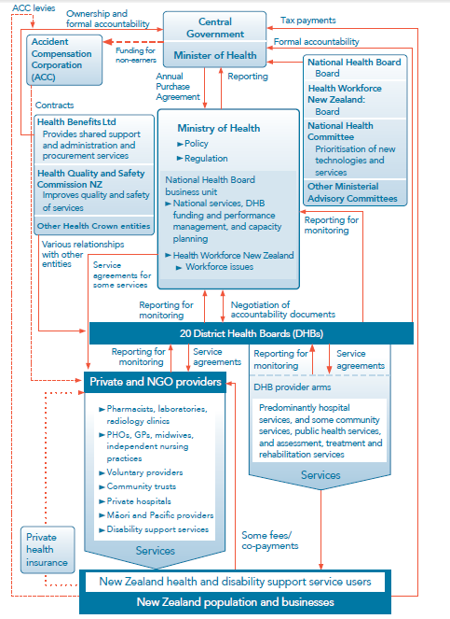
NZ Health Context- Accountability

Slide 14
Health reporting in NZ
FRAMEWORKS (a cross section)
Crown Funding Agreement
(NZ) Triple Aim
Health Targets
DHB Reporting
PHO Performance Reporting
Atlas of Variation (HQSC)
Health Roundtable (private)
Monitoring and Intervention Framework
REPORTING
Health and disability Commission
Health Targets
DHB Reporting (incl. Financial)
PHO Performance Reporting (Targets)
Atlas of Variation (HQSC)
Quality Accounts
Mental Health
(various others)
SILOS

Slide 15
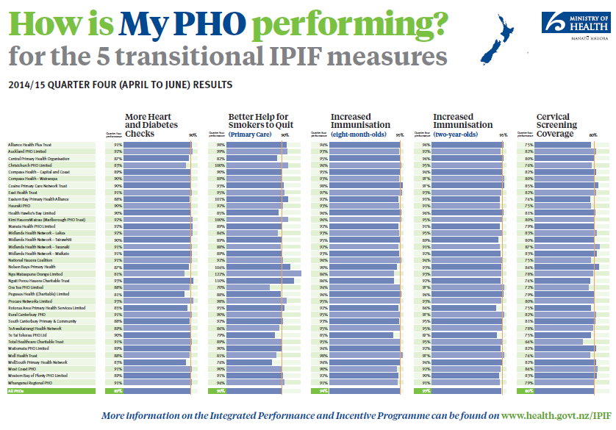
Public reporting - Example

Slide 16
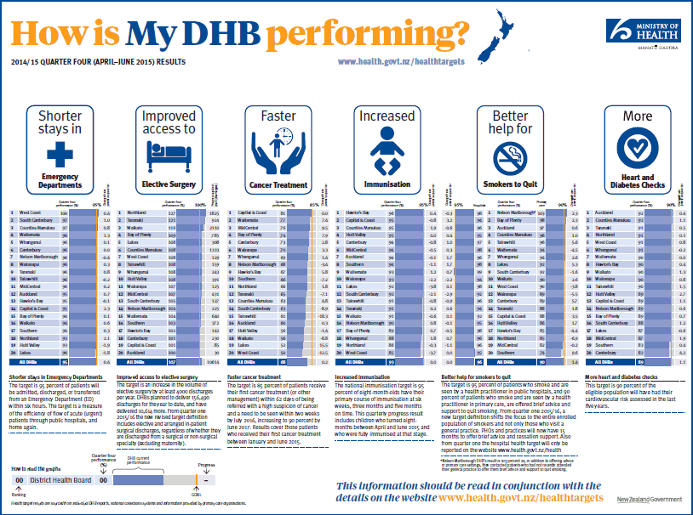
Public reporting - Example

Slide 17
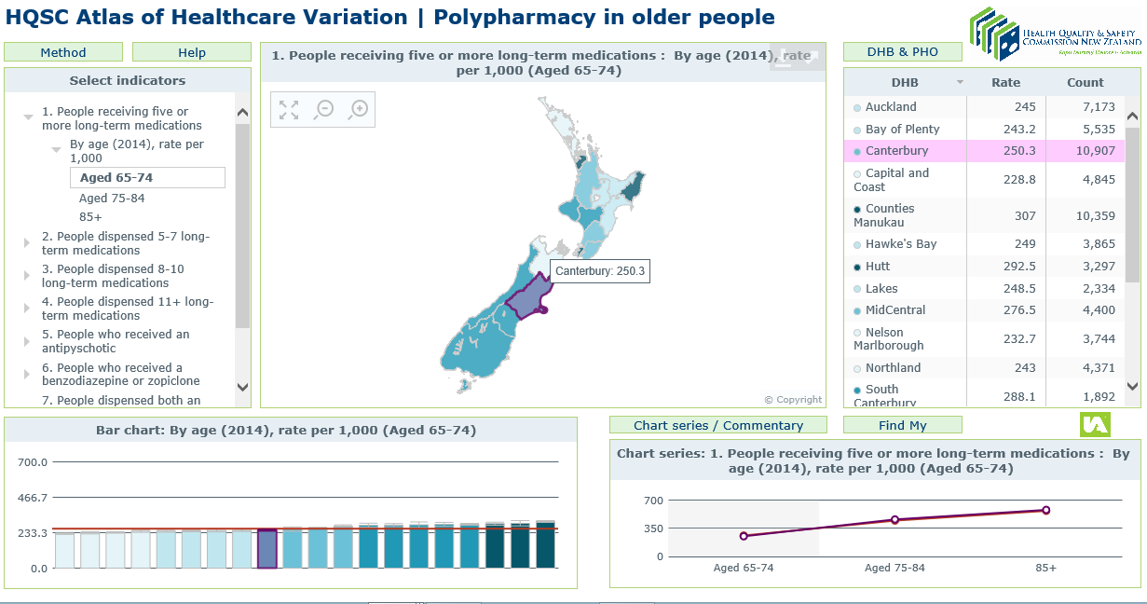
Public reporting - Example

Slide 18
Atlas of variation
Based on the Dartmouth Atlas
QI /tin opener measures
Compare and contrast between providers
Stimulate clinical and quality improvement discussion
Narrative without judgement
Home: (HQSC) Independence, expertise, evidence, reputation

Slide 19
Atlas of variation - HQSC
COMMENTARY
Why is this important? The number of medicines taken increases the likelihood of adverse drug reactions and poor adherence, and in the elderly can lead to geriatric syndromes such as urinary incontinence, cognitive impairment and impaired balance leading to falls. Despite these risks, these data show that those aged 85 and over receive more medicines than those aged either 65–74 or 75–84 years.
What questions does this prompt?
• Is it appropriate that people aged 85 and over are more likely to receive five or more long-term medicines?
• Are the rates of people receiving long-term medicines appropriate?
• Should 1 in 4 people aged 65–74 be receiving five or more medicines?
• Should over half of those aged 85 years plus be receiving five or more long-term medicines?

Slide 20
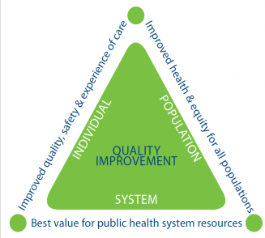
The NZ Triple Aim (a balancing act)
Implementing the Triple Aim requires comprehensive performance measurement, rebalancing the system towards primary care settings, and stronger arrangements for commissioning services and monitoring performance.
Importantly, the Triple Aim requires a focus on all three dimensions simultaneously. A singular focus one dimension is likely to generate negative results on one or both of the other dimensions.
[NZ Treasury –Briefing to the incoming Minister Nov 2014]
NZ Health Quality and Safety commission
Adapted from the IHI Triple Aim
For a publically funded health system

Slide 21
A unifying framework?
A more sophisticated approach is to target outcomes. This is not straightforward: defining, measuring and attributing responsibility for outcomes is hard. Because of this, some performance-related programmes focus instead on encouraging providers to perform specific, clinically-proven processes. However, measuring and attributing responsibility for outcomes is important in its own right and a larger role for performance-related payments may help to embed the necessary processes.
Adopting a more comprehensive measurement framework for the health sector, coupled with streamlined planning and reporting requirements and clearer lines of accountability, which would provide the basis for strengthened monitoring and the adjustment of operational autonomy for DHBs according to performance. These measures need to be accompanied by flexible funding models and priorities that align to incentives in the system and encourage quality and efficiency.
NZ Treasury – Briefing to the incoming Minister : Health Nov 2014

Slide 22
Integrated performance and Incentive framework (IPIF)
Originally envisaged to replace a dated primary care pay-for-performance framework
Approach captured the imagination of clinicians, policy makers and funders – as something with far greater potential
Recommendation 1: Build on the IPIF and other work to date to develop a
comprehensive performance measurement framework for the health sector. – NZ Treasury Briefing to the Incoming Minister -2014
…will measure and reward performance against measures that reflect the level of integration within the district. This new framework, which should be implemented in 2015, aims to encourage districts and their alliances to improve their performance . –2014 International profiles of Heath Care Systems –Commonwealth Fund 2015
It will ultimately measure how the whole system is performing and how each part of the system contributes, and will incentivise the right activity. It seeks to promote local responsibility and discretion to enable innovation and quality improvement, while at the same time being very clear about accountability – MoH Annual Report for the Year Ended 30 June 2014

Slide 23
IPIF – The intent
“The framework seeks balance between the local responsibility and discretion that is needed for innovation and quality improvement, and accountability for performance in meeting sector-wide national health goals.”
Integrated Performance and Incentive Framework – Expert Advisory Group Final Report (Feb 2014)

Slide 24
IPIF – The approach
"The framework relies upon the concept of system level measures , which are set nationally, encapsulate the high level goals of the health system, and serve as the basis for assessing performance of district health systems and all of their component systems.
System level measures serve as the high level organising principle for contributory measures, which are largely locally determined in response to the needs and priorities of communities and health services at the local level.
It is this contributory level that provides the engine to support clinical governance and quality improvement, which will ultimately deliver the best possible performance across the whole of the health system."
Integrated Performance and Incentive Framework – Expert Advisory Group Final Report (Feb 2014)

Slide 25
IPIF draft framework
Triple Aim Dimensions
Incentives
Improved quality, safety and experience of care
Improved health and equity for all populations
Best value for public health system resources
Breakthrough
Measures not predetermined
Measures apply equally to Practices, PHOs and DHBs, reflecting the goals of programme innovation
Maximum freedom, flexible accountability framework
Contributory measures, for each of practices, PHOs, DHBs
System level measures in common across practices, PHOs, DHBs
Contributory measures, for each of practices, PHOs, DHBs
Contributory measures, for each of practices, PHOs, DHBs
Financial
Reputational
Increased ability to influence service design
Excellence
(Higher thresholds)
Contributory measures, for each of practices, PHOs, DHBs
System level measures in common across practices, PHOs, DHBs
Contributory measures, for each of practices, PHOs, DHBs
Contributory measures, for each of practices, PHOs, DHBs
Financial
Reputational
Improvement
DHB Accountability Framework
Sanction
Entry
Quality Accounts
PHO Minimum Requirements
RNZCGP Foundation Standards

Slide 26
IPIF - Approach
Co-development with the sector(dual governance)
Measures of System performance
Contributory measures
Accountability (and reward/sanction) at the Alliance level
Life Stages approach for measures
Expert reference groups (multi-discipline including clinical, management, funding and informatics)
Work streams:
  Governance
  Measures , incentives and reporting
  Audit and Business improvement
  Infrastructure and management Support
  Evaluation
  Change Management

Slide 27
The Measures
A small number of measures reflecting performance of the “system”
Supported by commonly defined “contributory measures” -selected by Alliances to reflect their local context
Organised across life stages: (i.e. agnostic to health setting or discipline)
  Health Start, Healthy Child, Healthy Adolescent, Healthy Adult, Healthy Aging
  Supplemented with
  capacity and capability measure(s)
  a “Patient Experience of Care” survey
  a peer reviewed “self-assessment” against PHO minimum requirements contract

Slide 28
Selection and Development of Measures
Common definition
System level v contributory (big dot, little dot theory)
Life stages
Candidate measures (headings)
  Polypharmacy
  (Childhood) obesity
  Immunisations
  Before School Checks
  Ambulatory Sensitive Hospitalisations
  Caries Free (tooth decay in infants/adolescents)
  Mental Health (youth access)
  Sexual Health (youth access)
  Smoking (adult and elderly)
  Acute demand
  Palliative care
Patent experience of Care survey
Patient access to ePortals

Slide 29
Measure selection and definition
Common definition
Hallmarks of effective measurement
  Clinically relevant
  robust and evidence based
  Reflecting the system and national goals
  Ability to influence the result
Measure definition and selection
Trail run of measures (information, confounders, balancing measures)

Slide 30
Contributory Measures
The engine room of quality
  “front line” service level measurements that show a tangible and meaningful result of (clinical) interaction at the coal face
Ability to influence change(s)
Local applicability
Selected at (local) alliance level to reflect the population needs
Common definition
Net up to system level measures
Inclusive and permissive (not “set” nationally)

Slide 31
Key considerations
(Clinical) relevance and face validity of measures
Shared governance
Nationally consistent definition of measures
Nationally available data
Ability to traverse up and down stream (aggregate and disaggregate) measures
Equity lens (all measures able to be disaggregated by ethnicity and deprivation)
Careful consideration of incentives…

Slide 32
The role of incentives
Squaring the circle on pay for performance and quality improvement...
  Who to pay
  Criteria for payment
  Applied at the ‘lowest common denominator’ of Alliance level?
  How to set targets and thresholds (tin openers v dials – Carter and Klein)

Slide 33
The role of Alliances
Do not exist in policy settings
Based on PPP (public/private partnerships) and construction industry in origin
Attempt to drive beyond silos of existing structures (organisational and funding) and incentivise innovation and shared accountability and investment
Geographic boundaries (serving local population)
However – various levels of capability and maturity and some outliers in “interpretation”

Slide 34
The bigger picture
Social Outcome Measures
Broad social outcome measures
Health Outcome Measures
Broad health outcome measures
Health Activity Measures
Health
Police
Education
Justice
Social Development
DHBs, PHOs, NGOs, etc
Health system efficiency in completing key health milestones
Frontline health professionals and health organisations

Slide 35
Challenges and Constraints
Veracity of information
Evidence base - what makes a good measure?
Mixing QA and QI ingredients in a common pot
Autonomy v control – achieving the right balance
Earned autonomy
Incentives - Rewards and Sanctions
The role of pathways
The biggest challenge is…

Slide 36

Maintaining Currency and momentum
Some lessons from IPIF:
You need to be moving to turn
The course is never straight
wind changes direction
There will be waves!
Start, adapt, improve

Slide 37
Current progress of IPIF in NZ
New Minister
Revision of NZ (primary care) health strategy
Move to a bolder set of measures – a high level set that reflect performance of the system
Put incentives discussion on hold and focus on the measures first
Overarching/unifying framework
Life stages approach not explicit (though implicit)

Slide 38
The role of monitors
Moving from QA to QI – a different lens
Identifying and documenting outliers – at both ends of the spectrum
  Shepherds at the safety margins
  Diffusion of innovation /quality and improvement
Research and input to measurement
Benchmarking
Independent facilitators / moderators
Creating the accompanying narrative from the results
Enduring narrative and reference point (mitigating against the risk of losing institutional knowledge)

Slide 39
What hope for IPIF?
Too soon to tell
However, a central and recurring theme
“…none of us are as smart as all of us”

Slide 40
To include…References
International Profiles Of Health Care Systems, 2014 - The Commonwealth Fund
http://www.hiirc.org.nz/page/45527/expert-advisory-group-eag-report-on-the-integrated/?q=IPIF&highlight=ipif&section=35484
www.treasury.govt.nz/publications/briefings
http://www.hqsc.govt.nz/
http://www.health.govt.nz/

Slide 41
About the author and this presentation
This presentation has been prepared by Andrew Terris (Andrew.Terris@dotjoiner.net) in an independent capacity and is not purported to represent the views of the NZ Ministry of Health.
The author has held a number of national and strategic roles in New Zealand in the areas of health process, information and measurement. He has worked in a number of industries and countries and has a background in consulting, process improvement and programme leadership. He now resides in Europe.

