Slide 1
Measuring the effectiveness of supervisory organisations Innovations in regulatory practice EPSO Conference, Helsinki, 30 September 2015
ERIK KOORNNEEF, PhD candidate,
institute of health policy & management,
erasmus university rotterdam, the netherlands

Slide 2
Today’s presentation
Short description of the study
Regulation & supervision
Objectives of regulation & supervision
Key challenges
Measuring effectiveness
Testing the effectiveness of an alternative model: a natural field experiment
Helsinki, 30 September 2015

Slide 3
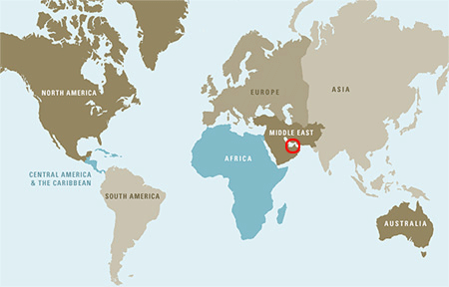
Short description
Aim of the study:
contribute to a better understanding of the effects of healthcare regulation by taking an in-depth look at two specific, innovative regulatory interventions.
This study will examine the roles of procedural justice and behavioural cues on the levels of compliance with hand hygiene requirements amongst medical and nursing staff in the United Arab Emirates.
About myself:
Over 15 years experience in regulatory / supervisory organizations in Ireland and UAE
Currently working as a special advisor to the UAE Government
MSc (Educational Sciences) – Radboud University Nijmegen, the Netherlands
MSc (Health Services Management) – Trinity College Dublin, Ireland
PhD Candidate – Erasmus University, Rotterdam, the Netherlands

Slide 4
Regulation & supervision
Regulation/supervision covers a wide range of interventions and can be viewed as an attempt to direct events, activities and behavior through:
directive measures: standards, targets, guidelines, etc
oversight: monitoring, surveillance, audits, inspections and assessment of compliance
enforcing compliance: sanctions, penalties and rewards).

Slide 5
Regulation & supervision – Objectives
There are three main objective pursued by regulators / supervisory organisations (Walshe, 2003):
Quality / performance improvement
Assurance of minimum standards
Accountability

Slide 6
Key Challenges
Regulatory capture – at times, regulatory bodies may be perceived to have been captured by the industries they regulate
Regulatory escape – over time regulated organisations will try and avoid adherence to the regulations
Regulatory burden – overly prescriptive, large number and complex regulations
Regulatory creep – often more regulatory interventions are introduced to address perceived hazards and risks
Regulatory obsolescence – unnecessary rules are slow to go and new rules to address new risks are slow in coming
Regulatory impact – it is often difficult to establish a causal relationship between regulatory activities and outcomes

Slide 7
Measuring effectiveness
Healthcare supervisory organisations and their funding bodies have made numerous attempts to establish ways to measure effectiveness.
However, research into this field and the empirical evidence is still limited.
Source: Prof. Paul Robben, 2010
Research has found associative rather than causal links between regulation and quality improvement (Leatherman and Sutherland, 2006).
Input
Troughput
Output
Outcome
Final
Outcome
Inspectorate
Inspectee
Society

Slide 8
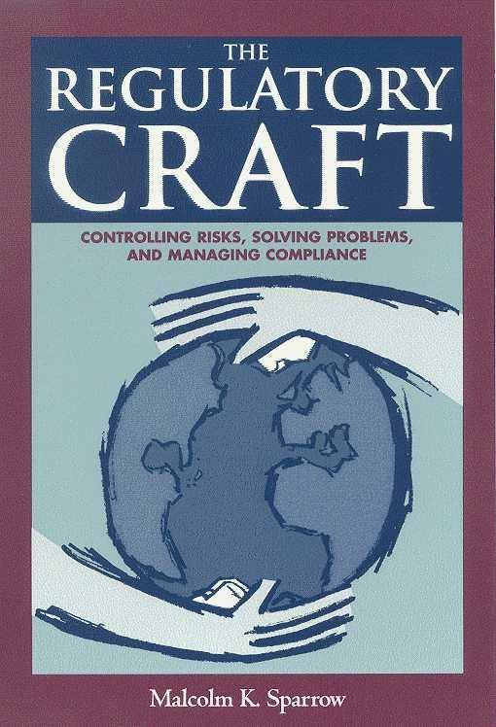
Measuring effectiveness
Current evaluation approaches:
Instrumental/Functional – This type of evaluation looks at whether the regulator / supervisory organization meets its goals and objectives. For example: Jeffrey Braithwaite’s research into the impact of accreditation
Craftmanship – focus on specific problems, implement solutions/ projects and conduct periodic evaluations. For example: Malcolm Sparrow’s research
Risk based approach – is the regulator / supervisor able to predict the future? For example Kieran Walshe and Denham Phipps’ research into the predictive validity of CQC’s Quality and Risk Profile
One of the difficulties is the lack of a comprehensive framework by which to analyse and compare the effects of regulation / supervision

Slide 9
Measuring effectiveness – alternative models
What would a “comprehensive framework” look like?
Indicator based model – a certain level of consensus amongst key stakeholders is emerging to establish a set of valid indicators for measuring patient safety and quality.
Behavioral approach – People can be nudged towards making decisions that are better for their own health and wellbeing as well as patients.
Procedural justice - perceptions of procedural fairness exert more influence on people’s overall view of the authorities than their perceptions of distributive fairness. Research has shown that when regulatees believe the regulator’s process was fair they are more likely to comply with the regulator’s instructions and comply with requirements.
Transparency – making healthcare providers accountable by reporting against agreed, evidence based indicators
People as ‘amoral calculators’ – are people rational actors who are motivated by self interest – do they seek to maximize their gains and minimize their losses?
How people perceive the regulator’s processes may have a big impact on compliance.

Slide 10
Measuring effectiveness – an alternative model

Slide 11
Hands, eyes & compliance: A natural field experiment
Erik KoorNneef (Erasmus University, Rotterdam, the Netherlands)
Nikos Nikiforakis (NYU Abu Dhabi, UAE)
Paul Robben (Erasmus University, Rotterdam, the Netherlands)

Slide 12
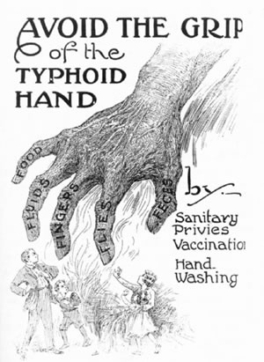
Rationale
One of the biggest patient safety challenges in healthcare is the prevention and control of healthcare-associated infections (Institute of Medicine, 1999).
Around 80,000 people (USA) and 37,000 (EU) die each year as a result of healthcare associated infections (European Centre for Disease Prevention and Control, 2008).
Adequate hand hygiene by healthcare professionals is as one of the most effective measures to reduce HCAIs (WHO, 2009).
Hand hygiene can prevent between 15 and 30% healthcare-associated infections (Grol & Grimshaw, 2003)
Despite this importance of hand hygiene, studies across the globe have shown that compliance rates amongst healthcare professionals are often very low (around 40%)
Why is hand hygiene important?
Public Health poster from 1921

Slide 13
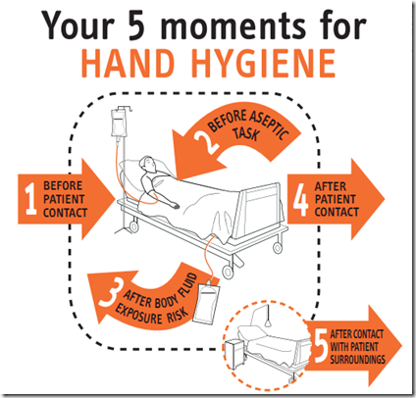
The Problem
The World Health Organization (WHO) has identified “Five Moments for Hand Hygiene” (WHO, 2009):
Before patient contact;
Before an aseptic task;
After body fluid exposure risk;
After patient contact and
After contact with patient surroundings.
Nurses in pediatric wards have an average of 8 opportunities for hand hygiene per hour of patient care; nurses in ICUs have an average of 30 opportunities per hour.
Hand hygiene compliance – 40%
The average healthcare worker correctly washes their hands in 4 out of 10 opportunities

Slide 14
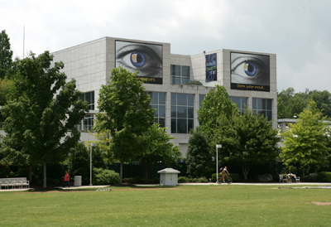
Our Research Question
Our research question:
To what extent can providing individuals with information about how to properly wash their hands as well as a simple 'behavioral' intervention which has been shown to increase compliance in lab experiments affect compliance rates to hand hygiene requirements in a natural field setting?
Our intervention primes people to think they are being monitored while washing their hands.

Slide 15
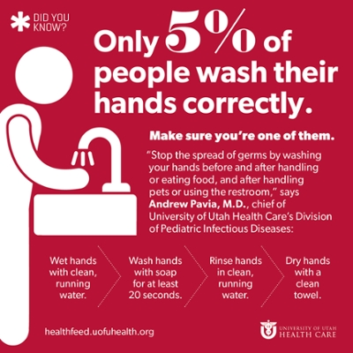
Solutions
Numerous studies have reviewed interventions aimed at improving hand hygiene
A multi-modal approach to hand-hygiene promotion is considered to be the most efficient and effective way to improve compliance.
However, this multi-modal approach can be expensive and resource intensive to implement
An easier to implement solution might be to introduce different type of promotional material
To date, very few studies have investigated the effects of promotional and awareness posters
Are there effective ways to improve hand hygiene compliance?

Slide 16
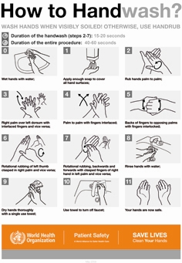
Measurement
WHO Hand Hygiene Observation Tool:
Technique – 11 steps correctly followed?
COMPLIANCE SCORE
LENGTH OF TIME
WHO has developed a standardized measurement tool
Unobtrusive observation by trained professional
In this study the duration and technique are measured
Notes:
NIKOS I guess for our study we don’t really need to discuss the 5 moments. We only care about the before patient contact (or will we also look afterwards)? Maybe the top poster should go to slide 4.

Slide 17
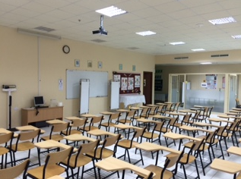
Our Study
Independent variables
Behavioral prompt (‘watching eyes’)
Participants’ perceptions of the legitimacy of the regulator / supervisory organisations
Dependent variables
Hand hygiene technique
Duration of hand washing
(measured using an observation tool reflecting the WHO Hand Hygiene Guidelines)
Participants
Doctors and nurses in a large hospital in the United Arab Emirates (UAE): between 200-300 participants
Controlled experiment

Slide 18
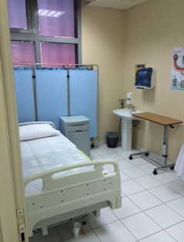
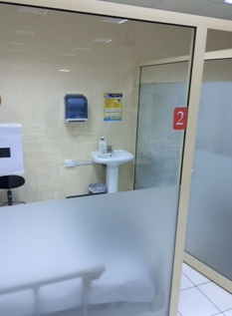
Our Study
Doctors and nurses are invited to take part and select a time slot (15-20 mins.) over a three day period.
The Research Assistant (RA) gives the students an overview of the study, asks them to read the information sheet and sign the consent form.
RA asks the participants to prepare a bandage (aseptic) in order to address a wound on a mannequin (patient).
This task takes place in one of the observation rooms.
Methodology
Clinical Skills Lab
Notes:
TO DISCUSS BEFORE TALK
NIKOS How is the bandage preparation related to the study mentioned in the first bullet point?
NIKOS What incentives do students have to participate?
NIKOS What incentives do they have to properly wash their hands and apply the bandage? This is a key question. Are they being graded?

Slide 19
Our Study
It is anticipated that a high number of participants will wash their hands without any prompting.
However, the RA may need to prompt the participants who do not attempt to wash their hands in the first instance.
The RA will observe the behavior and record the duration of the hand washing as well as the level of compliance (hand hygiene technique), using a standardized tool based on the WHO tool
Observation

Slide 20
Our Study
Once in front of the hand wash basin, the hand washing duration and technique of each participant will be observed by a trained observer.
The participant are randomly assigned into the following treatments:
Participants are not aware they are taking part in an experiment.
Controlled experiment
 | Without ‘watching eyes’ | With ‘watching eyes’ | With ‘CCTV camera’
No WHO Poster | T1 | T2 | T5
WHO Poster | T3 | T4 | T6
Notes:
POWER TESTS In sum, it seems we will be able to detect differences which are about 16 percentage points with a sample of 280. With 200, we need a 20 percentage point difference.
. power twoproportions 0.40, n(200) power(0.8)
Estimated effect size and experimental-group proportion:
delta = 0.1969 (difference)
p2 = 0.5969
. power twoproportions 0.40, n(280) power(0.8)
Estimated effect size and experimental-group proportion:
delta = 0.1666 (difference)
p2 = 0.5666
. power twoproportions 0.30, n(280) power(0.8)
Estimated effect size and experimental-group proportion:
delta = 0.1619 (difference)
p2 = 0.4619

Slide 22
Watching eyes – The evidence
Human Evolution:
Fast, automatic psychological mechanisms appear to have evolved to respond to eye-like stimuli. Humans are attuned to cues that indicate reputational consequences of behavior (Haley & Fessler, 2005; Bateson et al, 2006).
Automatic priming effect of ‘watching eyes’: the presentation of a stimulus (the ‘prime’) alters the subsequent behavior of an observer (Powell, Roberts & Nettle, 2012)
Possibility of punishment: the presence of eye images is a cue to the possibility of punishment.
Reputational consequences: prosocial acts are performed in order to increase the likelihood of being chosen by others (reciprocity).
Why do eyes matter?

Slide 23
Watching eyes – The evidence
LAB Studies
Haley & Fessler (2005): ‘watching eyes’ increase the likelihood and amount given in a Dictator Game
Nettle et al (2013): (meta-analysis) ‘watching eyes’ increase likelihood but not amount given in Dictator Games
Fehr & Schneider (2011) found no effect of ‘watching eyes’ on reciprocal behavior
FIELD Studies
Bateson et al (2006): ‘watching eyes’ & message of ‘personal plea’ have a significant effect on contributions to an ‘honesty box’ in a university coffee room
Ernest-Jones et al. (2011): ‘watching eyes’ reduce littering in a cafeteria, but only when few people are around
Francey & Bergmueller (2012): ‘watching eyes’ had a significant effect on the time people spent cleaning garbage but no effect on the likelihood they would clean up.
Nettle et al (2012): in locations where researchers had placed and warnings there was a 65% reduction in bicycle thefts (non-random selection, and full displacement of crime).
The presence of implicit social cues such as a picture of a pair of eyes can affect human behaviour in areas such as:
Charitable giving
Paying for coffee
Cleaning
Bicycle theft
Notes:
NIKOS The literature seems to suggest mixed results. In addition, most studies are done by the same team (Nettle and Bateson) which means that experimenter fixed effects may be strong…

Slide 24
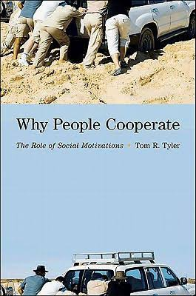

Slide 25
Legitimacy – The evidence
Tom R. Tyler discovered in the 1980s that people who perceive to have been treated fairly by authorities, are more likely to comply with requirements, because of a relational bond.
This is also known as procedural justice, which is in stark contrast with the traditional viewpoint and approach that links cooperation and compliance to instrumental judgements of distributive fairness, fairness that is associated with outcomes decisions and distribution of resources.
Several studies demonstrate that when people who are being regulated believe the regulator’s process was fair they become more likely to comply with the regulator’s instructions and follow the law and requirements.
Perceptions of procedural fairness exert more influence on compliance behavior than their perceptions of distributive fairness:
Tax compliance
Justice system
Policing
Adherence to medical advice
Notes:
NIKOS The literature seems to suggest mixed results. In addition, most studies are done by the same team (Nettle and Bateson) which means that experimenter fixed effects may be strong…

Slide 26
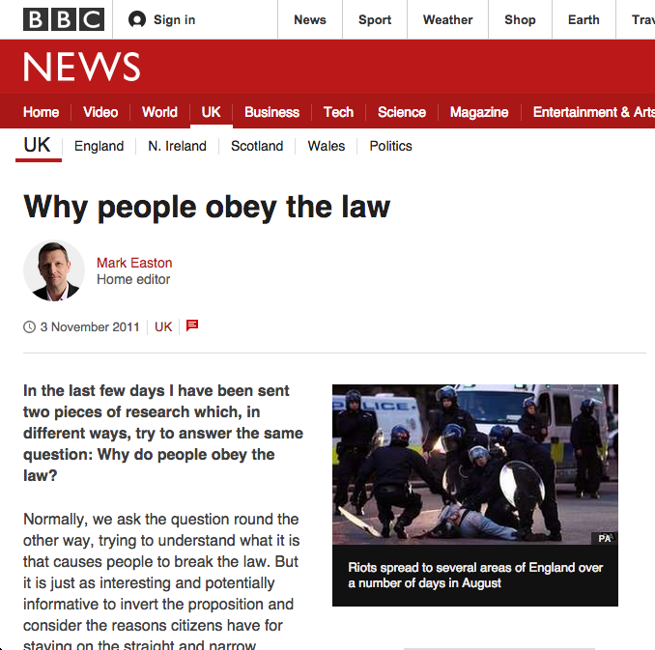
Legitimacy – Survey
The survey asks the participants to indicate the extent of their agreement to 20-30 items on a Likert scale. These items include statements such as:
If everybody respected regulatory requirements, the quality of services would be better (Legitimacy)
A healthcare professional should do whatever the regulator tells you to do even though you do not understand the reasons for their decisions (Legitimacy)
If a healthcare professional does not renew their professional license on time they should lose their license to practice (Distributive Fairness)
If I became aware of a potentially danger to the health and wellbeing of patients or the public, I would immediately contact the relevant regulatory authority (Cooperation)
Notes:
NIKOS The literature seems to suggest mixed results. In addition, most studies are done by the same team (Nettle and Bateson) which means that experimenter fixed effects may be strong…

Slide 27
Contact details
For more information:
Erik Koornneef, PhD Candidate
Institute of Health Policy & Management,
Erasmus University Rotterdam, the Netherlands
ekoornneef@gmail.com
https://sites.google.com/site/erikkoornneef/
00971 56 622 1005
Professor Paul Robben
Institute of Health Policy & Management,
Erasmus University Rotterdam, the Netherlands
Professor Nikos Nikiforakis
Department of Economics,
New York University Abu Dhabi, United Arab Emirates
Notes:
NIKOS We need to do a power calculation to find out how likely we are to detect any significant treatment differences.

