Slide 1
18th EPSO Conference Dublin 25-26 September 2014
Welcome to Dublin
Céad míle fáilte
Professor Jane Grimson
Acting Chief Executive,
Health Information and Quality Authority (HIQA)
25 September 2014

Slide 2
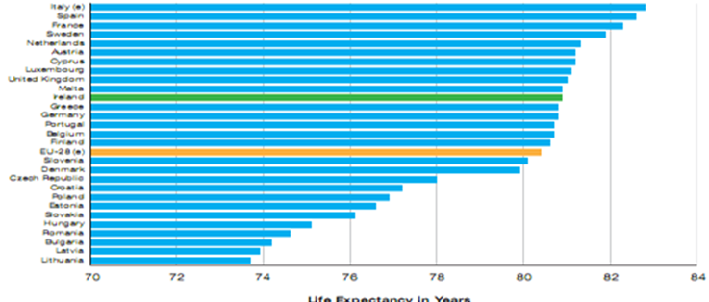
Ireland – population and health
Life expectancy at birth for EU-28 countries (2011)
Population of Ireland is 4.57 million (2011 census) – a 13% increase since 2004
Life expectancy in Ireland has improved by 38% in the last 90 years – from 57 (1925) to 79 (2013)
Cardiovascular disease accounts for 36% of all deaths in Ireland

Slide 3
Ireland – age profile

Slide 4
The Irish public health service
Total public expenditure
€13.9bn (8.9% of GDP)
100,266 employees
Hospitals
1.53m inpatients & day cases
1.28m emergency department attendances
Residential care
28,785 beds for older & dependant persons
9,800 persons with a disability
5,000 children
Longstanding illness or health problem
33.9% of females
29.5% of males
Healthcare entitlement
‘Medical card’ = 40.4%
Private health insurance = 45%

Slide 5
Structure of the Irish health service
Department of Health and Department of Children & Youth Affairs
- Policy
- Regulatory framework
Public, private and voluntary services
The Health Service Executive (HSE) provides health and social services to everyone living in Ireland. These public services are delivered in hospitals, health facilities and in communities.

Slide 6
A global leader in health technologies and innovation
The world’s largest net exporter of medicines
Highest number of people per capita in EU working in medical devices industry
24% of exports are information and communications technologies (ICT)
28% of Irish exports are medical devices and pharma products
9 of the world’s top 10 pharma companies have significant operations here

Slide 7
The perfect storm
Falling budgets
Increasing demand
Notes:
It’s not just us – delivering high reliability healthcare is a challenge for all countries

Slide 8
Health Information and Quality Authority (HIQA)
HIQA exists to promote sustainable improvements, safeguard people using health and social care services and support informed decisions on how services are delivered.

Slide 9
HIQA’s functions
Set standards in health and social care
Monitor healthcare
Monitor and register social care services

Slide 10
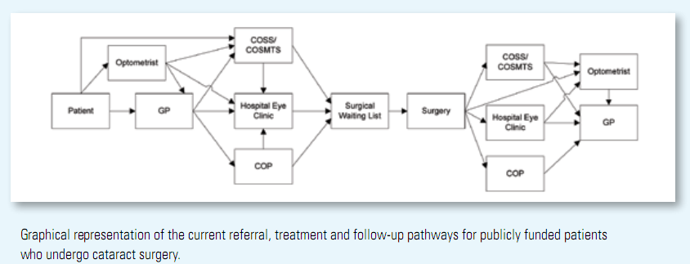
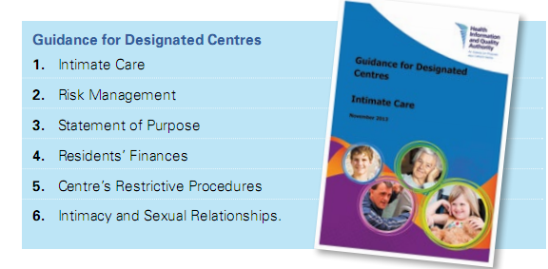
HIQA’s functions (continued)
Health technology assessment
Development of health information
Driving patient safety initiatives and
quality improvement

Slide 11
Is fearr an tsláinte ná na táinte Thank you

