Slide 1
Organisational structure of supervisory organisations – The CQC approach
Husna Mortuza & Claire Robbie
Strategy & Policy
29 September 2015
1
Notes:
1

Slide 2
CQC purpose and role
Our purpose
We make sure health and social care services provide people with safe, effective, compassionate, high-quality care and we encourage care services to improve
Our role
We monitor, inspect and regulate services to make sure they meet fundamental standards of quality and safety and we publish what we find, including performance ratings to help people choose care

Slide 3
Landscape of health and care
General public
54.5 million (44.5m adults)
Care homes
565,000 residents
165,000 going into care per year
39,000 people with learning disabilities in residential care
18,000 in a care home or care in their own home with no kith or kin
Home-care
700,000 people receiving home-care support per year
Private hospital
1.61 million people receive surgical treatment in a private hospital / year
NHS hospitals
90 million outpatient appointments / year
11 million inpatients / year
18 million A&E attendances
5 million emergency admissions / year
600k maternity users
42,000 detained and treated against their will
Dentists
22 million on a dentist list
15 million NHS
7 million private
GP practices
52 million registered with a GP
150m appointments / year
Health & social care staff
1.7m NHS staff
1.5m in adult social care
Stroke 1m Diabetes 3m Arthritis 8.5m Cancer 2m Dementia 0.7m
↑25% by 2020 ↑67% by 2025 ↑100% by 2030 ↑100% by 2032 ↑100% by 2040
NB There is overlap between our different audiences – none are wholly distinct from the others

Slide 4
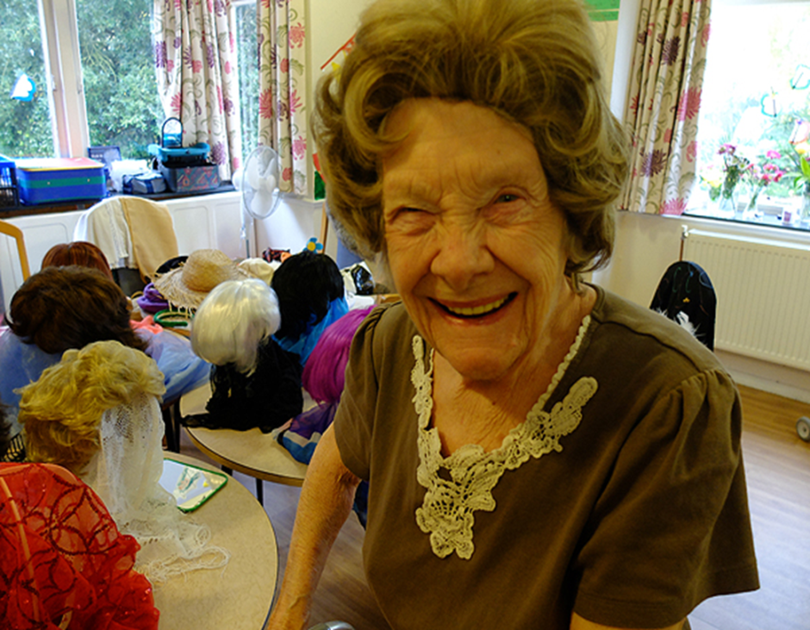
Regulation to inspire improvement at local- regional- national level
What we do:
Set clear expectations
Monitor and inspect
Publish and rate
Celebrate success
Tackle failure
Signpost help
Influence debate
Work in partnership

Slide 5
Organisational structure

Slide 6
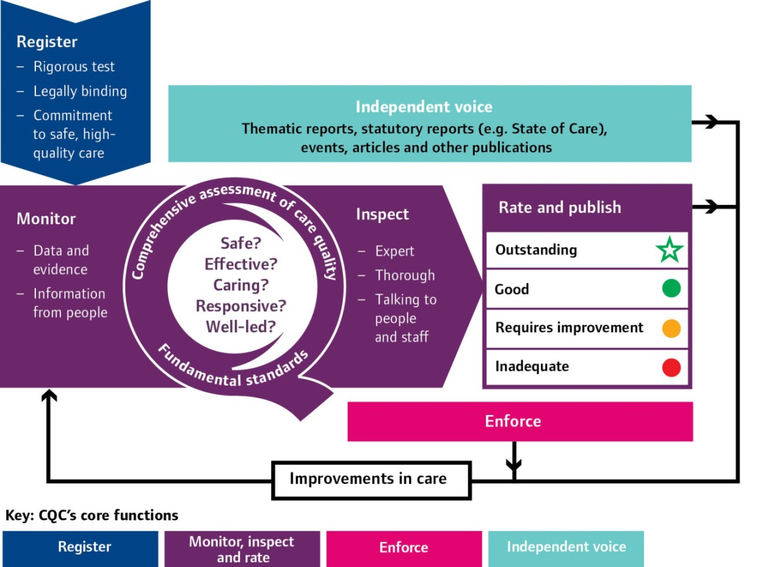
Our new approach
6

Slide 7
All ratings at 7 September 2015
(approx. figures)
Hospitals
4 (2%) Outstanding
77 (36%) Good
Adult Social Care services
Primary medical services
63 (4%) Outstanding
115 (55%) Requires Improvement
14 (7%) Inadequate
34 (<0.5%) Outstanding
4241 (58%) Good
2500 (34%) Requires Improvement
512 (8%) Inadequate
1315 (81%) Good
188 (11%) Requires Improvement
64 (4%) Inadequate
7

Slide 8
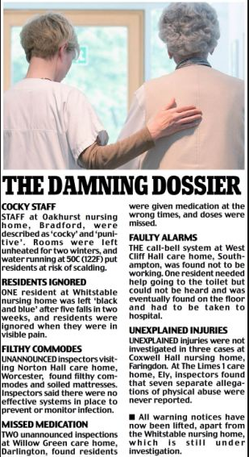
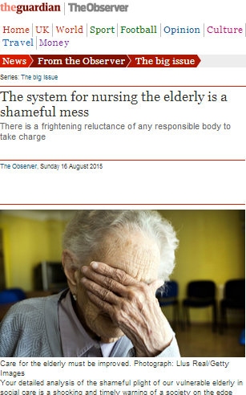
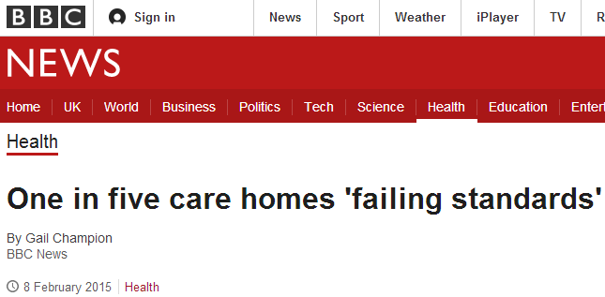
A snapshot of the news
8

Slide 9
Being Open to the public
Raise awareness and understanding of CQC’s role and purpose.
Engage the public in our shape & design
Listen to, and act on people’s views and experiences of care.
Provide high quality information about care services
9

Slide 10
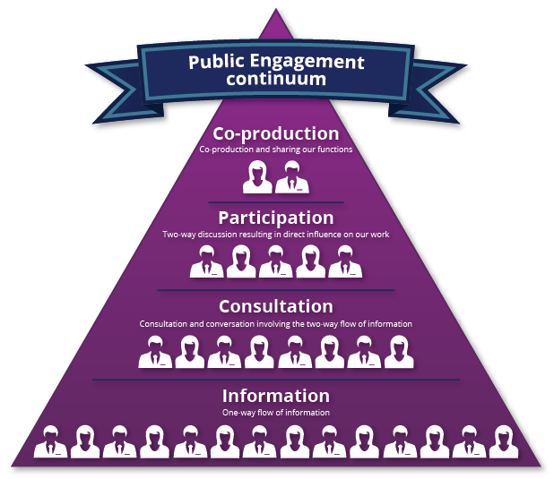
Co-production and involvement
10

Slide 11
Making information accessible
and available
We currently have over one hundred thousand inspection reports on our website and we add another 150 a week
11

Slide 12
Impact and value for money
£££
INPUTS
ACTIVITIES
OUTPUTS
OUTCOMES *
The financial resources CQC receives through grant in aid and fees.
How we convert £ into resources that can be used to deliver activity.
The activities undertaken which lead to creation of outputs.
The outputs which in total create impact and help CQC to achieve its objectives.
The impact we have which allow CQC to demonstrate its value for money.
IMPACT APPROACH – UNDERSTANDING COSTS AND BENEFITS
Economy – Is CQC procuring goods and services and paying the market rate in a way that allows us to get the greatest number of inputs for the money we have available?
Efficiency – Is CQC using its resources in the best way? How might we deliver our activities better? How are we converting inputs to outputs and how can we maximise this process?
Effectiveness – What is the impact of our regulation and are we having the desired effect? Does the cost to CQC and others justify the benefits?
* Within the logic model this is described and split out as intermediary and final outcomes

Slide 13
Understanding our costs
Understanding the total cost of CQC’s activities for each operating component by sector:
CQC’s own costs
(finance)
Costs to providers and other stakeholders
[In the medium term this will focus on provider costs only, collected through case studies and surveys]
Total Cost of CQC existing
[It is likely that this will be presented as a range, for the medium term at least, given the qualitative approach to understanding the costs to others]

Slide 14
Understanding how we influence behaviour…
Capturing Intermediary Outcomes:
Case studies
Post inspection survey
Provider feedback survey
Answers to: Are providers making changes as a result of CQC’s activities? And what are the specific changes made?
Inspection Team Survey
Frontline Staff Survey
“what have you done differently as a result of the CQC inspection/ guidance/ enforcement;” [Intermediary outcomes]
to follow up with “what did it cost;” and [provider costs]
(if possible) “did it improve quality.” [final outcomes]
Surveys
Capturing Final Outcomes:
Does behavioural changes also improve the quality of care?

Slide 15
Reflections on CQC Structure
1. We have created a more open culture in CQC and are more transparent
2. We are more credible with stakeholders and providers because of our expert and rigorous inspections, and because of the action we take when we find poor care
3. We are starting to provide more useful information for the public, including ratings

Slide 16
Moving forward- what next?
1. A more mature model- efficient and effective
2. Working with partners to improve quality
3. Understanding Quality in a Place

Slide 17
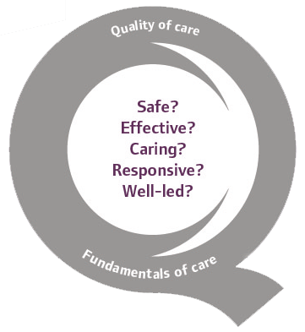
Thank you
www.cqc.org.uk
17

