Slide 1
Vilans KICK- protocols
Providing professional care based on the latest evidence
datum
31-5-2016
door
Marleen Versteeg

Slide 2
High risk procedure protocols in nursing
The Vilans KICK-protocols are standardized descriptions of procedures carried out by professional caregivers like:
Punctures
Infusion of fluids
Inserting catheters
Injections
Suction and caring for tracheatubes
Administration of medication

Slide 3
Characteristics
Practice and evidence based e.g. national guidelides, research and opinions of experts
Protocols checked and tested in daily practice by professional caregivers
Written in understandable language
Online accessible
Efficient
“Unnecessary disconnection of catheterbags increases the risk of urinary tract infection”

Slide 4
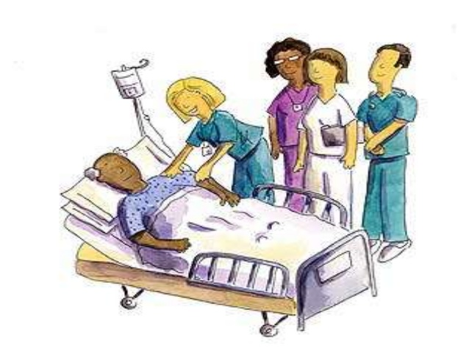
Protocol database (500 procedures) Every procedure has the same setup
Background information about risks and complications
Background information about materials e.g. syringes, medication
Background information about hygienic measures
Each protocol consists of:
Long version (teaching/ instruction)
Short version
Checklist

Slide 5
Community of practice:
Members are healthcare organisations with a subscription
Users are professional caregivers, teachers and instructors
From different fields (homecare, mental healthcare, nursing homes)
Input of users is shared with users and other members
Users can make requests for new protocols. The newly developed protocols become available (after testing) for all the other menbers

Slide 6
Notes:
Branche Aantal
VVT: 239 (verpleeghuis en thuiszorg)
GH: 39 (gehandicaptensector)
ROC: 26 (scholen)
Overig: 9
GGZ: 7 (geestelijke gezondheidszorg)
Ziekenhuis: 5
Branche org.: 3
Hogeschool: 1

