Slide 1
Risk indicators for monitoring quality EPSO September 2016
1

Slide 2
Our next strategy at a glance
Our ambition for the next five years is…
A more targeted, responsive and collaborative approach to regulation, so more people get high quality care.
We will achieve this by focusing on four priorities…
1
2
3
4
Encouraging improvement, innovation and sustainability in care
Delivering an intelligence-driven approach to regulation
Promoting a single shared view of quality
Improving our efficiency and effectiveness
We will know we’ve succeeded when…
People trust and use our expert, independent judgements about the quality of care
People have confidence that we will identify good and poor care and that we will take action where necessary so their rights are protected
We encourage organisations that deliver care to improve quality
We encourage organisations to use resources as efficiently as possible to deliver high-quality care.

Slide 3
What do we mean by ‘delivering an intelligence-driven approach to regulation?
We will deliver an intelligence-driven approach to regulation – we will use our information from the public and providers more effectively to target our resources where the risk to the quality of care provided is greatest and to check where quality is improving.
Through our comprehensive inspection regime we are building a unique baseline of knowledge that provides critical insights into the quality of care people are receiving.
We will soon complete inspections of all the services we rate. When we have finished, the answer is not simply to start again, but to use what we have learned.
More resources used to assess services with poor ratings or where a rating is likely to change
Less resources used on services where care quality is good and likely to remain so
3
Notes:
We will finish our programme of comprehensive inspection in the first year of the new strategy. This provides us with a unique view of the quality of health and social care across England. We are not going to repeat the same process. We are going to build on what we have learned. In doing so we need to adapt our regulation approach to the way services will be delivered in future, the changing expectations of the public, providers and partners and the realities of reducing budgets. And we need to take advantage of the opportunities presented by our knowledge and by new technology to carry out our purpose, which has not changed.
To evolve our approach the strategy says we will deliver an intelligence-driven approach to regulation: We will use our information from the public and providers more effectively to target our resources where the risk to the quality of care provided is greatest and to check where quality is improving.
In order to do this, we need to better monitor changes in quality by bringing together what people who use services are telling us, knowledge from our inspections, and data from our partners. This includes monitoring both where our insight suggests risk is greatest or quality is improving.
We will use our insight model to make decisions about what action to take, such as responsive inspections triggered by information that highlights concerns or suggests quality has improved.
In practice, when we talk about CQC becoming ‘intelligence driven’ it means that good information as evidence should consistently permeate all our decision making. CQC is a complex organisation that makes decisions every day both about how we run CQC and how we judge providers’ performance and respond to changes in the quality of care.

Slide 4
What does this mean for our risk monitoring products?
We will build a new Insight model that monitors quality. We will inspect all new services, but then focus our follow-up inspections on areas where our insight suggests risk is greatest or quality is improving.
We will better monitor changes in quality by bringing together what people who use services are telling us, knowledge from our inspections, and data from our partners.
When we complete our comprehensive inspections we will be even clearer about the data that tells us most about quality.
Need to identify positive change as well as risk
Need to focus on the data we know is most closely related to quality
Need to provide more timely and detailed information to inform decisions about what action to take
4
Notes:
We will finish our programme of comprehensive inspection in the first year of the new strategy. This provides us with a unique view of the quality of health and social care across England. We are not going to repeat the same process. We are going to build on what we have learned. In doing so we need to adapt our regulation approach to the way services will be delivered in future, the changing expectations of the public, providers and partners and the realities of reducing budgets. And we need to take advantage of the opportunities presented by our knowledge and by new technology to carry out our purpose, which has not changed.
To evolve our approach the strategy says we will deliver an intelligence-driven approach to regulation: We will use our information from the public and providers more effectively to target our resources where the risk to the quality of care provided is greatest and to check where quality is improving.
In order to do this, we need to better monitor changes in quality by bringing together what people who use services are telling us, knowledge from our inspections, and data from our partners. This includes monitoring both where our insight suggests risk is greatest or quality is improving.
We will use our insight model to make decisions about what action to take, such as responsive inspections triggered by information that highlights concerns or suggests quality has improved.
In practice, when we talk about CQC becoming ‘intelligence driven’ it means that good information as evidence should consistently permeate all our decision making. CQC is a complex organisation that makes decisions every day both about how we run CQC and how we judge providers’ performance and respond to changes in the quality of care.

Slide 5
CQC Insight will replace Intelligent Monitoring
CQC Insight is…
An intelligence tool which identifies potential changes in quality of care to support decision making about our regulatory response
CQC Insight will…
Build on what we have learned about the relationship between Intelligent Monitoring and ratings
Bring together more of the information we use to monitor the quality of care in one place, more frequently and in a more user friendly format
Include new sub-sectors, alert reports for high risk services, data broken down by key question and KLOE, and analysis of change over time, including positive change
5
Notes:
CQC Insight: an intelligence tool which identifies changes in quality of care to support decision making about our regulatory response.
The response to a change in care quality could be to re-inspect because we think quality has improved, or to re-inspect all or part of a service because we think quality has declined, or it could be to call the provider to request further information. The aim of CQC Insight is to give us increasing confidence that we are making the right decisions about what, where and when we inspect.
From 2013, Intelligence has delivered three key products to support inspection colleagues with monitoring care quality:
Intelligent Monitoring: outputs 2-3 times a year for Acute NHS hospitals, NHS Mental Health providers, ASC, GPs
Outliers Panel: a monthly panel reviewing mortality and maternity data for Acute NHS hospitals
Inspector and manager dashboards: CRM dashboards for all sectors which show inspectors and managers key data about the providers and locations they or their team are responsible for, such as safeguarding, enquiries, ongoing inspections, ratings, breaches and enforcement activity
We are bringing these products together as CQC Insight and expanding the scope, data coverage and analysis, as well as improving the frequency and presentation of the information.

Slide 6
Questions that CQC Insight is seeking to answer
All sectors
Does the information we have suggest a change in overall performance since the last rating was awarded?
Does the information we hold suggest there are concerns or improvements relating to any of the five key questions?
Safe, effective, caring, responsive, well led
Hospitals
GPs and ASC
Since our last rating, does the information we hold suggest there are concerns or improvements at location and/or core service level?
Across corporates, multi-location providers and federations, is there any change in overall performance?
6

Slide 7
How will CQC Insight develop over time?
CQC Rating
Information from people who use services, staff and professionals
Information from local relationship management
National data and surveys
Information from national partners
CQC registration and management information
CQC Insight 2016/17
Information from providers
Intelligence driven planning and scheduling
7

Slide 8
How will CQC Insight develop over time?
CQC Rating
Information from people who use services, staff and professionals
Information from local relationship management
National data and surveys
Information from national partners
CQC registration and management information
Information from providers
CQC Insight 2020/21
Intelligence driven planning and scheduling
8

Slide 9
What have we learned from our previous risk monitoring products?
Quality & Risk Profiles
Lots of indicators based around 16 essential standards; difficult to identify “What do I follow up?”
IM development
Clearer picture of indicators that correspond most to ratings
Model still lacks local information required for monitoring
No qualitative risk indicators
CQC Insight
Bring together all information CQC holds in one risk model.
Combining quantitative and qualitative data.
Identifying sentinel indicators to follow up directly as well as those that need routine monitoring as a theme.
Intelligent (IM) Monitoring Acute prototype
Priority Tier 1 indicators based around key questions
Good for scheduling but less so for ongoing monitoring
9

Slide 10
NHS Acute Intelligent Monitoring: Key learning from evaluation
A “high volume” indicator approach was less successful in demonstrating a relationship with ratings than a subset of indicators which has a stronger correlation with quality ratings
Inpatient and staff survey questions are among the strongest
A composite of 12 indicators that predicts ratings will be tested for monitoring potential changes in quality
Additional evaluation work is underway where quality ratings were better or worse than the available intelligence to help improve the use of information in our processes
A&E wait time
Ambulance wait time
Cancelled operations
Infectious disease in-hospital mortality
Health worker flu vaccination
Advice and support from midwife
Treatment with respect and dignity
Privacy, dignity, and well being
Confidence and trust in doctors
Good staff communication
Open reporting culture
Support from managers
10

Slide 11
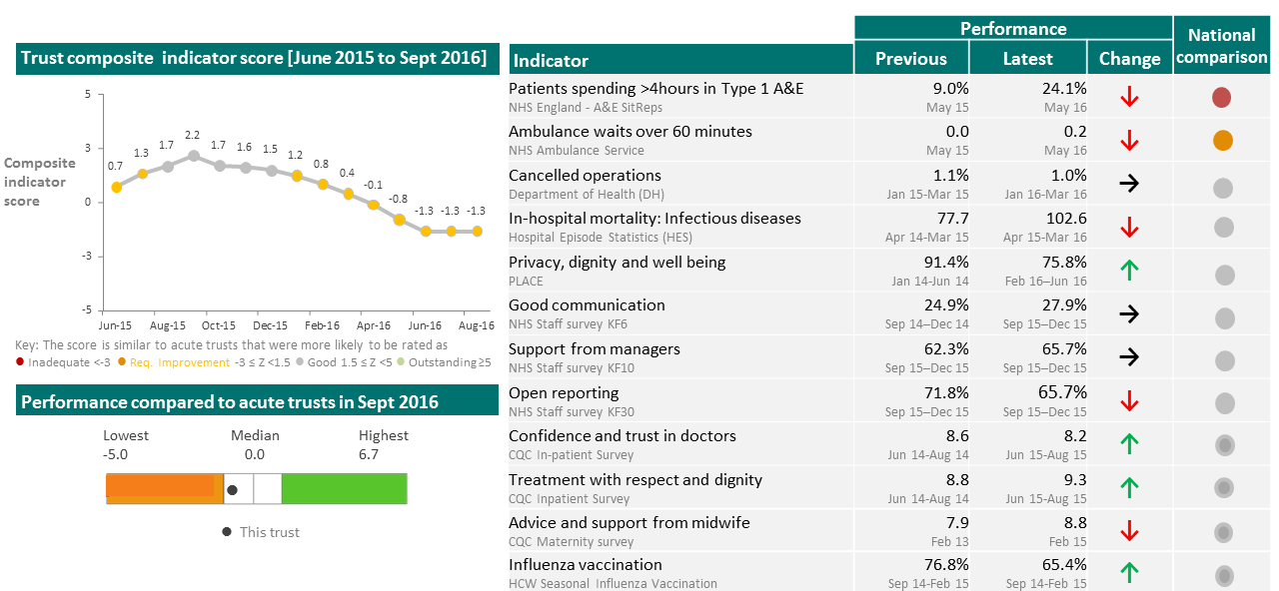
NHS Acute Intelligent Monitoring: New composite indicator
The composite indicator is one component of our new monitoring model. It is experimental and will be tested with inspection teams and refined.
11

Slide 12
GP Intelligent Monitoring showed the link between ratings and quantitative data … and also the limitations
GP IM Indicator | Level of correlation (1.0 implies all variation in ratings is explained by the indicator)
GP Patient Survey: % of respondents to the GP patient survey who stated that the last time they saw or spoke to a GP, the GP was good or very good at treating them with care and concern. | 0.26
GP Patient Survey:% of respondents to the GP patient survey who described the overall experience of their GP surgery as fairly good or very good. | 0.25
GP Patient Survey: % of respondents to the GP patient survey who stated that the last time they saw or spoke to a GP, the GP was good or very good at involving them in decisions about their care | 0.24
The majority of GP practices rated Good or Outstanding have IM scores <3%, whereas most RIs and Inadequates have IM scores >3%
12

Slide 13
GP Intelligent Monitoring: Key learning from evaluation
What we learnt from IM | What we are doing for Insight
Significant gaps in data about General Practice, particularly about whether they are Safe or Well-Led | Developing a new information collection with NHS England and the General Medical Council and improving current collections
A national average benchmark is not always useful because of variation in the populations served by practices | Exploring whether we can benchmark using selected demographic variables to provide more useful comparisons
Low numbers for some indicators reduces the efficacy of our current statistical scoring methodology | Exploring alternative methods for scoring indicators and comparing performance
IM reports are poorly understood by the public and even some providers | Developing a more user friendly version for publication
13

Slide 14
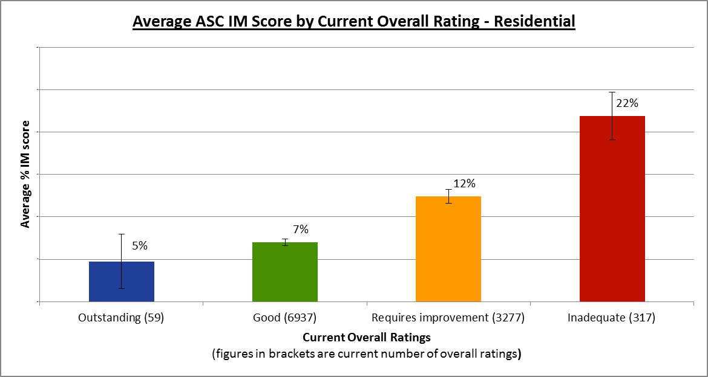
ASC Intelligent Monitoring showed a similar picture to the GP results
ASC IM Indicator | Level of correlation (1.0 implies all variation in ratings is explained by the indicator)
Residential Safeguarding | 0.27
Concerns and complaints received by the CQC in the previous 12 months | 0.27
Whistleblowing | 0.24
The majority of ASC providers rated Good or Outstanding have IM scores <8%, whereas most RIs and Inadequates have IM scores >8%
Error bars show two standard deviations, roughly equivalent to 95% confidence limits

Slide 15
ASC Intelligent Monitoring: Key learning from evaluation
What we learnt from IM | What we are doing for Insight
Lack of good quality data, especially about whether services are Caring or Response | Developing our Provider Information Returns (PIR) to data that covers our key questions and exploring ways to better capture the experiences of people who use services
Data we hold is often out of date and does not reflect the current position of the service, especially about staffing | Moving our PIRs from one-off collections for inspection to an ongoing collection that providers can update regularly
Some indicators are of limited value to inspectors and did not influence decision making | Focussing on a core set of indicators which are of most value in making regulatory decisions
15

Slide 16
The Outlier programme is a success and will be a core part of CQC Insight
The Outlier programme is a monthly panel reviewing mortality and maternity data for Acute NHS hospitals
Outliers identified are explored in detail and follow up action is taken
Presenting outlying indicators has prompted NHS trusts to investigate and address related quality issues
This approach has two key benefits:
Better insight into performance, using time series and triangulation between data sources
A process which is clear and easy to understand, internally and externally
We are extending the approach to other high priority data sources
16

Slide 17
New data sources being explored for use in identifying outliers
Activity
Learning
GP
‘Alerts’ reflecting potential risk in practices from information of concern from the public and other corroborating intelligence.
Due to low numbers, the model would most likely work better if more than one data source were used, combining qualitative information with quantitative indicators.
ASC
‘Alerts’ reflecting potential risk in care homes based on death notifications and other corroborating intelligence.
Promising results. This work will be developed further and incorporated into CQC Insight for ASC residential care providers.
NHS Acute
‘Alerts’ generated from patient survey results, which are correlated with ratings.
New statistical outlier approach developed, using ‘poor’ rather than ‘good’ scores and pilots underway.
17

Slide 18
Summary
A new Insight model that monitors quality
Bringing together what people who use services are telling us, knowledge from our inspections, and data from our partners
Building on our learning from Intelligent Monitoring evaluation to focus on most relevant, predictive indicators and incorporate different types of analysis
Identifying positive change as well as negative
Improving presentation as well as content
Developed over the next 3-4 years, with prototypes in 2016/17
18

