Slide 1
EPSO WORKING GROUP on
OBSERVATION in SUPERVISORY PRACTICE
Sipko Mülder
Stockholm, September 28th 2016

Slide 2
Agenda
1 Welcome
2 Informal start of the working group
3 Introductory round by the participants of the working group.
4 Discussion of key issues, thoughts and questions
5 Round up, next steps,

Slide 3
Kosovo June 3rd 2016….
An Introduction to the psychological background and practical use of “The Short Observational Framework for Inspection (SOFI)” as a specific tool for Observation and a powerful instrument for Health Care Supervision by David Francis, Care and Social Services Inspectorate Wales (CSSIW);
Observation in Scotland by Heather Edwards, Care Inspectorate Scotland;
Observation in the Netherlands, by Carien Geertse (Senior inspector) Dutch Health Care Inspectorate (IGZ), The Netherlands;

Slide 4
Sofi
Short
Observational
Framework for
Inspection
David Francis

Slide 5
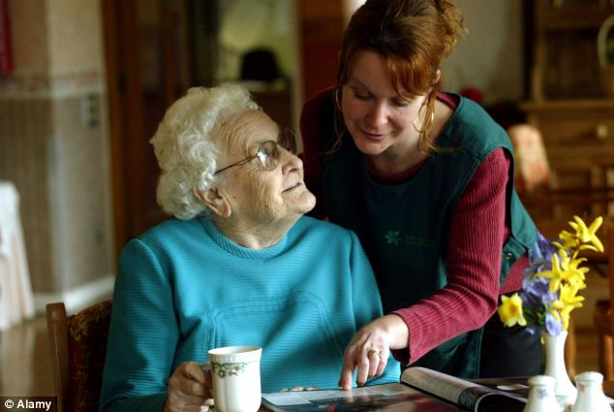
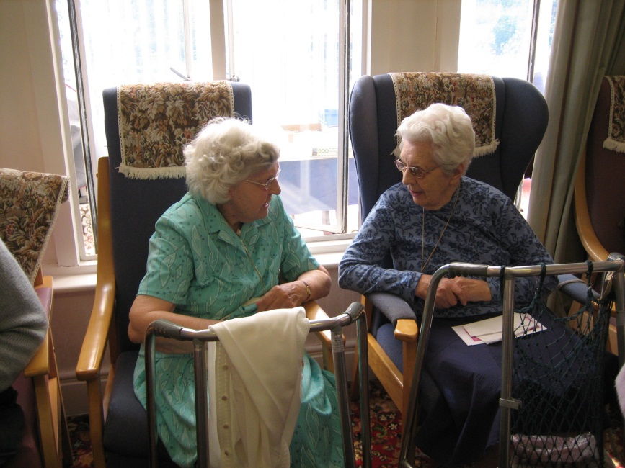


Slide 6
Kitwood’s Flower :
Psychological needs
Occupation
Attachment
Identity
Comfort
Inclusion
Love

Slide 7
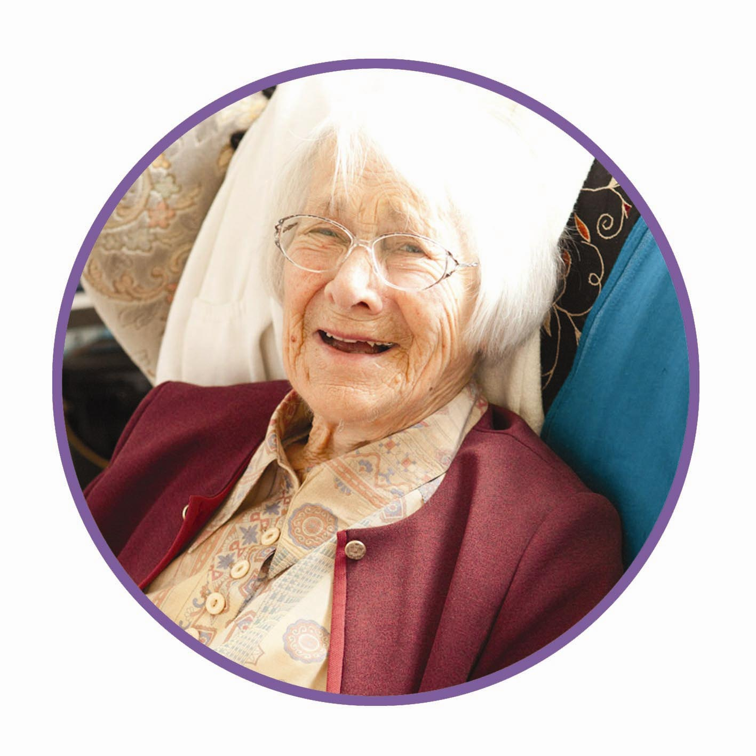
Vision
The Care Inspectorate believes
that people in Scotland should
experience a better quality of life as a result of accessible,
excellent services which are
designed and delivered to
reflect their individual needs
and promote their rights.
Notes:
Our vision at the Care Inspectorate is that people in Scotland experience a better quality of life as a result of accessible, excellent services which are designed and delivered to reflect their individual needs and promote their rights.
The right services at the right time, meeting the needs of the individual,
Recognising that we are all unique and to live well we need that personalised care
In this room, people who use services directly, people who provide services, people who commission services as well as the folk who regulate services.
In the blink of an eye we could use those services, hearing the voice of the service user.

Slide 8
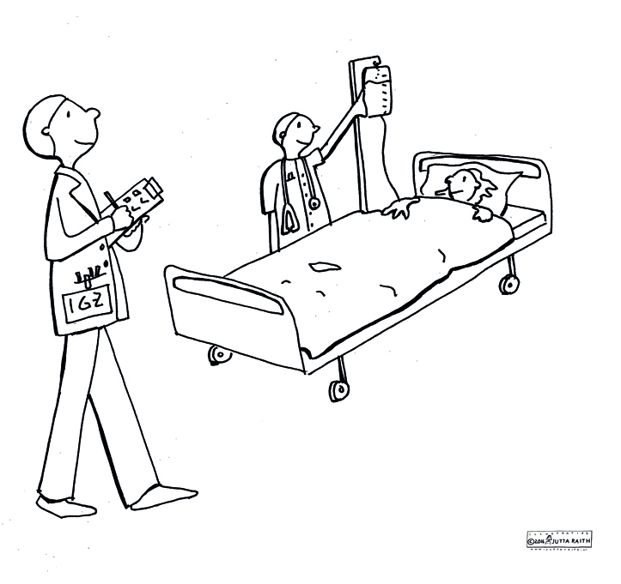
Our Mission - in summary -
Care workers and care providers are required to meet the (legal) standards for responsible care. It is the Inspectorate’s task to supervise this.
In doing so, the Inspectorate contributes to the quality of healthcare in the Netherlands.
Notes:
Our healthcare system ranks among the best in Europe → must be preserved, also for future generations.
Transition from a predominantly supervisory role → to one also including safety and quality promotion.

Slide 9
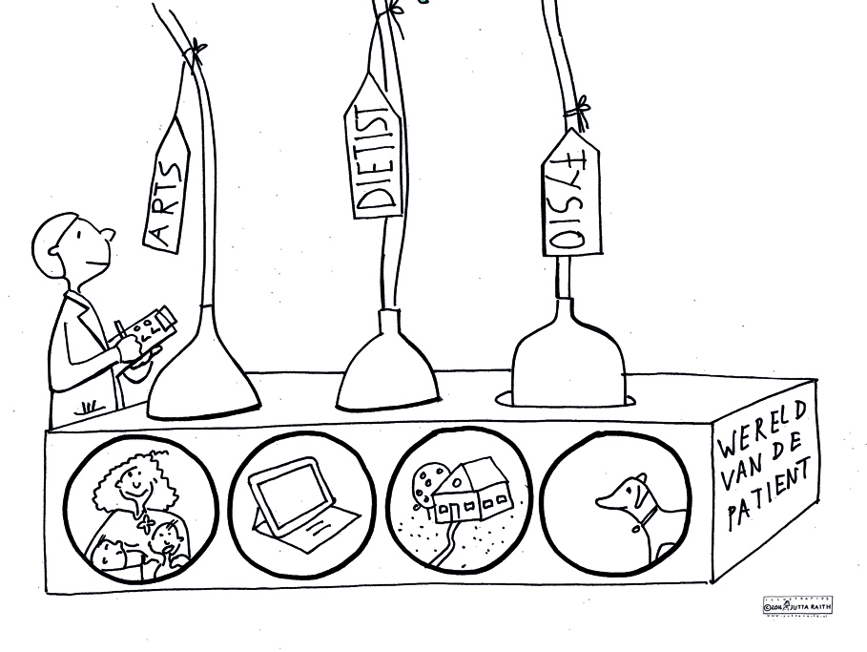
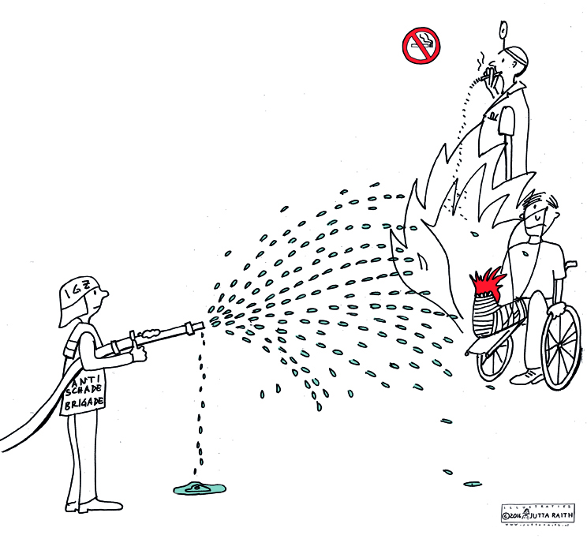
Intended Results
Fewer risks in the care sector
Less (preventable) health damage
Care in line with the patient’s/client’s environment
-> wants and needs of patients and clients are becoming increasingly important!
Notes:
Traditionally, the focus of care was restricted to safety and medical/technical aspects of quality. Now, this focus is being expanded to make healthcare more patient-centred.

Slide 10
Visiting day
Unannounced visits
Introductions
Short tour (also medication record)
Two 45-minute SOFI observations
Review of about 3 to 4 client records, document review
Talks with client representative, therapists/doctor, care staff, management
Report, report results from care provider, possible repeat inspection

Slide 11
Findings
Awareness about dementia and challenging behaviour is growing
Implementation of a vision is very important
Living the vision is vital (cooking or instrumental methods)
Focus of education is shifting more and more to knowledge about dementia and culture
Building/fysical environment is important
‘It is up to us to understand the behaviour of people with dementia’

Slide 12
Findings
Know your client
Covers a wide range of requirements:
General outline and superficial / detailed book of the life
Most of it is in the heads of care workers rather than on paper
Observed in practice:
Difficulty of having a conversation / in passing
Being committed/attachment to something or someone
Contact with lower-skilled staff

Slide 13
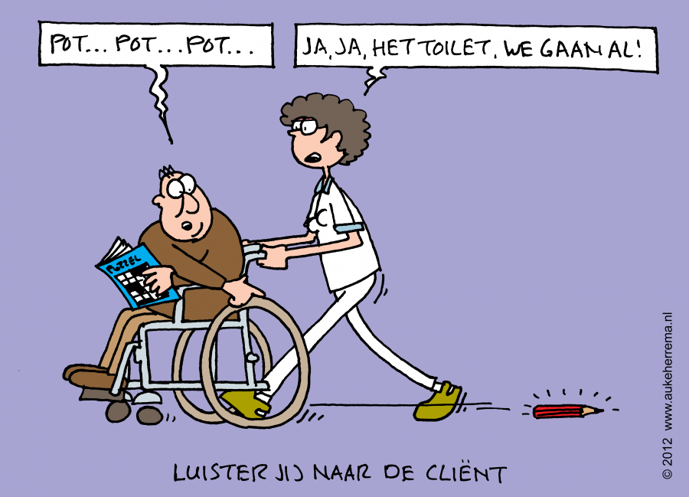
Know your client
Know your client
Pe.. Pe.. Pe..
Yeah, you have to pee. Let’s go!
Do you listen to your client?
Source: Knibbe
Source: Knibbe
SOFI of the Netherlands Health Care Inspectorate | 2 June 2016

Slide 14
Future
SOFI in Challenging Behaviour Instrument
(promoting awareness)
Integrate SOFI in Core Instrument (develop “client-centered module” covering elderly care, care for physically/mental handicaped people, psychiatric care)
Over all: base inspections more strongly on appreciative inquiry (AI) principles

Slide 15
EPSO Working Group (1)
At the round up session on Friday afternoon June the 3rd led by Carien Geertse , Davis Francis, and Heather Edwards, quite a number of delegates from various countries have raised their hands when being asked if they were interested to participate in a follow up EPSO activity.

Slide 16
EPSO Working Group (2)
Carien Geertse from the Netherlands has agreed on being chair of this new working group while David Francis from the Wales inspectorate and Heather Edwards from Scotland have agreed in working together with the group as far as their time will permit this.
The EPSO secretariat will support the group as usual with EPSO working groups

Slide 17
Introductory Round

Slide 18
Question 1
Statement: As is often stated in supervisory practice : ‘the quality of care is reflected in the interaction between patient/client and healthcare professional. The first question to healthcare regulators / supervisory organisations is therefore:
Question 1a- How do you as supervisory organisation get hold of this quality? What kind of methods do you use to look at the quality of care as provided by healthcare professionals to clients/ patients?;
Question 1b Do you look at the relation between the healthcare professionals and their clients/patients ?

Slide 19
Question 2
Statement : Regulators / inspectors are to find out if and what quality is delivered in healthcare
Question 2a Are you using medical standards/ other standards, intervention methods , observation methods? Who or what kind of documents / information do you trust when you want to be informed about the quality of care?
Question 2b What time do you spend as an Inspector at the ward/living room/ place where clients/patients are?
Question 2c What do you look at?

Slide 20
Question 3
Statement : Observation methods and results differ from working field to working field. Therefore it is interesting to look more in detail into the working fields of the supervisory organisation.
Question 3 In what fields of supervision is your organisation operating: hospital care; elderly care; social care ; youth or child care or other fields?
Question 3a What is the field of supervision in which you are operating: hospital care; elderly care; social car ; youth or child care or other fields?

Slide 21
Question 4
Statement : Supervisory organisation use various methods of observation and information gathering without being aware of the differences between countries and possibly best practices not being seen
Question 4 What do you consider to be best practises of observation in your country ? Can you give an example to share with other colleagues in other countries?

Slide 22
Question 5
Statement: conclusions in an inspection report should be independent, objective and not based on N=1.
Question 5 If you use your observation results in your reports, how do you validate your observations and do you guarantee objectivity?

Slide 23
Next steps……

