Slide 1
Risk-based supervision in the Netherlands
Sipko Mülder
Head of Risk Detection and Development

Slide 2
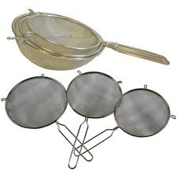
Why do we use Quality and Risk indicators?
Inspectorate supervises 1,200,000 health care professionals and 40,000 treatment facilities
We need a sieve:
To sieve out increased risk of irresponsible or unsafe care

Slide 3
Quality and risk indicators are used for risk-based supervision
The inspectorate identifies where the greatest risks to the quality and safety of care are to be seen.
Three phases of risk-based supervision:
1: identification of risks by analyzing (quality) information
2: inspection visits, assessment and selection of appropriate measures
3: administrative or disciplinary measures
(or institution of criminal proceedings where appropriate)

Slide 4
Sectors for risk-based supervision
Nursing homes, retirement homes, home care
Mental health care and forensic psychiatry
Hospitals and private clinics
Ambulance services
Health care for disabled
General practitioners (GP’s)
Oral care
Pharmacies
Clinical research
Medical devices

Slide 5
Data sources for risk-based supervision

Slide 6
IGZ indicators: how does it work?
What are the risks? - Assessment by experts
Who is the main owner of this risk? - What are the guidelines? - With ‘main owner’ the indicators are designed and implemented
Data collection and analysis, visualization by dashboards
Supervision on the basis of prioritization of visits and risk signals

Slide 7
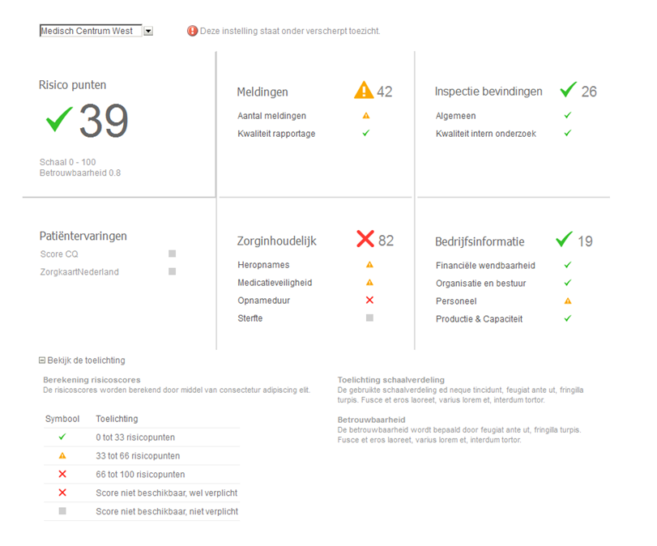
Overall risk score
reports of incidents
inspection judgments and
signals other inspection
patient experiences
quality of care indicators
company / operational information
Klachten LMZ

Slide 8
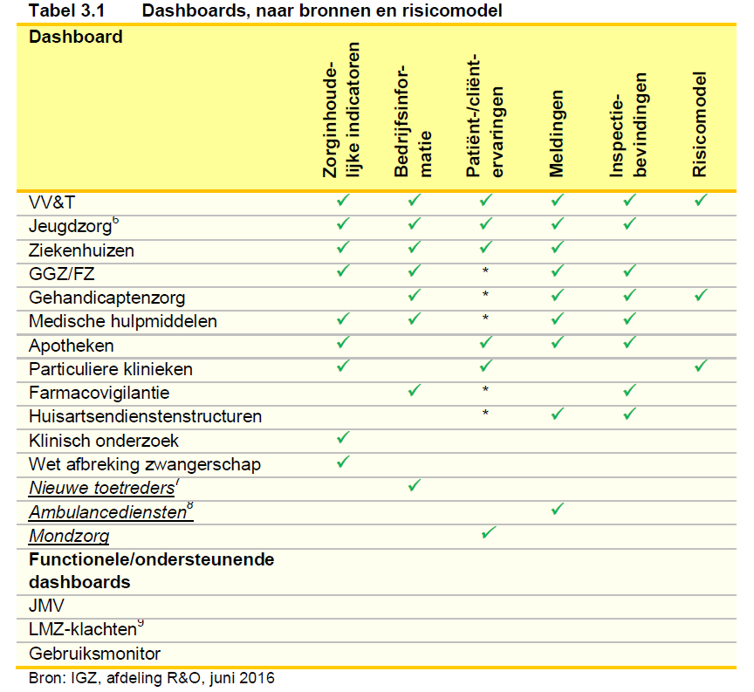

Slide 9
Thanks for your attention!

