Slide 1
Patient involvement in supervisory practice in the Netherlands
Sorien Kleefstra PhD,
senior advisor Risk Detection and Development, IGZ

Slide 2
Patient Involvement in Dutch supervision
Incident-based supervision: calamities reported by citizens
Risk-based supervision: patient rating site ZorgkaartNederland
National Reporting Centre for Health care Complaints (LMZ)
Inspection practice: SOFI-method for elderly clients with dementia, mystery guests, layman inspectors (pilot)
Interview with clients or family during visit, especially in care sector

Slide 3
Risk-based supervision
Until recently based on:
Calamities from incident-based supervision
Quality indicators
Financial and organizational information
Topics from thematic research
However:
Information merely not up to date
No patient involvement
Not all organizations can be visited (priority missing)
Can information on social media add to daily supervision? And if so, how?

Slide 4
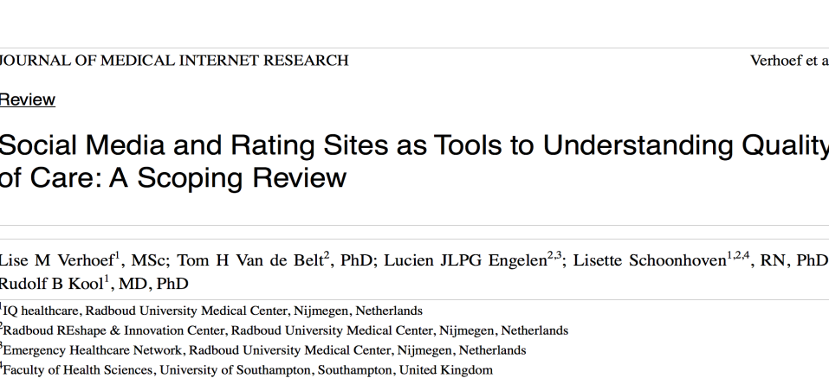
Research on social media:
Information on social media often related to quality outcome measures
Social media can be of additional value to daily supervision, especially next to ‘objective’ quality information
Patient rating site ZorgkaartNederland is the most relevant source
More suitable for risk-based than for incident-based supervision
Learn from other inspectorates
More research is needed on specific social media (Twitter, Facebook)

Slide 5
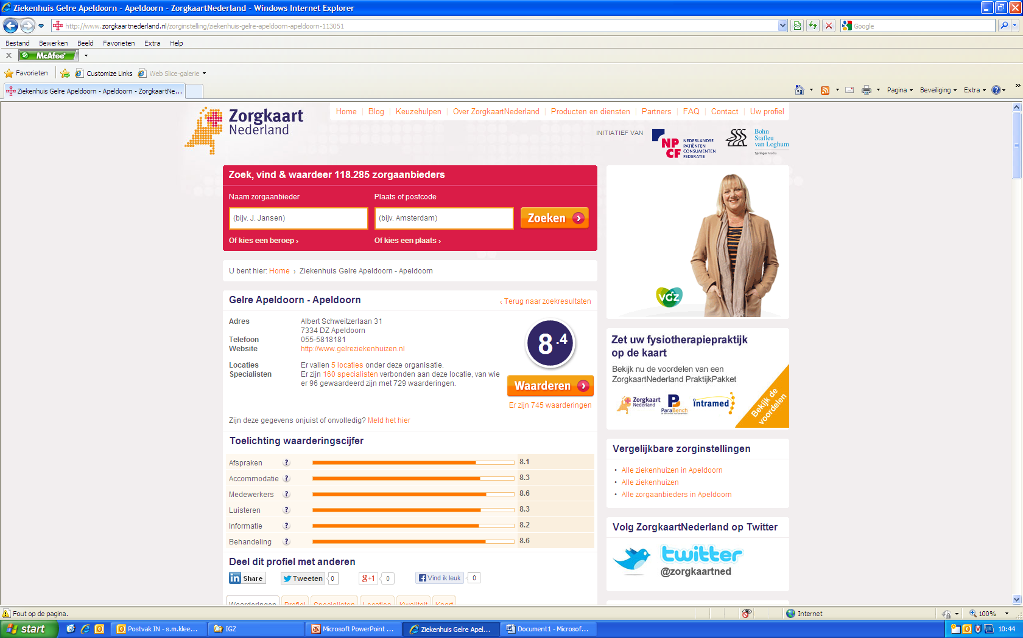
Patient rating site ZorgkaartNederland

Slide 6
ZorgkaartNederland:
PRS of the Dutch Patient Federation, since 2008
Ratings and reviews
800,000 visitors per month
9,000 new reviews per month, more than 300,000 reviews in total
Editorial office
Check on IP-addresses, names
Only explanatory, constructive reviews
Subject of studies

Slide 7
Study 1: exploratory interview study of the potential contribution of ZorgkaartNederland to daily hospital supervision
Method: 10 hospital inspectors, 10 selected known hospitals, texts of all reviews <6.5
First interview round:
Do hospital inspectors already use patient experiences on PRS in their daily supervision, and in what way?
Do inspectors expect patient experiences reported on PRS, to contribute to their estimation of risk?
Second interview round:
Does presenting, actively, patient reviews reported on ZorgkaartNederland alert inspectors in their estimation of risks to patient safety?

Slide 8
Study 1. Conclusions
23 % relevant
Background information
Overall view of a hospital
In accordance with inspector’s knowledge of / experience
Supportive information
Relevant: major safety problems, such as medication errors, serious incidents, severe consequences or damage, malfunctioning departments or professionals
Verified by clinical indicators
Negative reviews increases usability
Annual interviews or unannounced visits

Slide 9
Study 2: influence of intensified supervision on hospital ratings on ZorgkaartNederland
Aim: to which extent is intensified supervision of hospitals associated with online hospital patient ratings on ZorgkaartNederland?
Method: multilevel study of more than 43,000 hospital ratings of 7 hospitals under intensified supervision compared to 28 control group hospitals in time (2010-2015)

Slide 10
Study 2: Conclusions
Hospitals under intensified supervision have lower ratings on ZorgkaartNederland
The scores are independent of period
IGZ identifies the same hospitals at risk as the patients rate as underperformers

Slide 11
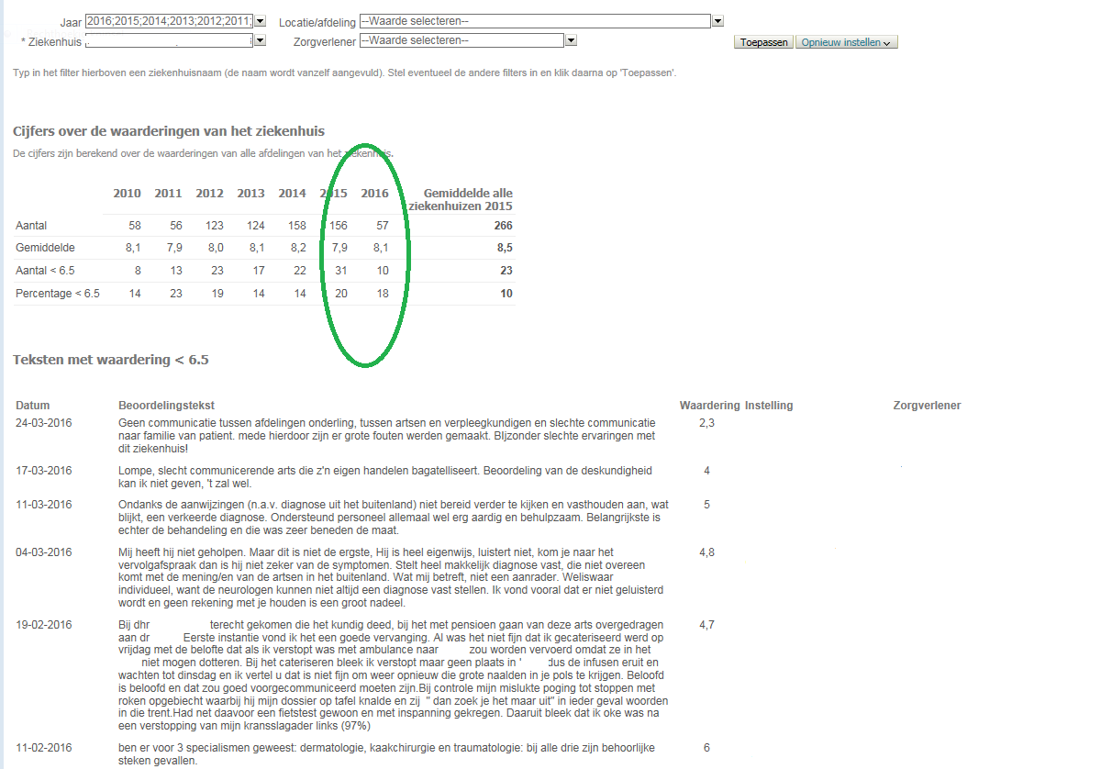
ZorgkaartNederland in daily supervision practice:

Slide 12
What can inspectors do with signals on ZorgkaartNederland?
Structural part of the risk detection dashboard
Check signals before visiting
Not more than a signal
Subject in annual or unannounced visits
List of priority visits
Contextual information

Slide 13
Literature
Verhoef LM, TH van de Belt, JLPG Engelen, L Schoonhoven, RB Kool. Social media and rating sites as tools to understanding quality of care: a scoping review. Journal of Medical Internet Research (2014);16(2):e56
Van de Belt TH, JLPG Engelen, LM Verhoef, MJA van der Weide, L Schoonhoven, RB Kool. Using patient experiences on Dutch social media to supervise health care services: exploratory study. Journal of Medical Internet Research (2015);17(1):e7
Kleefstra SM, LC Zandbelt, I Borghans, JCJM de Haes, RB Kool. Investigating the potential contribution of patient rating sites to hospital supervision: exploratory results from an interview study in the Netherlands. Journal of Medical Internet Research (2016);18(7):e201
Kool RB, SM Kleefstra, I Borghans, F Atsma, TH van de Belt. J Influence of intensified supervision by health care inspectorates on online patient ratings of hospitals: a multilevel study of more than 43,000 online ratings. Journal of Medical Internet Research (2016);18(7):e198

Slide 14
Questions and discussion
Sorien Kleefstra PhD
Dutch health care inspectorate
Sm.kleefstra@igz.nl

