Slide 1
Openness about malpractice in medical care
Input from Denmark
Anette Lykke Petri
Head of Division, Consultant, PhD
Danish Patient Safety Authority
Notes:
I want to thank EPSO for giving me the opportunity to come here and speak about how open we are in Denmark in the supervision area.
My name is Anette Lykke Petri, and I am Head of Division and Senior Consultant at the Danish Patient Safety Authority.

Slide 2
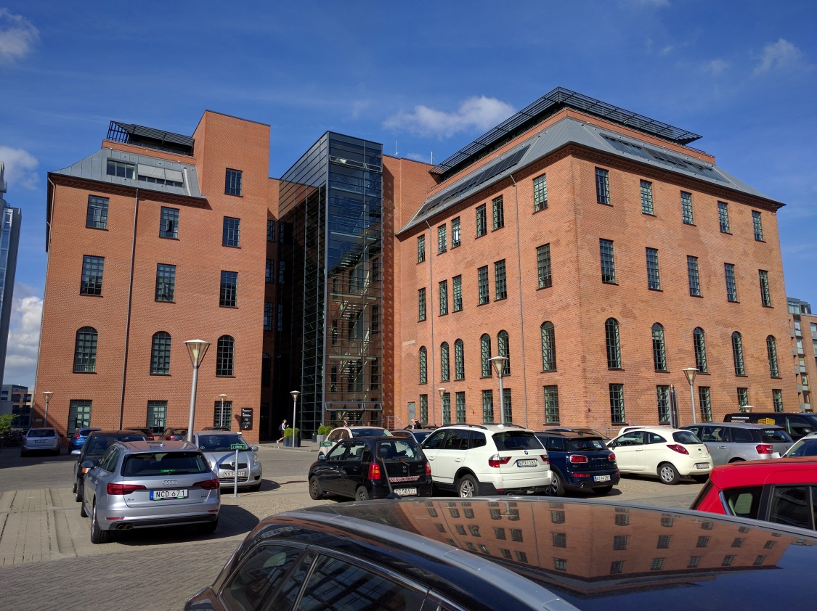
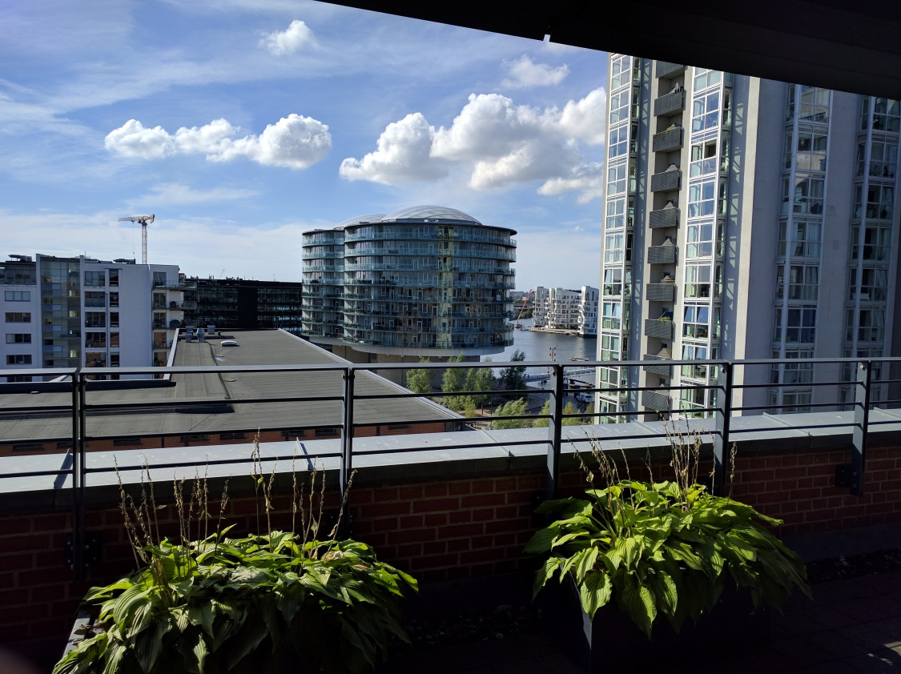
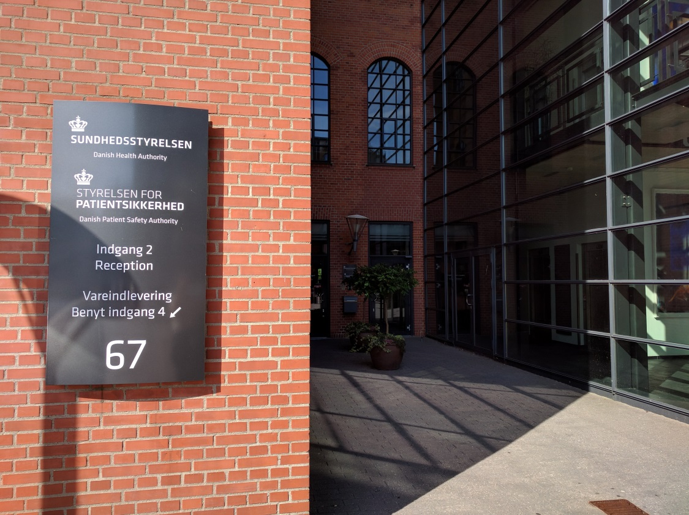
View from the Danish Patient Safety Authority
Notes:
The Danish Patient Safety Authority is in central Copenhagen. From our roof terrace, we have a magnificent view of Copenhagen, and we can actually see the Danish Ministry of Health.
It's a practical location, for they decide on our level of openness when it comes to supervision cases.

Slide 3
Openness about malpractice
In Denmark, our openness is regulated by executive orders.
It applies to supervision-related penalties imposed on treatment facilities as well as individual healthcare professionals.
We are also obliged to publish reports on the supervision of private treatment facilities, cosmetic clinics and nursing homes – regardless of whether conclusions are good or bad.

Slide 4
Individual healthcare professionals
Notes:
The group of individual healthcare professionals covers all authorisation groups in Denmark (e.g. doctors, nurses, physiotherapists, dentists, etc.).

Slide 5
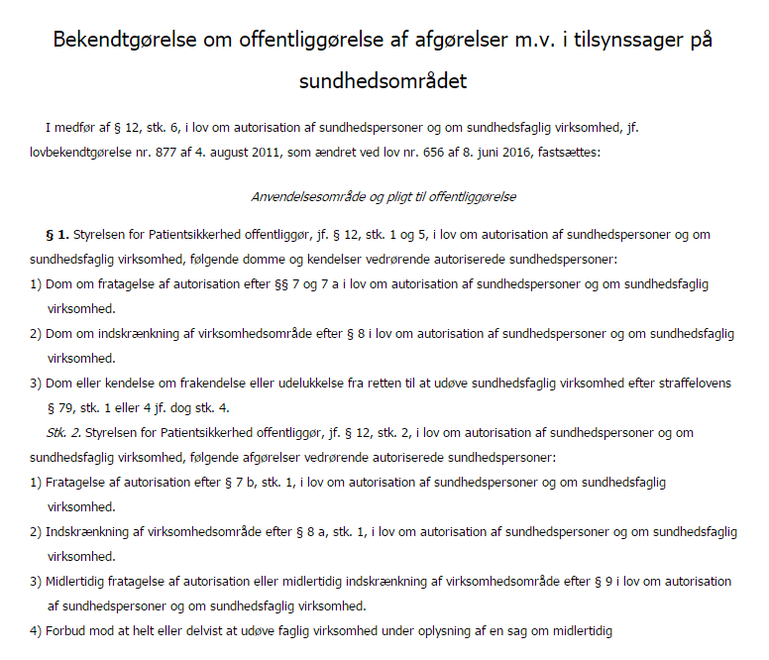
Publication of decisions made in supervision cases
Obligation to publish decisions on:
Professional performance injunctions
Temporary or permanent authorisation withdrawals
Activity area restrictions
Suspensions
Work prohibitions
Intensified supervision
§
§
§
Notes:
The decisions to be published appear from executive orders. It applies to ……………………………..

Slide 6
What is to be published?
The scope and justification of the supervisory measure imposed by the Danish Patient Safety Authority.
Voluntary authorisation withdrawals and activity area restrictions.
Authorisation withdrawals or activity area restrictions by court order (the Danish Criminal Code and the Danish Health Act).
Notes:
We must publish the decisions we make ourselves and the voluntary withdrawals made by healthcare professionals as well as cases where a healthcare professional loses his or her authorisation by a court order.

Slide 7
How many details must be published?
Name of the healthcare professional
Title of the healthcare professional
Authorisation ID
The scope and justification of the supervisory measure
Effective date
Notes:
We are obliged to publish the name, title and authorisation ID of the healthcare professional. In addition, we must describe the scope and justification of the supervisory measure.

Slide 8
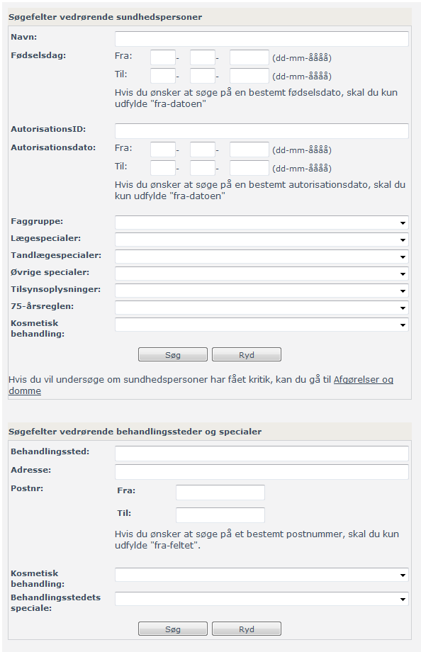
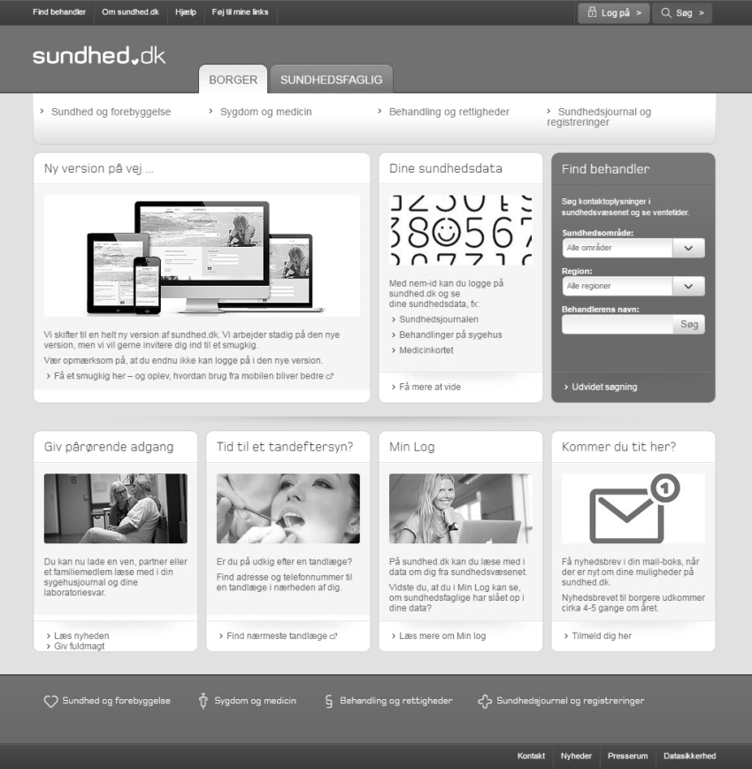
Where to publish it?
On the Danish e-Health Portal, Sundhed.dk
In the authorisation register (STPS.dk)
Notes:
Supervision-related penalties are published on a Danish website where information about the entire Danish healthcare sector is gathered. This website is targeted at patients.
Likewise, it is possible to search for information about individual healthcare professionals in the authorisation register on the website of the Danish Patient Safety Authority.

Slide 9
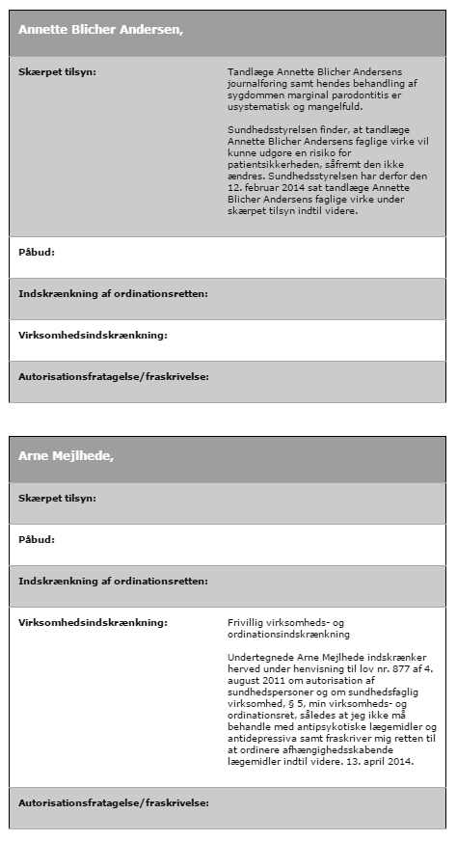
Supervision list
Until 2016:
A public supervision list
From 2016:
A register with all statutory supervision information
Notes:
Previously, we had a specific supervision list on which all persons with a supervision-related penalty appeared by name. This list was very popular with journalists. Some journalists watched it closely to see if new healthcare professionals entered the list, following which they would request access to documents. So, we decided to discontinue the list.
All the information could already be found in a register. By gathering all information in a register, we made it easier for the regions and recruiting authorities to obtain the correct information before hiring a healthcare professional. They did not have to go through two registers to get the needed information.

Slide 10
Online register
Registered health professionals in Denmark
In the register of authorised health professionals, you can search by the type of decisions made the by the Danish Patient Safety Authority:
Intensified supervision
Professional performance injunction
Authorisation restrictions
Without valid authorisation
Suspension
Work prohibition
Link: http://stps.dk/da/ds/opslagautreg
Notes:
In the online register of authorised healthcare professionals, you can search for individual healthcare professionals, but you can also extract entire lists, for example of all doctors subject to intensified supervision.

Slide 11
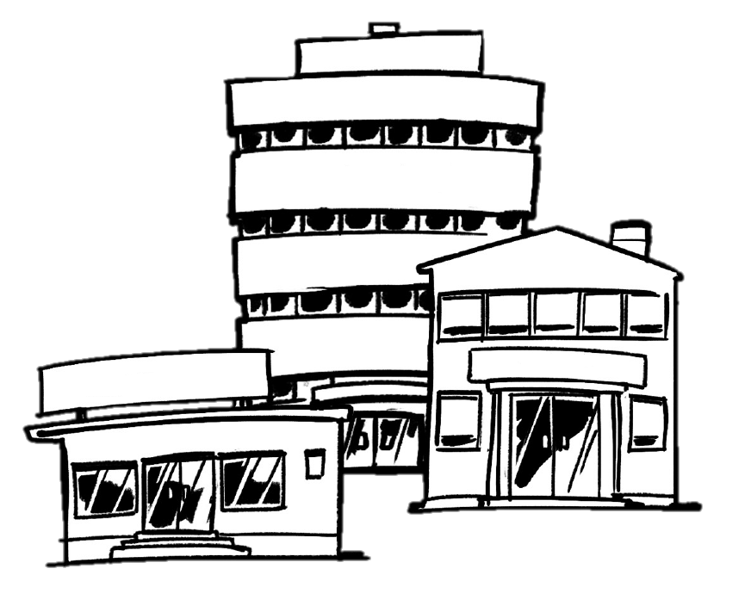
Healthcare institutions
Notes:
Healthcare institutions are governed by other rules than individual healthcare professionals.

Slide 12
What must be published?
Injunctions imposed on hospitals, clinics and other treatment facilities.
Where to publish it?
On the website of the Danish Patient Safety Authority and on the Danish e-Health Portal, Sundhed.dk.
Injunctions must be easy to find on the treatment facility‘s website.
It must be easily accessible at the treatment facility's premises.
Failure to do so is punishable by a fine.
Notes:
For hospitals, clinics and other treatment facilities, we are obliged to publish injunctions on the website of the Danish Patient Safety Authority and the Danish e-Health Portal, Sundhed.dk.
The information is removed once the injunction is lifted.

Slide 13
Supervision reports
Until 2017, we conduct frequency-based supervisions of:
Cosmetic clinics
Private treatment facilities
Nursing homes
For each treatment facility, we issue a report, which is published on the same places as injunctions are published.

Slide 14
Information for other authorities
The five regions in Denmark
Greenland
The Faroe Islands
Other supervision units in Denmark
The office issuing authorisations
Pharmacies
IMI (Internal Market Information System)
Notes:
Besides publication through the register of authorisations and websites, we continually send the information to all the Danish regions, Greenland, the Faroe Islands, all supervision units in Denmark, the office issuing authorisations and all pharmacies in Denmark.

Slide 15
Hiring of healthcare staff
– Good advice and clarifications
In September 2016, we published a leaflet targeting the authorities responsible for recruitment.
The leaflet draws attention to the responsibility that employers have when recruiting healthcare staff and the information we make available to employers.
Notes:
We have just published a leaflet with good advice and clarifications about hiring healthcare staff. The leaflet lists the possibilities available to employers to search for information about a healthcare professional before hiring. The leaflet has been extremely popular due to a number of cases in the regions where unqualified doctors had been hired.

Slide 16
Conclusion
In Denmark, supervision decisions are handled with great openness.
The only exception is highly personal data (abuse, disease).
Our mission is to ensure safety and security for patients.
Complex situations related to poor healthcare quality are currently handled in the regions, which hold data in the clinical quality databases. These data will become part of our risk-based supervision in the future.
The disadvantage of openness is that it may stigmatize healthcare professionals/hospitals or clinics.
The disadvantage for us is that we use many resources on giving journalists access to documents because of openness – malpractice among healthcare professionals makes good headlines.

