Slide 1
Openness about malfunctioning in social practice in Denmark
EPSO Conference 28-30 september 2016
Notes:
My name is Henrik Frostholm.
I’m a deputy head of office - at the National Board of Social Services - in Denmark.
At the national board - I’m working with the implementation of the new reform of supervision of specialized social services.
Today I’m going to give you a quick outline of one of the central elements of the reform – which is openness about malfunctioning in social practice in Denmark

Slide 2
Act on Social Supervision In effect on 1 January 2014
Purposes of the Act:
Improving quality control of social facilities
A more professional and independent social supervision
Systematic use of best knowledge
Results/progression for the citizens (not proces and structure)
Matching target groups and methods
Greater transparency in financial issues
Tranparancy/openness about malfunctioning in social practice
Notes:
In Denmark in 2014 we got a new act on social supervision
The act is the centerpiece in the reform of the supervision of specialized social services
The act covers almost 2,200 social facilities and 6,500 foster care families in Denmark
The act has been in effect now for almost three years – and we are still working hard on the implementation of all the aspects of the reform
The horizon of implementation of this kind of reform is typically 3-4 years, before all the core components are in place and starting to work as intended
The purpose of the reform is:
Improving quality control of social facilities
Securing a more professional and independent social supervision (the creation of five social supervisory authorities – earlier we had more than a 100 local authorities)
Systematic use of best knowledge – as a base for supervision and evaluation of the facilities
Strong focus on results/progression for the citizens (the quality model in the reform focuses on results, not proces and not structure)
Matching target groups and methods is essential – if you want to achieve results!
Greater transparency in financial issues – and effective use of public funding
Re-approving all social facilities in DK in 2014-2015
AND Tranparancy/openness about malfunctioning practice

Slide 3
Local Responsibility in a National Context
Organization: 5 + 1
The social supervision is handled by 5 selected municipalities - one in each region of Denmark (from 98 to 5).
The 5 municipal councils are referred to as social supervisory authorities.
Ministry of Social Affairs - active in implementation at local authority level.
The Governmental Audit of the 5 social supervisory authorities is conducted by The National Board of Social Services (NBSS).
Notes:
Slidetekst sat ind her, så du kan se noterne på selve computeren.
The social supervision is handled by 5 selected municipalities - one in each region of Denmark (from 98 to 5).
The 5 municipal councils are referred to as social supervisory authorities.
Ministry of Social Affairs - active in implementation at local authority level.
The Governmental Audit of the 5 social supervisory authorities is conducted by The National Board of Social Services.

Slide 4
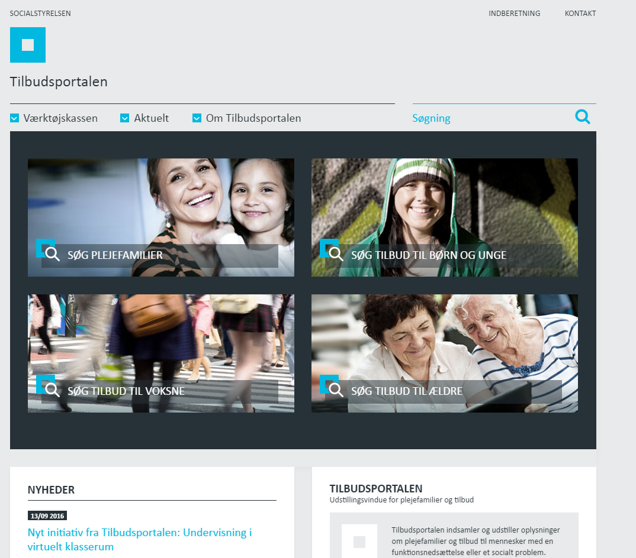
Social Services Gateway www.tilbudsportalen.dk
The National Board of Social Services shall register information and publish the quality assessment of social facilities on the Social Services Gateway.
Notes:
Social Services Gateway is a public search-engine where all facilities and foster homes are published. The search-engine is intended to improve the municipals opportunities to create the right match between facility and citizen. At the same time it serves to create openness and overview too all citizens about existing facilities.
If a facility is not on the Social Services Gateway, the municipals cannot find - nor use the facility.
This also means that the sanction of withdrawing the approval of a facility – results in closing of the facility, simply because the municipals cannot subscribe citizens.

Slide 5
Quality Model - Themes - The required quality standards
Act on Social Supervision, § 6
”(1) To be eligible for approval, social facilities shall, following an overall assessment, meet the required quality standards. (2) The quality of facilities shall be accessed on the following themes:”
Education and employment
Skills and competencies
Autonomy and relations
Finances
Target groups, methods and results
Physical framework
Organization and management
Notes:
The quality of facilities shall be accessed on the themes mentioned here.
The conclusion of all seven themes, are published on the Social Services Gateway.
If any sanctions or malfunctioning occurs – it will, as mentioned on the previous slide, be visible on the Social Services Gateway

Slide 6
Types of sanctions that indicate malfunctioning
Types of sanctions:
Conditions
Enforcement order
Increased supervision
If none of the above has the desired effect:
Withdrawal of approval
Notes:
These are the four types of sanctions that indicate malfunctioning.
The sanctions has legal basis (hjemmel) in the Danish Act on Social Supervision.
Conditions (vilkår)
The social supervisory authority may, in connection with the approval or the continuing supervision, lay down particular conditions.
Enforcement order (påbud)
The social supervisory authority shall decide to issue an enforcement order where compliance is a condition for continued approval. The social supervisory authority shall fix a deadline for compliance with an enforcement notice.
Increased supervision (skærpet tilsyn)
The social supervisory authority shall decide to increase supervision when the circumstances in the individual facility so warrant. A decision to increase supervision shall be made for three months at a time and be stated in the Social Services Gateway. In the context of a decision to increase supervision, the social supervisory authority shall issue an enforcement order, cf. subsection hereof
Withdrawal of the approval of a facility (ophør)
The social supervisory authority may decide to withdraw the approval of a facility if the facility no longer satisfies the conditions for approval

Slide 7
Openness about malfunctioning in social practice
Dialogue with the facility
Registeration of information in the “Social Services Gateway”
The social supervisory authority shall notify the municipalities responsible of the individual citizens in the facility, if any malfunctioning has occured.
Notifying other authorities
Notes:
Dialogue
The social supervisory authority shall, as part of the operational supervision, ensure compliance with the quality standards of the facility and enter into dialogue with the facility for the purpose of maintaining and developing the quality of the facility
The social supervisory authority shall notify the municipalities responsible.
If the social supervisory authority becomes aware of any matters of concern in a facility, the social supervisory authority shall notify the municipalities responsible for the stay of the individual citizens in the facility pursuant to the Act on Social Services, cf. sections 9-9b of the Act on Legal Protection and Administration in Social Matters when such matters may affect the citizens.
Registeration of information in the “Social Services Gateway”
The National Board of Health and Welfare shall register information in the Social Services Gateway, about facilities (more about this in a min.)
The information shall include
approval of a facility;
the current status of the facility in terms of the approval, including information about any terms, enforcement notices and increased supervision
and the outcome of the supervision of a facility
The social supervisory authorities shall notify other authorities, not only when worried about certain citizens, but also other elements at the facilty.

Slide 8
How to handle transparency, openness and public disclosure in supervisory practice in cases of malfunction?
Level 1:
Registration of the facility in the Social Services Gateway (key information)
Assessment with the use of a quality model (transparency)
Public quality report on the SSG (at least annual)
Level 2:
Issuing sanctions when quality problems
Public disclosure of sanctions in the Social Services Gateway
Notification of the concerned municipalities with citizens placed on the facility when severe sanctions
(Maybe halt of new citizens being placed at the facilities)
Level 3:
Removal of the facility from the Social Service Gateway
Notification of the municipalities to remove citizens from the facility
Closure of the facility

Slide 9
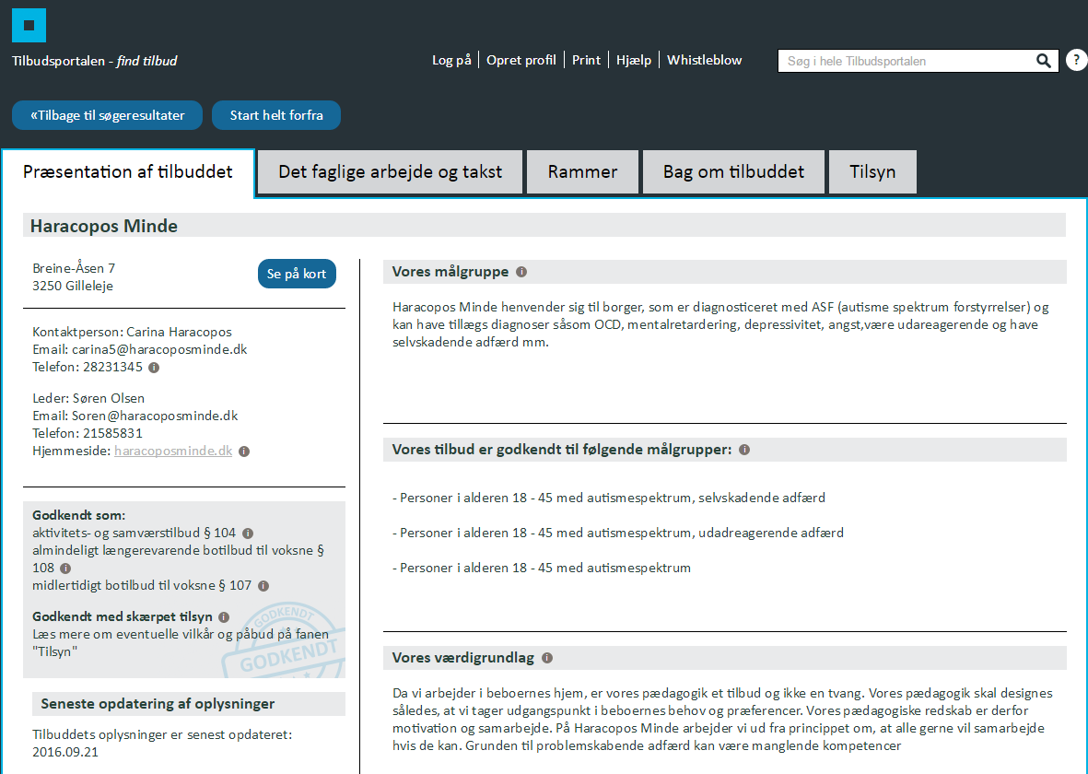
Example, Social Services Gateway
Example of a facility that is under increased supervision on the Social Services Gateway.
Notes:
This is an example of a facility that is under increased supervision on the Social Services Gateway. The page showed in this screen dumb, is the front page of the facility selected and the headline is “a presentation of the facility.”
The arrow shows the facilities approval and in Danish it’s stated here, that the facility is approved - but under “increased supervision”.

