Slide 2
What is effectivness from a Swedish point of view?
EPSO working group
Oslo 11th of May 2016
Klas Öberg, Lena Weilandt
Dep. of Development and Analysis, IVO

Slide 3
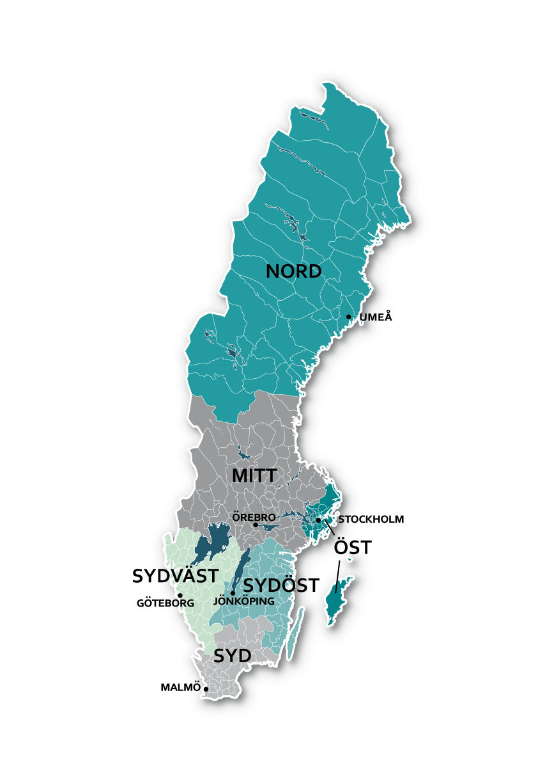
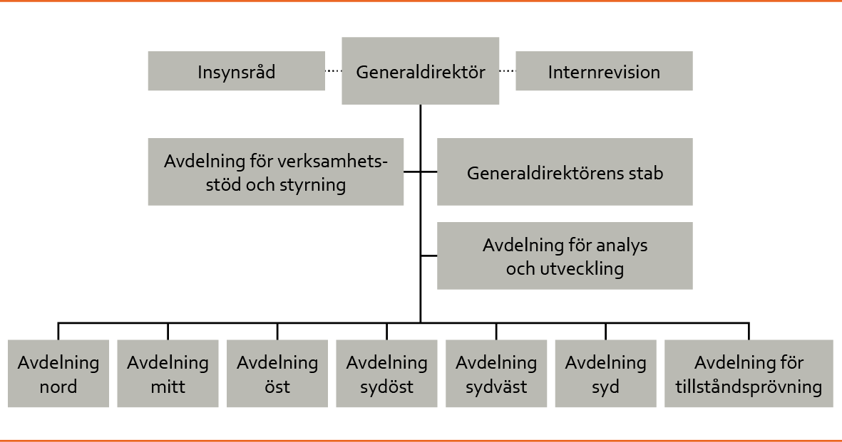
Health and Social Care Inspectorate
A regionalized organisation

Slide 4
The aim of supervision
Supervision shall contribute towards ensuring that health and social care is both safe and of high quality, and works to best serve its recipients.
Notes:
As supervision must work to best serve the health and social care recipients,
primarily review the quality and safety of its activities.
Point out – do not stipulate that IVO must examine whether the health and social care services are conducted in accordance with laws and regulations.
This is implicit, as laws and other regulations have been created to contribute towards a health and social care service which is safe and of high quality.

Slide 5
The supervision's focus
Supervision is carried out from a user- and patient perspective, and must focus on matters that are important for individuals or groups. Unless laws or ordinances state otherwise, supervision should be risk-based and only review matters that are essential to ensure a health and social care service which is safe and of high quality. Supervision must be effective.
Notes:
the essential starting points for IVO's work, such as the user and patient perspective.
It involves focusing on what really is important when providing a good health and social care service for its users and patients, and to concentrate on more than just documentation, guidelines and procedures.
risk-based supervision, but it involves systematising and analysing our own and other actors' findings at a national and regional level, as well as making use of our patients' and users' views and experiences to create an overall picture of our supervision area.
What is considered essential can vary according to the purpose of supervision.
The effectiveness of the supervision must be seen in relation to the extensive demands and expectations which are placed on the organisation, in combination with its limited resources. This allows a lot of room for manoeuvre when selecting the emphasis of the supervision. As such, the emphasis becomes a prioritisation matter based on what elements will contribute the most toward a health and social care service that is safe and of good quality.
It involves weighing the required efforts against the achieved results of the supervision.
Här lyfts väsentliga utgångspunkter för IVO:s arbete fram som brukar- och patientperspektivet. En riskbaserad tillsyn handlar om att systematisera och anlysera våra egna och andra aktörers iakttagelser på nationell och regional nivå samt att ta tillvara patienters och brukares erfarenheter och synpunkter för att skapa en helhetsbild av vårt tillsynsområde.
Väsentlighet handlar om att fokusera på det som i realiteten är betydelsefullt för en god vård och omsorg för brukare och patienter och ha fokus på mer än dokumentation, riktlinjer och rutiner.
Effektivitet handlar bl.a. om prioritering utifrån vad som bidrar mest till en vård och omsorg som är säker och av god kvalitet. Det handlar om att väga den insats som krävs mot det resultat som kan uppnås med tillsynen. Dvs. att med tillgängliga resurser lämna ett så stort bidrag som möjligt.

Slide 6
Supervision's methods and tools
IVO uses different methods and tools when supervising, both regulatory and supportive. The tools are selected based on the effect which they are anticipated to have on the supervised entities, and on the possibilities under the law.
Notes:
IVO uses different methods and tools when supervising, both regulatory and supportive. The tools are selected based on the effect which they are anticipated to have on the supervised entities, and on the possibilities under the law.
There are different methods for carrying out supervision, such as announced and unannounced inspections, desk supervision, collegial supervision, self-evaluation and system supervision. While performing these different types of supervision, various techniques can be used, for example, document reviews, focus groups, observations, conversations with users and patients, private interviews and questionnaires.
In addition, IVO has a number of tools at its disposal to achieve the objective of its supervision, i.e., to ensure that the supervision has the desired effect:
This list includes both regulatory and supportive tools. In order to ensure that the effects of the supervision are as positive as possible, IVO must be familiar with the “entire range” When choosing which tools to use, the basic rule is to start with the less radical measures, and introduce stricter ones if necessary. Important to keep in mind:
When laws and other ordinances contain mandatory requirements which are essential to the outcome of the patients' and users' health and social care, supervision should be regulatory and, if necessary accompanied by decisions regarding forced measures. Occasionally, the IVO may be under statutory duty to take certain measures, such as legal action.
In other situations, when laws and ordinances do not contain mandatory requirements, supervision should be supportive and accompanied by recommendations. It is important to clarify that these are merely recommendations on part of the authority.
When IVO offers guidance to staff at different organisations without having performed supervision, it does not attempt to interpret laws and ordinances or offer advice on how supervised entities shall act in specific cases, but instead, it provides general guidance. See policy regarding advice and guidance in the context of supervision..
Reg. No. 1.3-43252/2013
IVO behöver behärska ”hela paletten” och situationsanpassa tillsynen.
När lagar och andra föreskrifter innehåller bindande krav och dessa är väsentliga för utfallet av vården och omsorgen för patienter och brukare bör tillsynen vara kontrollerande och vid behov åtföljas av beslut om tvingande åtgärder. Ibland kan det också finnas en författningsreglerad skyldighet för IVO att vidta vissa åtgärder.
När lagar och andra föreskrifter inte innehåller bindande krav – t.ex. i målparagrafer – kan en främjande tillsyn användas och åtföljas av rekommendationer. Viktigt att det framgår att det endast är fråga om rekommendationer.
Återföring till tillsynsobjekten. Återföringskonferenser etc.
Att följa upp tillsynens effekter för brukare och patienter, målsättning, behövs utvecklingsarbete.
När IVO vägleder personal i verksamheterna, finns en policy från 2013 angående råd och vägledning inom ramen för tillsyn.
Återföring på aggregerad nivå, t.ex. i den årliga tillsynsrapporten.

Slide 7
Policy under implementation
Patient and users perspective
Riskbased supervision
Support for learning and development
- Feedback of the result of the supervision to those inspected and stakeholders
Dialogue
Good examples
Following up the supervision entities opinion on inspection
Next step
IVO follows up the effect of supervision on users and patients.

Slide 8
Riskbased supervision
(2014) National riskanalysis
(2014) System analysis (regional level)
(2015) 35 riskbased supervision – supervised 200 enteties
(2016) National inspections with targeted riskanalysis (caregivers)

Slide 9
2016
Riskbased National Inspektions
Target area in the system analysis - Primary Care
Very large number of primary care clinics - 1200
Target clinic where service quality and safety is assesed to be low
Using data from different sources
Data from IVO - Reported adverse events, patient complaints
Data from other organisations – Quality registers, waitingtime database, the national patient survey and data from the Patient Advisory Committee
Suggested 30 primary care units in each region – the inspectors will now do the the final selection based on their own experience and knowledge of the quality of care at the primary care clinics
Next step develop a method for inspection – national team planning how and when to do the inspection.

Slide 10
Best Practice Principles for Regulatory Policy- Regulatory enforcement and inspections, OECD, 2014
”Principels for improving regulatory enforcement through inspections…, making them more effective, efficient, less burdensam for those inspected and less resource demandig for goverments”
1. Evidence-based enforcement; Where and how to inspect should be grounded on data and evidence, and results should be evaluated regularly.
2. Selectivity; - can not supervise everything, are there any other mechanisms to support compliance and development?
3. Risk focus and proportionality; -resources allocated in proportion to level of risk
4. Responsive regulation; - enforcement should be regulated to profile and behavior
5. Long-term vision; - policy on regulation with clear objectiv and a roadmap
6. Co-ordination and consolidation; -supervisory functions should be coordinated to avoid overlap
7. Transparent governance; policies should support transparency, professionalism and result-oriented management
8. Information integration – sharing information and data, focus on risks and co-ordination
9. Clear and fair process; - Governments should ensure clarity of rules and processes for inspection
10. Compliance promotion; - should be promoted
11. Professionalism. – inspectors trained in both technical skills and in generic supervisory skills

Slide 11
Thoughts on next step
How can we measure and monitor the effects on
those supervised?
patients and clients?
health and social care system?
- and how to do this over time?

Slide 12
Tack! Lena Weilandt lena.weilandt@ivo.se

