Slide 1

EPSO e-Health working group
Meeting at the
22th EPSO conference, Stockholm , Sweden Sep 28th 2016
Chaired by Tove Gemzell (IVO, Sweden)

Slide 2
Trends in Sweden
eHealth vision in Sweden
In 2025, Sweden will be the best in he world at using opportunities offered by digitalization and eHealth to make it easier for people to achieve good and equal health and welfare, and to develop and strengthen their own resources for increased independence and participation in the life of society.

Slide 3
Agenda
Presentation round the room
The group and its aim
Definitions and Focus
The swedish case and a framework
Work ahead
Expected results
Discussion

Slide 4
Participants so far
Sweden
The Netherlands
Estonia
England
Finland
Bulgaria
Denmark
Spain?
Notes:
Tove Gemzell (chair), Sipko Mülder (IGZ, The Netherlands), Eve Pilt and Mihhail Muzõtsin (Terviseamet, Estonia), Heikki Matlar (Valvira, Finland), Dimitar Georgiev (EAMA, Bulgaria),Sigríður Haraldsdóttir (landlaeknir, Iceland), Charles Rendell and Nicola Stewart (CQC, England), Adrian Paravani, Eltar Deda (Nat Health Inspectorate of Albania) supported by Jooske Vos and Mari Murel (EPSO)
cc: Wouter Meijer, QAEF, Leonard Witkamp and Job van der Heijden KSYOS, NL, Laine Mokrik Estonian e-Health Foundation, Michael Strübin Personal Connected Health Alliance/Continua

Slide 5
Aim
to stimulate the debate, thinking and research about supervision and E-health;
to organize a forum for exchange of ideas and practical co-operation between supervisory organizations that amongst other, supervise e-health related care and telemedicine;
to promote cross border fine-tuning, alignment and harmonization of norms and standards used by supervisory organizations for supervision on e-health and telemedicine.

Slide 6
WHO Definitions we will use
eHealth is the use of information and communication technologies (ICT) for health. Examples include treating patients, conducting research, educating the health workforce, tracking diseases and monitoring public health.
Where health refer to physical, mental and social wellbeing

Slide 7
Focus
Consumer related eHealth services
  Because they:
  travel cross-border
  and are similar in different countries
  Special attention to:
  -choosing the relevant services from at patients perspective and risk analysis

Slide 8
Supervision of Werlabs
- a structured run-through
Identified cause for supervision
Better care
Plan
Do
Study Act
Evaluate

Slide 9
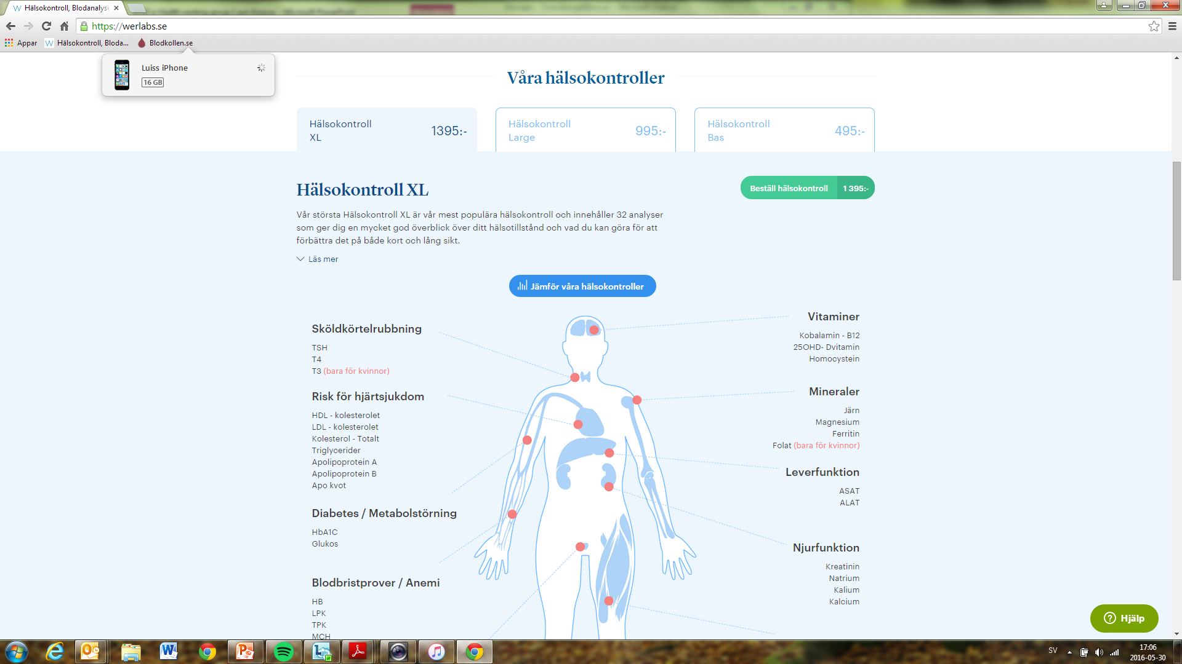

Slide 10
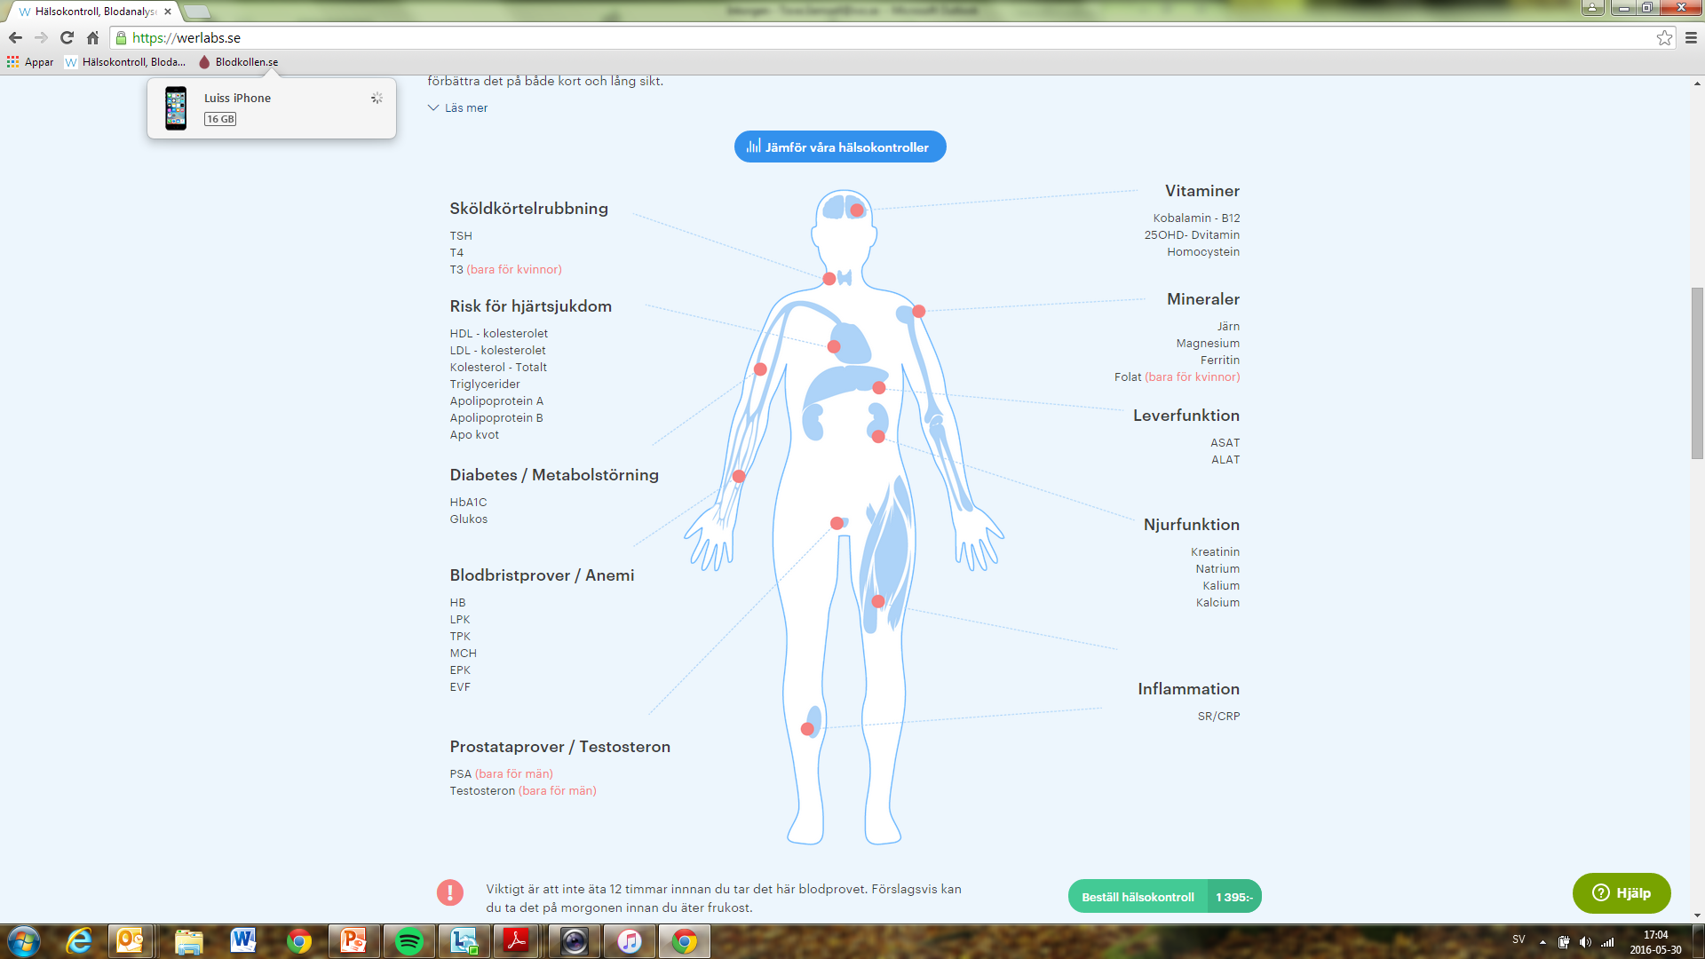



Results back to Werlabs
Feedback with advice

Slide 11
Identified cause for supervision
In April 2016 – anonymous complaint
We checked the web page
Some red flags went up
They seemed to think they were not care providers
Question1. they promised that the patient could erase their information
Question 2. Did they report infections diseases to proper authorities
Question 3. Did they ha a reliable identification of the patient?

Slide 12
Do
Contact with other supervisory authorities to identify overlap
Contacted Werlabs by mail
The three questions were put with its corresponding regulations
Promt answers were sent to us by their lawyer
Also contacted by their doctor responsible

Slide 13
Study act
Response was satisfactory- perfect!
Maybe to perfect – self correction?
No imeadient risks for patients safety

Slide 14
Evaluate
Lack of competence
Show our precence
See their reactions
Media attention
A proactive approach?

Slide 15
Better care
Info of the possibility to erase medical records is now gone
Routine in place for reporting of certain diseases
Routine in place for reliable identification

Slide 16
Work ahead
Each participant send in a description of a finished inspection/supervision of one eHealth services aimed at a consumer. And describes it in accordance with the presented framework.
Sweden will collect the examples and compose the start of a document. January 2017?
Next EPSO-meting: We meet and discuss the results and from this and choose one case; where we will reach an consensus on what would be best practice in this situation.
Agree upon further questions to looked into
Finalize a document that sums up our work and conclusions
Spread it through EPSO in May 2017

Slide 17
Results
A description of best practice
A case that illustrates the supervisory proceedure
A collection of practical experiences from different contries
Forum for the exchange of ideas and experience other contries that have on similar problems
A better understanding of witch questions should be furter looked into

Slide 18
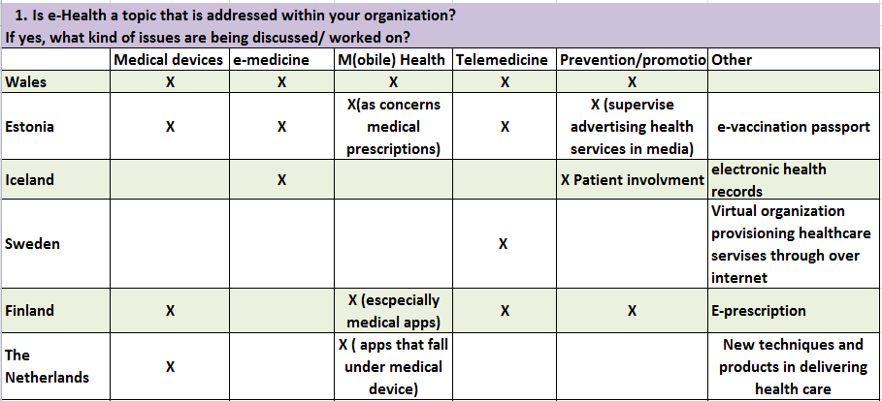
Questionnaire

Slide 19
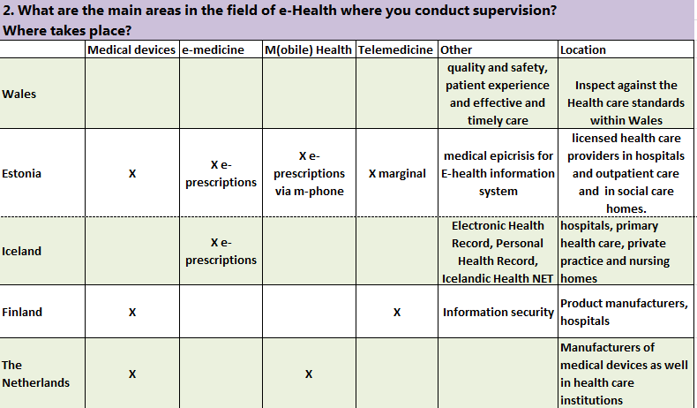
Questionnaire

Slide 20
Additional thoughts
Should we be careful not to hinder this (eHealth) development?
Could we determine that care takes place where the patient is situated. (Cross-border health care)

Slide 21
Four main questions
To what extent does supervising of E-health services vary from supervising the traditional care services? Don’t know yet, but we need to consider risks for the individual
Do we need special norms and standards for monitoring e-health and telemedicine? Yes --ma
Do we need special methods tools and instruments to supervise e-health and telemedicine? Yes
Is there a special need to work together cross-border to protect quality and safety in healthcare with regard to quality and safety of e-health and telemedicine? Yes, Especially concerning eHealth because it moves cross-border

