Slide 1
EPSO e-Health working group
Meeting at the
21th EPSO conference, Prishtina , Kosova Jine 3 2016
Chaired by Tove Gemzell (IVO, Sweden)

Slide 2
Agenda
The group
Aim and questions discussed
Definitions
Proposed focus
Proposed work ahead
Expected results

Slide 3
Participants so far
IVO - Sweden
IGZ - The Netherlands
Terviseamet – Estonia
CQC – England
Wales
Valvira – Finland (?)
EAMA - Bulgaria (?)
Landlaeknir – Iceland (?)

Slide 4
Aim
to stimulate the debate, thinking and research about supervision and E-health;
to organize a forum for exchange of ideas and practical co-operation between supervisory organizations that have responsibilities of healthcare supervision including supervision on e-health care and telemedicine;
to promote cross border fine-tuning, alignment and harmonization of norms and standards used by supervisory organizations for supervision on e-health and telemedicine.

Slide 5
Four main questions
What is the difference between supervising /monitoring /regulating of E-health services and supervising monitoring or regulating traditional care services? Or in other words: to what extent does supervising of E-health services vary from supervising the traditional care services? Don’t know yet, but we need to consider risks for the individual
Do we need special norms and standards for monitoring e-health and telemedicine? Yes
Do we need special methods tools and instruments to supervise e-health and telemedicine? Yes
Is there a special need to work together cross-border to protect quality and safety in healthcare with regard to quality and safety of e-health and telemedicine? Yes, Especially concerning eHelth because it moves cross-border

Slide 6
WHO Definitions we will use
eHealth is the use of information and communication technologies (ICT) for health. Examples include treating patients, conducting research, educating the health workforce, tracking diseases and monitoring public health.
Where health refer to physical, mental and social wellbeing

Slide 7
Focus
Consumer related eHealth services
Because they:
travel cross-border
and are similar in different contries
Special attention to:
-choosing the relevant services from at patientsperspective

Slide 8
Next step, steps,,
Each country choose an example of an ongoinng or planned or finnised inspection/supervison of one of these eHealth services. Describes it.
We meet and discuss the results and from this choose one case; where we will reach an consensus on what would be best practise in this situation.

Slide 9
Results
A description of best practise
A case that illustrate the proceedure
Forum for the exchange of ideas and experience other contries have on similar problems
A better understanding of wish question should be furter looked into

Slide 10
Swedish example
eHealth vision in Sweden
In 2025, Sweden will be the best in he world at using opportunities offered by digitalization and eHealth to make it easier for people to achieve good and equal health and welfare, and to develop and strengthen their own resources for increased independence and participation in the life of society.
Werlabs

Slide 11
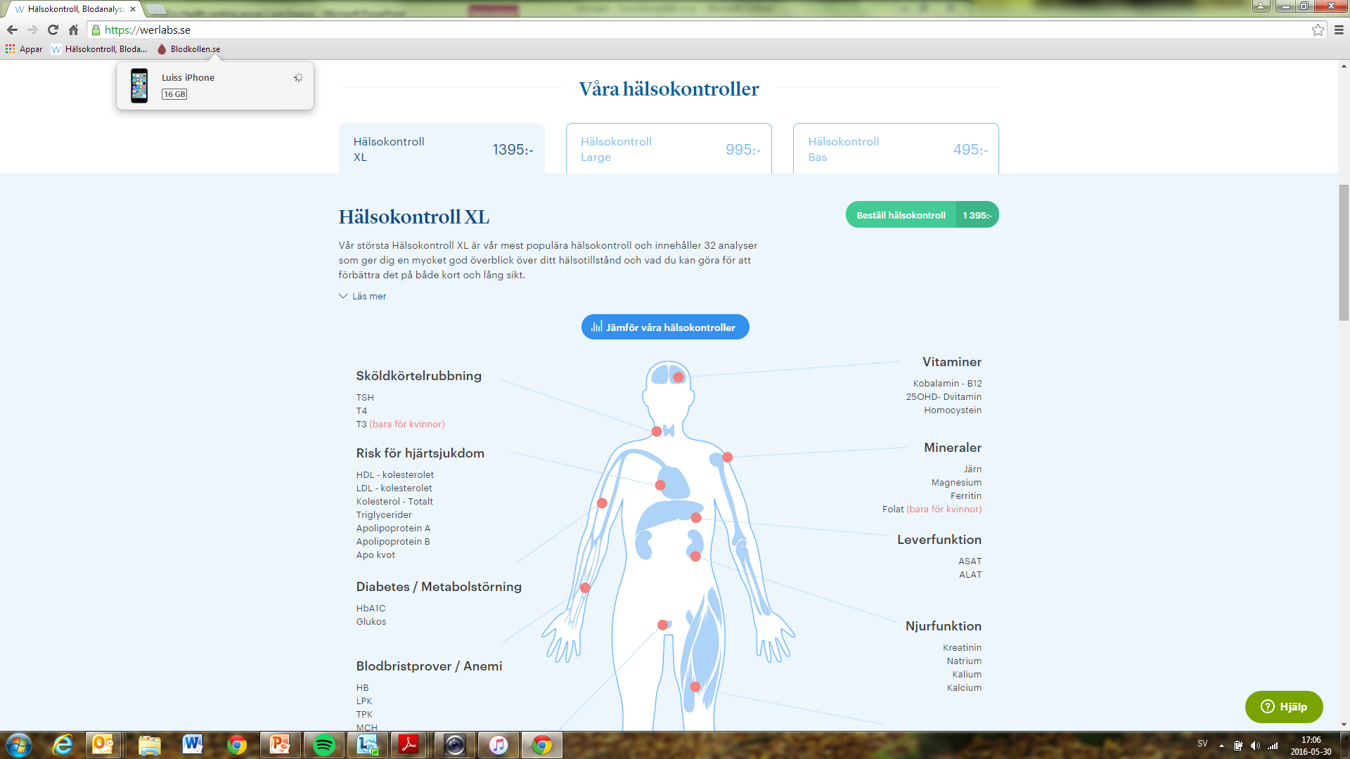

Slide 12
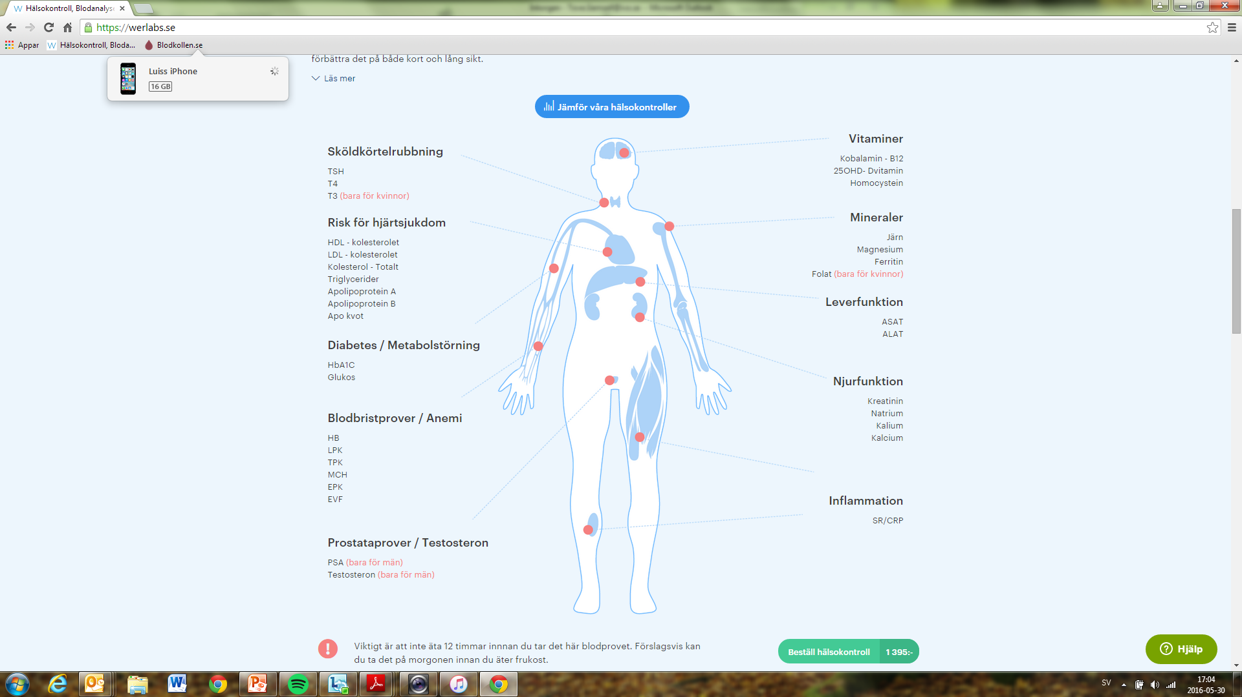

Slide 13
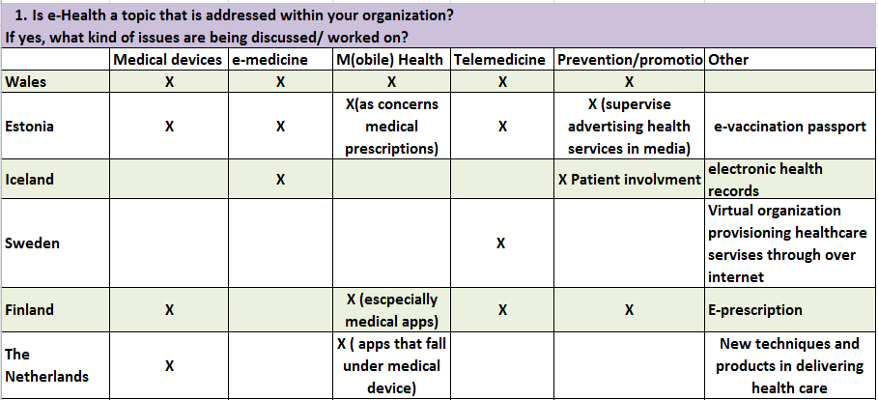
Questionnaire

Slide 14
Questionnaire

Slide 15
Additional thoughts
Should we be careful not to hinder this (eHealth) development?
Could we determine that care takes place where the patient is situated. (Cross-border health care)

