Slide 1
EPSO Effectiveness Group;
Riitta Aejmelaeus
Senior Medical Officer,
MD, Ph.D, Specialist in Geriatrics, MBA

Slide 3
Assessment of effectiveness
Regulatory bodies can´t directly effect patients health, the effect comes through healthcare providers

Slide 4
Effectiveness is an umbrella, that

Slide 5
Covers wide variety of issues
Research
Visions and strategies
Patient safety data
Cases

Slide 6
Learning from incidents in healthcare: the journey, not the arrival, matters BMJ Quality and Safety BMJ Qual Saf doi:10.1136/bmjqs-2015-004853
Ian Leistikow1,2, Sandra Mulder1, Jan Vesseur1, Paul Robben2,3
+ Author Affiliations
¹Medical Specialist Care, Dutch Healthcare Inspectorate, Utrecht, The Netherlands
²Department of Health Policy and Management, Erasmus University, Rotterdam, The Netherlands
³Dutch Health Care Inspectorate, Utrecht, The Netherlands

Slide 7
Questionnaire for scoring used by the IGZ
Aftercare
▸ Is the aftercare for the patient/relatives described?
▸ Is the aftercare for the professionals involved described?
▸ Has the report been shared with the patient/relatives?
▸ Reaction of hospital board
▸ Is the reaction of the board adequate?

Slide 10
CQC’s approach to assessing its Impact and Value for Money EPSO Effectiveness working group meeting 11 May 2016, Oslo
Emily Hutchison, Economics Manager
PPP, Strategy and Intelligence
151 Buckingham Palace Road, London, SW1W 9SW
Emily.Hutchison@cqc.org.uk

Slide 14
What is effectivness from a Swedish point of view?
EPSO working group
Oslo 11th of May 2016
Klas Öberg, Lena Weilandt
Dep. of Development and Analysis, IVO

Slide 15
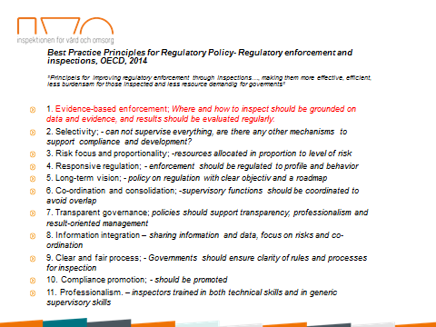

Slide 16
CQC: Shaping the future: Strategy for 2016 to 2021

Slide 17
Effectiveness
Pre-conference meeting in Stockholm September 2016
Everybody is invited to come and share ideas and concerns with us

