Slide 1
ESTONIAN
E-HEALTH SYSTEM
Laine Mokrik
Estonian E-health Foundation

Slide 2
Estonia
Area - 45 000 km2
1.33 mlj. inhabitants
GDP:
Agriculture 3.9%
Industry 29,7%
Services 66,4%

Slide 3
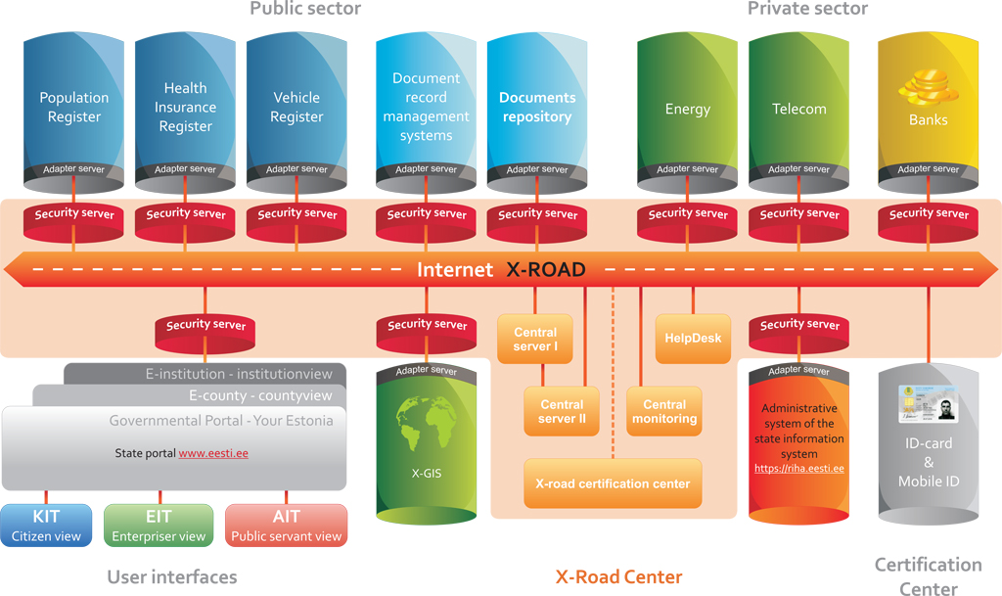
E-STATE ARCHITECTURE

Slide 4
E-HEALTH ARCHITECTURE
STATE AGENCY OF MEDICINES
- Coding Centre
- Handlers of medicines
HEALTH CARE BOARD
- Health care providers
- Health professionals
- Dispensing chemists
POPULATION REGISTER
BUSINESS REGISTER
HOSPITALS
2009
FAMILY DOCTORS
2009
PHARMACIS
2010 january
SCHOOL NURSES
2010 september
EMERGENCY MEDICAL SERVICE
2011
X-Road, ID-card, State IS Service Register
NATION- WIDE HEALTH INFORMATION EXCHANGE PLATFORM 2008 december
PRESCRIPTION CENTRE
2010 january
PATIENT PORTAL 2009
X-ROAD GATEWAY SERVICE 2009
PHARMACIES AND FAMILY DOCTORS 2009

Slide 5
8 main softwares (totally 20)
752 associated juridical persons
21 main hospitals
73 stationary healthcare institutions (hospitals)
479 family doctors (juridical persons)

Slide 6
E-health Foundation (EHF)
ORGANIZATION
Ministry
of Social Affairs
Society
of Family Doctors
Tartu
University Clinic
East Tallinn
Central Hospital
Union of Estonian
Medical Emergency
North Estonian
Regional Hospital
Estonian
Hospital Assosiation
Estonian e-Health
Foundation Board
Management board
Standards management
IT
management
ENHIS Operation
Services management
Communication management

Slide 7
eHealth Foundation TASKS
Development and administration of e-health services
Coordination of information systems harmonization used by medical professionals
To lead standardization process, includes classifications administration
Housing HIS and other supportive systems
International cooperation
Scientific cooperation with universities

Slide 8
LEGAL ASPECTS
The Health Service Organization Act provides that January 1st of 2009 all health care service providers in Estonian are obligated to forward medical data to the Health Information System.
The obligation of health care service providers is to conclude an interfacing contract with the Estonian eHealth Foundation since it is the authorized processor of the Health Information

Slide 9
LEGAL ENVIRONMENT OF E-HEALTH
The Health Information System Act is being prepared to
regulate the development and maintenance of the health information system
Lay down the necessary requirements to the patient, health service provider, etc
Ministerial act for digital documentation
Updated regulary
Documentation data sets, stakeholders and implementation schedules
e-prescription system is regulated with Medicinal Products Act and the governments Statute no 130 August 14th 2008.
Data protection law

Slide 10
Health care providers
Health care providers are required to submit information to the HIS:
1) for maintaining a waiting list;
2) for making medical images available;
3) for making medical documents available to other doctors and patients;
4)for maintaining information for health registers;
5) forensic expert of the state forensic institution has the obligation to forward data (to HIS) on the cause of death if it appears that death has arrived as the result of an illness or injury.

Slide 11
DATA ACCESS POLICY: OPT OUT Regulated by the law
All healthcare providers must send data to HIS
Access only to licensed medical professionals
(The attending doctor concept)
ID card for authentication and digital signature
Patient has the right to close his/her own data collected in the central database (opt out)
Patient can access their own data
Patient can declare their intentions and preferences
Patient can monitor visits to their PP

Slide 12
Patients’ rights
Patient can express his or her wish 1) to donate cells, tissues or organs for transplantation after his or her death; 2) to donate corps for academic work; 3) about blood transfusions; 4) to name contact person; 5) to name a person who is authorized to purchase medication on behalf of the patient

Slide 13
THE MAIN SECURITY PRINCIPLES
OF ESTONIAN E-HEALTH SYSTEM – OPT OUT
A secure authentication of all users with ID-card or Mobile ID
Digital signing or stamping of all medical documents
A maximum accountability (transparency): all actions will leave an unchangeable (and unremovable) secure trail
Encrypted database that allows to remove the confidentiality risk
Monitoring of all actions together with the corresponding counter-measures (both organizational and technical)

Slide 14
Data and statistics services
A medical certificate services
Digital laboratory services
2015
Services for Social Insurance Fund
Services for dental care
2015
Services for blood center
2016
Services for registers
2015
Services for nurse
2016
M-and tele-health services
Health information services for patient
E-learning services for medical staff
Analytics services
eAmbulance services
2014
Cross Border Data Exchange services
2013 (EPSOS)
Digital archiving (x-ray images)
Digital registration
2016
eConsultation services
EHR services for physician
EHR services for patient
MAIN SERVICES OF THE
E-HEALTH IN ESTONIA
Supporting services
Connecting Health
- Completed
- Development
- Planning
Infrastructure services
External services
Subservices

Slide 15
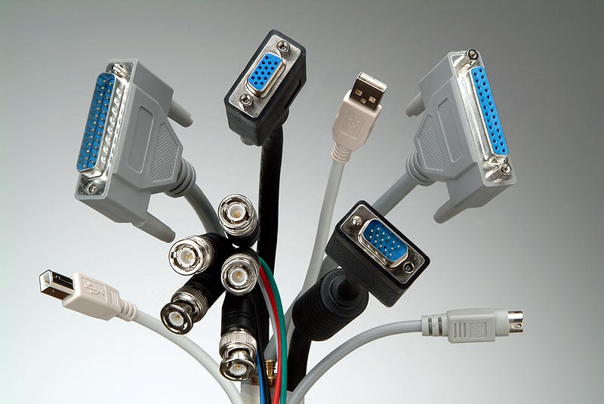
STANDARDS
HL7 and DICOM (Picture Archive)
International classification: ICD-10, LOINC, NCSP, ATC
Estonian eHealth’s OID registry
Local eHealth classificators
Published in publishing centre
http://pub.e-tervis.ee/classifications
State classificators are regulated by government act https://www.riigiteataja.ee/akt/12910889

Slide 16
Data collection via standard
EHF
publishes the document standards , controls, lists
HCP develop their IS accordance standards
HCP update their information systems for data Exchange

Slide 17
ACCEPTANCE
98% of family doctors are sending documents to the central system
The central system has over 10 300 medical users
All bigger hospitals use central system on a regular base
1.35 mio persons have documents in central system (98% of the population)
0.74 mio persons information in the central DB have used by medical professionals
ePrescription covers 98% of issued prescriptions
Over 97% of stationary case summaries have sent to the central DB

Slide 18
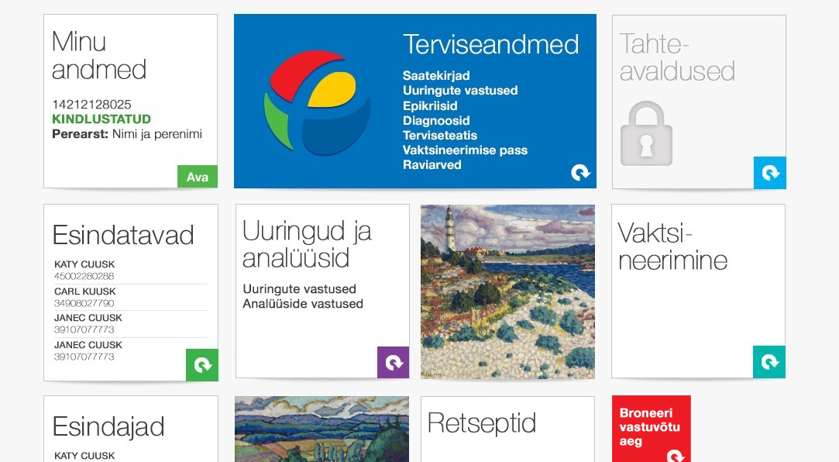
PATIENT PORTAL (UPGRADE) – 1.4 mio persons medical data

Slide 19
PATIENT PORTAL
Patient can:
view and print out medical documents sent by health care providers to the central system;
view information about their general practitioners and validity of health insurance;
provide general information about themselves for health care providers;
express his or her wish:
to donate cells, tissues or organs for transplantation after his or her death to donate his or her dead body for academic work
about blood transfusions to name contact person to name a person who is authorized to purchase medication on behalf of the patient
monitor logs

Slide 20
Laine Mokrik
Estonian E-health Foundation

