Slide 1
Danish patient safety database
Effective system?
Lena Graversen, Head of Unit, Danish Patient Safety Authority

Slide 2
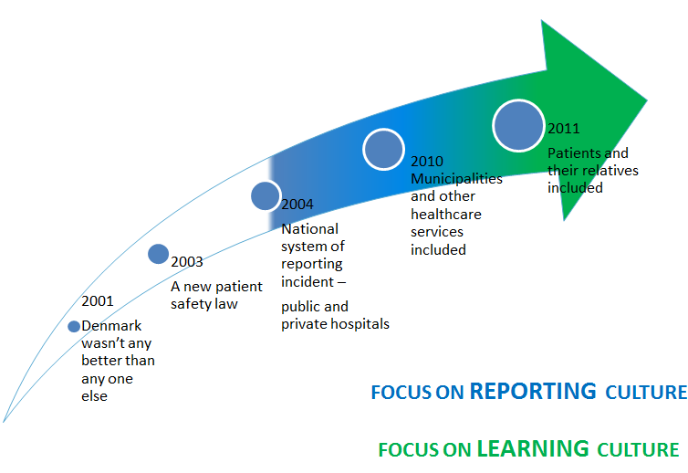
The Danish Patient Safety Database – DPSD
May 2016
Notes:
The purpose of the Danish reporting system
“The reporting system for patient safety incidents must support patient safety by collecting, analyzing and disseminating information on patient safety incidents, thus creating a systematic learning; partly by patient safety incidents that occur within the health sector, and partly by patient safety incidents that occur in the transition between sectors”

Slide 3
Characterization of the Danish reporting system
(DPSD)
Mandatory
  A health care professional who becomes aware of an adverse event has to report such an event
Confidentiality
  Information about reporting health care professional’s identity to anybody can’t be disclosed
Notes:
Frontline personnel are obligated to report adverse events to a national reporting system.
Patients and relatives may report
Reporting on adverse events from the regional council and the municipal council to the National Agency for Patients’ Rights and Complaints shall be anonymised with regard to the patient concerned as well as the reporting individual.
Information on the identity of the person that has submitted a given report may only be shared with the individuals in the same region or municipality that take care of tasks.

Slide 4

The Danish Patient Safety Database – DPSD
Sanction-free
A health care professional can not be subjected to disciplinary investigations or measures by the employer, supervisory reaction by the Danish Patient Safety Authority or criminal sanction by the courts.

Slide 5
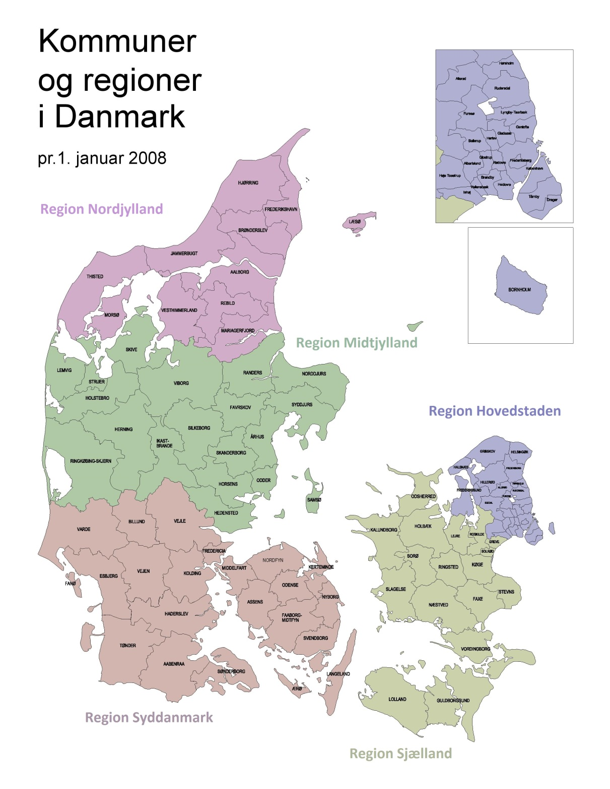
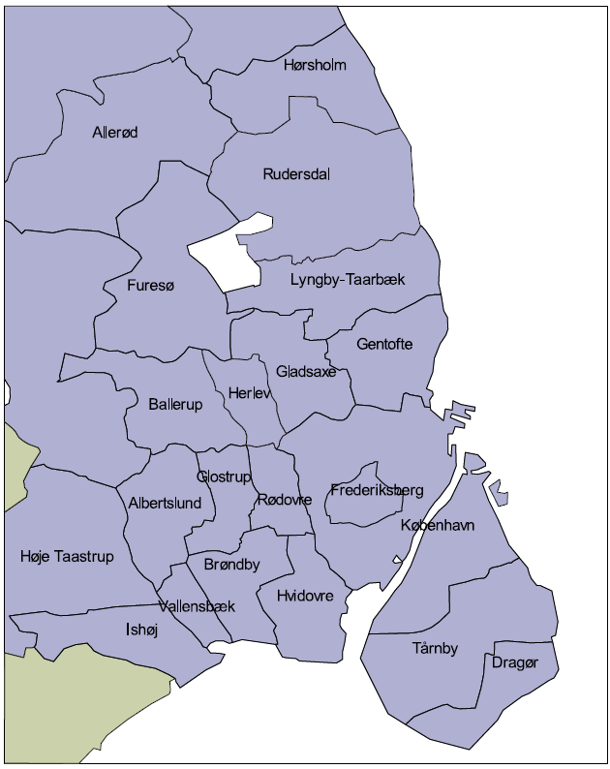
Regions and Municipalities in Denmark

Slide 6
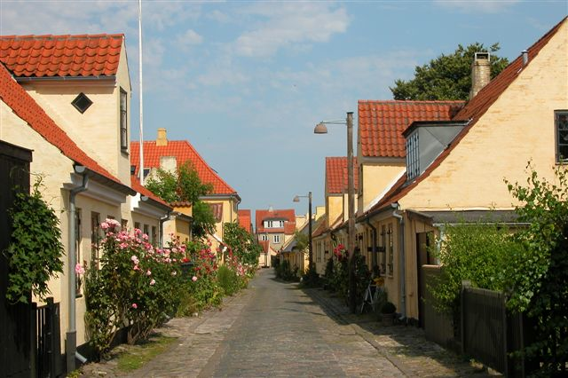
Dragør

Slide 7
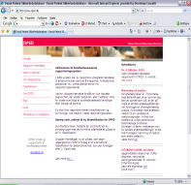
The Danish Patient Safety Database
One National Database
CASE-FLOW
Reporting
Case handler
(municipal / regional)
Danish Patient Safety authority
External data users
Citizen
Local case handler
Central case handler
Healthcare staff

Slide 8
Primary care sector
Public hospitals
Private practitioners and pre hospital care
Analyzed by the municipal council
Analyzed by the regional council
Analyzed by the private hospitals themselves
Private hospitals
5 regions and 98 municipals
Notes:
Nursing homes
Home nurse
Home Care
The public dental
Housing for citizens with disabilities
Nurses
Social housing
Addiction treatment
Care centers
Prevention Centre
Training
Others
GP
Specialists
Therapists and chiropractors
Midwives
Dentists and dental hygienists
Psychologists
Pharmacies
Doctor on call
Regionale housing
Pre-hospital og ambulances

Slide 9
The Danish Patient Safety Database – DPSD
Many Patient safety preventive actions is taken at local level
regional/municipal learning
national learning.
Notes:
Outcome at local level
Many patient safety preventive actions are taken at a local level
Outcome at national level
Incidents categorized as ”Lethal” and most medicine incidents are analyzed.
At national level we should take action on incidents that cannot, because of their nature, be handled at local level.

Slide 10
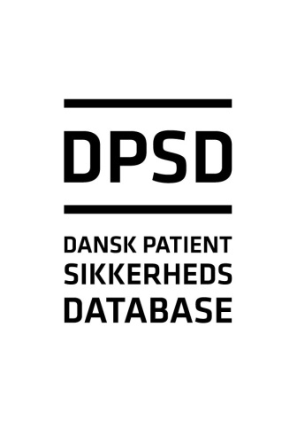
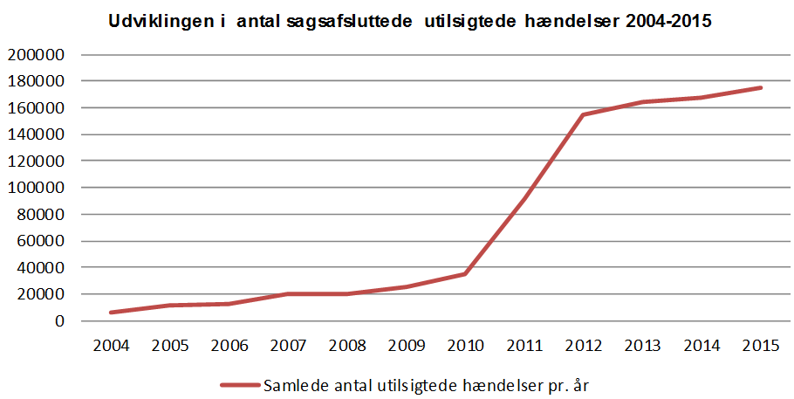
Dansk Patientsikkerhedsdatabase
ca. 175.000 cases in 2015
116.000 muncipalities
56.000 regions
1200 privathospitals
1800 patients and relatives.

Slide 11

New methods
Service inspection
Public Accounts Committee investigation
Evaluation Patient complaint system

Slide 12

Pilot project- aggregated reporting
reporting identical incidents aggregated
more quality in local patient safety work
short learning loops

Slide 13
Pilot project
health care in Muncipalities
medicin not given and fall
no harm or mild severity
60.000 cases pr. year

Slide 14
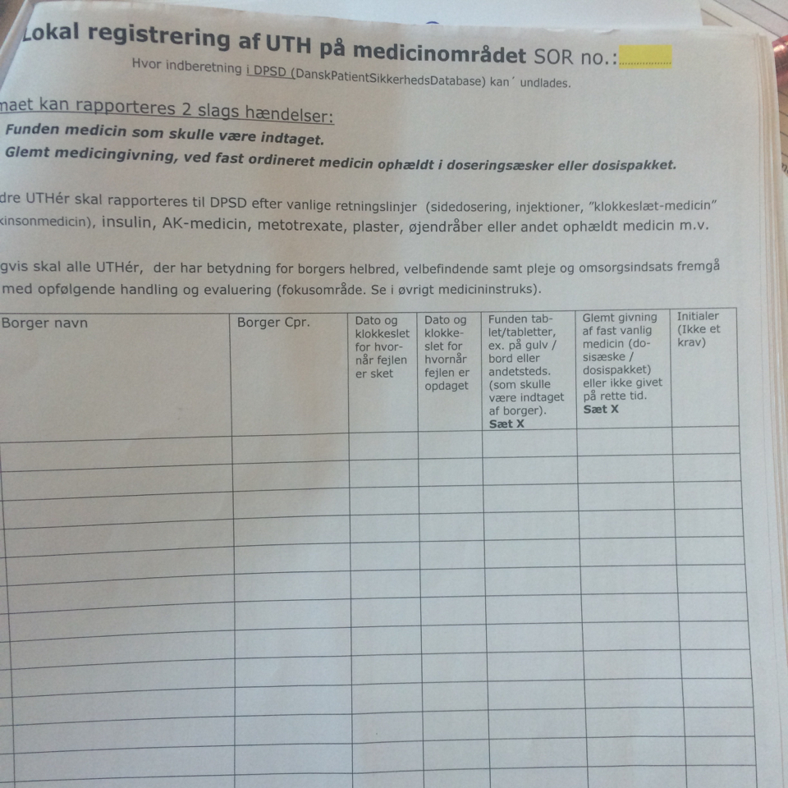
Local reporting

Slide 15
What is important for us?
Local learning- better local overview
Easier to report incident
Involvement of all health personnel
Local organisation and leadership
National level- aggregated data and learning activity

Slide 16
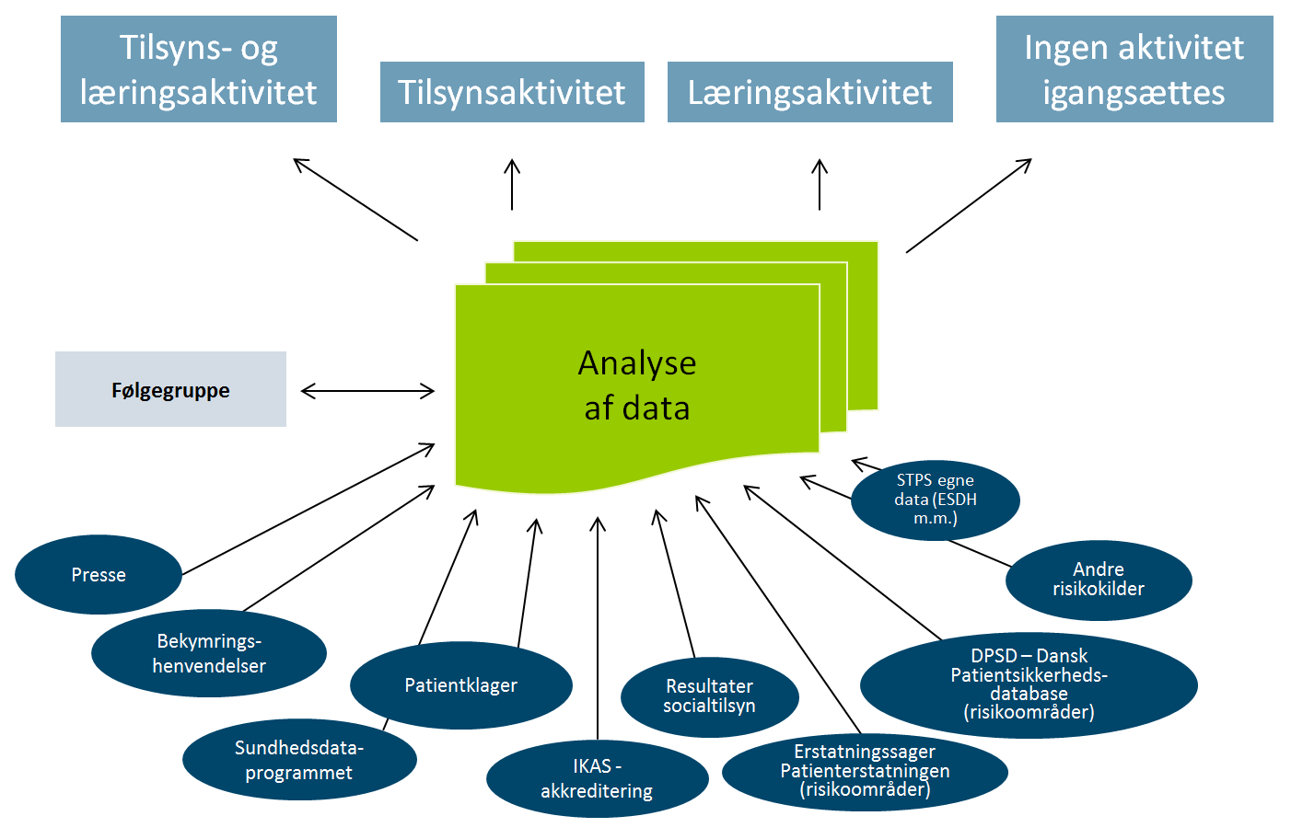
Ny måde at arbejde med læring på – typer af data

Slide 17

Questions and Comments?
May 2016

