Slide 1
SOFI in practice
Carien Geertse
Senior Inspector, IGZ

Slide 2
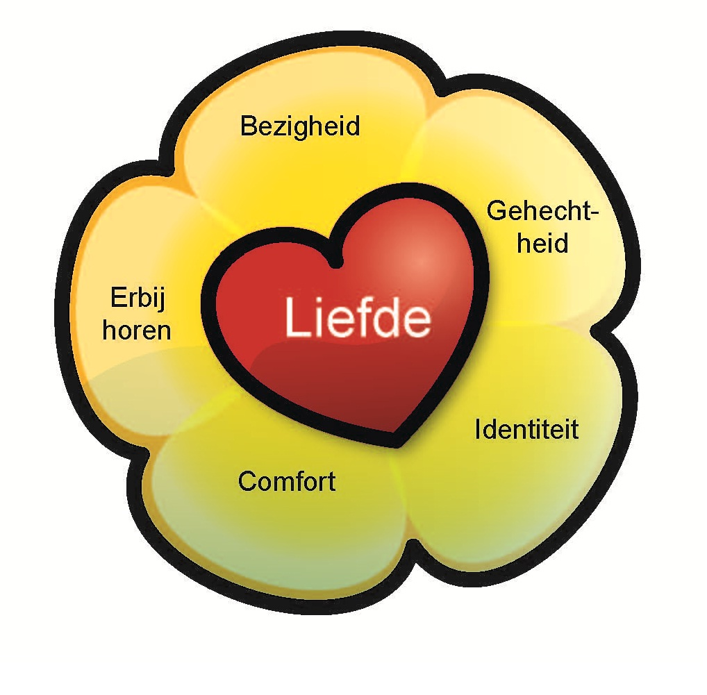
Person centered care – Kitwood

Slide 3
Psychological needs
Occupation
Attachment
Identity
Comfort
Inclusion
Love

Slide 4
Visiting day
Unannounced visits
Introductions
Short tour
Two 45-minute observations
Review of about 3 to 4 client records, document review
Talks with client representative, therapists, care staff, management
Report, report results, possible follow up inspection visit

Slide 5
Mood state
Engagement
Staff interaction

Slide 6
Look at a scene
What did you see?
Mood state, engagement, staff interaction
Which client file would you like to read?
Which questions would you ask the nurse/ carer?

Slide 7
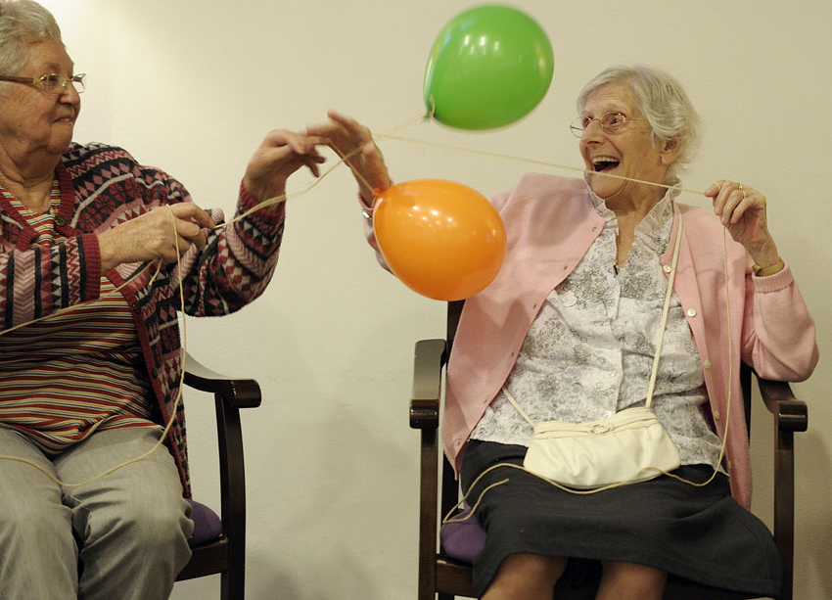

Slide 8
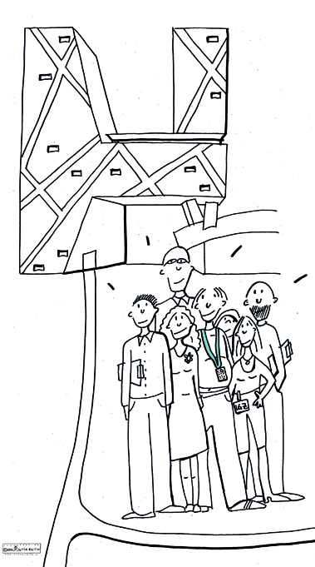
Thank you very much for your attention!
cj.geertse@igz.nl

