Slide 1
Supervision on medical apps
Sipko Mülder
Head of Risk detection and development at Dutch Healthcare Inspectorate IGZ
EPSO Kosovo, June 2016

Slide 2
Outline
Examples of medical apps
Use by health care professionals and patients
Risks
Requirements
Supervision in The Netherlands

Slide 3
Skinvision

Slide 4
Easy diabetes

Slide 5
EMR Antibiotic Guide

Slide 6
Vaccine schedules

Slide 7
Seasonal Influenza

Slide 8
And many more….

Slide 9
And many medical apps for patients

Slide 10
Overview of approved apps (by the field)
Notes:
GGD Appstore: toont door hen goedgekeurde apps.

Slide 11
Increasing use of medical apps by physicians

Slide 12
Risks (1)

Slide 13
CONCLUSIONS:
The majority of insulin dose calculator apps provide no protection against, and may actively contribute to, incorrect or inappropriate dose recommendations that put current users at risk of both catastrophic overdose and more subtle harms resulting from suboptimal glucose control. Healthcare professionals should exercise substantial caution in recommending unregulated dose calculators to patients and address app safety as part of self-management education. The prevalence of errors attributable to incorrect interpretation of medical principles underlines the importance of clinical input during app design. Systemic issues affecting the safety and suitability of higher-risk apps may require coordinated surveillance and action at national and international levels involving regulators, health agencies and app stores.

Slide 14
Risks (2)

Slide 15
Why supervision on eHealth / mHealth?
Pilot starts in 2016
Healthcare needs to be safe, also when eHealth is used
Healthcare is increasingly dependent on eHealth
eHealth develops rapidly
Political aim: eHealth letter by the Minister in 2014: “In 5 years time 80% of chronically ill patients will use eHealth in some form”
The medical field does not have enough awareness on potential risks that eHealth can bring.

Slide 16
IGZ Activities on medical apps
Two conferences in 2013
For manufacturers of medical apps
For Healthcare professionals
To inform the field that software products with medical purposes can be regarded as a medical device
Announcement of inspections on medical apps as of 2014.

Slide 17
IGZ Contacts with Microsoft and Apple
Selling medical apps through Appstores
Therefore, they are distributor and have responsibilities
Agreement on having contacts between IGZ and Microsoft / Apple in case of problems with apps
Legal advice: Supervision on Apple Google and Microsoft is possible, in case of selling apps which do not meet the legal requirements

Slide 18
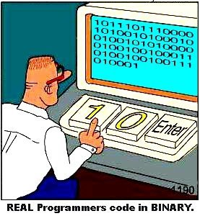
1. Introduction What regulations?
Health care professionals:
Quality regulation for health care institutions
“Good quality of care shall be delivered”
Manufacturer/ software vendor:
93/42/EEG Medical Device Directive
MEDDEV 2.1/6 Software as a medical device

Slide 19
1. Introduction Dutch timeline
Creating awareness for the Dutch priorities
Health care professionals develop guidelines
Inspections
HEALTH CARE
PROFESSIONALS
SOFTWARE
VENDORS
Interpreting MEDDEV 2.1/6 (thanks to Sweden!)
Communication (conference in June)
Inspections
Developing indicators for risk
Risk based inspections
PROCESS
DESIGN
Q3
Q4
Q1
Q2
Q3
Q4
Q1
Q2
Q3
oct
2012
jan
2013
apr
2013
jul
2013
oct
2013
jan
2014
apr
2014
jul
2014
oct
2014

Slide 20
2. More about….
Interpreting MEDDEV 2.1/6
Software as a medical device
PACS
Decision-support systems
Medical apps

Slide 21
Decision tree MEDDEV 2.1/6
“Simple search” is limited to the searching functionality only: retrieval of records by matching record metadata against record search criteria and not, for example, identifying, marking or drawing attention to portions of record data or portions of images that match the search criteria.
Definition from ISO/IEC 2382-1:1993: “A computer program is defined as a syntactic unit that conforms to the rules of a particular programming language and that is composed of declarations and statements or instructions needed to solve a certain function, task or problem.”

Slide 22
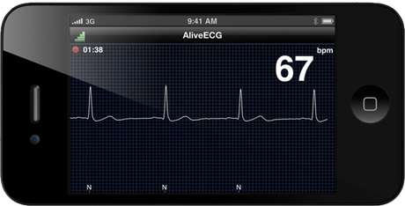
Medical apps/ mHealth
Categories:
Information providing => not a medical device
Decision-supporting
Diagnostic / therapeutic
Apps that perform measurements
Medical imaging
Apps as accessory
BYOMD – bring your own medical device

Slide 23
Requirements for Medical Apps in case of Medical Device
GUIDELINES ON THE QUALIFICATION AND CLASSIFICATION OF STAND ALONE SOFTWARE USED IN HEALTHCARE WITHIN THE
REGULATORY FRAMEWORK OF MEDICAL DEVICES
The modules which are subject to the medical device Directives ) must comply with the requirements of the medical device Directives and must carry the CE marking.
Risk analysis
Clinical evaluation
Registration of medical apps at the Dutch Ministry of Healthcare

Slide 24
Inspections in The Netherlands
50 Inspections on Software Products since January 2014
12 Inspections on Medical Apps
Many software companies with only two employees
Pharmaceutical Industry as sponsor
Health care institutes as sponsor
Health care professionals as external experts
In many cases it is not clear that IEC 62304 should be followed
Many cases no proper risk analysis
Difficult to do a clinical evaluation (developed by IMDRF)

Slide 25
Risk Framework by IMDRF

Slide 26
Supervision on medical apps in The Netherlands
Analysis of Software Market as Medical Device
Published on IGZ website
Sanctions for two software developers (fines)

Slide 28
Conclusions
The use of medical apps is increasing enormously.
Use by health care professionals and by patients
There is serious risk in software as medical device
In the development of medical apps Risk analyses and Clinical evaluations appear to be difficult
IEC 62304 is not familiar at all software development sites

Slide 29
Future
Patients will be more in control over personal health
The quality of medical apps will be increasingly important
IGZ will continue to perform inspections on software developers
IGZ will work towards supervision on eHealth within healthcare institutes

