Slide 1
Finding improved methods to inspect, regulate and assess Integrated Care Heleen Buijze, Inspector

Slide 2
Netherlands Health Care
Inspectorate (IGZ)
Independent, impartial and transparent
We trust in the intrinsic motivation of care providers
We seek to achieve a balance between providing room to learn and taking measures
The perspective of patients is paramount
Notes:
Before I get started on the topic, I would like to tell you a little bit about myself and my work.
Introducing myself
My name is Heleen Buijze and I’m a coordinating inspector at the Dutch Health Care Inspectorate.
The Dutch Health Care Inspectorate is part of the Ministry of Health in The Netherlands. Since 2015 all inspectors have been working in one national office in Utrecht, a city in the middle of our country.
Our office, which you can see on this slide, is just around the corner of the Central Station In Utrecht.
Currently around 650 people work at the Dutch Health Care Inspectorate.
I have been working here for 7 years now and my main focus at this moment is supervising integrated care at home. This is a subject that is keeping me busy for a few years now.

Slide 3
Field of activity IGZ
Notes:
Those 40.000 healthcare institutions include hospitals, elderly care institutions, individual professionals, public health institutions, manufactures and traders, dentists, etc.
This is why, as I mentioned before, we use risk-driven supervision.
I will now explain what we mean by that.

Slide 4
Transition of Health Care in the Netherlands
People stay at home as long as possible
More responsibility for the care to people themselves, their family and informal network
After hospital admission people go home as soon as possible
Local councils provide care-related services
Health care is provided in or close to the home
Notes:
First I will tell you something about the transition of Health Care in the Netherlands which started in 2015.
The general policy in the Netherlands is to make people stay at home as long as possible, give more responsibility for the care to the people themselves, to the family and to the informal network.
The amount of beds in nursing homes and in institutions for mental health care and disabled people have been decreasing. Currently only people who need 24-hour care and supervision are allowed in a nursing home.
After hospital admission people go home as soon as possible.
The local Councils got more responsibility for taking care of their citizens, especially for more vulnerable groups like the elderly, the mentally disabled and children. Local councils now provide care-related services such as transport, assistance at home, equipment, day-activity centers, etc. The idea is that the local Councils are more able than the National Government to provide customized services that suit people’s needs.
Medical care or support that is needed is arranged, at home or close to the home.

Slide 5
Three major goals
Shift from traditional care and support towards an integrated one, based on the personal situation and support from the social network
More prevention, early intervention and innovation
Budget control

Slide 6
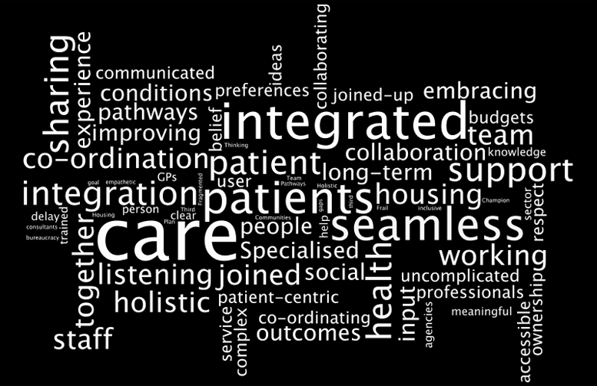
Integrated care
Worldwide trend in health care reforms, many different approaches
Response to the fragmented delivery of health and social services
Focus on treating the whole person
Continuity of care from the clients perspective
Particularly important to vulnerable elderly people with complex care needs

Slide 7
Challenges for the Dutch Health Care Inspectorate
Finding improved methods to inspect,
regulate and assess Integrated Care with:
the client’s perspective as the
starting point
a regional approach instead of focus
on institutions or professionals
a focus on quality of co-operation
and cohesion between health care workers
and social workers and informal caregivers
multidisciplinary inspection teams
Notes:
As I have said before, Integrated Care has been keeping me busy for a few years now. I’d like to fill you in on the way we are dealing with the transition.
First of all I must say: it’s a work in progress!
We carry out small pilots, develop our working methods with trial and error and we learn more every day how to adjust to the changing field of homecare.
We have made some fundamental choices.
Firstly: we have chosen the perspective of the client at home as our starting point. Secondly: we have chosen for a regional approach instead of a focus on institutions or individual professionals. We look at a whole region.
Thirdly: we have shifted our attention from assessing the quality of professionals and institutions to assessing the quality of cooperation and cohesion in a certain area. We do that by looking at networks around clients from the perspective of clients.
We do these pilots with multidisciplinary inspection teams, with inspectors from different departments in the Inspectorate. So we form a network as well and have to work together.

Slide 8
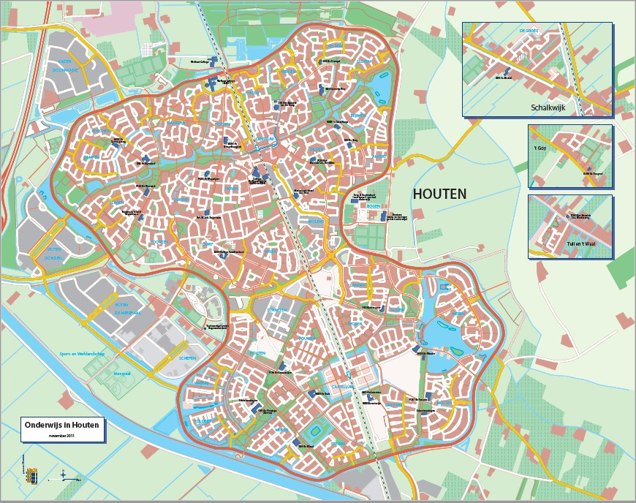
Assessing and regulating networks of health care and social support for elderly people at home in Houten
Notes:
I will show you an example of an investigation on integrated care we are working on right now.
Therefore I’ll take you to the municipality of Houten. It’s a town near to Utrecht, only 10 minutes by train.
Houten is a green town, with a small, typical Dutch old center. It has a lot of new houses and approximately 50.000 inhabitants.
We are investigating the networks of health care and social support for vulnerable elderly people at home in Houten.
We do this in quite a different way than we usual do. As I said before: the perspective of the client at home as our starting point

Slide 9
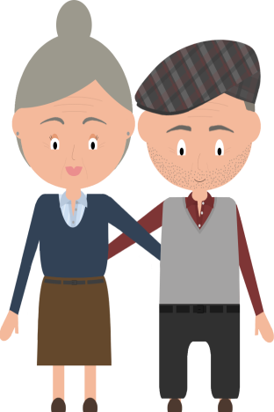
Mrs. And Mr. Jansen
General practitioner
Dementia tests in hospital
Primary care assistant diabetes
Pharmacist
Domestic help
Fysiotherapist
Day care
District nurse
Son and daughter
Neighbours
Notes:
For instance: Mrs. and Mr. Jansen. (Maybe you know: Jansen is the most common name in the Netherlands.)
Mrs. Jansen is 85 years old. She is happily married with mrs. Jansen. Mrs. Jansen’s health is – concerning her age – quite good.
Mr. Jansen is 89 years old. In the recent years his health has deteriorated. He suffers from diabetes, unfortunedly he fell from the stairs and now has a wound at his left leg which doesn’t cure. And recently he is diagnosed with vascular dementia.
Last year he has been in a nursing home for 6 weeks. Now he is home again and he gets health care and social support at home. At the slide you can see who is involved with mr. Jansen.

Slide 10
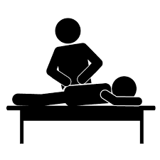
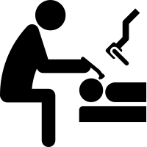
Regular inspection
IGZ
Health Care institutions
Health Care professionals
Citizen’s/cliënts
Notes:
Our regular approach is to visit health care institutions or health care professionals and make a report after this visit with results and the necessary improvements they have to make.

Slide 11
Inspection integrated care
Notes:
For supervising integrated care we use an other approach.
We start with patients en we look from the perspective of patients at the health care and social support they receive.
We have asked the GP’s in Houten select vulnerable elderly patients who have been temperarily in a nursing home last year and who now get health care and social support at home.
The GP’s sign patients in.

Slide 12
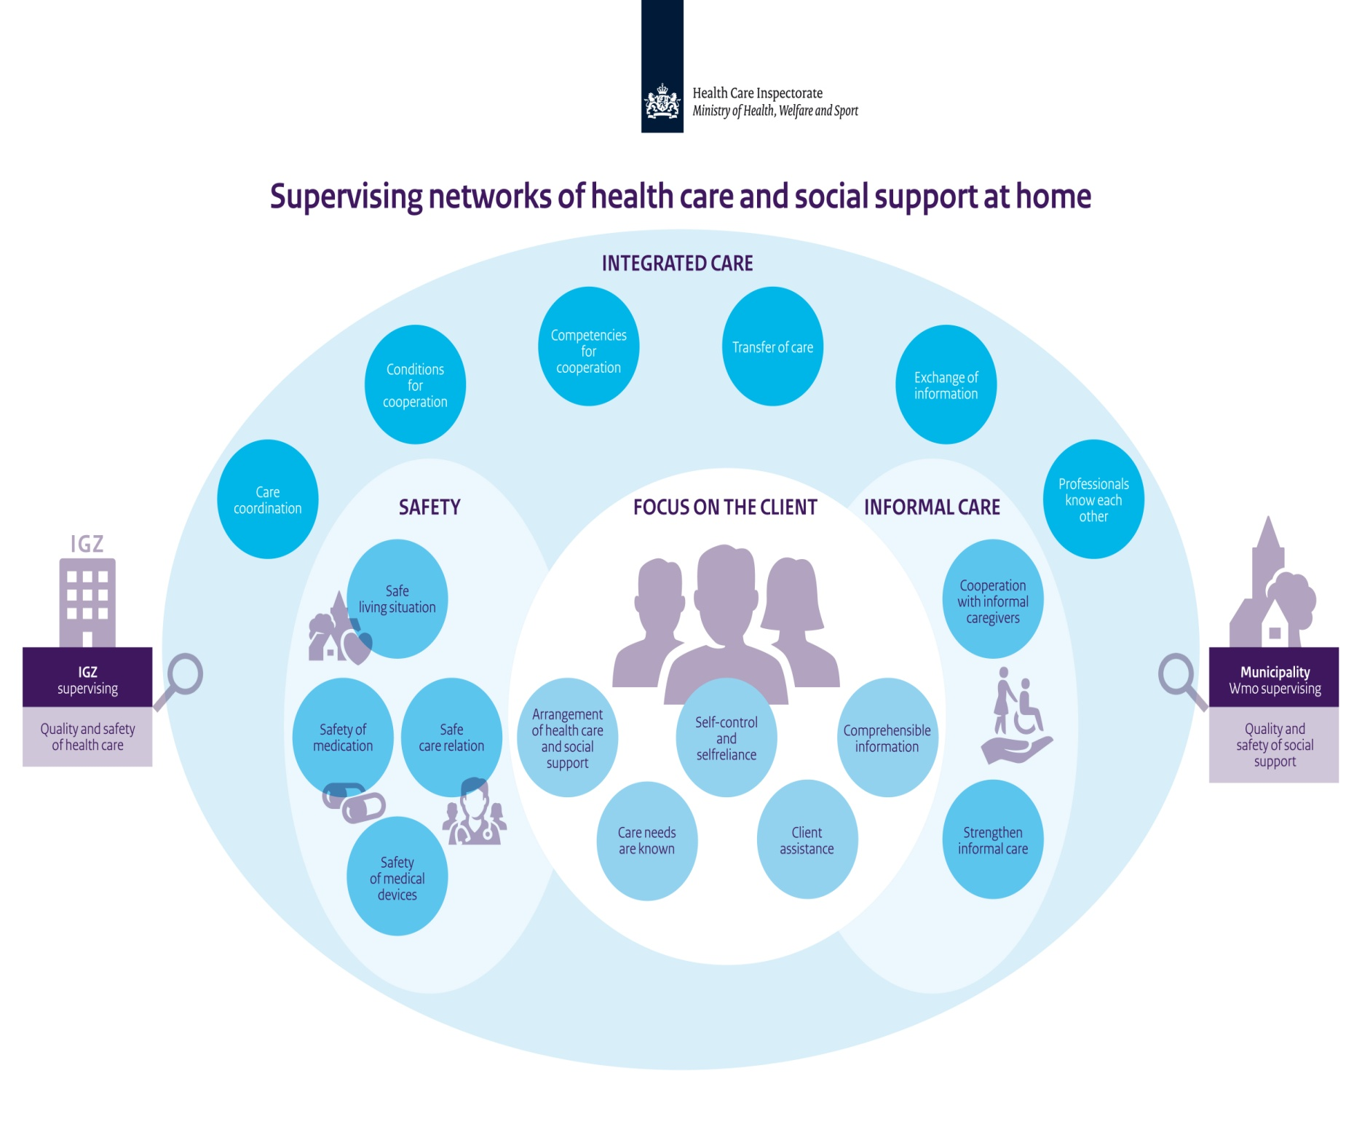
Notes:
With the health care workers and social support workers we discuss different subjects, like:
Is this network really focussed on the patients needs?
Are the professionals working together with the informal garegivers?
Is integrated care provided?
Is the patients safety garanteed?
We ask a lot off questions about these subjects in the interviews with professionals.
We work together with the local supervising organisation.
The interviews with the social support workers are held by an inspector of the Health Care Inspectorate and an inspector of the local supervising organisation.

Slide 13
Any Questions?
Bringing professionals together,
discussing results
Notes:
We present the results of this investigation to the professionals we interviewd. We check wether our findings are correct and recognisable.
After that we present the results and conclusions to the directors of the health care and social support organisations in Houten. We also invite the local authorities.
We make recomandations about the improvements that are necessary. We make arrangements about how and when we come back to see the results of the improvements.
With this different approach we hope to contribute to improve integrated care for vulnerable elderly in Houten.
We create an overview of the situation in Houten, from an independant point of view. We put the pieces together.

Slide 14
A number of questions......
How can we find improved methods to inspect, regulate or assess integrated care?
How can we measure or map quality aspects of integrated care?
What can we do if care providers don’t work together?
How can we change our approach from supervising individual care providers to regulating integrated care?
How can we stimulate integrated care in a changing field without bringing in new rules and protocols?
How does regulation fit with other system incentives to enhance integration?
How can we give clients a stronger voice in regulating integrated care?
Notes:
But, as I said at the beginning, it’s a work in progress.
We are struggling and learning every day about supervising Integrated Care.
We haven’t yet answered all of the questions, like:
How can we assess the quality of integrated care?
What can we do if care providers don’t work together?
How can we change our approach from supervising individual care providers to regulating integrated care?
How can we stimulate integrated care in a changing field without bringing in new rules and protocols?
How does regulation fit with other system incentives to enhaunce integration?
How can we give clients a stronger voice in regulating integrated care?

Slide 15
in the new EPSO working group Integrated Care!
Notes:
That’s why we are really anxious to work together with you in the new EPSO working group Integrated Care.
By discussing these themes with other EPSO members, we hope to create a broad view of the way Health Care Regulators deal with integrated care.
The aim of the new EPSO working group is to exchange knowledge on this subject, inspire and help to reform working methods and contribute to integrated care for older people with complex needs at home in Europe.
Thank you for listening.

