Slide 1
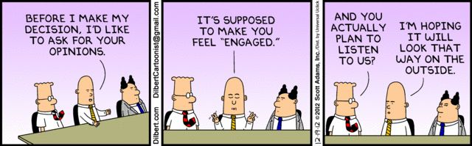
Working with the public and providers
Chris Day, Director of Engagement
EPSO, 25 September 2017
1

Slide 2

Start and the beginning and the top
Our purpose
We make sure health and social care services provide people with safe, effective, compassionate, high-quality care and we encourage care services to improve
Notes:
Our purpose
What did we do to get here? Written consultation response, a number of events across the region, online discussions via social media, e-bulletins, focus groups with interested members of the public, workshops with providers, external engagement through exhibition stands and speaking engagements.
Response on ‘our purpose’ Strategy 2013 to 2016
We consulted on the following purpose. To drive improvements in the quality of care through the unique function of measuring whether services meet national standards of quality and safety. What you said:
People generally welcomed a shift towards a focus on improvement. However they highlighted the need for further explanation, as there has been confusion in the past about our role. In particular, they requested clarity on whether or not our role is to bring providers up to national standards of quality and safety, or beyond that.
There was a lack of agreement among some about our role in improvement and what this should be.
The public want us to do more than make sure services meet minimum standards of quality and safety. They accept the importance of services meeting these standards. However they do not recognise the value of a regulator that does not encourage improvements beyond these minimum standards.
Some stakeholders felt the responsibility for improvement was with providers, commissioners and other improvement agencies, while our role was a ‘back stop’. As a result, this meant we should focus on setting standards of quality and safety, monitoring to make sure that organisations keep to the standards and taking action where standards aren’t being met.
Others felt we should do both ie making sure services meet minimum standards of quality and safety while indirectly encouraging services to improve beyond these standards.
People felt there was a need for a simple statement that is easily understood, clearly states our purpose and expresses what kind of regulator we are.
Our response:
Our purpose is to make sure health and social care services provide people with safe, effective, compassionate, high-quality care and to encourage care services to improve.
Our role is to monitor, inspect and regulate services to make sure they meet fundamental standards of quality and safety and to publish what we find, including performance ratings to help people choose care.

Slide 3

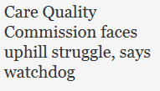


Where were we in 2012
Overall public awareness of CQC 22%
Positive perception of CQC 40%

Slide 4

Starting the journey
Working with providers and the public to understand what we should do and how we should work
Responding to a changing market
Using public insight effectively to improve how we approach organisation change
Our 5 key questions
KLOEs and consultation
Notes:
Since 2012 we have published two public engagement strategies. The first of which was published in 2014 under the key underpinning themes;
Raising public awareness and understanding of CQC’s role and purpose
Listening to and acting on the public’s views and experiences of care
Engaging the public in the design and shape of our work (how we do our job)
Providing high quality information to help people choose care
These have not changed very much when we launched our 2017 public engagement strategy.
To continue to improve the relationship CQC has with the public we must:
• analyse experiences of care in a more sophisticated way so the public can be assured we make the best use of their information
• get better at telling the public how we have used their experiences to improve care, or their feedback to drive changes in how we do our job
• publish information about the quality of care that meets the public’s needs.
In order to do this well, we’ll need to use public insight more effectively to improve how we approach organisational change and respond to the changing market – whether that’s changes to how care is delivered, or how the public interact and make transactions. Throughout 2017’s strategy, we use the term “public” to describe a lot of people. We know the public are not a homogenous group – they are diverse and have multiple needs. Over the life span of this strategy, these multiple needs will change and the tools which people use to engage will develop. This means need to be innovative and flexible in our approach. We’ll need to take advantage of new digital technology and trial use of new channels for engagement, which we constantly evaluate to check how effective they are and the return on investment.

Slide 5




How people are part of our work – how they help us
Voice before inspection
  Pre-inspection
Voice on inspection
  Experts by Experience (ExE)
Voice after inspection
  Thematic inspections
  State of Care
In 2016/17 ExE’s supported;
38% of adult social care,
21% of hospital,
13% of primary medical service inspections
Notes:
Voice before inspection:
People share their experiences which help form intelligence on a provider, more on that on the next slide.
Voice on inspection:
Charlie Fisher has put this together here which is a personal story from Jennifer Pearl being used in SoC – she is an ExE.
No of ExE:
Choice – 334
Remploy - 498
CQC is committed to embedding the voice of the public into its work. One of the key ways it does this is through the Experts by Experience (ExE) programme. Experts by Experience are people who have direct experience of care services we regulate, or are caring for someone who has experience of using those services. They work with our inspection teams, talking to people who are using a service and helping inspectors to assess and rate the quality of care being provided.
Sometimes people can find it easier to talk to someone with a shared experience, and/or someone who isn’t perceived as part of the ‘system’.
ExE help us make better inspection judgements and produce better inspection reports. Experts by Experience also co-produce aspects of our strategy, policy and method and contribute to other CQC events and activities.
We are constantly developing how we involve ExE in our work, and are currently looking at ways they can help us with ongoing monitoring of the quality of care services, and how they can get involved in inspector training.
To deliver the programme we contract with outside organisations who recruit, train, monitor and support ExE on our behalf, and these contractors have links to user-focused organisations, such as Age UK.
We made significant investment in our Experts by Experience programme. In 2016/17 we invested approximately £5 million in the programme, compared with £2 million in 2013/14. This reflects the value we place on the individual expertise that Experts by Experience bring to our inspections, policies, strategies and training of our own staff.
We have continued to involve people who use or have used services in our inspections. During 2016/17, there were 7,580 instances of Experts by Experience supporting CQC inspections. We acknowledge there have been some difficulties with this contract during the year. Our current contracts will come to an end next year and during 2017/18 we will undertake the procurement for new contracts to deliver this important service.
Voice after inspection:

Slide 6

How people are part of our work – how they help us
People share their experiences with us
As a result, 485 scheduled inspections brought forward and 112 urgent responsive inspections carried out
cqc.org.uk/share-your-experience-finder
Notes:
From Colin Penning:
People share experiences by email, by phone or through our dedicated Share Your Experience web form. During the year we saw an increase in people using the web form, with 21,681 sharing their experience in this way. This was a 21% increase from 2015/16 when the figure was 17,845.
In response to the share your experience forms submitted, 485 scheduled inspections were brought forward and 112 urgent responsive inspections were carried out.
Our ‘Tell us about your care’ programme, where we invest in partnerships with organisations that work with and represent people using services and carers, increases our access to people’s experiences of care on an ongoing basis. (source: annual report 16/17, pg 26)
This delivers about 10% of our Share Your Experience feedback (source: internal monitoring report).

Slide 7









Working with the media
Agreeing messages early
Testing the messages with others
Managing the message to the media
  Press conference and events
  Public and provider voice
  Agreeing early and checking impact

Slide 8
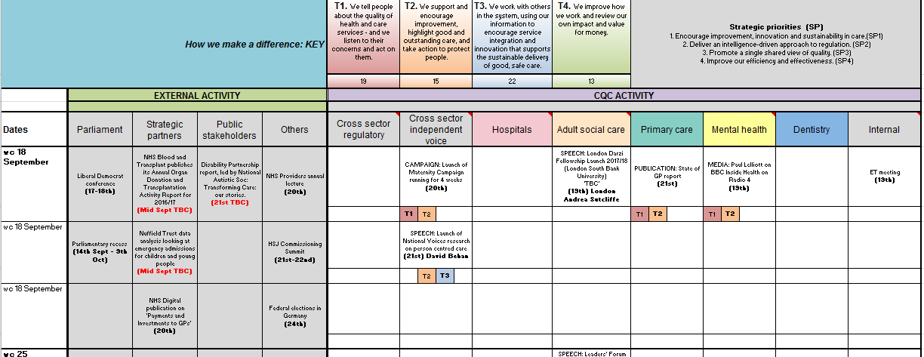
Planning our work

Slide 9
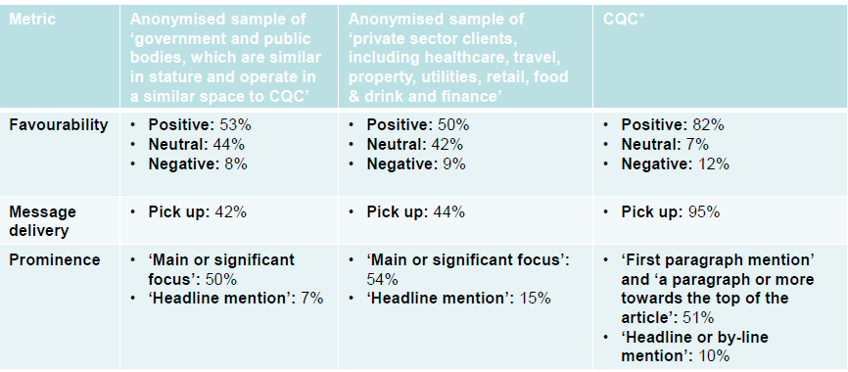
How does CQC’s media profile compare to other bodies?
Notes:
Our press team put together a monthly report which includes analysis of our message, how many online impressions we have had and which stories got the most traction.
Part of this report also looks at how favourable and impactful we are when looking at other bodies.

Slide 10

How have we moved on?
Overall public awareness of CQC has risen from 22% in 2012, to 65% in in 2017.
Positive perception of CQC is highest amongst those who are aware of CQC – engagement with us matters
Trust that CQC is on the side of people who use services has risen from 60% in 2014 to 77% in 2017

Slide 11
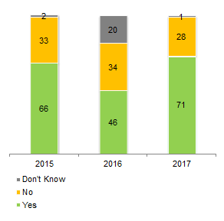



Where we are now - awareness and understanding 2017
47% aware of CQC Reports
22% seen, read and used a report
15% actively looked for a report
Notes:
People saying they were aware of a national organisation responsible for monitoring and regulating h/sc services has risen from 66% in 2015 to 71% this year. Only 1 % in this years survey did not know there was an organisation responsible for this.
General awareness had also increased across all subgroups this year – so awareness was up across the board – sub groups looked at age, gender, ethnicity, and whether people were carers, had long term health conditions, were recent health care users, had chosen a care home or used a maternity service

Slide 12
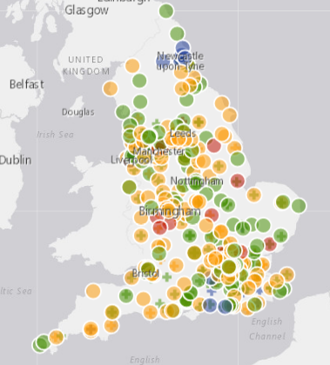
The future
Local system reviews – could be the future?
Working in coproduction with the public, providers, ExE and other stakeholders
How?
Focus groups
Coproduction events
Speaking to our stakeholders through speeches and exhibitions
Using our independent voice to publish our findings
Notes:
Working with the public and providers on local system review
Pre work
- Coproduction of the methodology (development) – providers, ExE, public, other stakeholders
On reviews
Holding focus groups with organisations that represent people who use services
Using ExE as part of the review team similar to inspections
Focus groups with providers and with front line staff and senior leadership
Following local reviews national report
Engaging with all key stakeholders through speaking engagements, focus groups, coproduction and

Slide 13
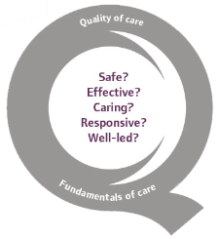
  Thank you
www.cqc.org.uk
enquiries@cqc.org.uk
@CareQualityComm
Chris Day
Director of Engagement
13

