Slide 1

Incident handling and transparency
Duty of candour
Notes:
1

Slide 2
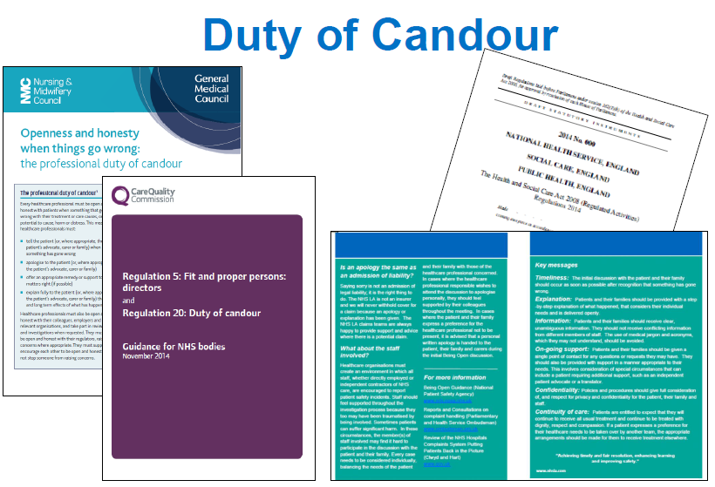
Duty of Candour

Slide 3
Duty of Candour
Health and Social Care Act 2008 (regulated activities) Regulations 2015
Duty of Candour (regulation 20)
  (1) A health body must act in an open and transparent way with relevant persons in relation to care and treatment provided to service users in carrying on a regulated activity

Slide 4
Candour
“I’d far rather be treated by a doctor who at some stage in their career has made a mistake, owned up to it, learnt from the mistake and become a better doctor as a result of that” – Peter Walsh, AvMA
“if I was going to be choosing -- if the only information I had was reporting systems for my choice of hospital, I would choose the one with the highest possible reporting rate” – Professor Charles Vincent

Slide 5
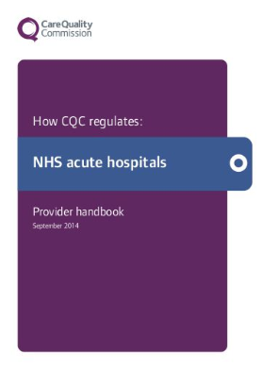
Duty of Candour
Good Practice:
Candour, openness, honesty and transparency and challenges to poor practice are the norm, with a culture of collective responsibility between teams and services.
Compliance with the regulation is necessary, but not sufficient, to build a culture that truly puts safety first.

Slide 6
Duty of Candour
The Duty of Candour is a legal duty on hospital, community and mental health trusts to inform and apologise to patients if there have been mistakes in their care that have led to significant harm
Duty of Candour aims to help patients receive accurate, truthful information from health providers
All NHS provider bodies registered with the Care Quality Commission had to comply with a Statutory Duty of Candour since November 2014
All independent sector health providers and social care providers had to comply from 1 April 2015

Slide 7
Duty of Candour
The Duty of Candour has two parts.
General requirement that providers act in an open and transparent way with service users.
Formal notification process which must be followed when certain safety incidents occur, described in the regulation as ‘notifiable safety incidents’.

Slide 8
Duty of Candour
Providers must have an open and honest culture at all levels within their organisation and have systems in place for knowing about notifiable safety incidents
Providers must be open and honest with service users and other ‘relevant persons’ (people acting lawfully on behalf of service users) when things go wrong with care and treatment, giving them reasonable support, truthful information and a written apology
The provider must also keep written records
CQC can take enforcement action against those providers who don’t satisfy these requirements.

Slide 9
CQC inspections
We expect all providers to
Have systems in place to handle notifiable safety incidents in accordance with Regulation 20 and the other regulatory requirements in relation to such incidents.
Ensure that their staff are aware of and act in accordance with their internal policies and procedures and in line with best practice in being open and transparent.
Ensure that staff are open and transparent with relevant persons in cases where care and treatment provided to people in the carrying on of a regulated activity have resulted in a notifiable safety incident.

Slide 10
CQC inspections
Our inspection teams check that the provider has effective systems in place to meet the duty of candour requirements.
The evidence they will look for includes:
staff approach to safety incidents
training for all staff on communicating with patients about notifiable safety incidents
incident reporting forms that support the recording of a duty of candour notification
support for staff when they notify patients when something has gone wrong
oversight and assurance

Slide 11

Duty of Candour leaflet
Notes:
Leaflet for service users

Slide 12

Freedom to speak up
National Guardian – purpose
1. Provide support and advice for FTSU Guardians
3. Advise providers (NHS Trusts / Foundation Trusts)
2. Advice to staff raising concerns
4. Provide support for the system

Slide 13

Freedom to Speak Up Guardians
All NHS trusts have appointed a Freedom to Speak Up Guardian. They work alongside trust leadership teams to achieve the following outcomes:
All staff have the capability to speak up effectively and are supported appropriately
The Board is engaged in all Freedom to Speak Up matters and issues that are raised
A culture of speaking up is instilled throughout the organisation and the NHS
Speaking up processes are effective and continuously improved
Safety and quality are assured

Slide 14
Concerns raised to date
Freedom to Speak Up Guardians shared data covering the period from the start of their role up until 31 March 2017.
Notes:
For the trusts that have responded so far

Slide 15
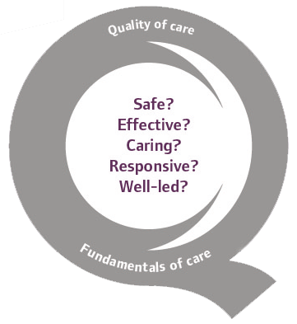

  Thank you and any questions?
www.cqc.org.uk
enquiries@cqc.org.uk
@CareQualityComm

