Slide 1
Getting a grip on integration
Richard Hamblin
EPSO, London, 24 April 2017

Slide 2
How on earth do we regulate integration?
What does good look like?
How do we incentivise?
How do we avoid perversity?

Slide 3
Why it’s hard to say what good integration looks like?
What do we mean by integration?
An interrelated series of concepts?
Continuity of Care
Continuity of relationships
Continuity of information
Patient-centredness/ one-stop shop
Turn all that into an index…

Slide 4
Proxies and PREMS
Proxies
Reduced use of emergency hospital admissions
Waste in the system
Structural measures of how different parts of the system interract
PREMS
Patient’s reported experience of care

Slide 5
Structures and frameworks

Slide 6
Applying Donabedian
 | Structure | Process | Outcome
Information continuity | Integrated Health IT | Availability of Test Results
 | % of patients with a shared EHR | % of patients confident their specialist knows their medical history
Integrated health services | Agreed shared clinical pathways | % of patients adhering to pathways | Acute hospital bed days associated with admissions for avoidable conditions

Slide 7
NZ emerging approaches
System level measures framework
Primary care patient experience

Slide 8
System level measures framework
Six system level measures
Childhood ambulatory sensitive hospital (ASH) admissions
Acute hospital bed days
Amenable mortality
Patient experience
Smoke free homes
Youth health services

Slide 9
Childhood ASH -Contributory measures
Lead Maternity Carer registration rate
New-born enrolment rate
Referral rate to Lead Maternity Carer
Referral rate from Lead Maternity Carer to Well Child Tamariki Ora
Breastfeeding rates
Core Well Child Tamariki Ora visits achieved
Respiratory initiatives
Housing sensitive hospitalisations
Immunisations
Enrolment with oral health services
Caries free at 5 years.

Slide 10
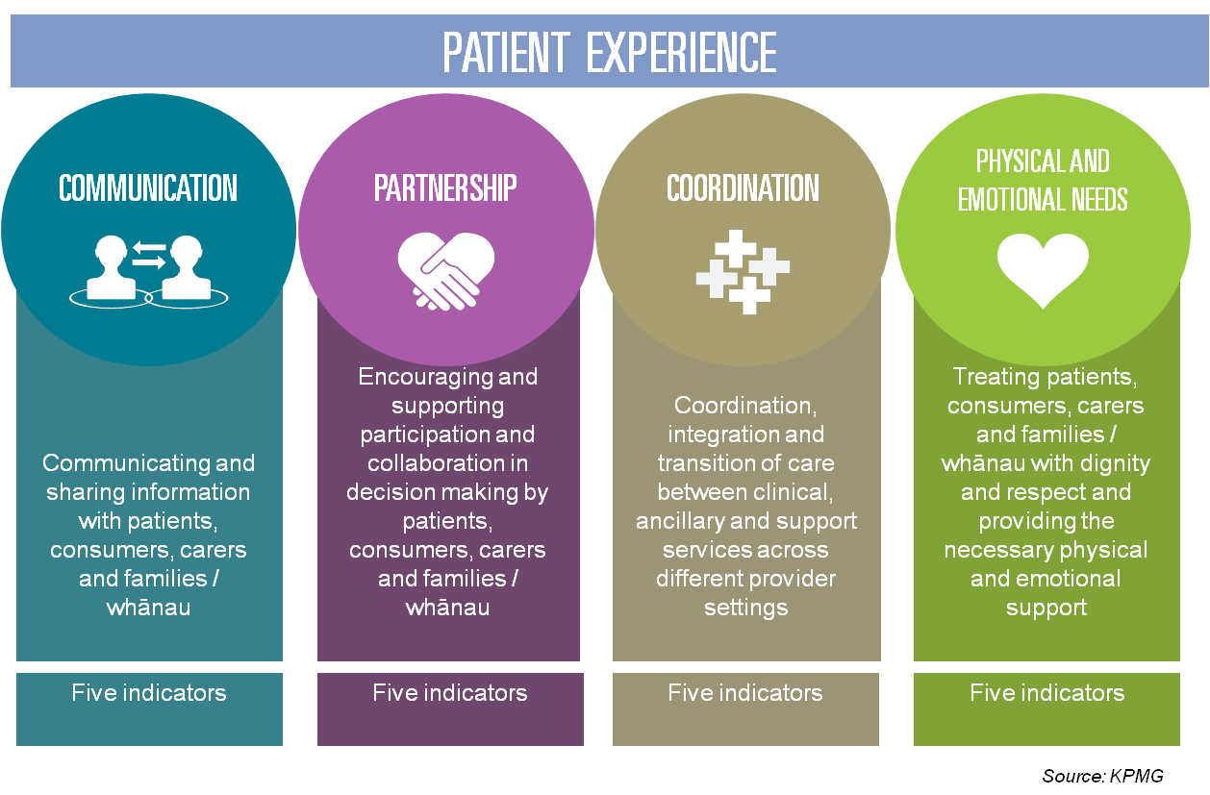
Patient Experience Domains

Slide 11
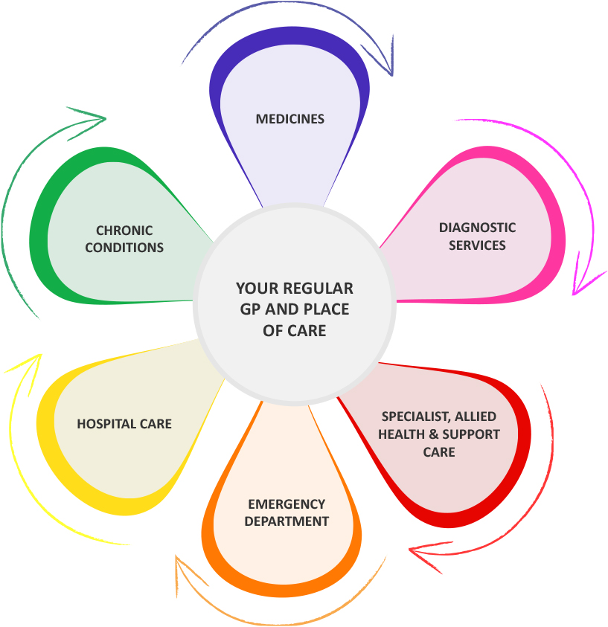
Patient Experience Locale

Slide 12
The Coordination domain questions (1)
Is there one GP or nurse you usually see?
Was there ever a time when you wanted health care from a GP or nurse but you couldn’t get it?
When you contact your usual GP clinic about something important, do you get an answer the same day?
Are you confident that your GP or nurse is aware of your medical history?
In the last 12 months have you been given the wrong medication or wrong dose by a doctor, nurse or pharmacist (outside of hospital)?
Do the specialist doctors know your medical history and the reason for your visit?
Has a doctor ordered a test (e.g. blood test, x-ray, etc) that you felt you didn’t need because the test had already been done?

Slide 13
The Coordination domain questions (2)
Does your current GP or nurse seem informed and up-to-date about the care you get from specialist doctors?
Did the hospital arrange follow-up care with a doctor or other health care professional?
Plus a series of questions on cost barriers

Slide 14
Results – ave score out of 10

Slide 15
But inequity by age

Slide 16
…and ethnicity

Slide 17
Incentivisation and perversities of supervisory approaches
Incentivisation beyond lip service – hold all bodies to account in an area for a result – but who gets blamed if its not achieved?
Regulation beyond structures tricky
Publication – kudos and censure incentive – but what level?
Financial responses (but which way lies causality?)
Can any incentives or regulatory responses override system design?

