Slide 1

Regulation for improvement? Regulatory approaches to conceptualising and assessing improvement capability: a qualitative study of UK agencies. Dr Joy Furnival and Prof Kieran Walshe NHS Improvement & University of Manchester
September 2017, EPSO

Slide 2
Background
Persistent and ongoing unexplained variation in healthcare & high profile care failures -> growth in regulation
Yet, wide criticism of regulation
Inconsistent; inaccurate; costly
Fail to effectively diagnose problems and lack valid/reliable regulatory judgements
Fail to understand organisational improvement trajectory/ predict
Fail to appropriately intervene & develop improvement solutions [enforcement strategy]?
Notes:
First, it may give greater assurance about current performance – the regulator can only do limited direct assessments of the quality of care, but may take some assurance that organisations with high improvement capability are able to monitor and assure quality for themselves. Second, it may have some value in predicting future performance, especially if problems with the quality of care are found

Slide 3
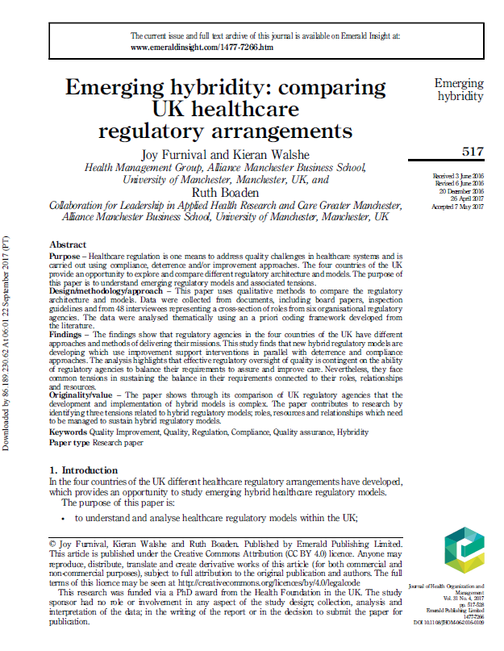
Emergent trend
Research identified emerging trend of regulators focusing on improvement and improvement capability
Why?
Predictive value
Increased assurance
Increased policy salience

Slide 4
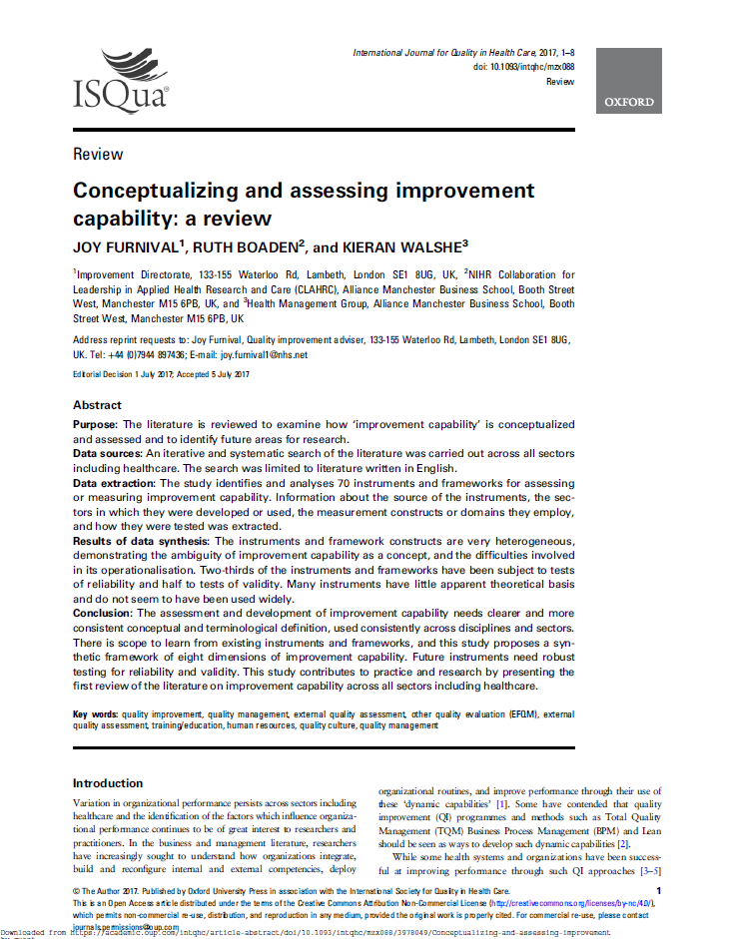
Improvement capability (IC)
‘The organisational ability to intentionally and systematically use improvement approaches, methods and practices, to change processes and products/services to generate improved performance’
Notes:
What do we mean by IC? In our study we followed this definition of IC which came from a systematic lit review… Through her review of the lit we found a lack of clarity of the definition of IC and over 70 assessment tool

Slide 5
8 dimensions of IC
# | Improvement capability dimension | Description
1 | Organisational culture | The core values, attitudes and norms and underlying ideologies and assumptions within an organisation
2 | Data and performance | Data and performance includes the use of data and analysis methods to support improvement activity.
3 | Employee commitment | Employee commitment encompasses the level of commitment and motivation of employees for improvement.
4 | Leadership commitment | Leadership commitment is described as the support by formal organisational leaders for improvement and performance.
5 | Process improvement and learning | Process improvement and learning is the systematic methods and processes used within an organisation to make ongoing improvement through experimentation.
6 | Service-user focus | Service-user focus relates to the identification and meeting of current and emergent needs and expectations from service users.
7 | Stakeholder and supplier focus | Stakeholder and supplier focus is the extent of the relationships, integration and goal alignment between the organisation and stakeholders such as public interest groups, suppliers and regulatory agencies.
8 | Strategy and governance | Strategy and governance represents the process in which organisational aims are implemented and managed through policies, plans and objectives.

Slide 6
How do regulatory agencies assess improvement capability in healthcare?
Qualitative data collection and analysis
content & thematic analysis
a-priori coding framework
document & report text & transcripts loaded into NVivo (qualitative analysis software)
functionality used to compare coding consistency & density

Slide 7
Data sources
Agency | Documents | Interviews | Assessment reports
Date | 2010-15 | 2014-15 | 2013-15
Selection criteria | Publically available strategic plans; annual reports; operational reports | Clinical & non-clinical cross section; board members, back office staff & assessors | Publically available acute and/or community range of performance judgements; identified during interviews
HIS | 18 | 8 | 5
HIW | 13 | 9 | 5
RQIA | 17 | 9 | 5
CQC | 13 | 8 | 5
Monitor | 16 | 7 | 5
TDA | 13 | 7 | 5

Slide 8
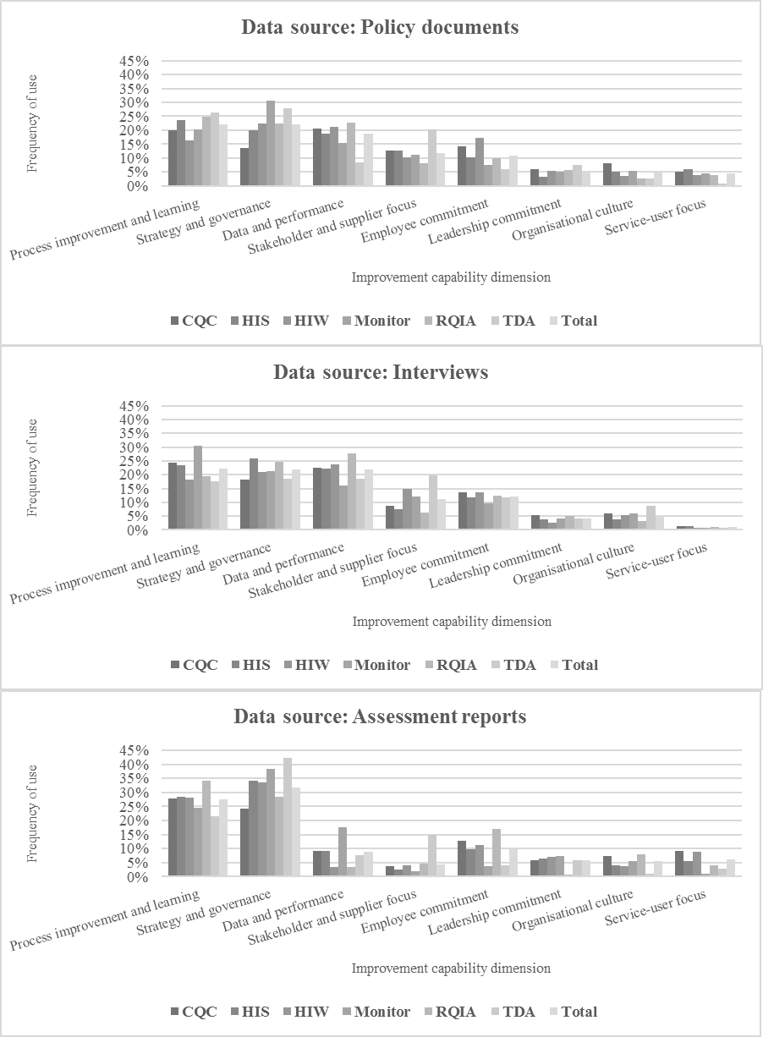

Slide 9
Observations
Overall pattern similar regardless of agency
Frequency of coding is greater on dimensions:
process improvement/learning;
strategy/governance;
data/performance
Shape of coding frequency
difference between ‘intent’ and ‘assessment’
less for data/performance; markedly less for all others
Service-user focus lowest across all data sources
Further analysis – 3 themes
Conceptualisation
Assessment data
Assessment practices

Slide 10
Themes: Regulatory assessment of IC e.g. Organisational culture dimension
Conceptualisation
‘How do you support staff and build that behaviour and culture? How do we build that peer pressure, that social acceptability, the whole environment people work in? That’s the challenge for the board’ (Interview E, HIW)
‘The culture of the team working within the department was one of cohesiveness, with staff displaying a very high level of professionalism and enthusiasm for the work they did ‘(Report B, CQC)
‘We perhaps talk in random terms about the culture but we really don’t get to grips with [it]… I suppose there are some sources of information that we would look at, but whether you really understand the culture of the organisation from that…?’ (Interview C, Monitor)

Slide 11
Themes: Regulatory assessment of IC e.g. Employee commitment dimension / HIW
DOCUMENT: ‘[Staff] need to see how they can contribute to the changes, how their voice will be heard and, importantly, how they will be enabled to work differently ', (Together for Health. A Five Year Vision for the NHS in Wales, Welsh Assembly Government, 2011).
Assessment data
INTERVIEW: I would want to see that there’s a good connection between the board and the operational side of the organisation, that there’s strong clinical engagement, that they’re starting to take ownership of the issues and get a grip of some of them’, (HIW, Interviewee H).
REPORT: ‘We found that staff were committed to delivering good quality care and they were kind and caring, in many cases, we found issues with staff numbers, vacancies, resilience and skill mix’ (HIW, Report B).

Slide 12
Themes: Assessment practices
‘[IC is] such a new area for our inspectors to, sort of, look at and look at it in this way’ (Interviewee B, CQC)
‘We really need to understand the current state better and part of that is about understanding the capability of the workforce and the people that we’re actually going to be…supporting, moving forward a bit better at doing it, but we’re not quite there yet systematically’ (Interviewee C, HIS)
Assessment practices
‘We talk about the fact that patients should be involved, … in the scrutiny of [organisations], but we don’t actually have a large amount of … patient involvement’ (Interviewee G, TDA)

Slide 13
Conclusion
Agencies do assess for dimensions of improvement capability; analysis highlights that two dimensions are more frequently mentioned in assessment reports & service-user focus is infrequently mentioned
Three themes:
conceptualisation
assessment data
assessment practices
Better understanding and conceptualisation of improvement capability could allow more tailored and effective regulatory interventions through improved assessment strengthening assessment, diagnosis and performance prediction

