Slide 1

23rd EPSO-Conference
3-5 July 2017
Saaremaa, Estonia

Slide 2
Estonian Presidency of the Council of the European Union

Slide 3
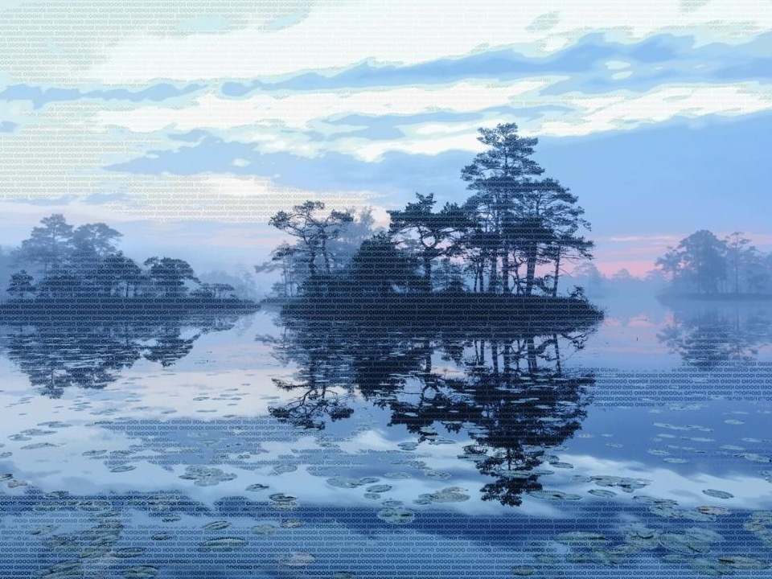

Our story: Synergy between pristine nature and innovative thinking
Population 1, 3 mln
Area 45 549 km²
Over 50% of our land is covered with woods
300 species of birds
Notes:
The story of Estonia is depicted in two values.
At the base is a connection with nature, at the top is a story of new technologies and ways of living.
The aim of finding balance and synergy between natural and man-made, old and new, is our unfolding story. Estonians have a special connection with nature, and this is reflected in our everyday life and values.
One can view Estonia as the world’s largest spa.
According to World Health Organization reports, Estonian cities are in fourth position when it comes to clean air.
1/5 of Estonia is covered with bogs that form ancient pristine ecosystems, more than 10 000 years old.
Over 50% of our land is covered with woods, 30% of it is under protection. Estonia provides attractive habitat for over 300 species of birds.
3. The sea has always been a door to the world for us. Connections and trading via waterways with other nations has been a natural part of our lives for thousands of years.
New digital technology makes our everyday life better by leaving more time for the important matters of the day.
The symbol of the presidency is also a modern building block, a fragment of the binary code. All the virtual world, the modern tools and services around us rely on ones and zeroes. This provides us with a reminder to never underestimate the genius of simplicity.
1. Public digital services and communications allow for a more efficient use of time, money and paper.
Estonia ranks first in the EU as regards the use of public digital (e-government) services. 88,4% of the population use the internet daily (among 16-74 year olds).
2. The Estonian ICT sector and an ambitious startup community continue to create innovative e-services ranging from mobile-parking to e-Residency, that not only simplify people’s lives in Estonia, but also all over the world.
- In Estonia, programming, robotics and contemporary technologies are even taught in kindergartens.
3. The Estonian experience shows that an e-state and information society can be built without jeopardising security and privacy.
There are almost as many active digital IDs as there are people in Estonia – 1.3 million.

Slide 4

Our role: To bring together and find the common ground
Notes:
The symbol portrays the role of the presidency – pictured in the centre – uniting and balancing different viewpoints.
Today, more than anything, Europe needs unity, in values, ideas and actions. To be able to advance Europe together and take full advantage of all possibilities for development, we must strike a balance between the various opinions, interests and visions amongst the member states. This aim is reflected in the symbol of the Presidency.

Slide 5
Competent authority for:
•Recognition of medical qualification
•Regulation of medical devices
Supervision function
Health care
Communicable diseases and control
Same 5 main departments
Environmental health
Chemical safety
Medical devices

Slide 6
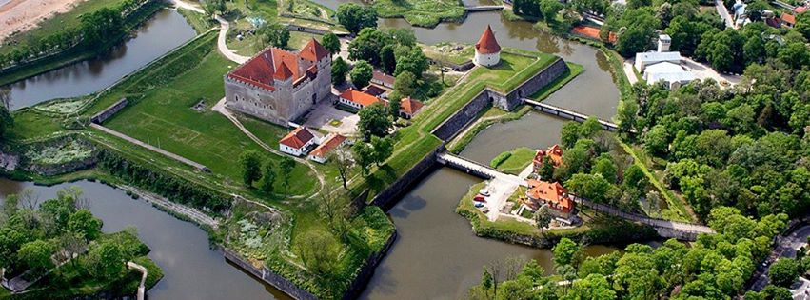
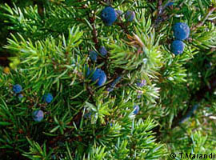
23rd EPSO-Conference
3-5 July 2017
Saaremaa, Estonia
Saarema
Area 2700 km²
Population 35 000

Slide 7
Thank you!
eu2017.ee
official website
events.estonia.ee
100 years of the Republic of Estonia & Estonian EU Council Presidency event programme
visittallinn.ee
Official tourist information websites:
@EU2017EE
official Twitter account
visitestonia.com

