Slide 1
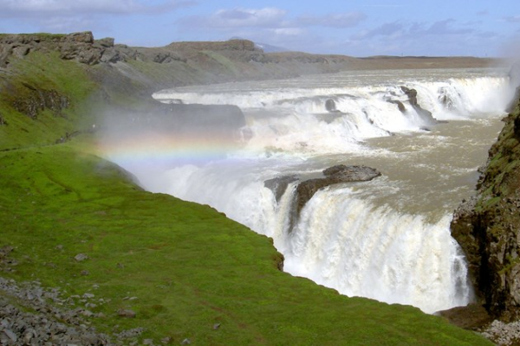
E
P
S
O
2
1
0
7
Working group meetings and 24th EPSO Conference
Reykjavik, Iceland
25 – 27 September, 2017

Slide 2
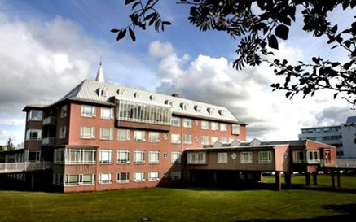
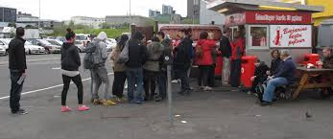
Working Group Meetings Day 1 – Monday September 25th
09:00 - 17:00
Venue
Directorate of Health
Barónstígur 47
101 Reykjavík
User Participation
Integrated Care
Effectiveness
Risk
Evening: Dinner at own cost

Slide 3
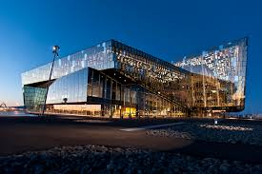
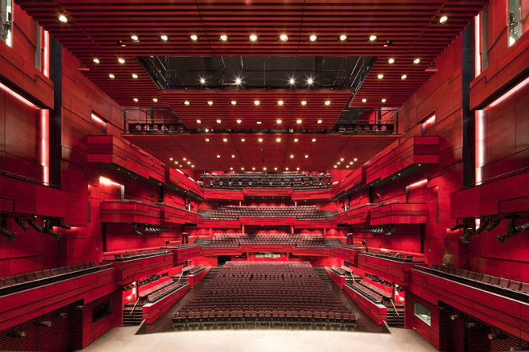
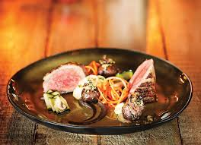
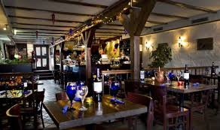
EPSO Conference Day 2 – Tuesday September 26th
Venu: Harpa Concert Hall
Main topics
Trust as important instrument in supervisory practice
How to increase patient safety by supervisory organisations
Change management ( interactive session)
Data driven information on patient safety
How to build and improve Effective risk-based supervision ?
08:15 - 17:00
Conference dinner 19:00

Slide 4
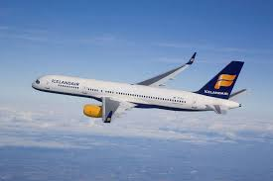
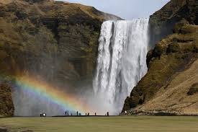
EPSO Conference Day 3 – Wednesday September 27th
Venu: Harpa Concert Hall
Main topics
Trust as important instrument in supervisory practice
How to increase patient safety by supervisory organisations
Change management ( interactive session)
Data driven information on patient safety
How to build and improve Effective risk-based supervision ?
Practical issues of EPSO
09:00 - 12:00
Afternoon
Departure from
Iceland or ?
https://www.youtube.com/watch?v=_IFsBBF_KQ0

Slide 5
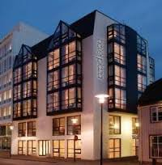
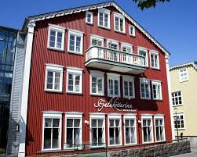
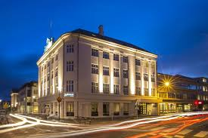
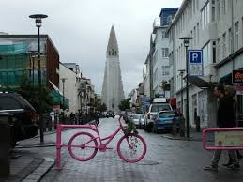
Accomodation
https://nordisktillsynskonferens.is/
https://booking.com
https://trivago.se

