Slide 1

CQC’s approach to inspection and regulation of General Practitioners
Paul Burdon, CQC
1
Notes:
1

Slide 2

Our purpose
The Care Quality Commission is the independent regulator of health and adult social care in England.
We make sure health and social care services provide people with safe, effective, compassionate, high-quality care and we encourage care services to improve.

Slide 3
Our current model of regulation
Register
Monitor, inspect and rate
Enforce
Independent voice
We register those who apply to CQC to provide health and adult social care services
We monitor
services, carry out expert
inspections, and judge each service, usually to give an overall rating, and conduct thematic reviews
Where we find poor care, we ask providers to improve and can enforce this if necessary
We provide an independent voice on
the state of health and adult social care
in England on issues that matter to the
public, providers and stakeholders
Notes:
In 2013 we introduced fundamental changes to our model of regulation.
We know we still have work to do to deliver this approach consistently and to a high standard.
Over the next five years we will continue to focus on the aspects of our model that people have said make the greatest difference – taking action swiftly when we find poor care and publishing independent expert ratings of quality.
Our core operating model will stay the same and we will ensure we continually improve how we deliver our four main functions.

Slide 4
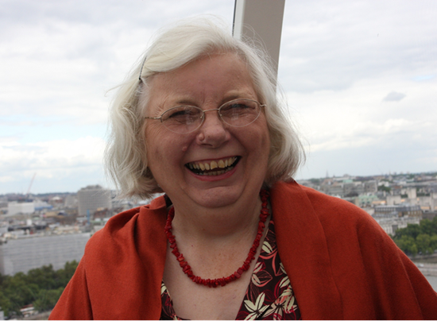
The Mum Test (or Anyone You Love test)
Is it responsive to people’s needs?
Is it good enough for my Mum?
Is it
effective?
Is it safe?
Is it
well-led?
Is it caring?

Slide 5

What do the overall ratings mean?
Outstanding
The service is performing exceptionally well.
Good
The service is performing well and meeting our expectations.
Requires improvement
The service isn't performing as well as it should and we have told the service how it must improve.
Inadequate
The service is performing badly and we've taken action against the person or organisation that runs it.

Slide 6
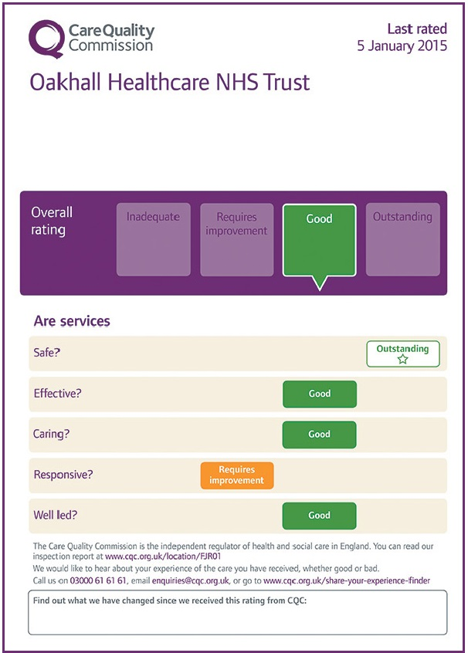
Display of ratings
  Why? Public able to see rating of service quickly and easily
  Where? Providers should display in prominent area in public view and on website
  CQC send a template for completion and display
  CQC check this during inspections
A Provider
Notes:
From 1 April 2015, if you have been awarded CQC ratings you must display them in each and every premises where a regulated activity is being delivered, in your main place of business and on your website(s) if you have any. This includes community premises and other premises which might not necessarily be registered with CQC (for example, premises from which you provide occasional clinics and therefore may not be registered with us as separate locations). You must always display your most up-to-date ratings.
Ratings must be displayed legibly and conspicuously to make sure the public, and in particular the people who use your services, can see them.
We also encourage you to raise awareness of your most recent ratings when communicating with people who use your services, by letter, email or other means.

Slide 7
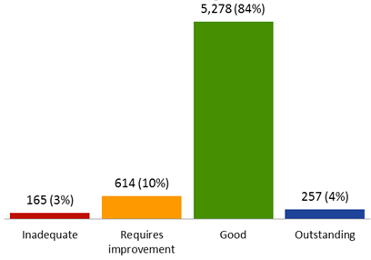
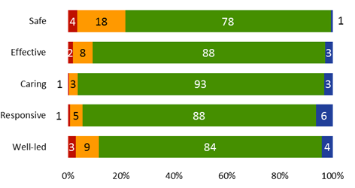
Overall picture of quality in general practice

Slide 8
Safety: key themes in poor care
Safety issues often relate to poor systems and processes, examples include:
  Insufficient evidence of risk management and learning from incidents
  Poor responses to patient complaint letters and failure to act on issues raised
  Lack of effective and timely safeguarding and training
  Poor infection control procedures
  The condition and storage of emergency equipment and the management of medicines
  Fridges at the wrong temperature, insufficient emergency drugs and expired medicines
  Poor recruitment processes, for example a lack of DBS checks
8

Slide 9
Effective: key themes in good care
We’ve found many examples of good, effective clinical practice, meeting the needs of local populations, for example:
  Quality improvement programmes
  Coordinated referral processes
  Joined up care with other healthcare providers
Strong relationships with local schools, universities, fire and benefits advisory services
  These relationships support practices to deliver enhances services
Joined up models of working, benefits observed include:
  Appointments outside normal working hours
  Wider range of services
9

Slide 10
Caring: key themes in good and poor care
Outstanding practices were able to demonstrate, for example:
  Specific support for individual population groups
  Innovative programmes for certain health conditions
  Flexible access to services
Of the small (but still concerning) number of practices we found to be Inadequate for caring we found:
  Staff to lack compassion and respect for patients
  Poor concern for patients’ privacy and dignity at the reception desk/waiting area
10

Slide 11
Responsive: key themes in good care
Practices rated as outstanding had considered the needs of its population and subsequently implemented change.
For example:
  Guaranteed same-day appointments
  Extended practice opening hours
  Language support for non-English speaking patients
Innovation in how primary care is provided is developing rapidly:
  Recently registered new GP care model using technology to provide consultation
  Social enterprises are leading the way in care provision models
  Demonstrate a clear vision to improve health of vulnerable and excluded groups
  Work closely with services across their locality
11

Slide 12
Well led: key themes in good care
GP practices are generally well-led, with 85% rated good or outstanding
Our inspection findings show good leadership is the foundation of an outstanding organisation. Examples include:
    Patients at the centre of their developments, with effective patient participation groups involved in multiple aspects of the practice’s business
    Excellent staff development and support, with the development of special programmes to aid staff development or support staff in their role
    The role and capability of the practice manager has an important influence, and the level of training and support for practice managers is key
12

Slide 13
Moving forward
  Our strategy for 2016 to 2021 set out an ambitious vision for a more targeted, responsive and collaborative approach to regulation, so that more people get high-quality care.
  We know that health and care services are changing to meet the demands on the system from an ageing population and the pressures on public finances.
  We need to be flexible to respond to new care models so we stay relevant and able to deliver our purpose which we are not changing.
  We will need to do this within a smaller budget.
  In Dec 2016 we consulted on changes to our KLOEs and in June 2017 we are consulting on changes being proposed to our inspection methodology (at the same time we are testing the changes proposed for GPs)

