Slide 1
Lena Weilandt
Inspectorate of Health and Socialcare
Sweden
London 24th of April 2017
Notes:
Macronivå:
Tillsynspolicy, Nationella riskanalysen ( tex,Patientenkäten )
Mesonivå:
Dialogforum med patient ovh brukarföreträdare, Särskilda analysrapporter (tex av EKPSL)
Aggregerad sammanställning av tex barnintervjuer, bra underlag för återkoppling till högsta ledningen såväl som för verksamheterna och de intervjuade barnen.
Micronivå:
Involvera pat/brukare i den direkta inspektionen tex via intervjuer, enkäter, fokusgrupper. Kan ske redan inledningsvis vid designen av tillsynen, i samband med inspektionen och återföringen av resultatet.

Slide 2
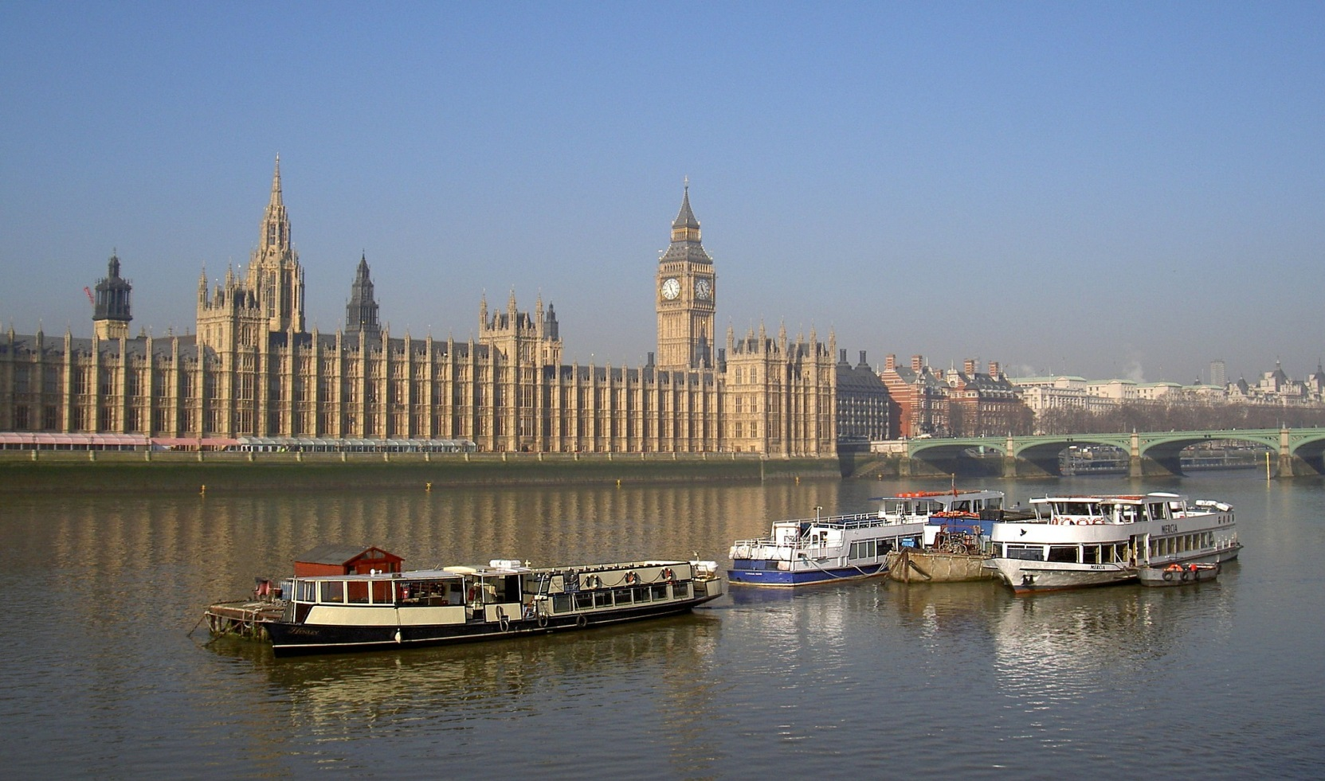
Good Morning and Welcome!

Slide 3
AGENDA
Welcome
How to engage people that uses services, Chris Day, Director of Communication, CQC, England
Earlier work and back ground
Users perspective in supervision of social services in Denmark. Henrik Frostholm, Lars Jensen, Danish Board of Social Services
What is going on in the member states - an overview
Next steps and commitments
Notes:
Formal start of the working group chair Lena Weilandt, Sweden)(10 min);
2. Introductory round by the participants of the working group. (30 min);
3. Discussion of key issues, thoughts and questions (30 min);
4. Next step (20 min).

Slide 4
A theme in the EPSO work

Slide 5
Definitions
‘User participation’ is part of a policy to actively involve users of health care or social care (or their relations), to include their opinions in the policy of the supervisor, with the aim to improve the quality of health care or social care.
Perspective –and emphasis on consequences and results for patient/ service users
- a starting point in planning, risk analysis
Giving the patient/users a voice - participation in supervisory activities

Slide 6
Starting point - The meeting in Stockholm October 2016
All organizations had patient and user involvement stated in their policys
Many used different sources of patient/user experience like patients complaints when planning supervisory activities.
The main challenges focused on involving patient/user in the actual supervision.
Notes:
The result showed that many of the participating organizations have patient and user involvement stated in their policys, and also use different sources of patient/user experience when planning supervisory activities. The main challenges focused on involving patient/user in the actual supervision. There answering organisations had done pilots but not yet done this in a systematic way. Only one organisation have hade patient/user as a partner in a supervisory team and only one or two have tried including patient organization when meeting organizations to give feedback after a supervision.
The group discussed have patient and user involvement stated in their policys, and also use different sources of patient/user experience when planning supervisory activities. The main challenges focused on involving patient/user in the actual supervision. There answering organisations had done pilots but not yet done this in a systematic way. Only one organisation have hade patient/user as a partner in a supervisory team and only one or two have tried including patient organization when meeting organizations to give feedback after a supervision.
Discuss how research could help. Help to gather information to develop recommendations for "best practice" in supervision. Identify research questions for this purpose.
Discuss if there are other methods or sources to give the patients a voice in supervision

Slide 7
EPSO Forum
Patient and user involvement in supervisory practice in Norway by Bente Smedbråten
Helsetilsynet- Norwegian Board of Health Supervision. Norway
Public voice about healthcare quality and patient perspective in the regulatory process by Renee Bouwman
NIVEL (Netherlands Institute for Health Services Research) The Netherlands
Patient and user involvement in supervisory practice in the Netherlands by prof Paul Robben and Sorien Kleefstra
( IGZ), The Netherlands;

Slide 8
How to engage people that uses services
Chris Day, Director of Communication Quality Care Commission

Slide 9
Users perspective in supervision of social services in Denmark
Henrik Frostholm and Lars Jensen,
Danish Board of Social Services

Slide 10
Example of ongoing work
Iceland | National Patient Survey |  | England CQC | Organization of service users – training programme how to report Expert by experience at inspections General information, social media Strengthen outcome of information/data from service users to drive change Feedback of results
Norway | Interviews children and users in welfare services and persons with drugrelated problems Expert by experience-pilots Research to identify cultural and organizational barriers for pat/user involvement |  | Wales | Advisory board Laymen reviews Patient experience at inspections
Finland | hearings - Patient /user organizations – focus for supervision |  | Latvia | Complaints as basis for supervision
Denmark | Patient involvement in info.project Project 2017- Methods to strengthen user perspective Eg. Terminology, use of data, reliable methods to gather user experiences |  | Estonia | Complaints as basis for supervision Patient user organizations- meetings
Sweden | Patientdata – focus of supervison Methods to involve patients-pilots Patient/user organizations - pilots |  | Netherlands IGZ | Zorgkaart and National hotline on complaints Consumer panel Experts by experience - pilot

Slide 11
Expectations from the members of the working group
Methods | Best practice | Handling of data | Evaluation of methods | Other
Inventory of methods | Find patient/users to address | Use of data in decision and analysis | Common protocol for evaluation of methods | Training of inspectors
Share experience and knowledge | Pat/user no voice of their own | Develop valid and meaningful data | Pat/user experience and result from supervision compared to assessed quality | Influence of social media
 | Advantages and potential risks |  |  | Complaints, taxonomy
 | Experts by experience/laymen |  |  | Connect research to this topic
 | Patient/user organizations

Slide 12
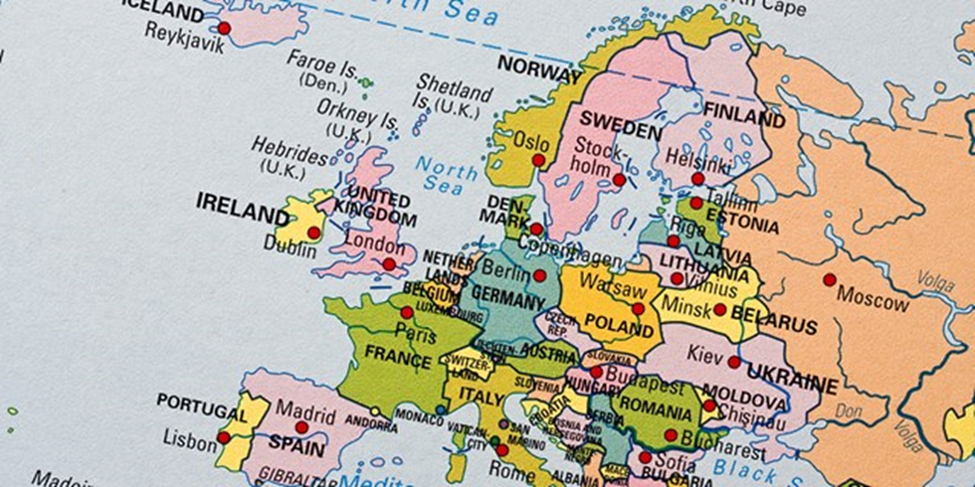
THANK YOU!
……and New Zealand

