Slide 1


Towards an outcome-focused model of scrutiny and improvement
Rami Okasha
Executive Director of Strategy and Improvement
Care Inspectorate, Scotland
@ramiokasha

Slide 2

Formal name:
“Social Care and Social Work Improvement Scotland”
Two separate organisations

Slide 3
> 80% inspections show good, very good or excellent care
7,500 inspections of care services
9 – 12 large local area inspections

Slide 4


London 2016

Slide 5

… slow, impoverished, scientifically-unfounded methods
You want quality? You define it, you measure it, and then you act on the deficient few… you close them…
Reliance on inspection does not work.

Slide 6
Inspection does not achieve continual, never-ending, pervasive improvement.
It doesn't foster creativity, learning or pride. It poisons them.
The main harvest of inspection isn't learning. It is fear.

Slide 7
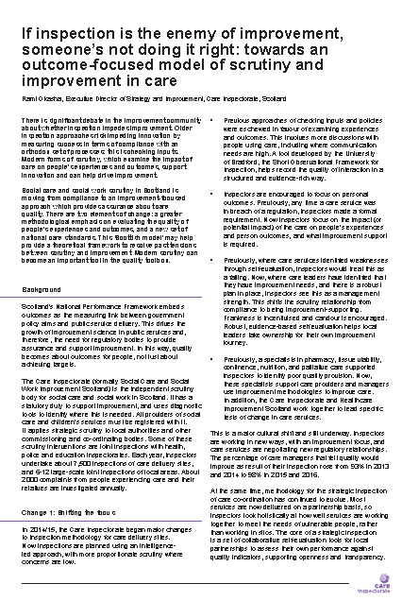
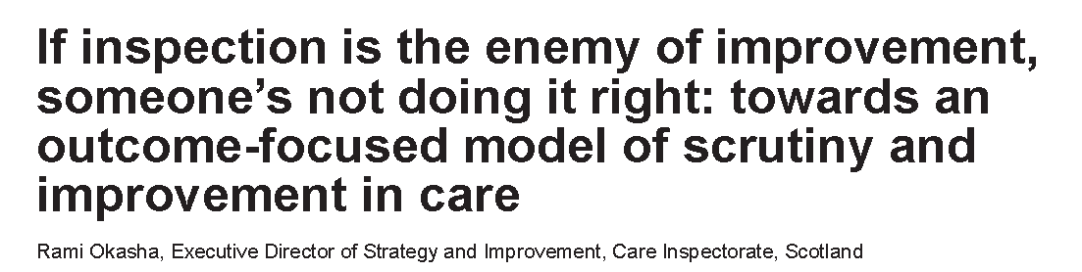

London conference, April 2017

Slide 8

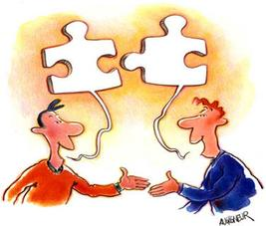
A new organisational vision in 2014/15
Compliance
Compliance
Collaboration

Slide 9
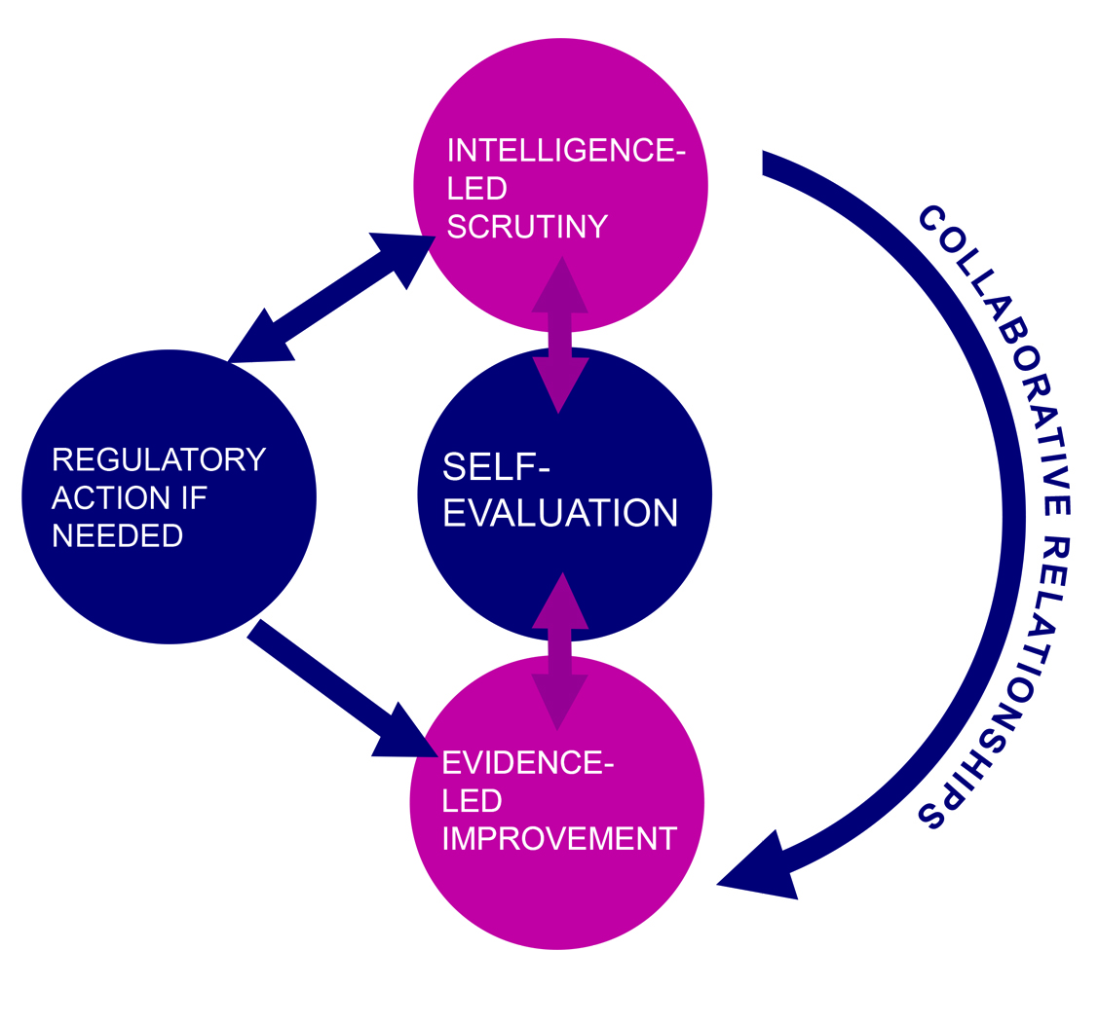
The ‘Scottish model’ of scrutiny and improvement

Slide 10

What are you doing wrong?
Are you doing this right?
Evidence what you are doing works well.
Are the outcomes good?
Is the leadership good?
Are key processes in place?
Focus on supporting improvement
Combined self-evaluation / inspection framework from April 2018

Slide 11
Proportionality
Every care service inspected in all 4 quality areas
Intelligence led
Better performing services inspected in 2 quality areas
Shorter inspection reports

Slide 12
Self-evaluation
Where a care service identifies a weakness in self-evaluation but has a plan in place…
Often we would treat this as an example of poor quality
Now we see it as a management strength

Slide 13
Power to make a requirement for change
In 2014/15
80% of care good
6,000 requirements
Breach of regulations
only when outcomes for people are poor… or potentially poor

Slide 14
More observation of people’s care
Read policies
Check procedures
Inspections start by speaking to people
Short Observational Framework for Inspectors (SOFI)

Slide 15

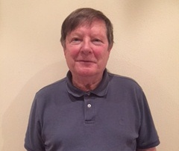

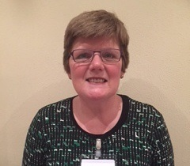
Involving people who experience care
70 inspection volunteers
Join the inspector on an inspections
“Experts by experience”
4 inspection volunteers with a diagnosis of dementia

Slide 16
Supporting improvement
Expert improvement support team
Support after an inspection
National / local improvement programmes
Expert health team
Support inspections

Slide 17
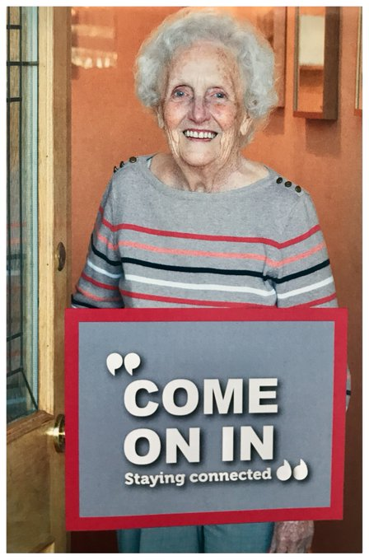


hub.careinspectorate.com

Slide 18
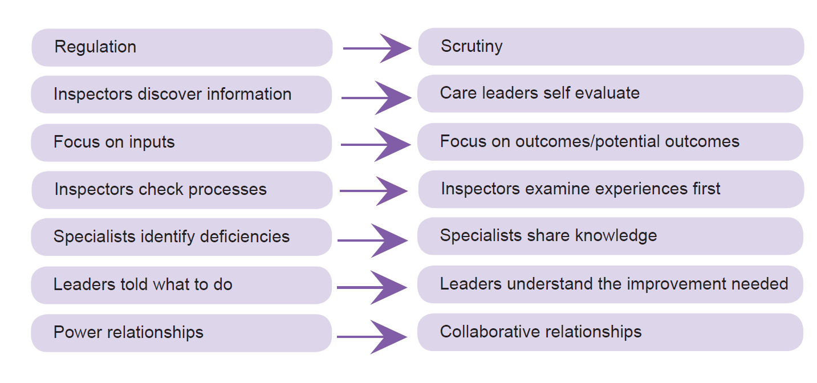
A continuum of different approaches

Slide 19
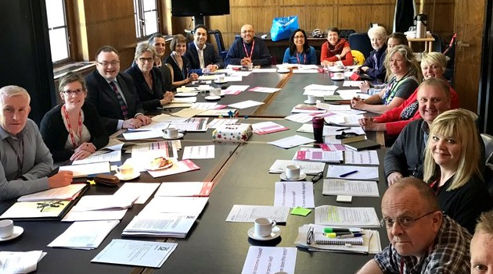
New National Care Standards

Slide 20
Safety?
Compassion
Be included
Dignity and respect
Responsive care & support
Wellbeing
“Safety is what my carer says when they want me to stop doing something”
Part of “wellbeing”

Slide 21

July 2017: Health and Social Care Standards
One set of standards across all health and social services
150 statements
www.NewCareStandards.scot

Slide 22
Human rights and wellbeing
1
2001
2017
What professionals must do to meet the minimum quality.
The quality I should experience.
Person-led approach

Slide 23
Decoupled from settings
2
2001
2017
Delivery in a single care service.
Planning
Assessment of needs
Commissioning by local authorities
Delivery in care

Slide 24
Person-led
3
Staff will treat you politely at all times.
Staff call you by your preferred name or title at all times.
If you need help, your request will be dealt with as soon as possible.
I get the most out of life because people have an enabling attitude.
I experience warmth, kindness and compassion, including physical comfort when appropriate.
I experience care and support where all people are respected and valued.
2001
2017

Slide 25
The outcome focus
4
Space size
12.5 sq.m.
3.5 sq.m. for toilet
3.9 sq.m. / person communal space
I have enough physical space to meet my needs and wishes.
2001
2017

Slide 26
Care Inspectorate registers all care services
We will publish expectations on room sizes
Guidance describes inputs we expect to see
Quality is measured through the lens of a person’s experience

Slide 27
Changing the question for inspectors
Is this a good care service?
To what extent are people getting the right care to meet their needs and wishes?

Slide 28
Combined self-evaluation / inspection framework from April 2018
Enablers
Results
How do we know?
How good is the care?
What difference does it make?
Dignity and compassion
Health and wellbeing
People in control of their own lives
Leadership | Staffing | Setting
Key processes care planning Involvement | Commissioning
Quality illustrations from the new standards

