Slide 1
The New EPSO Management Board Estonia, July 2017

Slide 2
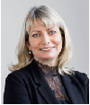
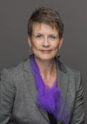
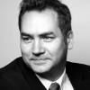
Anette Lykke Petri, Denmark
Swedish Health and Social Care Inspectorate, represented by Sabina Wikgren Orstam, Sweden
Jooske Vos, The Netherlands
Sipko Mülder, The Netherlands

Slide 3
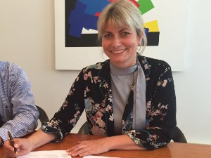
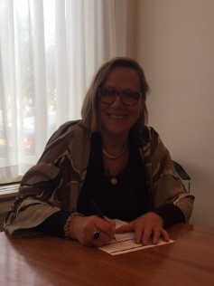
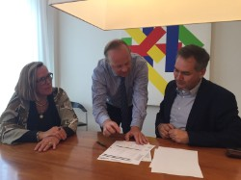
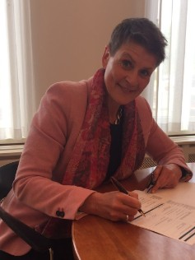
01.06.2017 new EPSO Management Board was installed at the Notary public and took office

Slide 4
The responsibilities of EPSO management Board
Financial and organisational responsibility for Foundation EPSO
Administrative responsibility for the administrative obligations of foundation EPSO
Management responsibilities for foundation EPSO and its relation to the EPSO secretariat
Organisational responsibility for a working relationship with Foundation Eurinspect as supporting the EPSO activities

Slide 5
The job requirements for members of the EPSO management board
Enthusiastic about and supportive to the aims of EPSO;
Experienced in the field of management of a supervisory , monitoring or regulatory organization preferably at a senior management position;
Access to a broad network of colleagues in the field of supervisory monitoring or regulatory practice;
Communicative and network skills;
Creativity in building a new organisation;
Available for consultation and support activities if necessary;
Availability during at least 2 hours per month.

Slide 6
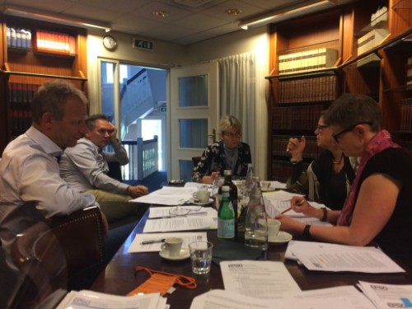
What have we done so far ?

Slide 7
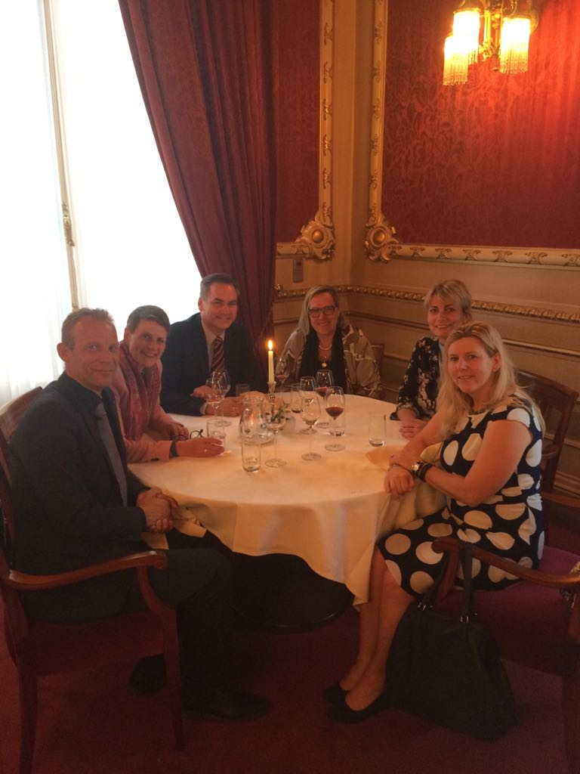

Slide 8
Next steps……
Management Board meeting in Iceland (sept. 2017)
Management Board presentation during EPSO conference in Iceland, including information on:
Annual EPSO report
EPSO Advisory council
Financial structure of EPSO
Preparation of EPSO conferences
Structure of EPSO working groups

Slide 9
Thanks

