Slide 1

Estonian
Connected Health Cluster
Maarika Merirand
Biotech Manager Connected Health Cluster

Slide 2
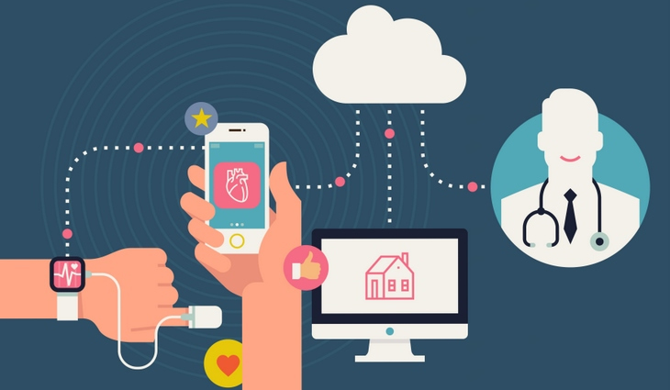
Connected Health Cluster
Accelerating connected health solutions from Estonia to new markets.
Making Estonia the best place
to start and grow
one’s health tech business.
Notes:
Connected Health is a country-wide partnership between health-related stakeholders in Estonia, who are committed to accelerating the adoption of connected health solutions, on an international scale and on commercial terms.

Slide 3
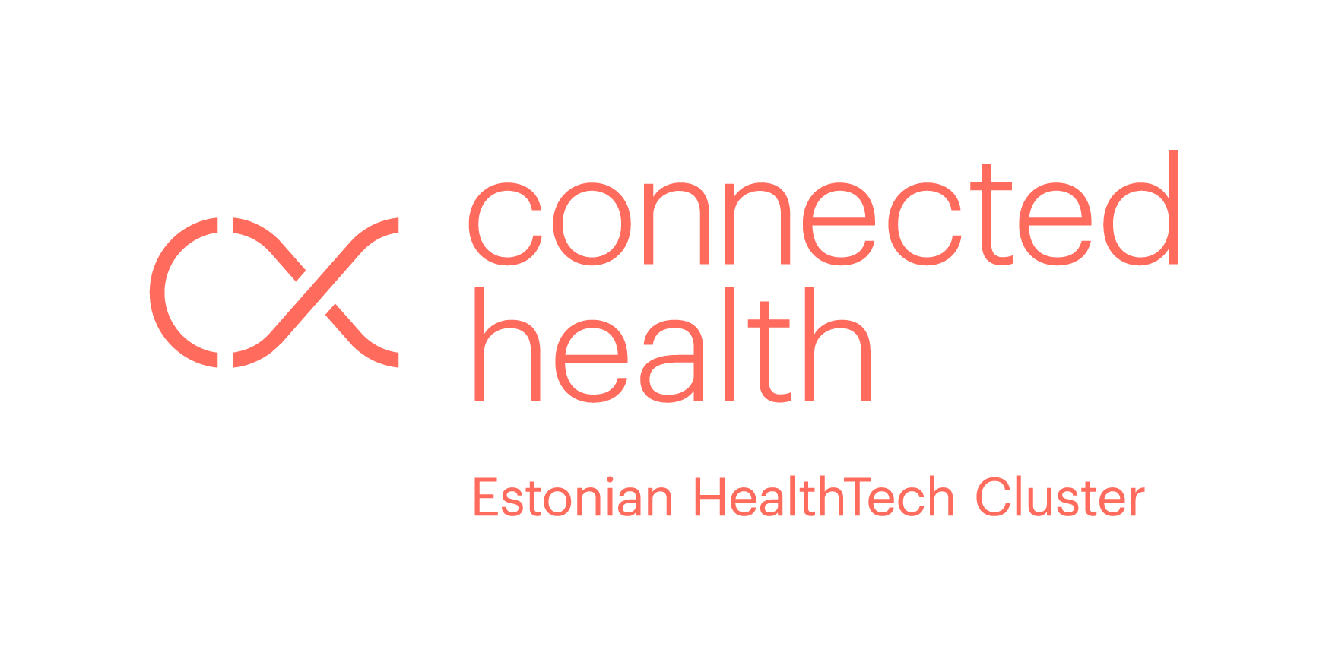
Connected Health Cluster
COMPANIES
R & D
STARTUPS | HEALTH IT
BIOTECHNOLOGY | MEDICAL EQUIPMENT
UNIVERSITIES
TECH R&D CENTRES
USER GROUPS
HOSPITALS, FAMILY PHYSICIANS, MEDICAL SPECIALISTS
CLINICS, LABORATORIES
PHARMACEUTICAL INDUSTRY
ATHLETES, SPAs
QUANTIFIED SELF
PUBLIC SECTOR
STRATEGIES
REGULATIONS
FINANCING
Notes:
Cluster brings together 70+ partners, including 43 companies (start-ups, health IT, medtech, biotech and pharma), R&D partners (universities and technology competence centres), health and wellness service providers (hospitals, GPs, occupational health, spas, fitness and sports), patient organisations and user communities, and public sector (ministries responsible for healthcare and entrepreneurship, national health insurance, national e-health development agency).

Slide 4

hINF video
Notes:
Hinf is a digital solution for HIV+ patients and their care team.

Slide 5
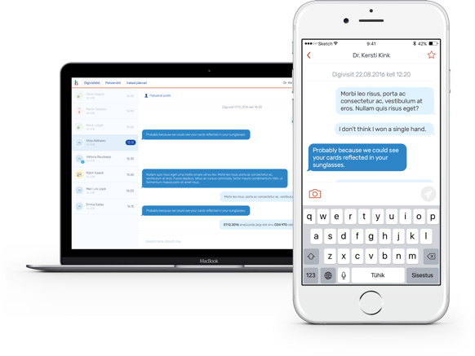
hINF
Digital solution developed for HIV patients and their care team.
Patient can register for a digital appointment in the clinic
Appointment connects the patient with the doctor – test results, discussing health matters, ask for digital prescriptions and medical certificates, send pictures

Slide 6
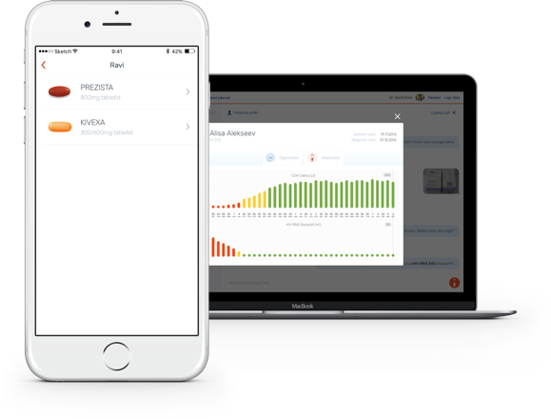
hINF
Detailed overview of the patient´s health
Interactive graphs displaying the most relevant test results and treatment plans
Notification system for the patient

Slide 7
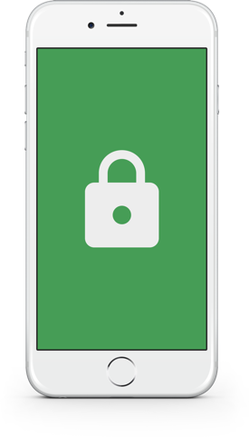
hINF
Unique code for each patient
Information flow between the patient ant the doctor only visible to the respective parties
Patient app access passcode

Slide 8

Health Circle

Slide 9

Health Circle
Hypertension treatment by helping a patient collect health data for the doctor
Connecting the patient with a Facebook chatbot assistant
Based on the medicine and blood pressure information provided by the patient

Slide 10

Health Circle
Patient reminders
Movement and sleep tracking
Interaction with the patient family
Generates a report for the doctor to have an overview of the patient´s treatment process

Slide 11

Cognuse

Slide 12
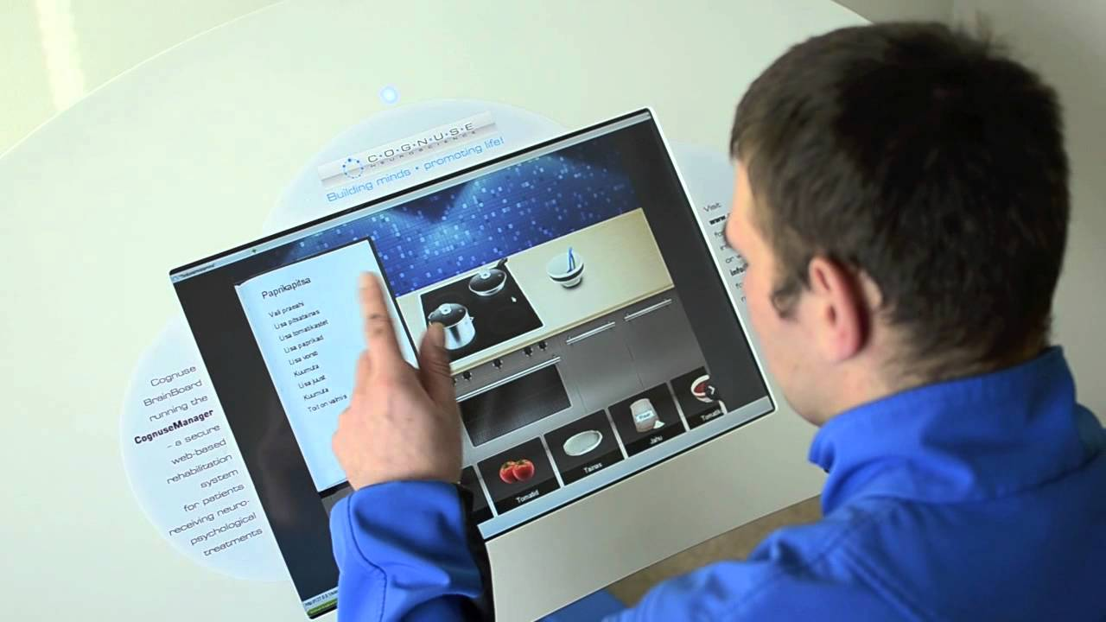
Cognuse
A solution for treatment of patients recovering from chronic neurological and cardiovascular diseases
Designed for patients that need long-term rehabilitation support by using different devices e.g. tablets and smart devices

Slide 13

Cognuse
interactive speech therapy platform that includes more than 1000 speech therapy exercises for a patient with speech disorder
Learing to speak again, understand the speach, read and write again

Slide 14

www.connectedhealth.ee

