Slide 1
EPSO Working group eHealth
Tove Gemzell
July 3 - 2017 Saaremaa, Estonia

Slide 2
Today
Welcome and introduction
Who is who and expectations
Agenda setting
Discussion about the Questionnaire on-line clinics by supervisory organisations in England ( CQC), Sweden (IVO), Estonia (Terviseamet)
Medical devices and supervision

Slide 3
WHO Definitions we will use
eHealth is the use of information and communication technologies (ICT) for health. Examples include treating patients, conducting research, educating the health workforce, tracking diseases and monitoring public health.
Where health refer to physical, mental and social wellbeing

Slide 4
Focus
Consumer related eHealth services
  Because they:
  travel cross-border
  and are similar in different countries
  Special attention to:
  -choosing the relevant services from a patients perspective and risk analysis

Slide 5
Trends in Sweden
eHealth vision in Sweden
In 2025, Sweden will be the best in he world at using opportunities offered by digitalization and eHealth to make it easier for people to achieve good and equal health and welfare, and to develop and strengthen their own resources for increased independence and participation in the life of society.

Slide 6
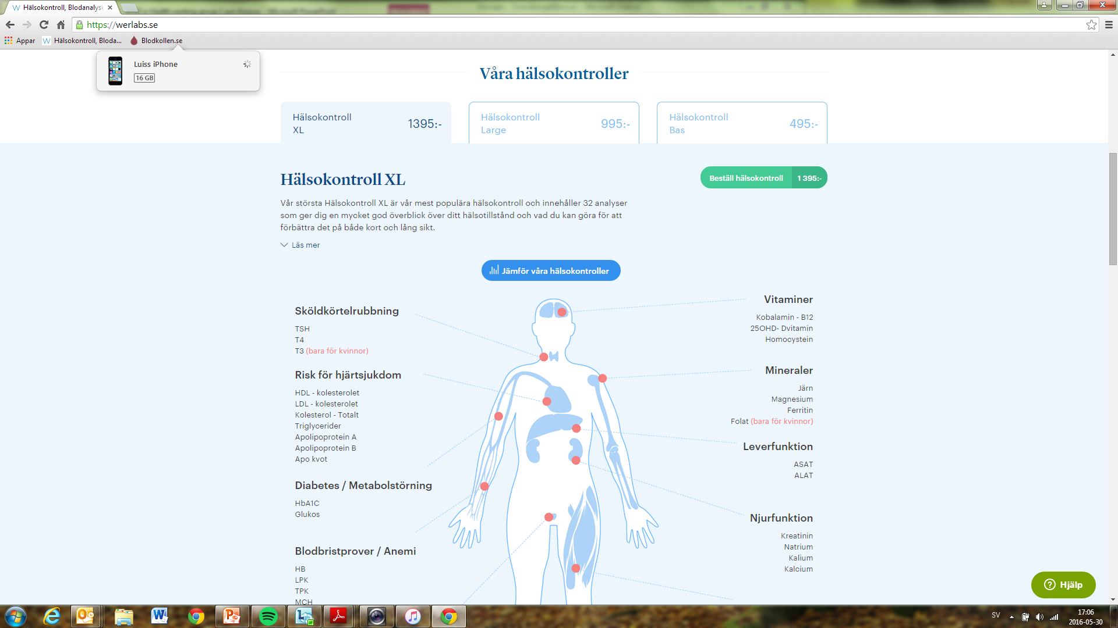

Slide 7
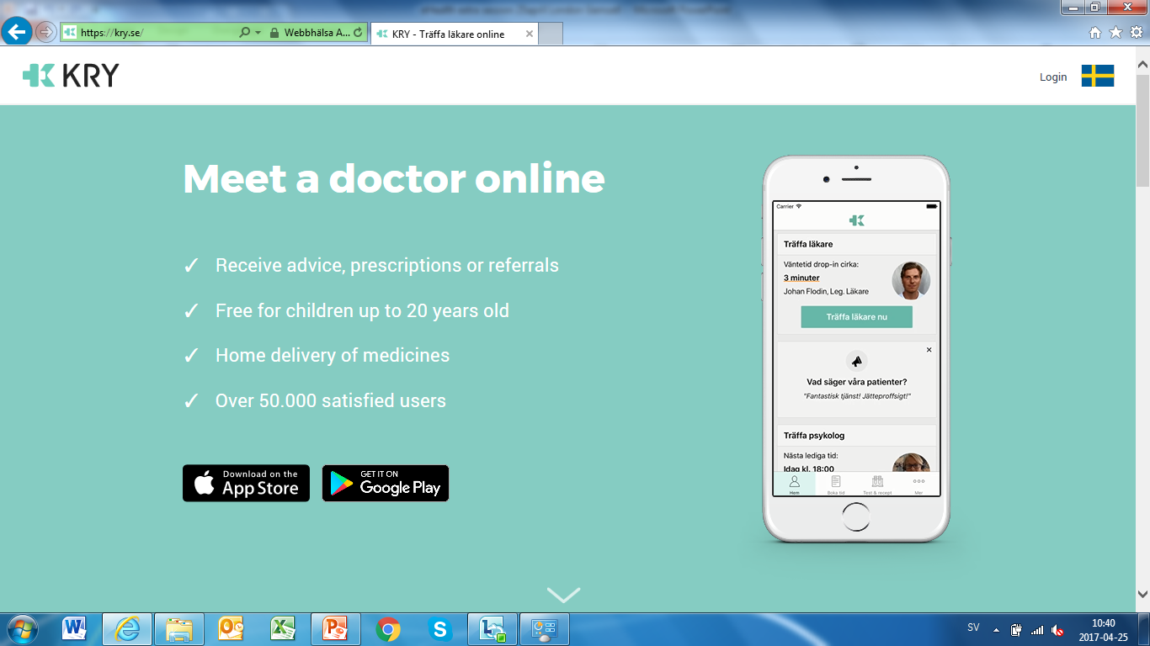

Slide 8


Slide 9

Loose-loose situation

Slide 10
Discussion
What are the specific areas of risk regarding online care?
How do you se this development coming about?

Slide 11
Discussion about the Questionnaire for the EPSO e-Health working group based on the experiences with or ideas about supervision of e-health clinics by supervisory organisations in England ( CQC), Sweden (IVO), Estonia (Terviseamet)

Slide 12
Has your organization any experience with supervision of online clinics ?
With online labs, yes. The cases we do have regardin online clinics aren´t tried yet.
If yes; why did you initiate it? - has it sprung from a specific complaint or tip or was it part of a larger plan to supervise many of the online providers?
From specific complaints and tips.
Can you briefly describe the supervision, i.e. how many care providers were supervised. What did you find and what actions did you take?
We have tried 3 cases regarding online labs, and appr. 10 cases regarding online clinics are being under investigation.
What was the focus of the supervision, what did you specifically look for?
Information safety (identification), disease control)
What is your over-all experience with this supervision? Was it different from “regular” supervision?
The providers gave us satisfactory answers and had a sincere will to follow laws and regulations.

