Slide 1
E-Health extra session
Tove Gemzell
EPSO – CQC Forum
London in 25th of April 2017

Slide 2
This hour
eHealth working group
Recent developments in Sweden
Primary care services delivered online CQC
Discussion

Slide 3
WHO Definitions we will use
eHealth is the use of information and communication technologies (ICT) for health. Examples include treating patients, conducting research, educating the health workforce, tracking diseases and monitoring public health.
Where health refer to physical, mental and social wellbeing

Slide 4
Focus
Consumer related eHealth services
  Because they:
  travel cross-border
  and are similar in different countries
  Special attention to:
  -choosing the relevant services from a patients perspective and risk analysis

Slide 5
Next meeting in Saarema 3-5 July
Aim at producing a report of what we have gathered so far and decide upon how we want to proceed with the group

Slide 6
Trends in Sweden
eHealth vision in Sweden
In 2025, Sweden will be the best in he world at using opportunities offered by digitalization and eHealth to make it easier for people to achieve good and equal health and welfare, and to develop and strengthen their own resources for increased independence and participation in the life of society.

Slide 7
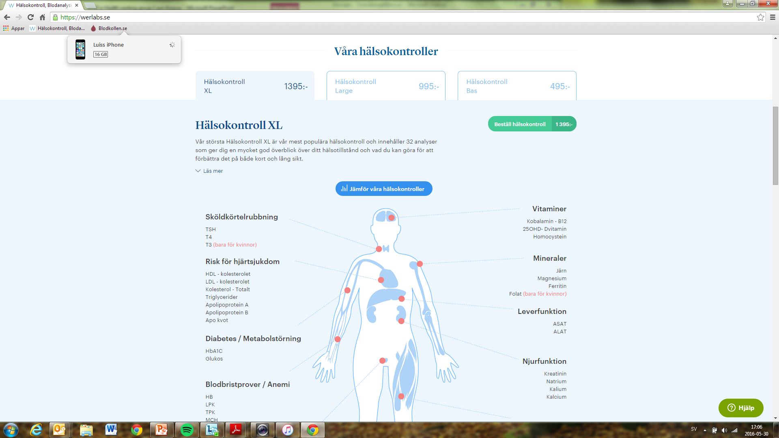

Slide 8
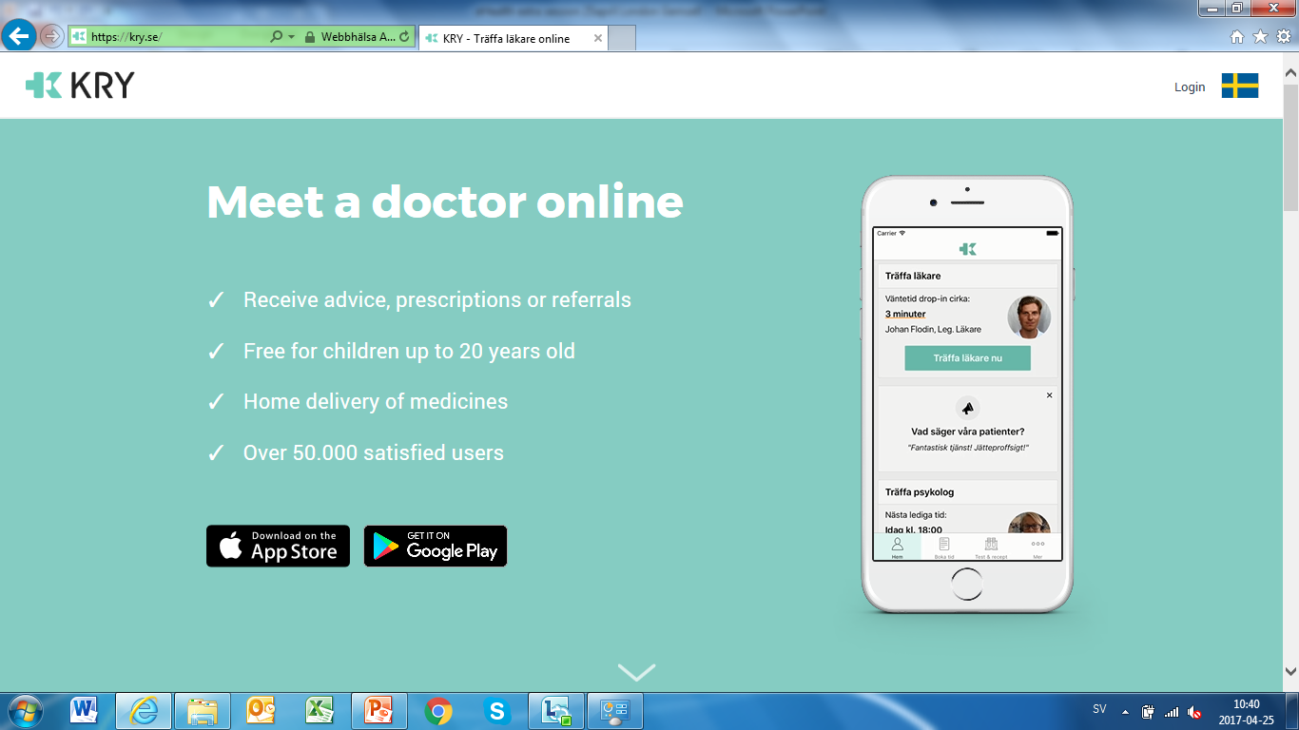

Slide 9


Slide 10

Loose-loose situation

Slide 11
Discussion
What are the specific areas of risk regarding online care?
How do you se this development coming about?

