Slide 1
Service user involvement in audit – a Norwegian case
Why and how involving service users can make a difference

Slide 2
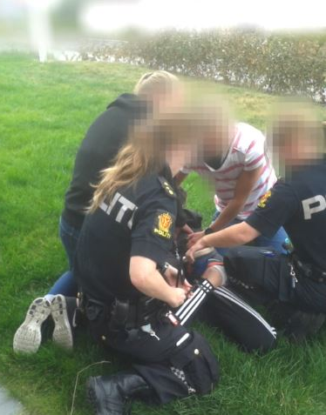
Service user involvement in audit – the Ida story
Newspaper report January 2016 about an adolescent girl with serious behavior issues.
She had been known to child welfare services since she was two years old, and had been under public child service care for two years at the time she created public interest
The list of health and child welfare services involved was long and she had been subject to more than a hundred incidents involving the use of compulsion

Slide 3
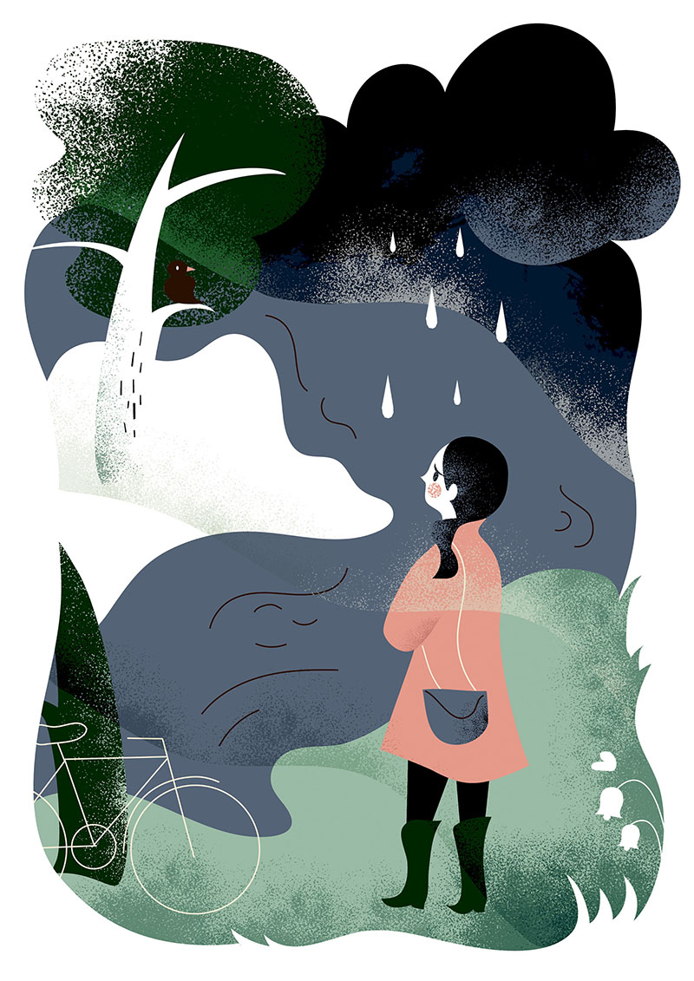
The supervisory approach
A story not unknown to child welfare or to the supervisory authority – but why? And how to investigate?
The normal procedure would be to write to all the various services and receive written explanations on their care for the child
Assess each of these against the expected good practice in the different services
And write a report on the need/or not for change to six of the 14 services involved
– Which was done

Slide 4

The supervisory approach
In addition the team leader asked an organisation for children in care for advice and help
The advice was – ask the girl herself where she has experienced failure
A simple answer to a simple question
Important lessons: nobody listened, nobody saw the full story, nobody really understood

Slide 5

Conclusions
Each case of use of force or compulsion was within the limits of the law, the sum was not – and constitutes a breach of law
Several agencies and institutions had given adequate care in line with good practice, the sum was not
Collaboration between services was sub standard
The services should have asked “Why does she behave in this way”

Slide 6
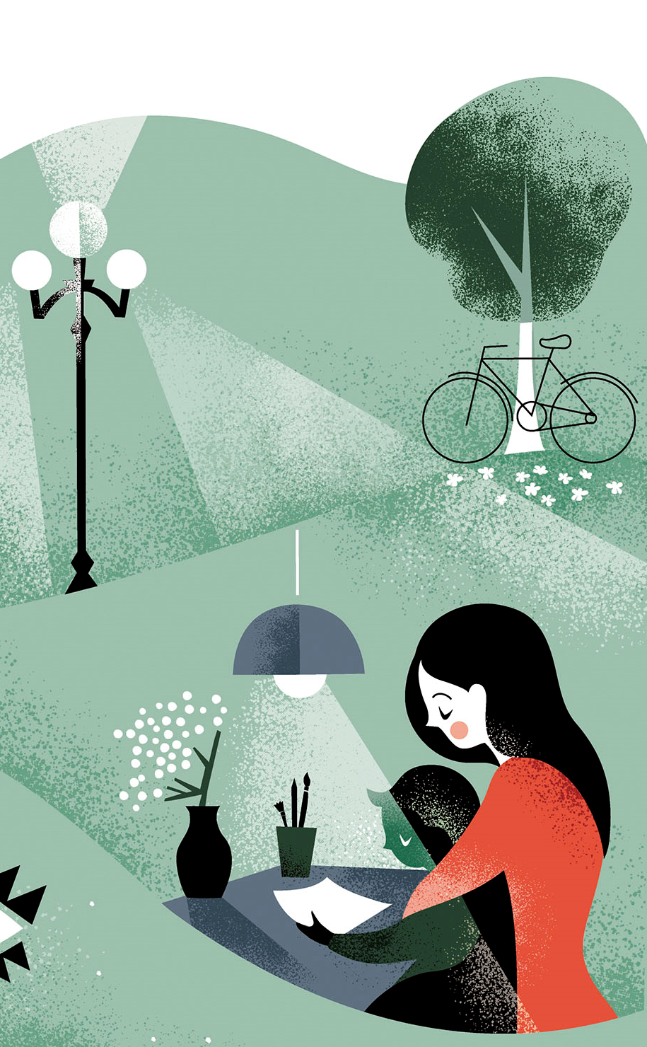
Some results
One overall report summarizing findings in 6 services has led to change in quality of child care, change in supervisory practice and a plan, signed by two ministers of government, for improved collaboration between sectors

Slide 7

Service users involvement in risk assessment and audit
Service users and/or their representatives participate in risk assessment, as informants about an individual or a group of services or as participants in the supervisory (review) team
Risk assessment is collecting experience and data from a range of sources – research, our own data on complaints, summaries by NGOs and anecdotal individual stories from users and services etc – it is our job to put this together to provide a basis for decisions
Selection by services and NGOs
Training ongoing development – so far adapted to the supervision in question

Slide 8

Information in English:
www.helsetilsynet.no/Norwegian-Board-of-Health-Supervision/no

