Slide 1
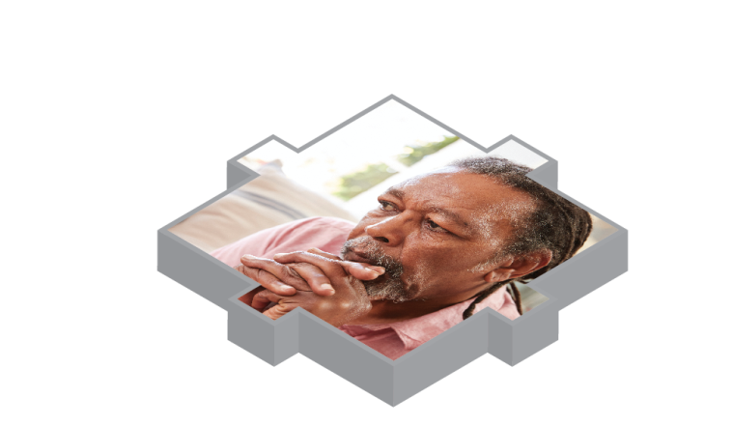
Beyond barriers
How older people move between health and social care in England
Charles Rendell, Strategy manager CQC
Learning from CQC local system reviews, EPSO Conference 2018

Slide 2
Our purpose
We make sure health and social care services provide people with safe, effective, compassionate, high-quality care and we encourage care services to improve

Slide 3
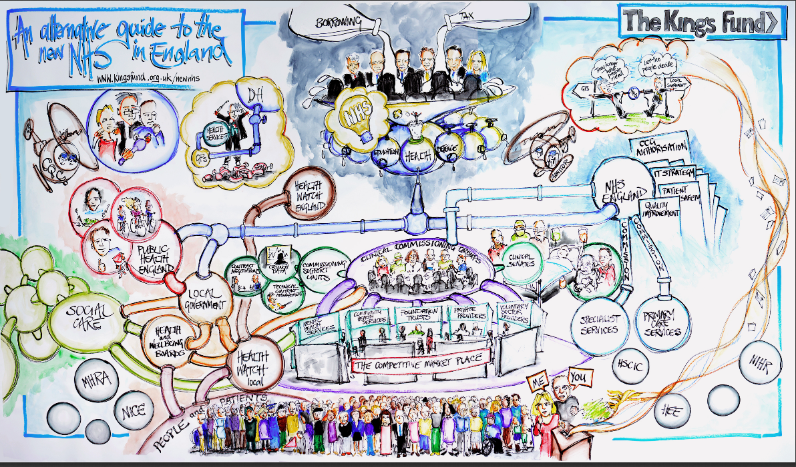

Slide 4
Why did we carry out these reviews?
Secretaries of State asked CQC to undertake a programme of targeted reviews in local authority areas
Reviews sat outside CQC’s usual legal powers (under Section 48 of the Health and Social Care Act)

Slide 5
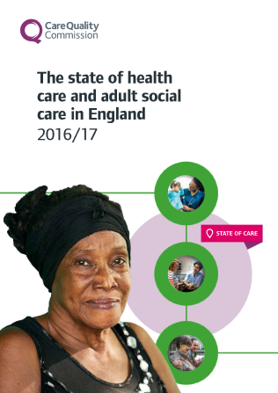
How did this fit with our usual work?
Reviewing local systems reflected key findings of recent reports including:
State of Care 2016 & 2017
Integrated care for older people
Also built on our previous programme of ‘place reviews’:
2015/16 – North Lincolnshire, Tameside, Salford
2016/17 – Cornwall, London Borough of Sutton

Slide 6
Scope and approach of the reviews
People aged 65+
Focused on health and care interfaces
Consider system performance
No ratings
2. Care and support in a crisis
Admission to hospital or alternative
1. Maintaining the wellbeing of a person in their usual place of residence
R e a b l e m e n t
3. Step down
Return to usual residence
Admission to new residence
Three ‘spheres’ and ‘pressure points’

Slide 7
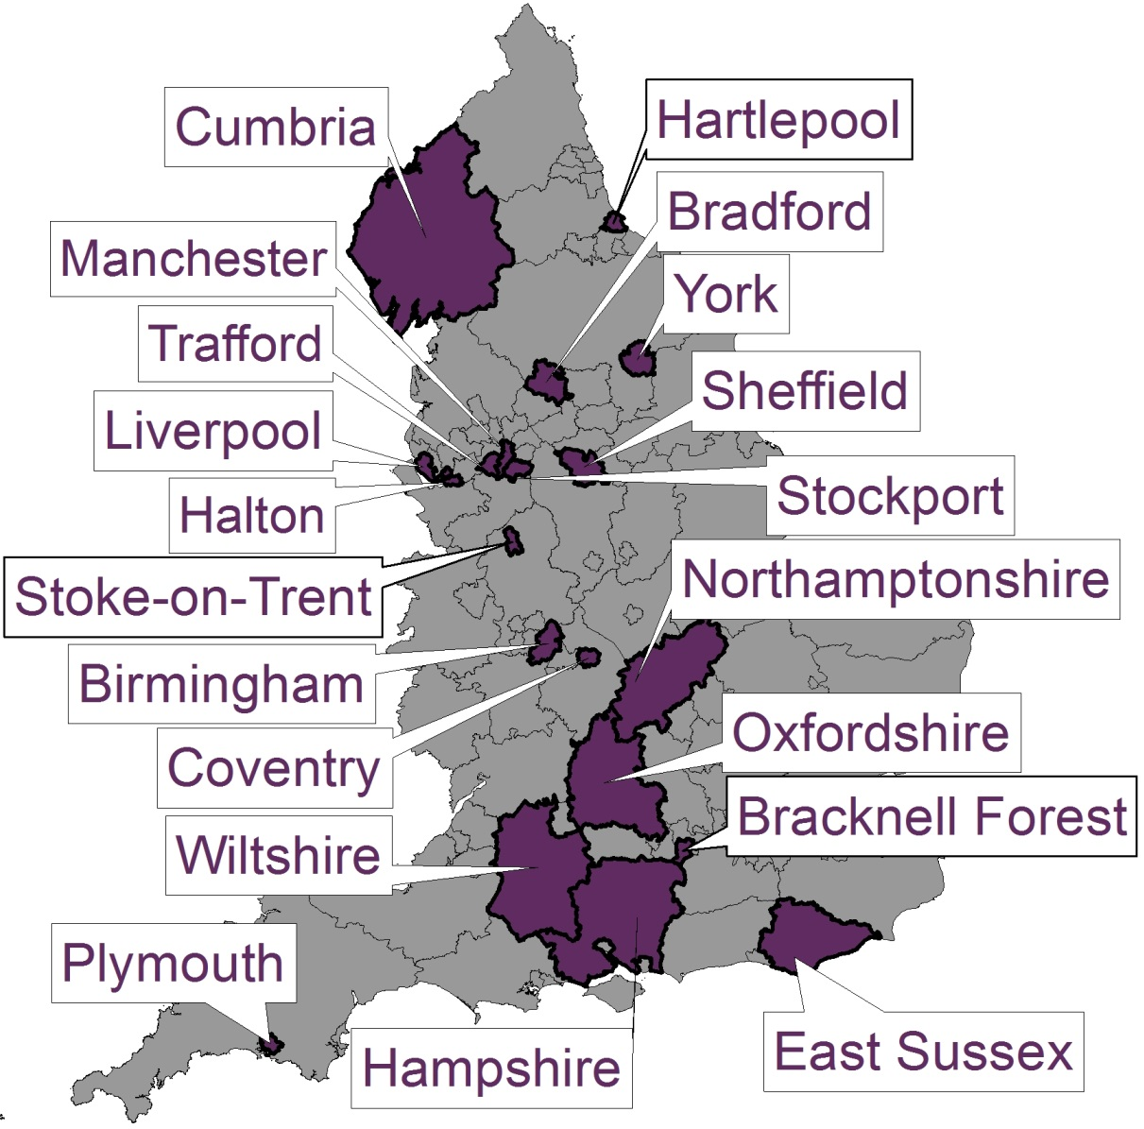
Where have we been and what have we delivered?
20 site visits
Beyond Barriers report – July 2018
20 local system reports
Interim report December 2017
7

Slide 8
England system designed in 1948 can no longer effectively meet 2018 needs
Living longer – but with more complex health problems
Increasingly, our care must be delivered by more than one person or organisation
In 2018, we expect care to be personalised to people’s individual circumstances
A fragmented health and care system designed in 1948 can not meet the needs of today’s population or operating environment
We must remove the barriers to collaboration at a local and national level and create an environment that drives people and organisations to work together

Slide 9
What we found 1/2
People experience the best care when people and organisations work together to overcome a fragmented system
Where local leaders share a clear vision, it provides a shared purpose for people and organisations across the local health and social care system
Dedicated staff regularly going beyond the call of duty
There were examples of good practice in every local system we looked at
But in a fragmented health and social care system there are barriers to collaboration at a local and national level

Slide 10
What we found 2/2
Funding: Health and social care organisations are limited in how far they can pool resources and use their budgets flexibly across prevention, social care and healthcare
Managing performance: Organisations are held to account for their own performance, not the performance of the system as a whole
Workforce: Services do not always have the right staff, in the right place, at the right time – the health workforce and social care workforce are seen as separate entities
Oversight: Regulation usually looks at quality of care in individual providers, rather than across a system as a whole

Slide 11
Recommendations to local and national leaders, and government
An agreed joint plan that sets out how older people are to be supported and helped which in turn, guides joint commissioning decisions over a multi-year period
A single framework for measuring the performance of how agencies collectively deliver improved outcomes for older people
The development of joint workforce plans with more flexible and collaborative approaches to staff recruitment, retention and development
New legislation to allow CQC to regulate systems and hold them to account for how they work together to support and care for older people

Slide 12
Questions to EPSO members
Are these Messages familiar?
Do you have similar challenges in your country/area??

Slide 13
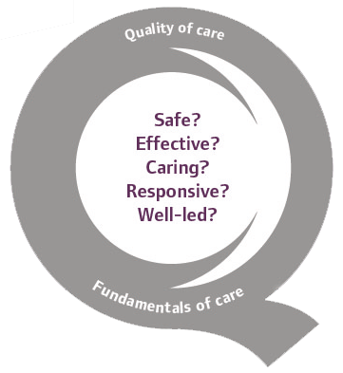
Thank you
www.cqc.org.uk/beyondbarriers@CareQualityComm #beyondbarriers

