Slide 1
National Supervisory Authority (Luova)
To be established on 1 January 2021

Slide 2
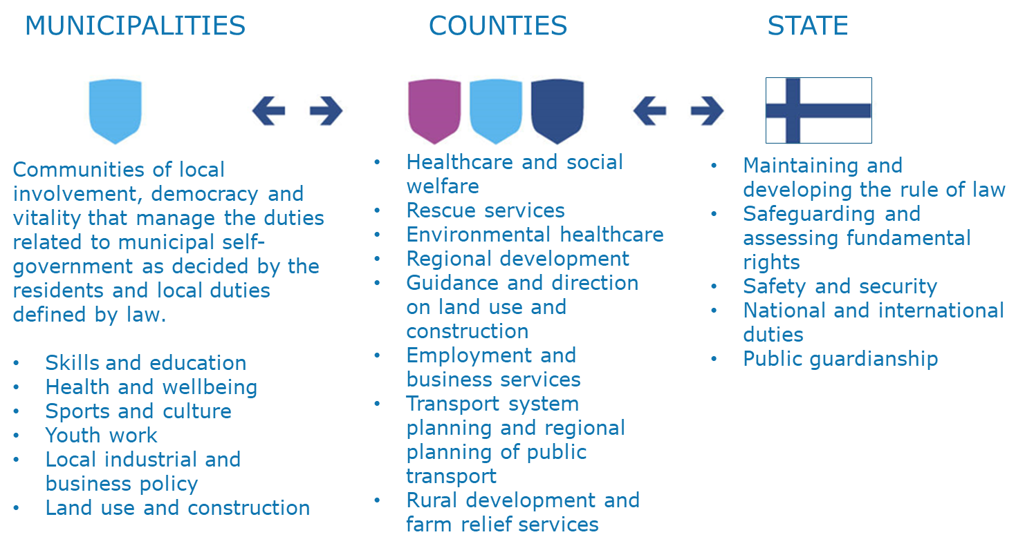
Regional government reform on 1 January 2021
As a result of the regional government, health and social services reform, Finland’s public administration will be organised at three different levels:
municipalities (local government),
18 counties (regional government) and
state (central government).

Slide 4
D
Ministry of Social Affairs and Health
Legislative drafting
Planning, steering and implementation of social and health policy
National Supervisory Authority for Welfare and Health
(Valvira)
Guidance to the Regional State Administrative Agencies to achieve harmonised licensing and supervisory practices
The national supervision programme for health care and social welfare
National licenses for private social and health care providers
Handling complaints that relate to a treatment of a severely and permanently injured patient or a patient who has died after a suspected medical error or medical malpractice
Grants the right to practice as a licenced or authorised professional
Supervision of the alcohol and environmental health sectors
Supervision of
Health and
Social Services
in Finland: current state
Six independent Regional State Administrative Agencies
Regional guidance and supervision of welfare and health care
Regional licenses for private social and health care providers
Handling complaints
Municipalities and health and social care providers
Self-monitoring
Handling complaints and objections from patients and clients
Municipalities supervise social services in their own area (along the Regional State Administrative Agencies)

Slide 5
New National Supervisory Authority: What's it all about?
Government licensing, guidance and supervision functions
will be brought together
in a new, multidisciplinary agency
A new, multidisciplinary agency called the National Supervisory Authority will be responsible for government licensing, guidance and supervision functions.
This new agency will operate in the fields of health and social services, the environment, occupational health and safety, and education and culture.
It will be a national authority, but it will also be close to its customers.
The new agency will have a uniform, customer-oriented approach, and its services will be proactive, digitalised, flexible and easy to use.

Slide 6
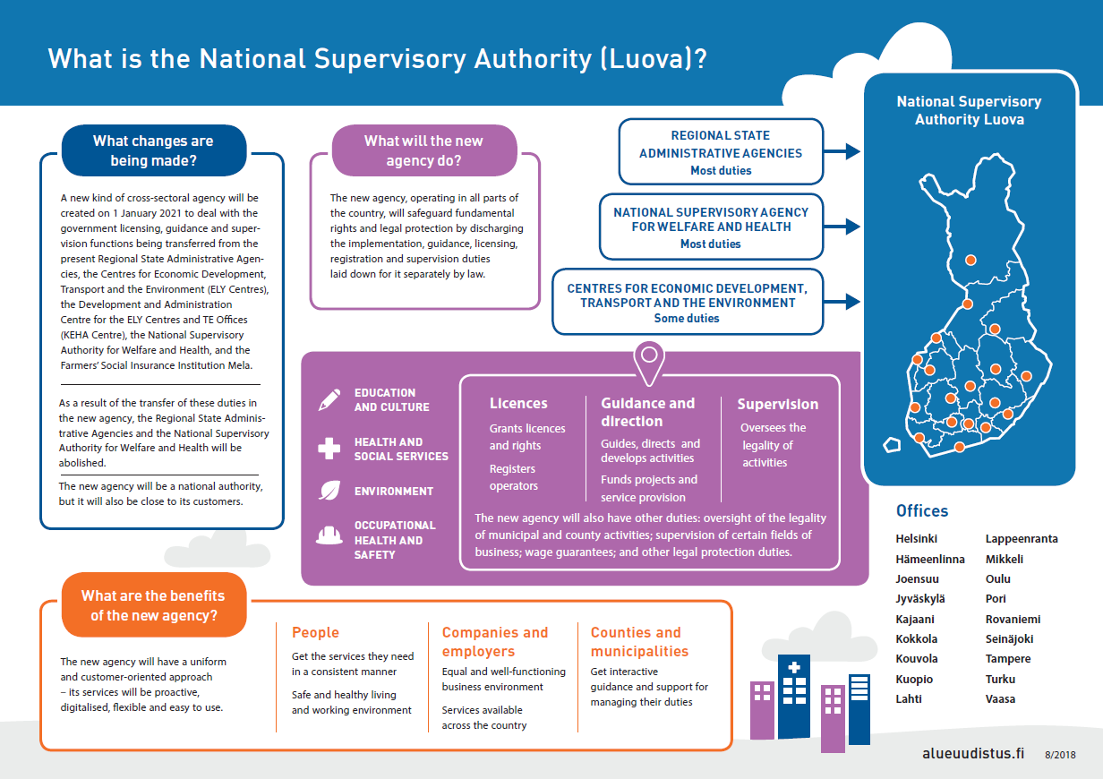

Slide 7
Luova-authority: 4 sectors

Slide 8
National Supervisory Authority serves all government ministries
Government
Joint guidance
Joint steering group and preparation network
Operational guidance and direction
Each ministry within its mandate
National supervisory authority
Management and issues subject to joint guidance
Work on the agency's specified areas
of responsibility

Slide 9
National Supervisory Authority organisation model
People Organisations Companies Counties Municipalities
Environ-ment
Approx. 500 person-yrs
Health and social services
Approx. 300 person-yrs
Occupatio-nal health and safety
Approx. 400 person-yrs
Education and culture
Approx. 80 person-yrs
Organisation of joint operations X
Organisation of joint operations X
Legal protection (4 ministries)
approx. 100 person-yrs
Internal audit
Administration and development
approx. 160 person-yrs
Management group
Director-General

Slide 10
Benefits of National Supervisory Authority
One authority, one-stop shop principle: An end to the ambiguities in the division of duties between Valvira and the regional agencies.
Increased equality thanks to nationwide operation.
By pooling together expert resources, expertise increases and can be utilised more flexibly.
The new “broader shoulders” allow better opportunities for e.g. ensuring the continuity of operations and developing information systems.
Location-independent operations and the multilocality model provide employees with new kinds of work opportunities.
Operations and the operational culture can be genuinely renewed together, and the various specialisations can learn from each other.

Slide 11
Benefits for customers
The new authority will have a uniform and customer-oriented approach – its services will be proactive, digitalised, flexible and easy to use.
People
Companies and employers
Get the services they need in a consistent manner
Safe and healthy living and working environment
Equal and well-functioning business environment
Services available across the country
Counties and municipalities
Get interactive guidance and support for managing their duties

