Slide 1
Joint inspections and organisational collaboration between authorities
Health and Social Care Inspectorate (IVO)
Anna Öström

Slide 2
Presentation: EPSO 11th of October
Examples of authorities that IVO have collaboration with
Benefits of joint inspections and organisational collaboration between authorities
When can joint inspections or collaborations be beneficial?
What are the key challenges?
Two examples: one joint inspection and one collaboration
A joint inspection between IVO and the Swedish Schools Inspectorate
A collaboration between IVO and Swedish Work Environment Authority

Slide 3
Examples of authorities that IVO have collaborations with
Health and Social Care Inspectorate (IVO)
Public Health Agency of Sweden
Swedish work environment Authority
Swedish social insurance Agency
Swedish School Inspectorate

Slide 4
Benefits of joint inspections and organisational collaboration between authorities
” I believe your collaboration with the Swedish work environment authority is a very positive force. We (our office) often fall between the cracks in your inspections, but there are strong links between human resource provision and quality within social work.”
An agency head within the social services
Less administration for the inspected agency
Less disturbance for the inspected agency
No contradictory recommendations
Better knowledge of the big picture for each authority
Can strengthen the supervision
Better outcomes for the users/patients/pupils

Slide 5
When can joint inspections or collaborations be beneficial?
When different authorities have a mutual goal
When the authorities needs to see the bigger picture at different levels within the inspected agency
When the authorities benefits to receive knowledge and information from each other regarding an agency
When there is no improvement for the users despite years of supervision
Example of inspections in one unit for youth and children at the Social services
2013
2014
2015
2016
2017
Inspections during a period of time and no visible improvements for the users

Slide 6
What are the key challenges?
Recourses: it can be quite costly to have a collaboration
Difficulties to formulate a common goal
Differences between the governmental authority's regarding regional organisations
Be aware of the different mission of each inspection authority
Maintaining clarity towards the inspected agency regarding the collaboration when the inspections are carried out at different times

Slide 7
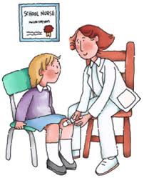
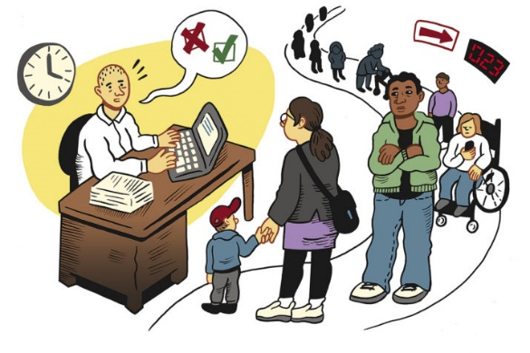
Two examples: one joint inspection and one collaboration
Joint
inspection
Health and Social Care Inspectorate (IVO)
Collaboration
Health and Social Care Inspectorate (IVO)
Student Health
Social services
Swedish Schools Inspectorate
Swedish Work Environment Authority

Slide 8
A mutual goal was beneficial for the joint inspection
One elementary school
Science of education
Student health
Compliance with laws and regulations
Pupils in school
The mutual goal is that all children are able to go to school regardless of medical, physical or physiological condition
Health and Social Care Inspectorate
Swedish Schools Inspectorate

Slide 9
Collaboration can strengthen the supervision
The unit for youth and children at the Social services in one municipally
Leadership and governance
Work- environment
Exercise of authority
Users (children and youth within social services)
How can we benefit from each others knowledge?
Swedish Work Environment Authority
Health and Social Care Inspectorate

