Slide 1
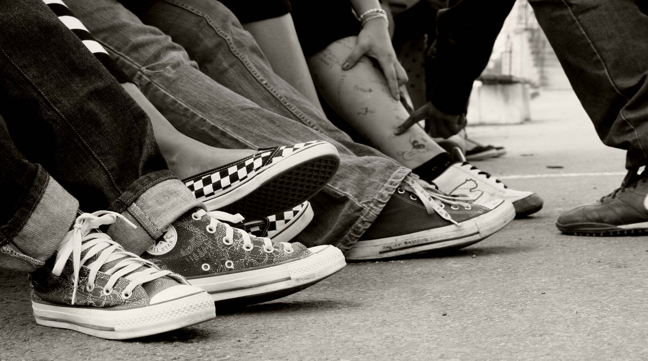
Inspection of child care homes from a risk based approach with a starting point in quality
Anna Öström: Inspectorate of Health and Welfare

Slide 2
Agenda
Short presentation of the Swedish supervision of care homes for children and youth
Mission and objective of the pilot project
Quality aspects of supervision – Scotland and Sweden
Step 1-4 in the project process

Slide 3
Current status of Swedish supervision of care homes for children and youth
Yearly supervision
Every year there is a specific national theme for the supervision
2018: The content of care
2017: Safety and security in care homes
Regulatory compliance is the main focus
The decisions following the supervision are particularly focused on regulatory compliance
Many interviews with children, but how do we take care of the information?
IVO makes thousands of interviews with children and youths every year but their opinions can be more visible in the supervision
Different ways to systemise the knowledge of care homes
Every department has different ways to systemize our knowledge of the care homes that pose a bigger risk to children and youth
Notes:
Vi gör en viss riskbedömning idag – beaktar indikatorer på andra brister och hanterar det inom ramen för tillsynen. Mest fokus på där vi har uttryckliga lagstöd.
Behöver utveckla vårt arbete med att låta barns röster väga lika tungt som andras. (4 032 interviews in 2017) 1 861 inspektioner 2017 (inkluderar även LSS)

Slide 4
Mission and objective
To develop a framework of supervision for child care homes from a risk and quality perspective.
The objective of this pilot project is to further develop the supervision so that children's experiences are further taken into account. When finalised, IVO should be able to describe the quality of care in all child care homes and be certain of the areas further supervisory work should focus on.

Slide 5
Quality aspects of supervision – Scotland and Sweden
Human rights
Framework of good quality
Laws and regulations
The minimum acceptable level of quality
Scotland
Sweden
How are children's experiences of quality in care homes taken into account in the supervision?

Slide 6
Step 1: What’s most important to children? Framework needed – what is good quality?
Points of departure:
UN Convention on the Rights of the Child
Scottish national standards, Handbook of the Scottish
supervision authority
Reports from other authorities/government bodies/academic
research
Previous internal and ongoing work (child questionnaire)
Content of our work
Reading and joint reflection
Workshops
Capturing the views of children using focus groups and interviews
Invited guests (Vårdanalys, IVO-staff)
Exchange programme with Scottland
Discussions, workgroup EPSO
Framework
Definition of good quality based on what is important for children.
Material forming the basis for our continued work.

Slide 7
Identifying what is important for children and youth is done by…
Children and youth
Focus groups
In-depth interviews with EKB
Child survey
”Frequency 2018”
Information service / ”The child telephone”
Reports from other authorities & academic research
External reference group:
The National Board of Health and Welfare
Swedish Association of Local Authorities and Regions
Research

Slide 8
Step 2: Prep work before inspection
Based on step 1, we’ve created…
A system of self-evaluation
A survey for children and youth living in care homes
Based on the answers from the care homes, children and youth and IVO’s previous work a risk assessment is carried out.
High
Low
Medium

Slide 9
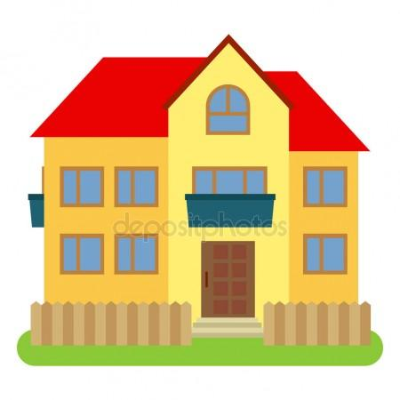
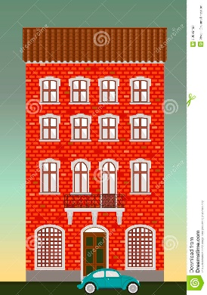
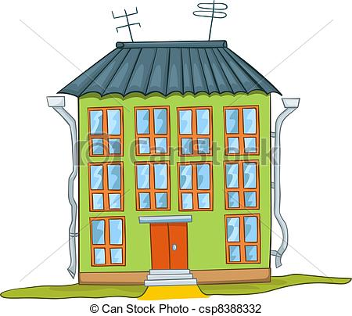
Step 3: Pilot inspections
Focus based on prep work and in accordance with the risk assessment
Supervision will differ between different care homes (time and content)
Examples of assessments
70 % of care homes OK according to most quality indicators
20 % of care homes Average scores on most quality indicators, but risks concering leadership
10 % of care homes
Risk according to most quality indicators and high risk concerning ’involvement’

Slide 10
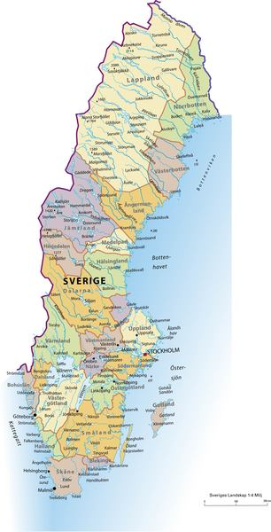
Pilot inspections
12 pilot inspections
4= high risk
4=medium risk
4=low risk
6 = private care homes
6= authority care homes
3=EKB
3=girls
3=boys
3=mixed

Slide 11
Step 4: After inspection
Decision/inspection reporting
Was our risk assessment correct?
Will it make a difference to children?
In the project, all steps in the process are shown in a report containing suggestions for supervision of care homes for children and youth from a risk and quality perspective. A prototype for a yearly report will also be developed.

