Slide 1

Reporting - current challenges within social supervision in Denmark.
Camilla Rebekka Rask
The National Board of Social Services, Denmark
The 25 th. EPSO-Conference & Working group-meetings,16-18 april 2018, Copenhagen, Denmark.

Slide 2
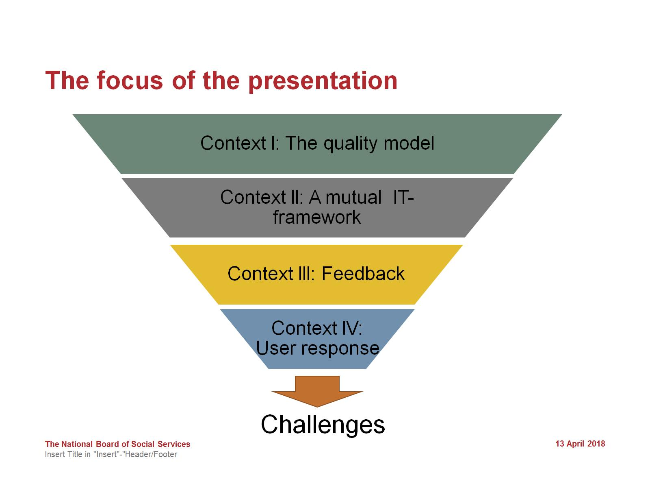
The focus of the presentation

Slide 3
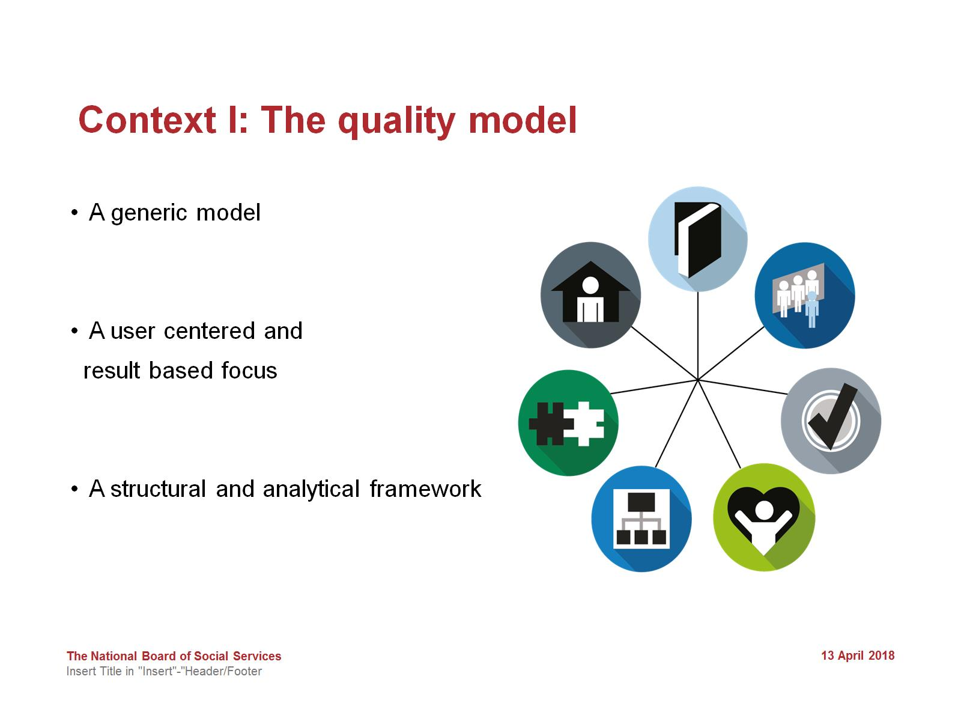
Context l: The quality model

Slide 4
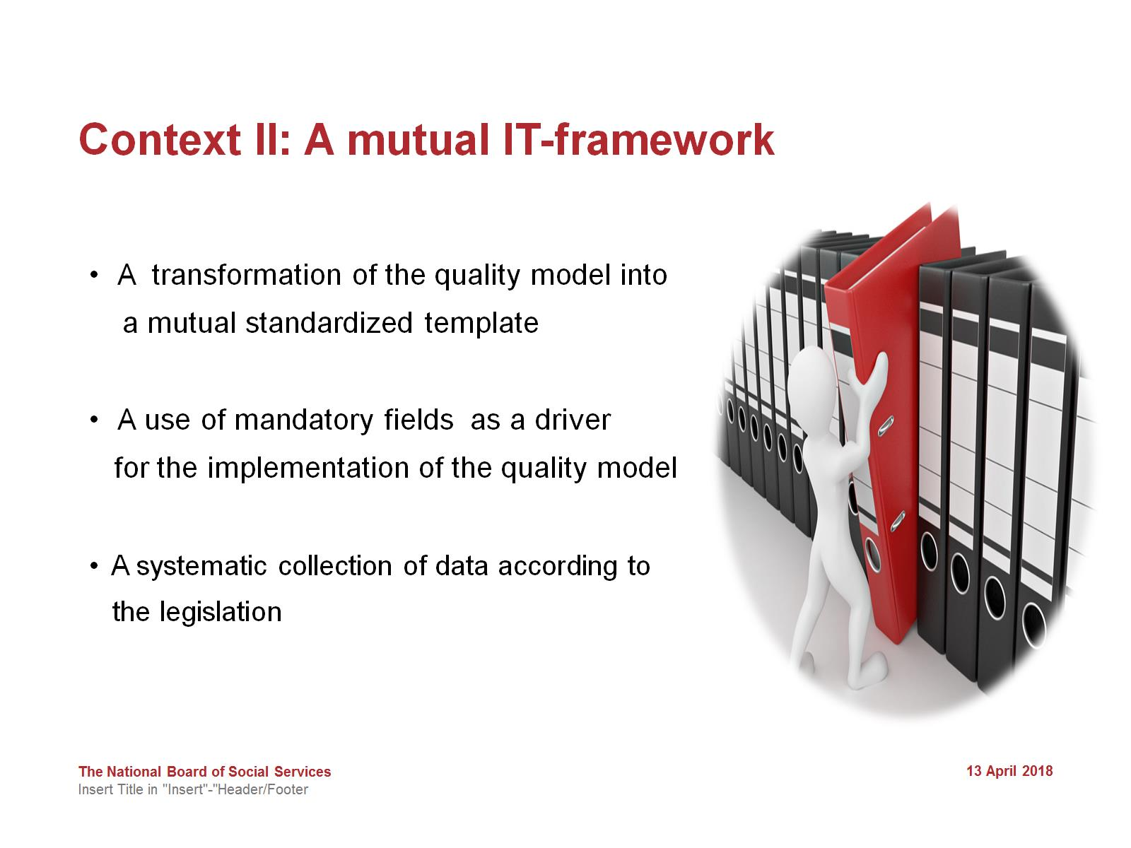
Context ll: A mutual IT-framework

Slide 5
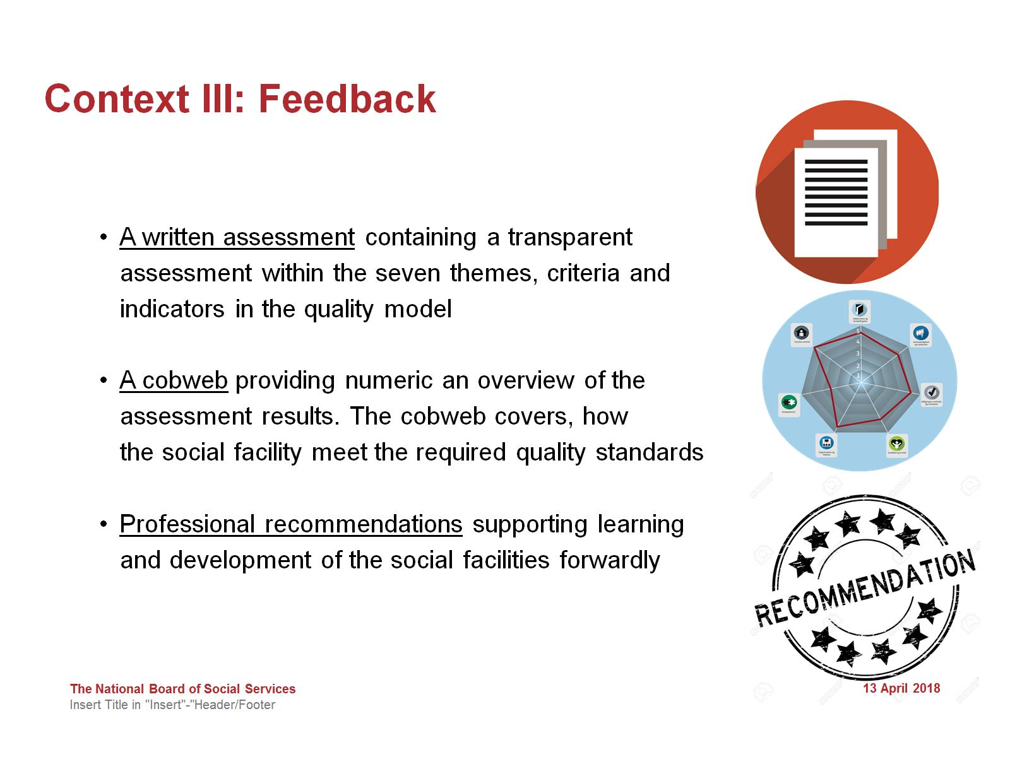
Context lll: Feedback

Slide 6
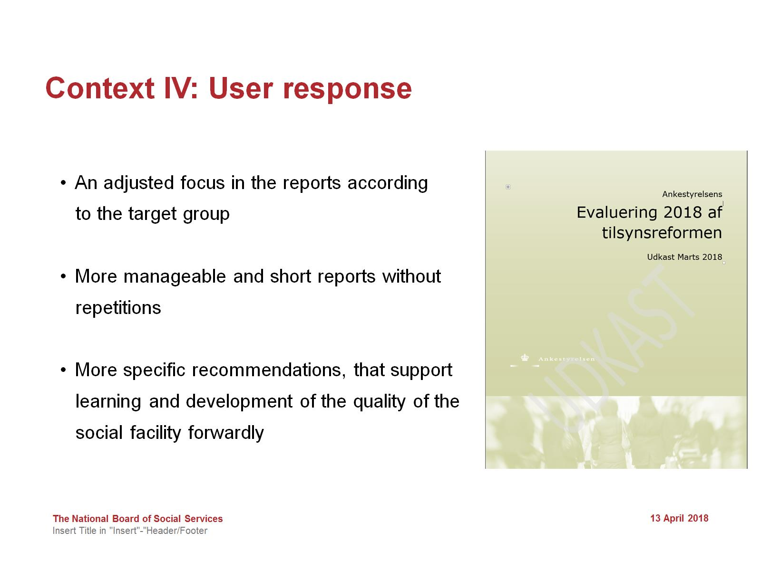
Context lV: User response

Slide 7
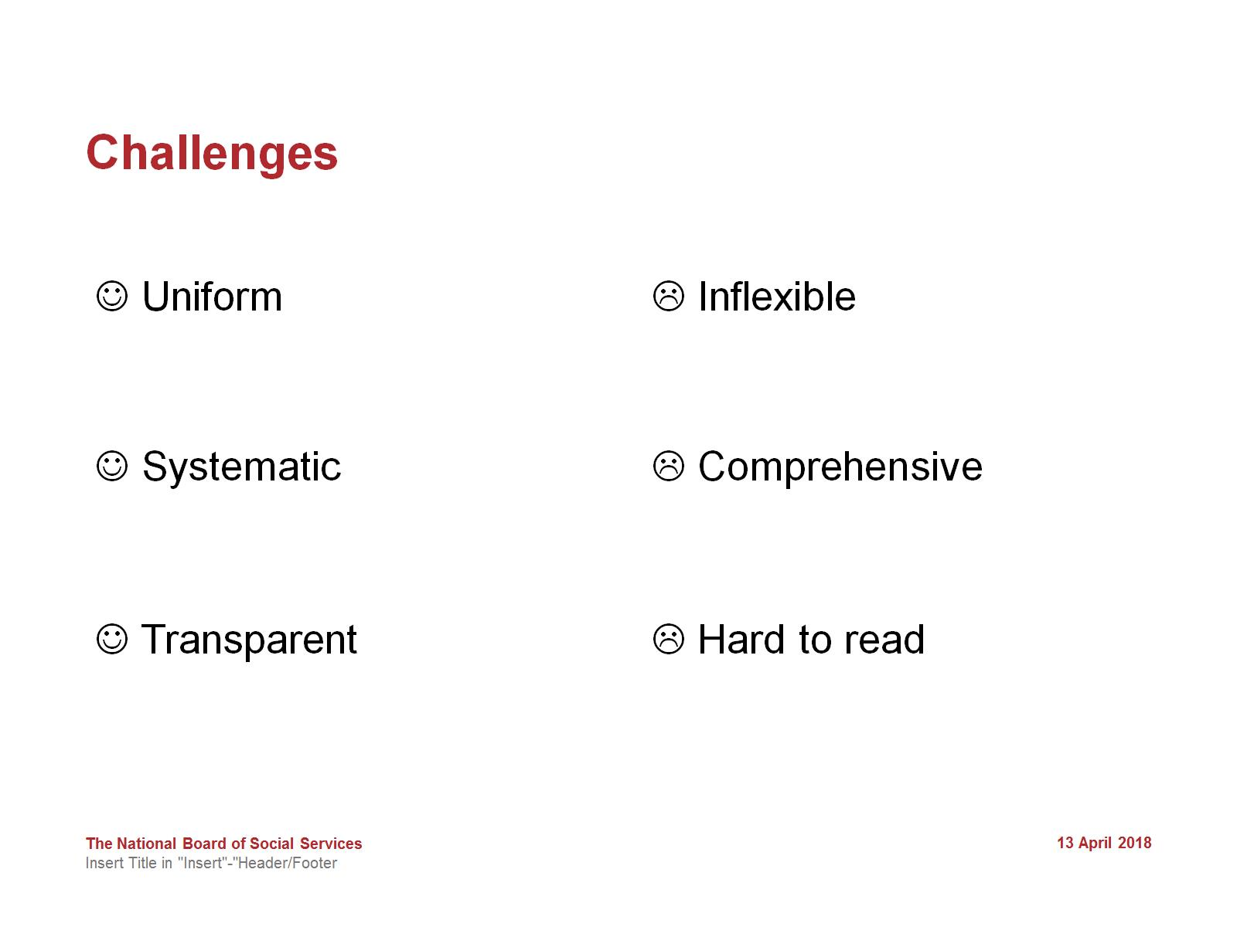
Challenges

Slide 8
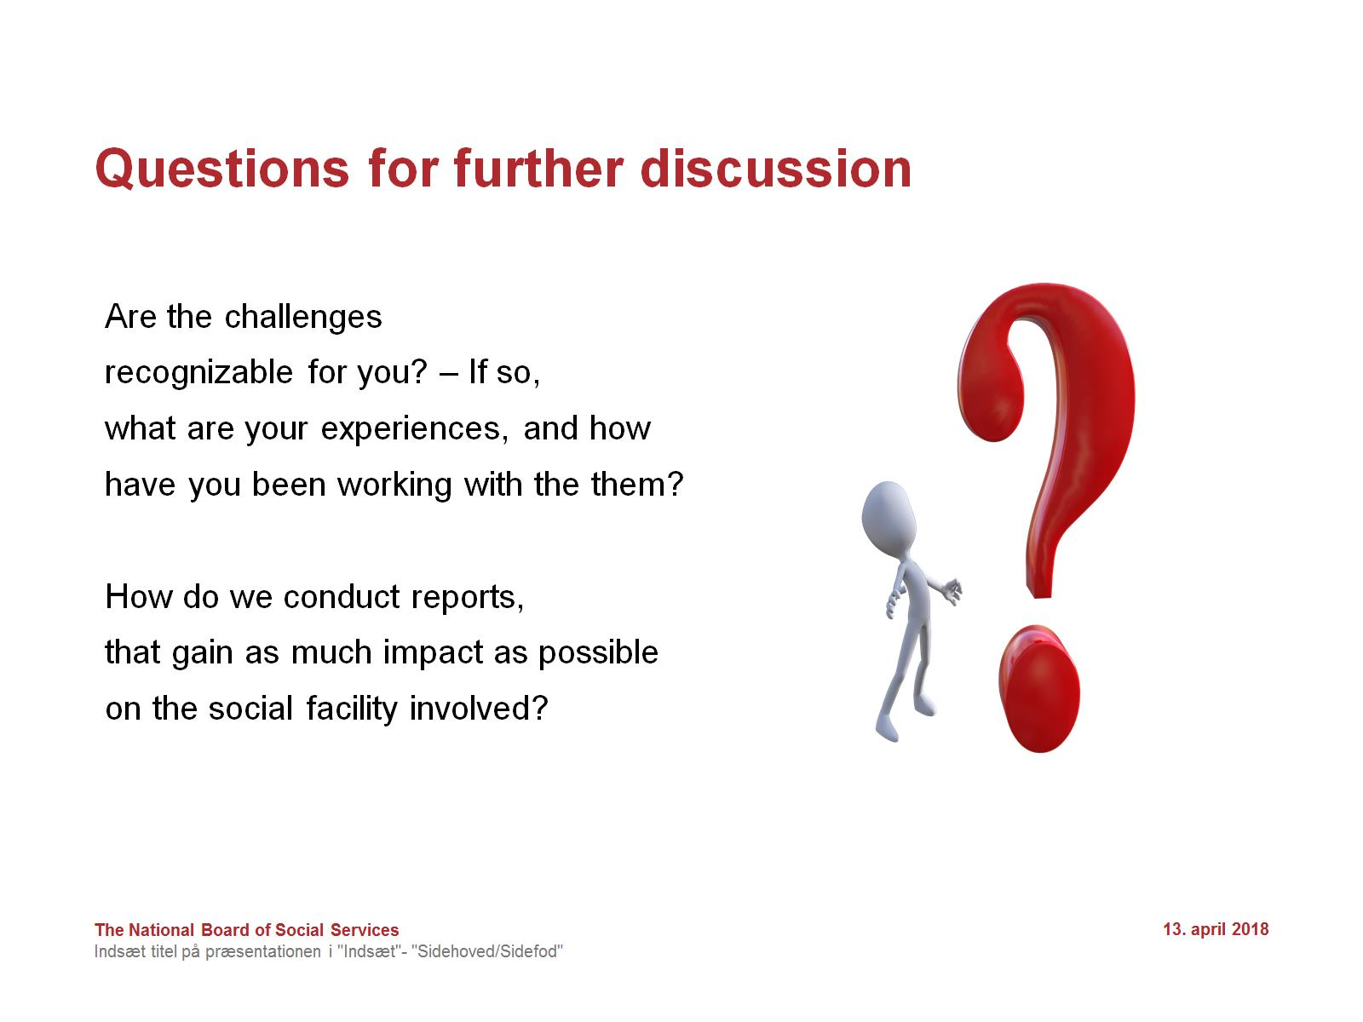
Questions for further discussion

