Slide 1
Latvian Peer Evaluation. Why did we ordered one? 26th EPSO - Conference
Head of Health Inspectorate, Latvia
Indra Dreika
12.10.2018.

Slide 2
Why did we ordered one?
Need for change in:
institution itself (changes in culture, systems and processes, and empowerment of the emploees)
supervision (aims and processes - from inspections and punishment towards analysis and support)
communication (feedback to the society, mass media, stakeholders, clients)

Slide 3
Health Inspectorate Supervision of:
Health sector
(institutional, quality, registers)
Public health sector (higiena, environmental health, water (drinking, swimming)
Market surveillance (medical equipment, chemical goods, cosmetics, liquids)
Pharmaceutical sector

Slide 4
Content of project
Started on 2016
EU Project
Public procurement (2017)
Contracting (May 2018)
Initial review for experts
Peer evaluation
Report and consultations (October 2018)
End up with summary
Neverending process of implementation of changes

Slide 5
Within the European Social Fund co-financed project “Elaboration and Implementation of Health Network Development Guidelines and Quality Assurance System in Priority Health Sectors”
Project procurement: “Expert services in the field of healthcare quality and patient safety”
Procurement in three parts :
- Expert services in the area of medical institution supervision;
- Expert services in the area of patient complaint analysis;
Expert services in assessing the work of Medical Risk Fund.
The purpose of the procurement implementation: to improve the knowledge and skills of the Health Inspectorate and other subordinate institutions of the Ministry of Health in the field of supervision of institutions and examination of patients' complaints, as well as to improve the functioning of the Medical Risk Fund.
The procurement is carried out by the National Health Service and the institutions involved: the Health Inspectorate, the Ministry of Health, the Center for Disease Prevention and Control.

Slide 6
Expert services in the field of healthcare quality and patient safety- Tasks and Schedule of Execution
No | Activity | Results | Time shedule
1. | Get acquainted with and evaluate the relevant section of the analytical material prepared by the Health Inspectorate, provide written suggestions and describe examples of foreign good practice. | Report | Within 8 (eight) weeks from the date when the National Health Service (Client) has sent electronically to the Contractor the analytical material prepared by the Health Inspectorate
2. | Presentation to the Client on the presented proposals and examples of good practice | Presentation materials | Within 3 (three) weeks after submission of the report
3. | Clarify and supplement the report, taking into account the comments received from the Client | Final Report | Within 3 (three) weeks from the day the Customer has electronically sent comments on the report prepared by the Contractor.
4. | Ministry of Health and its subordinate institutions on-site consultations (at least 50 persons in each procurement part) | Consulting materials | Within 3 (three) weeks from the date when the Client has agreed and approved the final report.

Slide 7
Expert services in the field of healthcare quality and patient safety
The decision of the National Health Service Procurement Commission - Foundation Eurinspect proposal was considered appropriate in all three parts of the procurement subject.
Expert team:
Álvaro Moreira da Silva
Andrew Terris
Anette Lykke Petri
Jooske Marijke Vos
Klas Öberg
Mari Amos
Mari Murel

Slide 8
List of Organisations included in the interviews of the Latvian Peer evaluation team Inspectorate from 2-5 July 2018 in Riga
Latvian Health Inspectorate(LHI)
Latvian Minister of Health
Latvian Ministry of Health
National Health Service
Ombudsman of the Republic of Latvia
Latvian Doctors Association
Latvian Hospital Association
Latvian Surgeons Association
Latvian Nurses Association
Latvian Rural Family Doctors Association
Riga Stradina University
Patient representative organisations

Slide 9
Resorces and contribution from Health Inspectorate
Time, work
Audience
Working groups
Willingness to participate, gain knowledges and experience
Evaluation of results
Implementation of accepted suggestions
Everybody has to be involved
Tables and chairs to be moved

Slide 10
Presentations by Stichting Eurinspect on the presented proposals and examples of good practice 27 - 30.08.2018.
Workshop groups 28- 29 August 2018 – 6 themes
1. Positioning of Health Inspectorate - independence
2. Communication with the public, patients and other stakeholders
3. Quality improvement within the supervision (use process and outcome indicators instead of structural indicators)
4. Risk management and risk- based supervision
5. Complaints handling as a source for learning (analysis, triage)
6. Medical Risk Fund
Meeting with stakeholders 30 August 2018

Slide 11
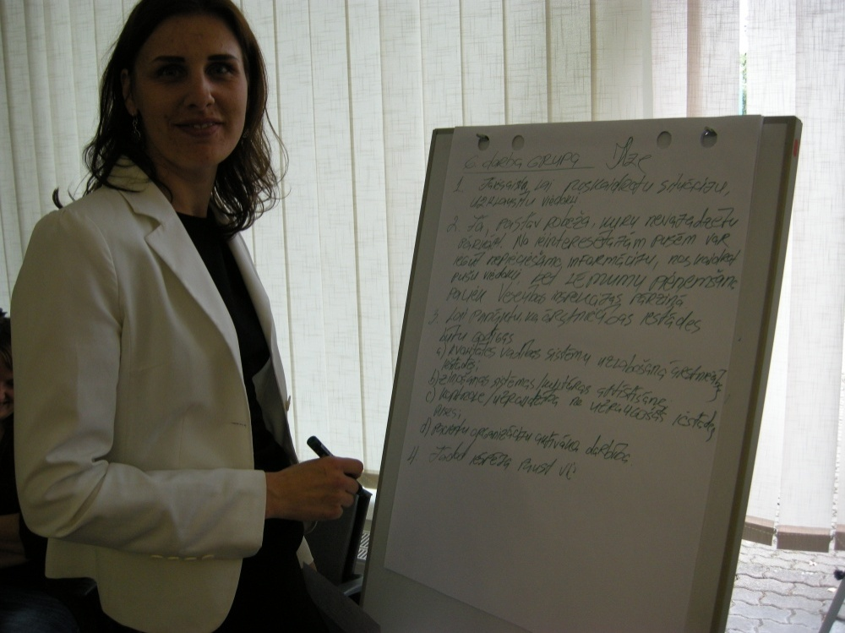
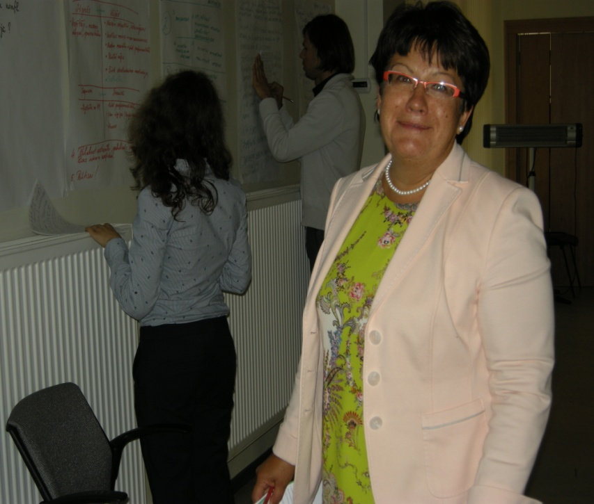
Some photos

Slide 12
Reflections and Recommendations of the Stichting Eurinspect team
1. Re-position the HI as more independent, transparent and accountable entity.
2. Move to more of a learning culture (including thematic review of common and systemic problems).
3. Empower the staff (including continuous education, training and fostering an integrated culture).
4. Improve the image of the inspectorate with the stakeholders and consider re-branding the organisation.
5. Focus on improving the quality and safety of healthcare.
6. Move from compliance to more co-operative methods of inspection to be a trusted partner for stakeholders.
7. Introduce self-assessment as part of the review framework.
8. Introduce better risk-based profiling for prioritisation of inspections and better use of indicators.
9. Redesign the complaints procedure e.g. consider introducing a triage process, categorisation and a mediation step into the process.
10. Improve engagement with health institutions and groups.
11. Externalise the Medical Risk Fund (MRF) function from the Inspectorate.
12. Separate the (expert) function of determining if an MRF case should receive a pay-out from the assessment of the amount to be paid-out. This could include creating a schedule of payment amounts, or ranges based on problem and severity (i.e. remove the subjectivity).
13. Separate the expertise functions of pharmacy from the existing HI general experts.

Slide 13
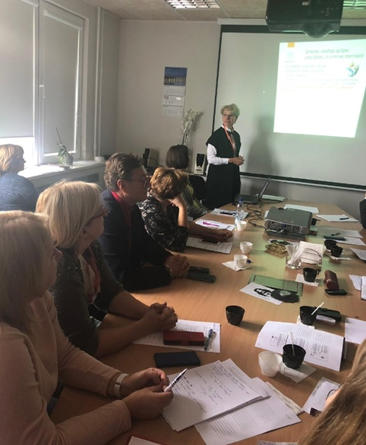
Benefits for the Health Inspectorate
inspiration
new energy
broder views to the existing processes
knowledge from other countries
ideas
new terms and conceptions (triage, complaints versus claims, mediation)

Slide 14
Benefits in more formal aspects
External assessment of the strengths and weaknesses of the Health Inspectorate
Involvement of a large number of Health Inspection staff (workshop groups) in discussion of problems and recommendations identified by Stichting Eurinspect experts
Opportunity to get acquainted with good practice examples from other countries

Slide 15
Changes in health care supervision and control
Three functions of health sector supervision:
- supervision of health care institutions;
handling complaints;
administration of Medical treatment risk fund
are going to be transformed in it’s philosophy and performance
The greatest changes are planned in the methods, principles, approaches and culture of the supervision
Change in attitudes, aims and processes concern all other sectors of supervision

Slide 16
Orientation on supervision not only on compliance to the norms New methods and approaches:
Consultations
Inspector as a consultant
Risk and cause analysis
Self assesment
Assessment of the quality management process in hospitals
Currently in progress, waiting for the feedback
Indicators
Orientation mainly on outcome indicators,
Planning to estabish working groups with stakeholders,
Secondary focus on process indicators,
Focus themes for the next years – oncology, cardiology, rehabilitation, complications during births
Clinical audits

Slide 17
Thematic controls
How the Inspection participates in the process of improving the quality of healthcare
The Patient
Control
Conclusions, proposals
Corrective actions
Check
Healthcare quality improved
Focus on the results/ process
Follow up control/ data in the system
The institutions are making improvements

Slide 18
Triage of complaints
All complaints
Dealing within
Answer based on the documents and information (medical records etc.)
Answer based on the opinion of institution
Overflowed
Comunication issues – to the institution
Concerning state paid healthcare – to the NHS
Imprisoned – to the prison administration

Slide 19
Revision of the Medical treatment risk fund administration/action
In Health inspectorate there has been established a working group which is working on developing proposals on the improvement of the Medical treatment risk fund.
Focus points on following issues:
1) definition of complainant (include or exclude heirs);
2) damages to be compensated (leave or exclude moral hazard);
3) more detailed determination of the amount of damage according to the Appendix 2 of the regulations of Cabinet of Ministers No.1268 «Medical Treatment Risk Fund Rules»;
4) revision of the criteria of determing the amount of the damage (quality of life etc.).

Slide 20
Problems and obstacles
short time for fulfilling peer evaluation;
Control of the process bu Central Finance and Contracting Agency (bureaucracy) - Monitoring the implementation of EU fund projects in Latvia: compliance with the technical specification and compliance with the timetable, achievement of results and financial control;
the need for cultural change in both the Health Inspectorate and the health sector as a whole;
Should all recommendations be implemented?
Will all recommendations be implemented?

Slide 21
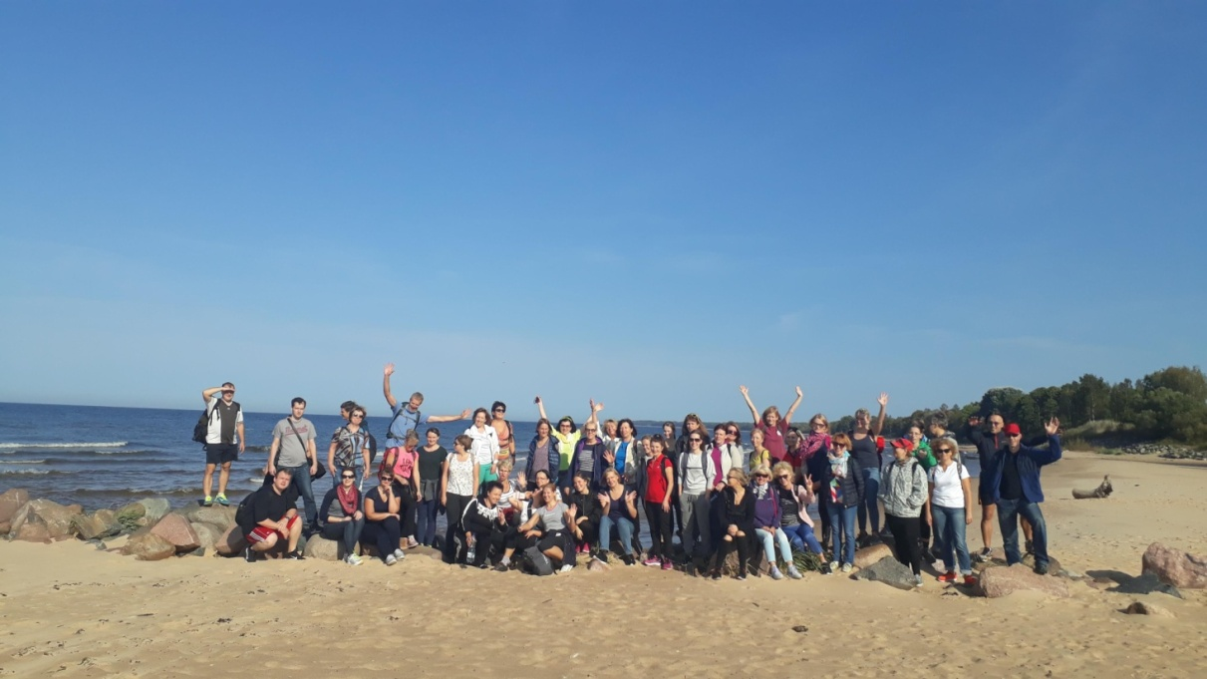
Waiting for new adventures with
Expert Team!
Health Inspectorate, Latvia
12.10.2018.

