Slide 1
EPSO Risk Working Group
Copenhagen 16 April 2018
Self-evaluation and Risk-based Approaches
Kevin Mitchell
Executive Director of Scrutiny & Assurance

Slide 2
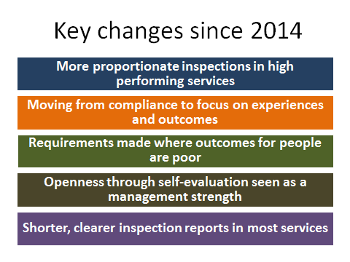

Slide 3
Young Inspection Volunteers
About our Young Inspection Volunteers
We have 13 Young Inspection Volunteers
Aged 18 – 26 years old
All have a personal experience of using care services
We train a new group once or twice per year
Supported to be involved in inspection
Speaking with children and young people
Involved in offering verbal and written feedback to Inspectors and services
On-going support and development opportunities
Notes:
What did you hear?
Did you need to read between the lines with Joe?
This is related to the role you will be doing – listening, recording and looking at other signals. We will explore all of this over the next 2 days.

Slide 4
Risk Based Planning Framework

Slide 5
Poorer performing services
(All service types)

Slide 6
Better performing services
(Service Specific)
– example below illustrates Care Homes

