Slide 1
System analysis – as basis for high level dialogue
Lena Weilandt
Sweden
EPSO 17 April 2018

Slide 2
Background
We sometimes see recurring shortcomings in some organizations
There may be contributing causes to the problem in the manners and incentives, created by the management of the larger organization - where the individual service is a part.
It seems that the individual departments, clinics can not handle or do not own the tools needed to improve
Notes:
It seems that the individual departments, clinics can not handle or do not own the tools needed to improve

Slide 3
We need a system approach to lift shortcomings and areas of improvement from a holistic perspective

Slide 4
System analysis of a County Council - a pilot
The 7 emergency department have had recurrent problems with waiting times
Several severe adverse events, some with fatal outcome
For some departments this has resulted in several inspections and injunctions
But –
Other departments had no problem with waiting times, and few adverse events

Slide 5
IVO wanted to
- get a better understanding of the cause of the recurring shortcomings
- understand why there where differences between hospitals

Slide 6

Supervision on 7 Emergency departments
  IVO:s own Data - Complaints, reported adverse events
  Data from The Patient Advisory Committee
  Inventory of waiting times
  Unannounced inspections
  Patient interviews
  Staff Interviews
  Written questions to the hospital management
  Interview with the County Council Commissioners
  (How they commission emergency care, care agreement, reimbursement, indicators and
  follow up )
Notes:
Collected data from county Council, national Board of health and welfare, County council Auditors

Slide 7
Waiting time Indicator
Lead time from the time the patient is stabilized and diagnosed, to time for admittance to a hospital ward

Slide 8
Waiting time (hours) in emergency departments for patients waiting for a hospital bed week 1-8, 2017
 | ECU 1 | ECU 2 | ECU 3 | ECU 4 | ECU 5 | ECU 6 | ECU 7
Total number of patients v. 1-8 | 5 983 | 10 568 | 10 654 | 16 484 | 13 993 | 3 853 | 14 340
door-to-door time | 3,3 | 5,4* | 4,1 | 5,3 | 4,4 | 2,4 | 2,9
Longest stay until transfer to ward | 12,5 | 26,7* | 20,6 | 34,0 | 32,5 | 0,0 | 4,5
20% of patients waited more than 8 hours in hospital 4
Notes:
Genom att titta bara på medeltider räcker inte för att förstå riskerna. Det är fåtal som väntar länge per vårdplats och det blir farligt för de. Har ni en kontinuerlig uppföljning av den gruppen och hur vanligt är det med de långa väntetiderna? Säsongsvariationer?
Utfallet från Huddinge. Det följs upp kontinuerligt.

Slide 9

Result of the inspections
 | ECU 1 | ECU 2 | ECU 3 | ECU 4 | ECU 5 | ECU 6 | ECU 7
Patient safety risks
Special waiting area
Waiting times
Supervision of patients
Registration of adverse events
Administration of drugs
Routines and areas of responsibilities among staff
Notes:
Risker. Förtydliga varje punkt. Vad står den för och koppla det till vad vi funnit i tillsynen. Det var vad personalen uppgav.
Vad är den största skillnaden mellan sjukhusen?

Slide 10
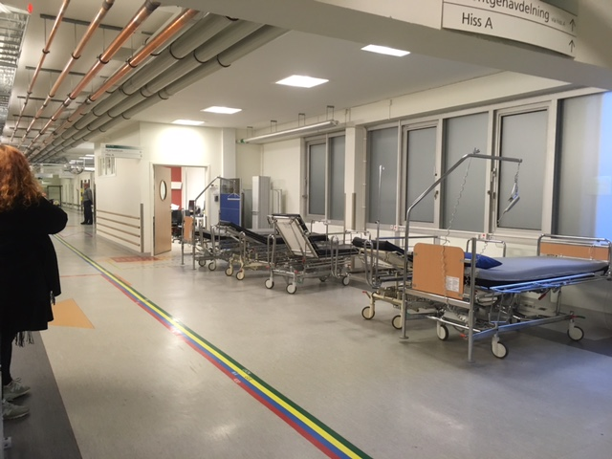
Exit Lounge

Slide 11
Many activities deployed to handle the situation
In the departments
ex. Coordinators, displays, nursing teams, in-house geriatricians, Silver Track for elderly
On hospital level
ex. Intermediary hospital beds for semi-emergent conditions, HR- programs to create incentives to attract and retain nurses
By the commissioners
redirecting ambulances, support coordinated care with municipalities and geriatric clinics

Slide 12
Challenges in the health care system
  Growth of population
  Increased demand of health care
  Increased number of admission to hospital
  Lack of nurses – lack of hospital beds
  Patients ends up in the wrong level of care
  A large scale ongoing structural change to meet these challenges
Notes:
IVO: s genomgång av de utmaningar som verksamheterna och landsting står inför visar på både exceptionell ökning av behov och efterfråga, vårdutbudets påverkan, patienternas förändrade sökmönstren, incitamentets utformning, etc.

Slide 13
The governance of the County Council of Stockholm
- an overwiew
The County Council Assembly
County Council
Ägarutskott
Strategisk styrning och ledning
Personal-utskott
Landstingsstyrelsen
Kommunstyrelse Norrtälje
Landstingshuset i Stockholm AB
Agreements-contracts
Kommunalförbundet Sjukvård och omsorg i Norrtälje
The Commissioner/ Providers
Patientsafetycommitté
Capio-koncernen
KS
SöS AB
DS
AB
SS
AB
TioHundra AB
Capio S:t Göran
Hospitals
Patientsäkerhetsarbete, styrning och ledning av förbättringsarbete
Akutm Hudd
Akutm Solna
Akutm SöS
Akutm DS
Akutm Södert
Akutm TioH
Akutm S:t Göran
Departments
processes, routines, local management, continues improvement
Notes:
För att förstå hur besluten av betydelse för patientsäkerheten i länet fattas och vilken ansvarsfördelning finns har vi ritat en förenklad bild över L&S av PS i länet. Systemets komplexitet kan föreställas med en komplicerad organisationsbild. Det är flera parter som har ansvar för verksamhetens resultat.
Syftet med bilden: Hur tar detta hänsyn till verksamheternas förutsättningar och hur stödjer detta sammantaget verksamheterna att uppnå en hög patientsäkerhet?

Slide 14
One County Council -Three parties – one area of responsibility
The Owner/ Provider:
Policies for recruitment of staff
The Commissioner:
Services surrounding the hospitals
Primary Care – Specialized Care - Geriatric care – Care provided by the Municipalities
Emergency Department
The Hospitals:
Capacity, staff and competence

Slide 15
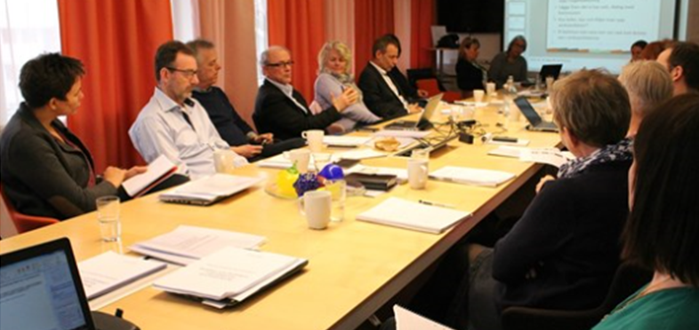
IVO had a dialogue meeting with all parties - representatives from departments, hospital management, head of commissioner and the director of the county council

Slide 16
Discussion - 4 main questions
The same challenges – but very different results. How come?
Many measures - but are they the adequate? How do you evaluate?
You are three parties with different responsibilities– how is this set of keys used together?
Considering the ongoing structural change – how can the patient safety be guaranteed the coming year/ years?

Slide 17
Result of the meeting
Why so different results?
The best hospital have work with continues improvement for many years – with clear structures and processes, including the emergency processes.
Coordinated care with the geriatric care and municipalities to optimise out-flow from the hospitals
Problems for some hospital to adjust elective care to fluctuation in emergency care demand – highly specialised care
Problems with recruiting nurses

Slide 18
Are the measures to handle waiting times adequate?
SAFE
CARE
Identify
Plan
Do
Follow up
Evaluate
Department Level
Hospital Level
Commissioner
A challenge for the leadership at all levels
Notes:
När vi analyserade underlaget och framförallt de vidtagna åtgärderna använde vi oss av en modell för utveckling och ständiga förbättringar, PDSA-cirkeln. Enligt modellen ser vi att ni jobbar aktivt med insatser på alla nivåer
Förändringar och utvecklingsinsatser i det komplexa adaptiva system som sjukvården utgör kräver ständig uppföljning och utvärdering samt analys. Hur ser ni på detta? Hur arbetar ni med detta? Är detta tillräckligt, givet att problemen fortsätter?
(Egenkontroll är systematisk uppföljning och utvärdering av den egna verksamheten samt kontroll av att den bedrivs enligt de processer och rutiner som ingår i verksamhetens ledningssystem. )

Slide 19
The three different keys- how are these used together to support the emergency department?
”We need a common forum to discuss how we can support the emergency departments”

Slide 20
Patient safety – in the short and long perspective?

Slide 21




WHEN YOU NEED ADVICE
CALL 1177
WHEN YOU NEED TO SEE A DOCTOR –
SEE YOUR FAMILY DOCTOR
WHEN YOU HAVE HAD AN ACCIDENT/GOTTEN SUDDENLY ILL
GO TO THE WALK-IN CLINIC
WHEN YOU HAVE A LIFE TREATHENING ACCIDENT OR ILLNESS
GO TO THE EMERGENCY DEPARTMENT

Slide 22
”We expect it to be worse before it get better”

Slide 23
Lesson learned
We acquired new understanding for the underlaying problems
We acted as facilitators
We need to continue to follow up the development regarding the patient safety

Slide 24
THANK YOU!

