Slide 1
Presentation of a Survey of Nordic Supervisory Institutions
Nordisk Tillsynskonferens 2017
Reykjavík
ICELAND
Leifur Bardarson, MD
Head of division
Supervision and Quality
Directorate of Health
28. September 2017

Slide 2
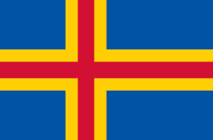
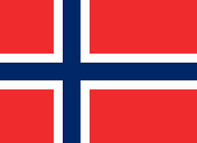
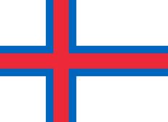
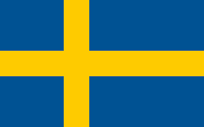
The Nordic Family

Slide 3
Dear Nordic friends, The goal of this survey is a try to map the similarities and dissimilarities of the supervision bodies within the Nordic countries. We hope that the results will help us to point out where the strengths in collaboration of the supervision organisations within the Nordic countries lie and where the weaknesses might be. We will present the results at Tillsynskonferensen in Reykjavik this autumn. It is therefore important that you answer all the questions. If you feel uncertain in your answers please add comments or explanations to the free text boxes.. We hope that the results will help us to point out where the strengths in collaboration of the supervision organisations within the Nordic countries lie and where the weaknesses might be. We will present the results at Tillsynskonferensen in Reykjavik this autumn. It is therefore important that you answer all the questions. If you feel uncertain in your answers please add comments or explanations to the free text boxes.

Slide 4
Question asked
STRUCTURE: 4 question
PROCEDURES: 10 Questions
OUTCOME: 6 Questions

Slide 5
Question asked
How many national supervision organizations are there in your country?
If there are many national supervision organizations within your country, what is the level of cooperatin?
Where there are many organisation do they have common superior except for minister/muncipality
Can higher authority interfere with the work of the supervision organization?
Can higher authority reject/overrule the descision or conclusion of the supervision organization?
What is the purpose og the supervision? Rank the the following in accordance with importance. 1 being the most important
What is the content of the supervision report in general, Rank the following choices in accordance with importance. 1 being the most important
What is the reason for supervision
Are conclusions published officially?
What is the educational background for inspectors?

Slide 6
Question asked
11. Do organizations/law demand special certifications of inspectors?
12. How often is consultation from a specialist outside the organization needed when carrying out inspectio?
13. What is the reason for supervision?
14. Are conclusions from inspection only mnade available to the institution involved?
15. Do supervision organisation have authority to take punitive action against the institions if needed?
16. Can you measure the impact of supervision?
17. Do you have predefined standards to measure the impact of supervision?
18. Do supervision organizations have predefined performance goals to measure the effectiveness of their supervision?
19. Is the impact of the supervision accessed by other indemendant supervision organizations
20. Do reports from organization/s get attention outside the targeted institution such as by mass media or social media?

Slide 7
Answeres from the Survey of Nordic Supervisory Institutions

Slide 8
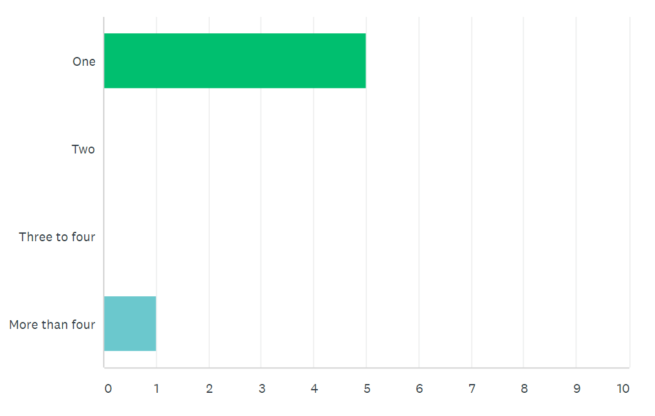
How many national supervision organizations are there in your country?

Slide 9
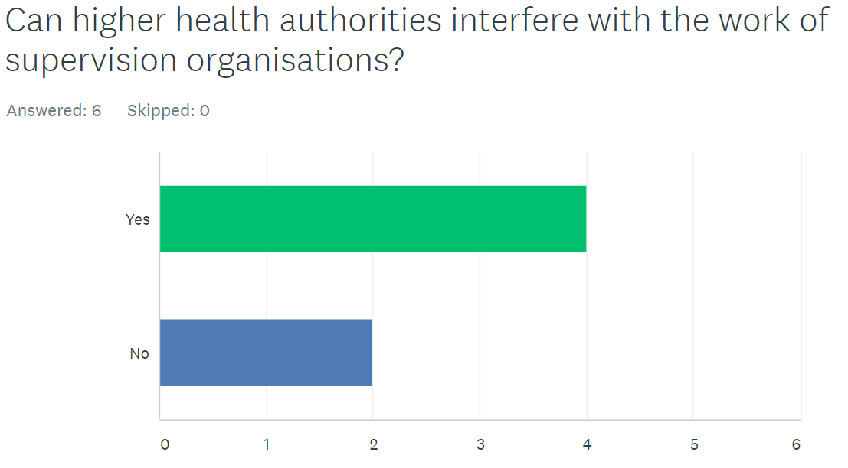

Slide 10
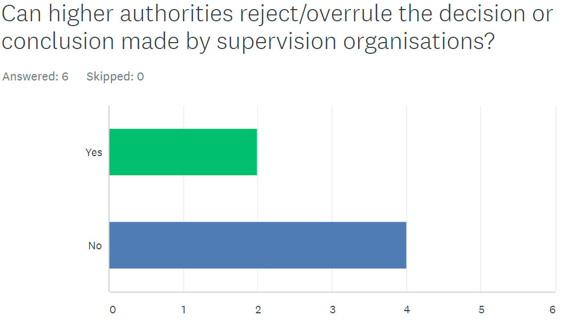

Slide 11
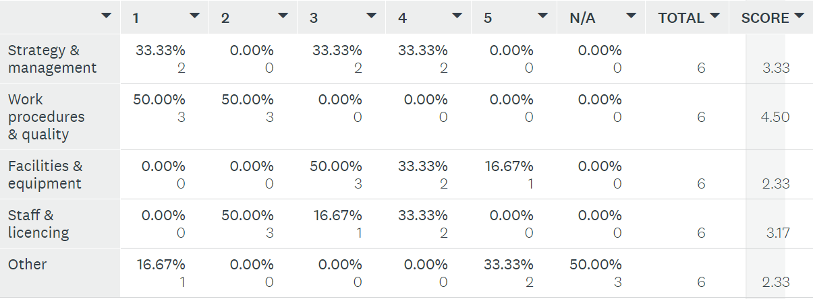
What is the content of the supervision report in general?
Ranked in order of importance (1=most important)
2
1
4-5
3
4-5
Comments:
“Compliance or non compliance with legislation is the most important content”
“The content depends on the target/cause of supervision”

Slide 12
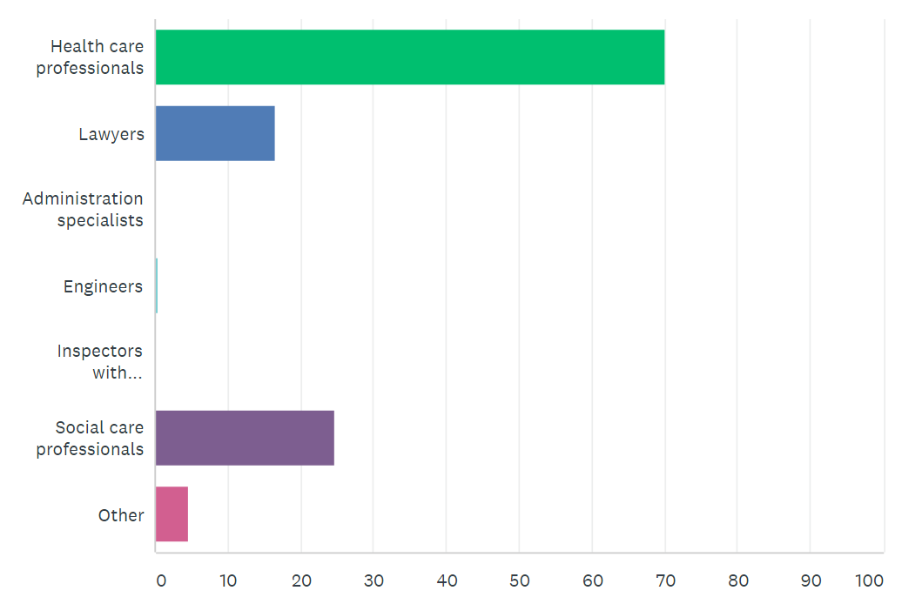
What is the educational background of inspectors?
%

Slide 13
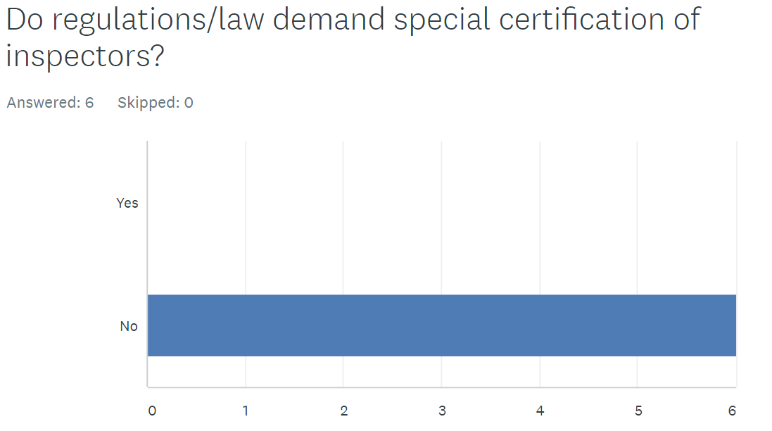

Slide 14
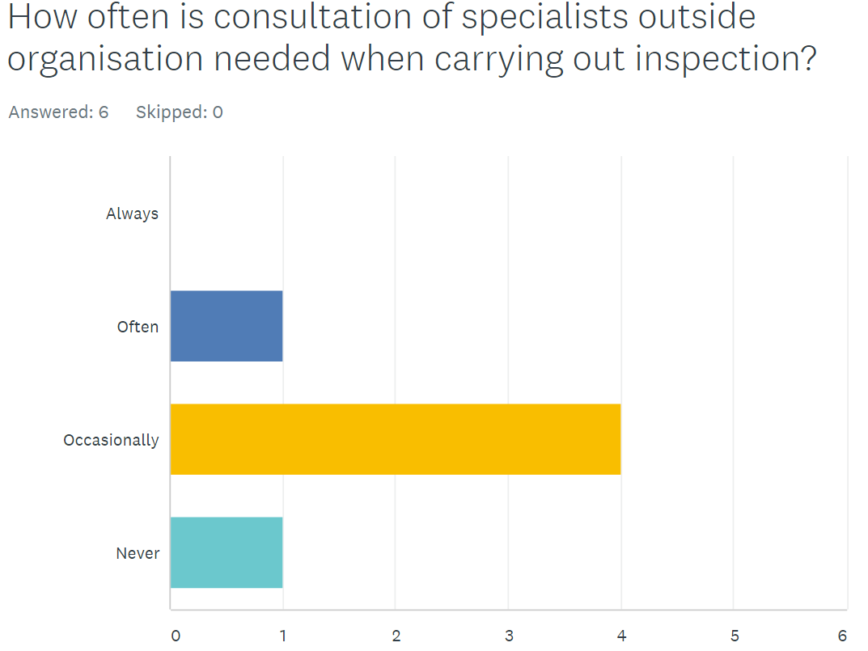

Slide 15
What is the reason for supervision?

Slide 16
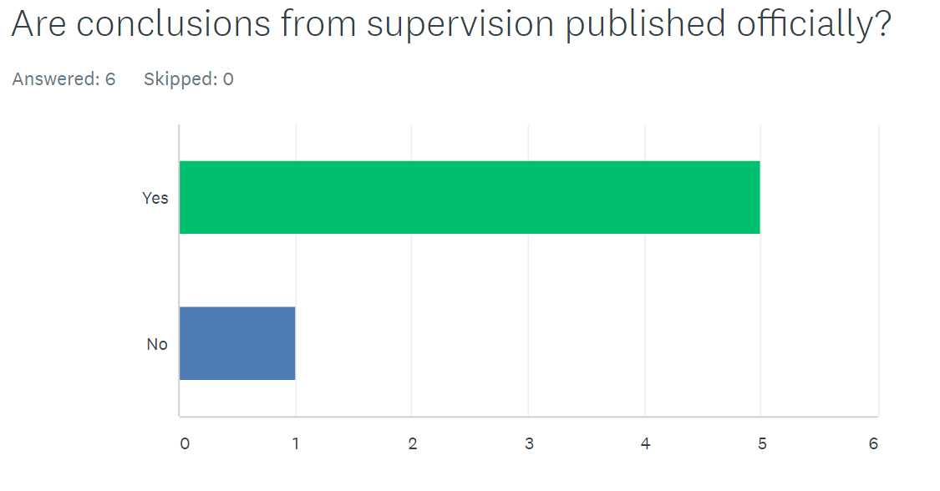

Slide 17
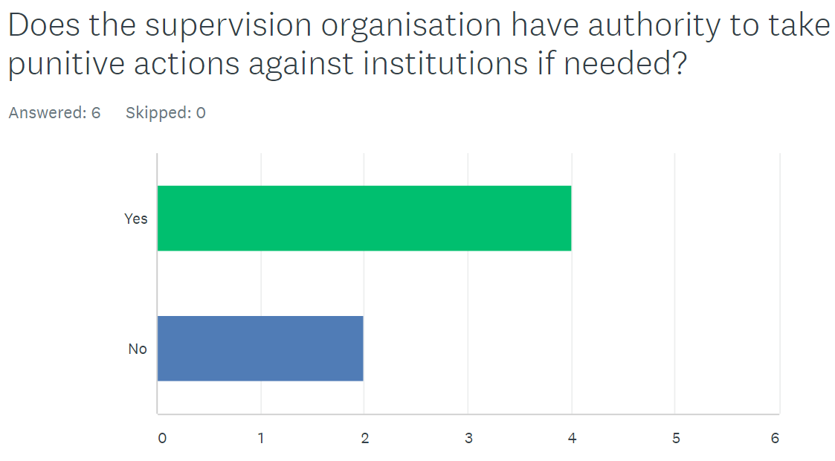

Slide 18
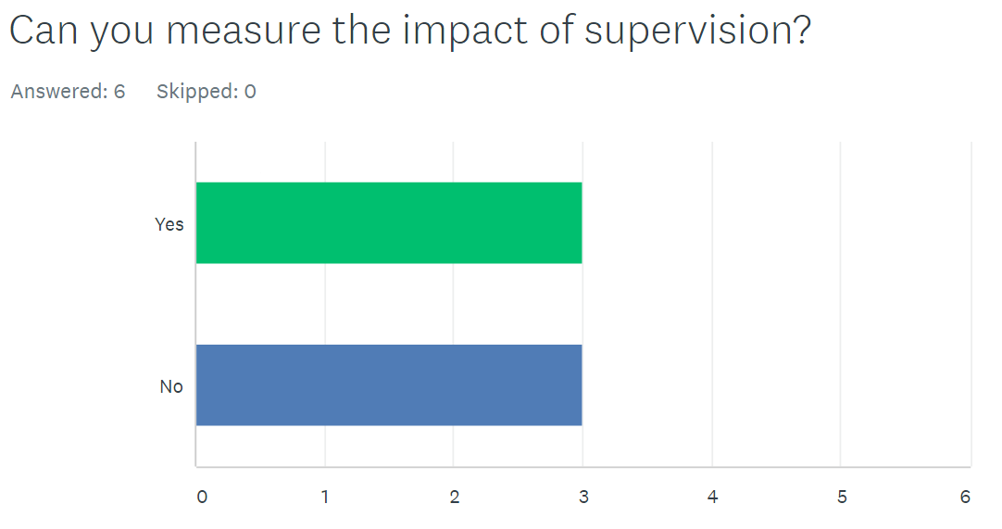

Slide 19
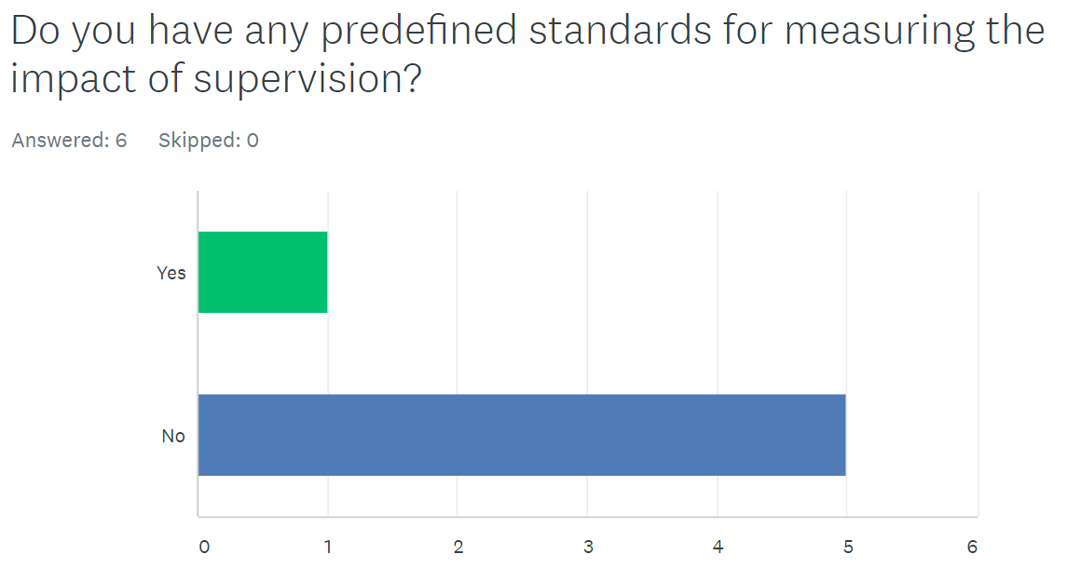

Slide 20
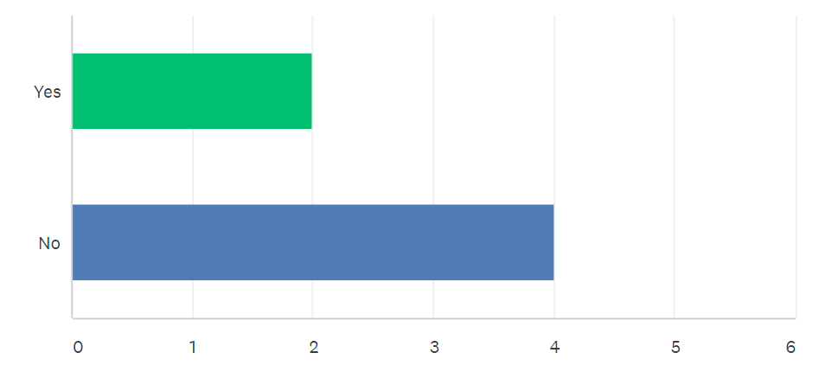
Do supervision organization/s have predefined performance goals to measure the effectiveness of their supervision?

Slide 21
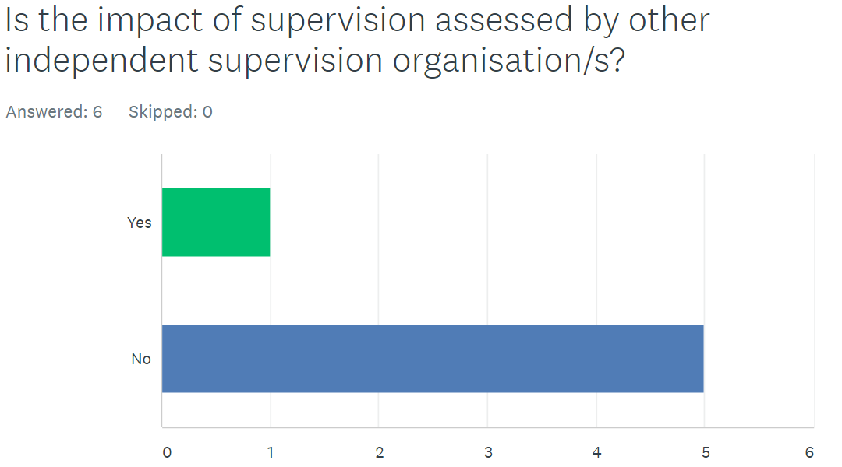

Slide 22
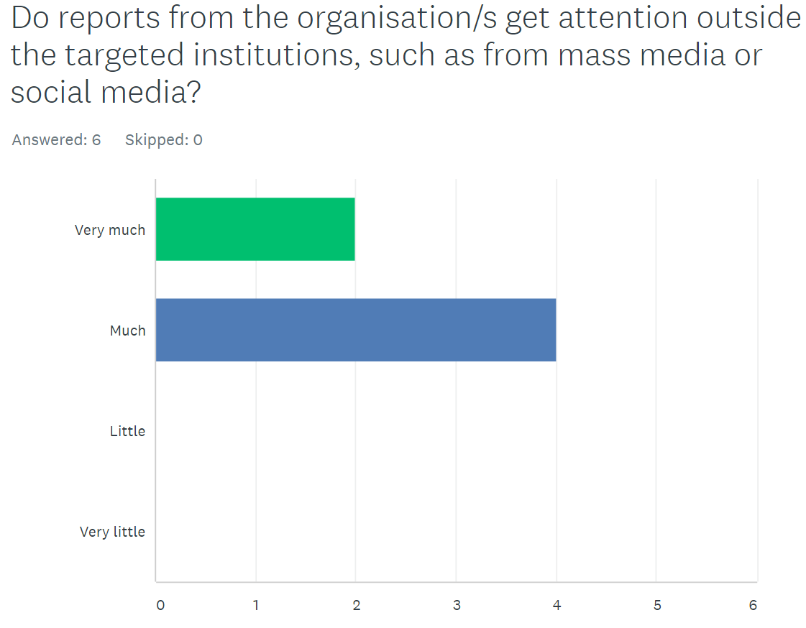

Slide 23
Summary 1
Similarities
Dissimilarties
All except have only one supervision organizations
Social- and health care workers are the mainstay of inspectors
No country demands special certification of inspectors
Only consults outside specialists often
Higher authorities can not reject/overrule the descision or conclusion made by supervision organizations except
Higher health authorities can interfere with the work of supervision organizations except

Slide 24
Summary 2
Similarities
Dissimilarties
All except publish conclusions from supervision officially
No one except has predefined standards for measuring impact of supervision
No one except has the impact of their supervision assessed by other independent supervision organization
Report from organizations in all countries get much or very much attention from mass media
can measure the impact of their supervision
have predifined performance goals to measure the effectiveness of their supervision

Slide 25
The Survey of Nordic Supervisory Institutions
DISCUSSIONS !!

