Slide 1
The EPSO-Balkan Working Group first meeting Bulgaria 2018
Ministria e Shendetësisë
Republika e Kosovës
Ardita Baraku
Health Inspectorate
Ministry of Health, Kosova

Slide 2
Content
Why the EPSO Balkan group
Establishment of the Group
What has been done so far
Difficulties at this stage
The initial aims and expectations

Slide 3
Why the EPSO Balkan Group
Kosovar EPSO experience:
2013-2015: cooperated with EPSO members ¨ (via TAIEX European Commision)
2014: started participation in EPSO Conferences
2015: EPSO membership
2016: 21st EPSO Conference in Prishtina, Kosova
Bulgaria and Turkey occasional participants

Slide 4
Experience with EPSO
”Window of opportunity”
Exchange of information
Learning
New ideas
Cooperation
Peer support
Comparison
...
”Differences”
Type of Problems
Needs
Resources
Local Context
Applicability
Confussion
...

Slide 5
Formal establishment of the Group
January 2018 EPSO Board decided to establish the EPSO Balkan Group
Chaired by Ardita (Kosova),
Deputy Chair Alexandrina (Bulgaria),
supported by Jooske and Mari (the Netherlands)
First meeting of the group is in EPSO Conference in Bulgaria, October 2018

Slide 6
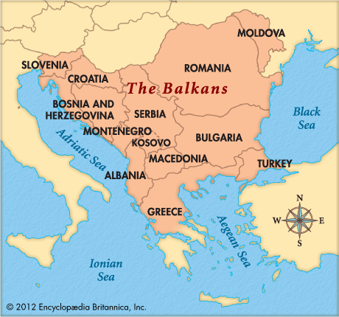
The
Balkan
peninsula

Slide 7
What has been done so far
Phone calls, emails, visits to:
Albania
Austria
Bosnia and Hercegovina
(Bulgaria)
Greece
(Kosovo)
Macedonia (FYROM)
Malta
Montenegro
Romania
Serbia
Slovenia
Turkey
Spring tour 2018 in:
Bosnia and Hercegovina
Albania
Montenegro
Kosovo
Macedonia (FYROM)
Turkey

Slide 8
Difficulties at this stage
As far as the invitees:
Mostly one sided comunication
Knowledge of English Language
Administrative procedures of the countries
Political background
As far as the group management:
Coordination and timing

Slide 9
The initial aims and expectations
Information – Empowerment
Focused exchange of ideas, experiences, learning, new ideas, cooperation, peer support, etc.
Professional/operational cooperation
i.e. Identifying and breaching cross country illegal activities in health area.
Keep the communication at professional level
All countries are wellcome to join.

Slide 10
Faleminderit
Ευχαριστώ
Благодаря
Hvala
teşekkür
Mulțumesc

