Slide 1



The EPSO-Balkan Working Group
Ministria e Shendetësisë
Republika e Kosovës
Ardita Baraku
Health Inspectorate
Ministry of Health, Kosova

Slide 2
Content
Why the EPSO Balkan group
Establishment of the Group
What has been done so far
Difficulties at this stage
The initial aims and expectations

Slide 3

Why the EPSO Balkan Group
Kosovar EPSO experience:
  2013-2015: cooperated with EPSO members ¨ (via TAIEX European Commision)
  2014: started participation in EPSO Conferences
  2015: EPSO membership
  2016: 21st EPSO Conference in Prishtina, Kosova
  2017: Bulgaria joined EPSO Conference

Slide 4
Experience with EPSO
”Window of opportunity”
  Exchange of information
  Learning
  New ideas
  Cooperation
  Peer support
  Comparison
  ...
  ”Differences”
  Type of Problems
  Needs
  Resources
  Local Context
  Applicability
  Confussion
  ...

Slide 5
Formal confirmation of the Group
January 2018 EPSO Board decided to create the EPSO Balkan Group
Chaired by Ardita (Kosova),
Cochaired by Alexandrina (Bulgaria),
supported by Jooske and Mari (the Netherlands)
First meeting planned to be held in Bulgaria in October 2018

Slide 6
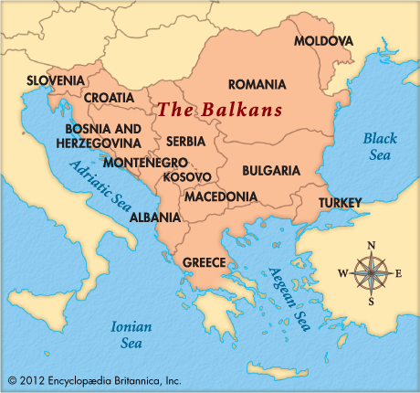
The
Balkan
peninsula

Slide 7
What has been done so far
Phone calls, emails, visits to:
  Albania
  Austria
  Bosnia and Hercegovina
  (Bulgaria)
  Greece
  (Kosovo)
  Macedonia (FYROM)
  Malta
  Montenegro
  Romania
  Serbia
  Slovenia
  Turkey
  Result: majority interested
  Probably joining
  Probably joining
  interested
  Joining
  ?
  Joining
  Probably joining
  Joining as guest
  Joining
  ?
  ?
  Joining
  Joining

Slide 8

Difficulties at this stage
As far as the invitees:
  Mostly one sided comunication
  Knowledge of English Language
  Administrative procedures of the countries
  Political background
As far as the group management:
  Coordination and timing
  Finances?

Slide 9
The initial aims and expectations
Focused exchange of ideas, learning, new ideas, cooperation, peer support,
Professional/operational cooperation
Compliance is our start; Professionalism is our way, Good care is our aim,
Crossways enrich the journey!
All countries are wellcome to join.

Slide 10

Faleminderit
Danke
Благодаря
teşekkür
Grazzi
Hvala

