Slide 1
A Vision on Quality
Towards sustainable change and improvement in the regulation of health and social care: How to manage a sustainable relationship between the supervisor and the service provider?
A new model for regulation
EPSO, Malmö, 2019-09-24
Johan Thor, MD, MPH, PhD
Associate Professor
E-mail: johan.thor@ju.se

Slide 2
WHO on Health Systems
”[H]ealth systems have a responsibility not just to improve people’s health but to protect them against the financial cost of illness – and to treat them with dignity.”
Health systems have three fundamental objectives:
improving the health of the population they serve;
responding to people’s expectations;
providing financial protection against the costs of ill-health.
World Health Organization. The World Health Report 2000: Health Systems: Improving Performance. Geneva: World Health Organization; 2000.

Slide 3
Swedish Healthcare
2 § The goal for the healthcare system is good health and care on equal terms for the entire population. Care should be given with respect for the equal worth and dignity of all individuals. The person with the greatest need for healthcare should be given priority.
The Swedish Healthcare Act (1982:763)

Slide 4
There is Room for Improvement
Patients are harmed by contemporary care
Effective care is not provided consistently
Human dignity is not sufficiently honored
There is widespread waste – inefficiency – in health and social care systems
There is widespread unwanted variation – inequity – in health and welfare; in access to care and to health information

Slide 5
How to manage a sustainable relationship between the supervisor and the service provider?
I won’t offer firm answers but hope to raise some useful questions.

Slide 6

Juran’s Quality Trilogy
Meet patients’, clients’ and other stake-holders’ needs; Evidence-based practice
Monitor performance, feed back to relevant actors, prompt corrective action
Quality Planning
Designing services to meet quality requirements
Quality Control
Managing services to reliably meet quality requirements
Quality Improvement
Changing services to better meet quality requirements
Reduce quality deficiencies; make services more reliable (and less costly)
Joseph Juran
(1904-2008)

Slide 7
Juran’s Quality Trilogy
Where might/should supervision come in?
Meet patients’, clients’ and other stake-holders’ needs; Evidence-based practice
Monitor performance, feed back to relevant actors, prompt corrective action
Quality Planning
Designing services to meet quality requirements
Quality Control
Managing services to reliably meet quality requirements
Compatible with quality standards
Compliance with quality standards
Demonstably functional quality management system
Quality Improvement
Changing services to better meet quality requirements
Reduce quality deficiencies; make services more reliable (and less costly)
Joseph Juran
(1904-2008)

Slide 8
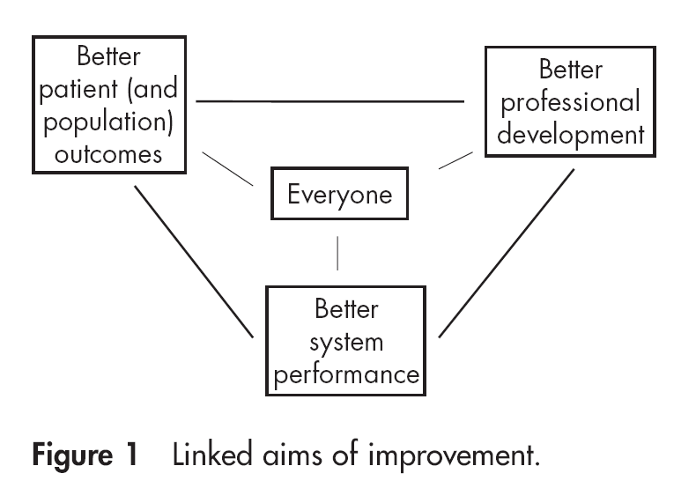
Quality improvement is “the combined and unceasing efforts of everyone — healthcare professionals, patients and their families, researchers, payers, planners and educators — to make the changes that will lead to better patient outcomes (health), better system performance (care) and better professional development”.
Batalden PB, Davidoff F. What is ‘‘quality improvement’’ and how can it transform healthcare? Quality and Safety in Health Care. 2007; 16:2-3.
Better health and welfare
Better professional development, learning, joy in work
Better care

Slide 9

A Model for Improvement
What are we trying to accomplish? (Aim)
How will we know if a change is an improvement? (Measurement)
What changes can we make that will result in improvement? (Change)
A
P
Langley GJ, et al. The Improvement Guide: a Practical Approach to Enhancing Organizational Performance. 2nd ed. San Francisco: Jossey-Bass; 2009.
S
D
Plan-Do-Study-Act

Slide 10

The Art and the Science
Improvement is ”a human and organizational accomplishment”.
Bate P, Mendel P, Robert G, et al. Organizing for quality: the improvement journeys of leading hospitals in Europe and the United States: Oxford ; New York: Radcliffe; 2008.

Slide 11
Regulation and Other Drivers of Quality
How do these affect each other?
How much weight should each driver be given?
Intrinsic Motivation:
Autonomy, Mastery, Meaningful contribution
Regulation and inspection:
Ensure requirements are fulfilled
Litigation/Insurance:
Fear of suits; cost of premiums
Professionalism:
Peer pressure and support; reputation; active research
Market Mechanisms:
Providers strive to attract business by offering good value for money
Public Reporting:
Promote learning and trust

Slide 12

Striking the Right Balance
What are the pros and cons of these approaches? How do you strike the right balance between them?
Ensure compliance with quality standards
Inspector looks for performance in line with quality requirements; demands remedial action regarding substandard performance
Promote continuous improvement
Inspector looks for presence of quality management system; its effectiveness in terms of good performance and continuous improvement

Slide 13
Trust and Supervision
Whose trust do you seek?
How do you optimize the balance of trust among stakeholders?
Politicians/ decision-makers
Patients
The Public
Supervisory Inspectorates
Regulators
Health professionals
Payers
Health care organizations

Slide 14
Which is the optimal allocation of resources for regulation and inspection to achieve the objectives of good health, good care and public confidence?
A
Health services regulation and supervision/inspection:
Impact – Cost – Unintended consequences
B

Slide 15
How might you define and demonstrate the utility of supervision?
Utility of supervision
Desirable direction
Cost of supervision
Potentially harmful
What constitutes the cost of supervision?

Slide 16
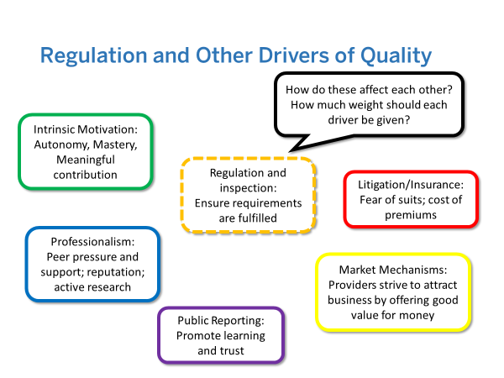
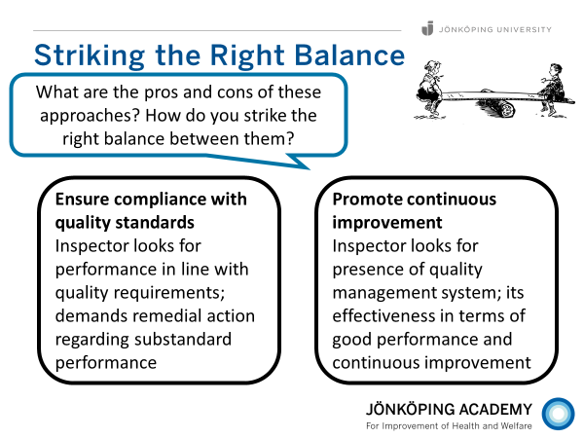
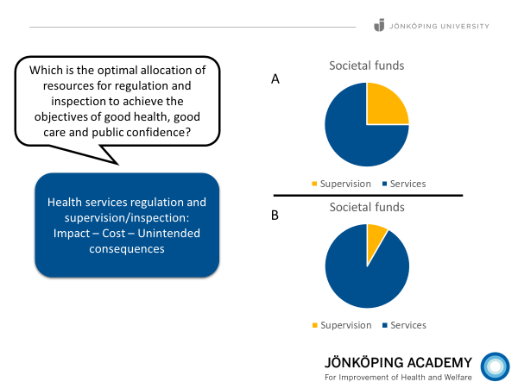
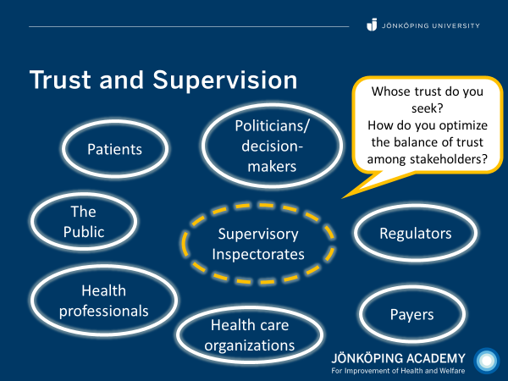
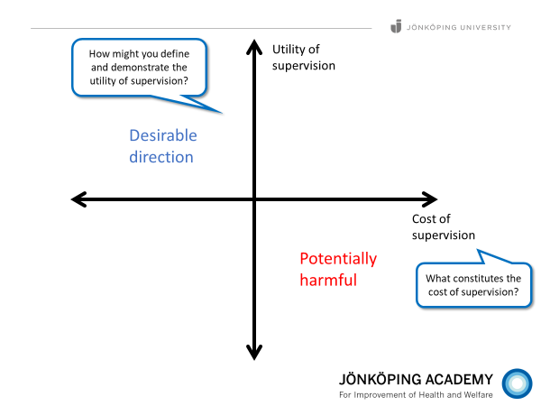

Slide 19
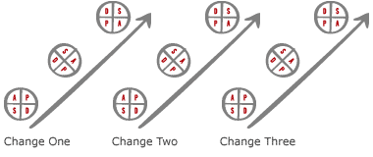
Safety and QI – Integrated or Separate?
Performance capability
Threshold – basic requirements for operation
www.ihi.org

Slide 20
A healthcare process:
”The series of activities we typically carry out when we care for different types of patients”
Diagnosing Therapy Nursing care Palliation

Slide 21
Prevention
Cure
Coping
Diagnosing Therapy Nursing care Palliation
Relief
Explanation
(Re)habilitation

Slide 22
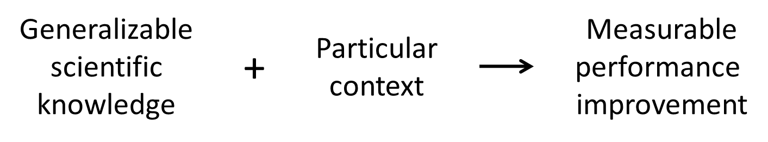
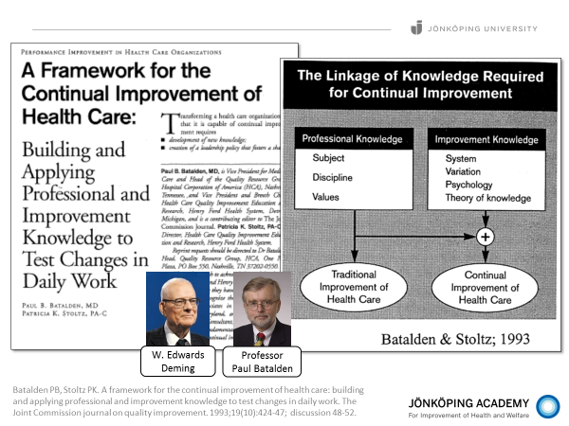
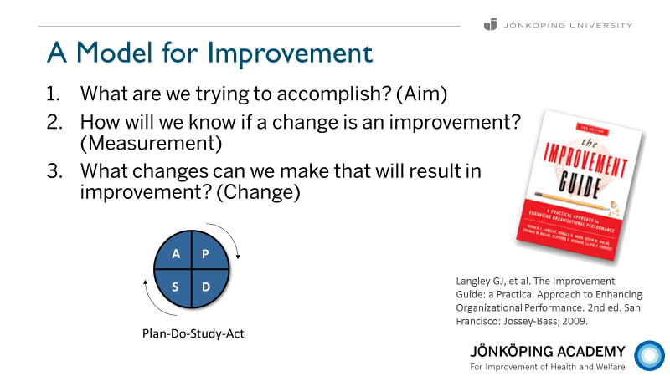
Quality measurement is central to improvement.
Batalden PB, Davidoff F. What is "quality improvement" and how can it transform healthcare? Qual Saf Health Care. 2007;16(1):2-3.
Batalden PB, Stoltz PK. A framework for the continual improvement of health care: building and applying professional and improvement knowledge to test changes in daily work. The Joint Commission journal on quality improvement. 1993;19(10):424-47; discussion 48-52.
Deming WE. Out of the crisis. Cambridge, Mass.: Massachusetts Institute of Technology, Center for Advanced Engineering Study; 1986.
Langley GJ, Moen R, Nolan KM, Nolan TW, Norman CL, Provost LP. The Improvement Guide: A practical approach to enhancing organizational performance. 2nd ed. San Francisco: Jossey-Bass; 2009.

Slide 23
Measurement and Improvement
“Reliable measurement [of quality indicators] is important for the ability to conduct, and evaluate, improvement efforts.”
Thor J. Getting Going on Getting Better: How is Systematic Quality Improvement Established in a Healthcare Organization? Implications for Change Management Theory and Practice. [PhD-thesis] Stockholm: Karolinska Institutet; 2007, p. 25.
Available electronically at:
http://diss.kib.ki.se/2007/978-91-7357-274-3/

Slide 24
Three Dimensions of Quality
Buildings, equipment, human resources
Structure
Outcomes of health and care services
Process
Activities; what we do in health and care
Outcome
Donabedian A. Evaluating the quality of medical care. 1966. Milbank Q. 2005;83(4):691-729.

Slide 25
Example: Diabetes Care
Availability of photographic eye examination
Structure
Maintained eye sight; incidence of retinopathy
Process
Regular eye examination; laser treatment when needed
Outcome

Slide 26
Berwick DM, James B, Coye MJ. Connections between quality measurement and improvement. Med Care. 2003 Jan;41(1 Suppl):I30-8.

Slide 27

Measurement and Improvement
Not all purposes with quality measurement can be satisfied with the same measurements – some purposes are incompatible and need to be addressed separately

Slide 28
Counterproductive mixing
”We are increasingly realizing not only how critical measurement is to the quality improvement we seek but also how counter-productive it can be to mix measurement for accountability or research with measurement for improvement.”
Improvement
Research
Accountability
Solberg LI, Mosser G, McDonald S. The three faces of performance measurement: improvement, accountability, and research. Jt Comm J Qual Improv. 1997 Mar;23(3):135-47.

Slide 29
Dimensions of goodness
Who can do what, where and how?
Safety
Timeliness
Effectiveness
Efficiency
Equity
Patient-
Centeredness
What do/ will you do?
Committee on Quality of Health Care in America, Institute of Medicine. Crossing the Quality Chasm: A New Health System for the 21st Century. Washington, DC, USA: National Academies Press; 2001

Slide 30
Suggested Literature
Batalden PB, Stoltz PK. A framework for the continual improvement of health care: Building and applying professional and improvement knowledge to test changes in daily work. The Joint Commission Journal on Quality Improvement. 1993; 19 (10):424-47.
Berwick DM. Controlling variation in health care: a consultation from Walter Shewhart. Med Care. 1991;29(12):1212-25.
Berwick DM. A primer on leading the improvement of systems. BMJ. 1996 Mar 9;312(7031):619-22.
Batalden PB, Davidoff F. What is ‘‘quality improvement’’ and how can it transform healthcare? Quality and Safety in Health Care. 2007; 16:2-3.
Staines A, Thor J, Robert G. Sustaining improvement? The 20-year Jönköping quality improvement program revisited. Qual Manag Health Care. 2015;24(1):21-37.

Slide 31
Suggested Literature
Langley GJ, et al. The Improvement Guide: a practical approach to enhancing organizational performance. 2nd edition. San Francisco: Jossey-Bass; 2009.
Nelson EC, Batalden PB, Godfrey MM. Quality by design: a clinical microsystems approach. 1st ed. San Francisco: Jossey-Bass/Wiley; 2007.
Bate P, Mendel P, Robert G, Nuffield Trust. Organizing for quality: the improvement journeys of leading hospitals in Europe and the United States. Abingdon: Radcliffe; 2008.
Batalden PB, Foster T, (eds). Sustainably improving health care: creatively linking care outcomes, system performance, and professional development. London: Radcliff; 2012.
Walshe, K. and J. A. Smith, Eds. (2016). Healthcare management. London, McGraw-Hill Education/Open University Press.

Slide 32
Quality – attributes of a product or service; its degree of “goodness”
Quality is partly subjective, “in the eye of the beholder”, and influenced by context. So, what is “good quality” will differ across individuals and contexts.
Minimum quality requirement

