Slide 1
How can a regulator encourage innovation? Tim Atkins, Head of Strategy, Care Quality Commission

Slide 2
Why does CQC want to encourage innovation?
CQC’s purpose
“We make sure health and social care services provide people with safe, effective, compassionate, high-quality care and we encourage care services to improve.”
Innovation has been an important driver of higher quality in the past and is likely to be in the future.
So more and better innovation in health and social care can help to achieve our purpose.
Our current strategy sets out a strategic priority to encourage innovation.

Slide 3
Where are we now and where do we want to be?
The current situation…
Our objective…
We don’t always do a good job of assessing quality of innovative care
Consistent assessments of the quality of care
Inconsistent messages to providers
Clear and consistent messages that promote innovation
We equate novelty with outstanding practice
Adoption is valued as highly as invention
We don’t reward providers that are good at innovating – only those whose innovations succeed
Safe failure is accepted as part of the innovation process and not penalised

Slide 4
We are doing three things to try to change it
Piloting “sandboxing”
This is a concept based on the work of the Financial Conduct Authority (FCA) that tries to work more proactively and collaboratively with new types of service to learn more quickly how to regulate them effectively.
Defining good innovation
Defining more clearly what we mean when we say innovation, and working with the health and social care system to articulate what good looks like for innovation in care providers.
Improving our consistency
Internal Quality Improvement work to understand what our inspectors need to support them to make consistent judgements about innovative care, and develop appropriate tools and guidance.

Slide 5
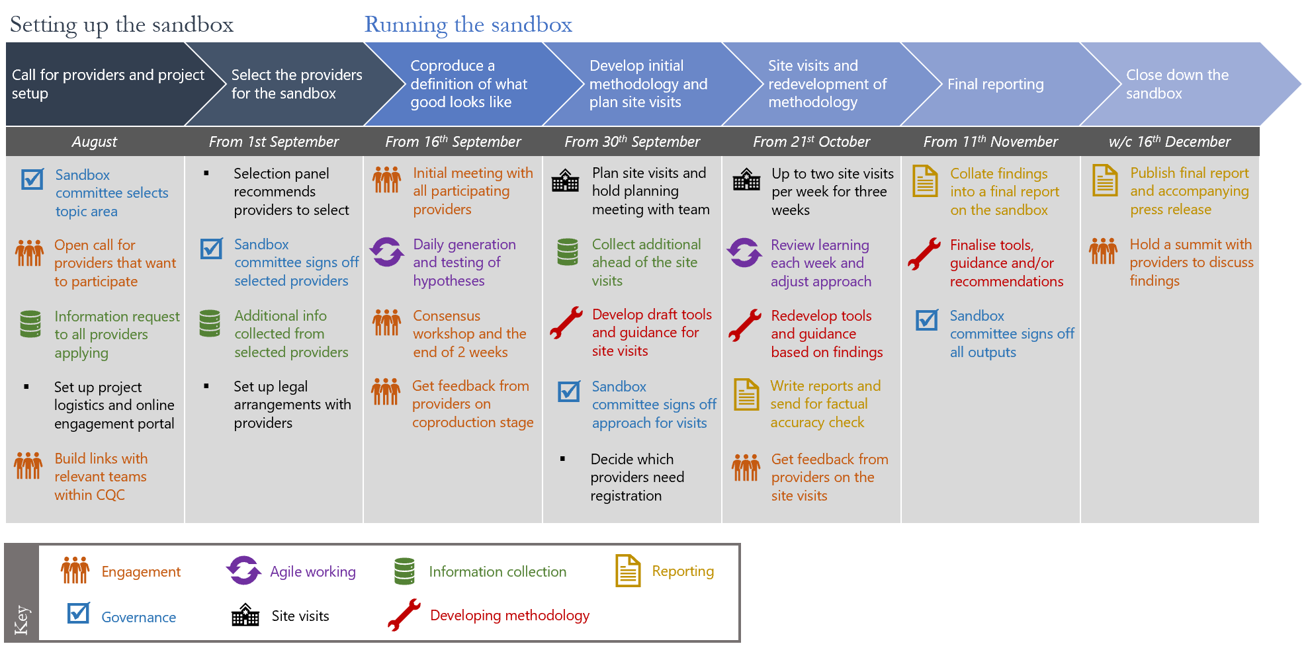
Process and timeline for first pilot sandbox on “digital triage”

Slide 6
Defining good innovation
Innovation is already included in our inspection frameworks…
KLOE W8: Are there robust systems and processes for learning, continuous improvement and innovation?
W8.1 In what ways do leaders and staff strive for continuous learning, improvement and innovation? Does this include participating in appropriate research projects and recognised accreditation schemes? W8.4 Do all staff regularly take time out to work together to resolve problems and to review individual and team objectives, processes and performance? Does this lead to improvements and innovation? W8.5 Are there systems to support improvement and innovation work, including objectives and rewards for staff, data systems, and processes for evaluating and sharing the results of improvement work?
But we’ve never defined what it means or what good looks like
As a result it’s not usually picked up on inspection – since our inspectors don’t know how to assess it
We do sometimes recognise invention but not adoption
Penalising failure per se can discourage innovation

Slide 7
Our current draft definition of good innovation focuses on five themes
1. Focus on outcomes and the needs of users
4. Take a flexible approach to managing projects
Understand the problem, use and build evidence, co-produce, test early and focus on outcomes
Take a chance on the best ideas, plan to adapt, manage contractual relationships well, fail well, flexible resourcing
2. Create (or borrow) new ideas and connections
5. Develop the right skills and capabilities
Elicit ideas internally, learn from other organisations, think broadly, make connections
Involve the right people, consider training needs, develop innovation capabilities, supportive corporate processes
3. Foster a culture that supports innovation
Set an organisational vision, give permission, celebrate success, don’t penalise failure, manage conflict

Slide 8



Improving our consistency
Developing and testing guidance for our inspectors on how to assess new and innovative approaches to care.
Establish a network of technology and innovation champions who can support colleagues and build organisational knowledge,
Reviewing our information and data requests from providers to see if we can incorporate more on technology and innovation

Slide 9
Questions for other regulators
Do you aim to encourage innovation? Do you have a similar/different view of it to CQC?
Have you tried anything similar to our “sandbox”? What was your experience?
Do you have a working definition of innovation? Do you know what good looks like?
How do you support your people to deal with new approaches to care they haven’t seen before?

