Slide 1
Budget and Personnel allocation and prioritisation of inspection activities in Croatia
Republic of Croatia
Ministry of Health
Independent Sector for Health Inspections
Vesna Sokol, DMD
Bojana Budimir, LLM
Ante Čović, LLM, MBA

Slide 2
Independent Health Inspection Sector
SECTOR
Health Inspection
Health Inspection for BTC
Pharmaceutical inspection
5 inspectors:
5 inspectors:
4 inspectors:
3 lawyers
2 DMDs
1 sanitary engineer
1 MD
4 biologists
3 biologists
1 chemist
Law on Health Care
The Law on Medicines

Slide 3
Budget - the role of the Independent Sector
Makes sure that any expense is justified
Participates in budgeting within its scope of work
04
01
Sector
Participates in the development of a budget for the professional supervision of professional chambers
Monitors and analyzes budget execution
03
02
Notes:
© Copyright PresentationGO.com – The free PowerPoint template library

Slide 4
Budget planning
Ministry of Health Strategic Plan
Annual monitoring plan for each chamber
A two-year plan that sets out the vision, mission, goals.
Strategic plan
Chambers
BUDGET
An annual monitoring plan for each chamber of expertise is defined. Chambers adopt an annual monitoring plan for which the Ministry plans a budget.
Ministry's Annual Work Plan
Annual work plan for each unit.
Annual plan

Slide 5
The Ministry's Strategic Plan defines:
How to achieve general and specific goals
Target values.
Result indicators
Vision, mission, general and specific goals
Relation with financial plan
Strategic plan
Notes:
© Copyright PresentationGO.com – The free PowerPoint and Google Slides template library

Slide 6
Inspection Control Objectives Defined
Specific objectives
GENERAL OBJECTIVE
Protection, preservation and promotion of health
More accessible healthcare.
More efficient management of financial resources.
Protection of public health interest
Health care quality system developed
Notes:
© Copyright PresentationGO.com – The free PowerPoint and Google Slides template library

Slide 7
Result indicators
request/
Regular
inspections
corrective
measures
Accusative
motions
inspections
Number
Number
Number
Ratio
Notes:
© Copyright PresentationGO.com – The free PowerPoint and Google Slides template library

Slide 8
Inspection - Annual PLAN
Risk assessment
Requests from other bodies
State Attorney's Office, Ministry of Internal Affairs - for possible professional omissions and possible criminal offense of malpractice.
Specific laws
Notes:
© Copyright PresentationGO.com – The free PowerPoint and Google Slides template library

Slide 9
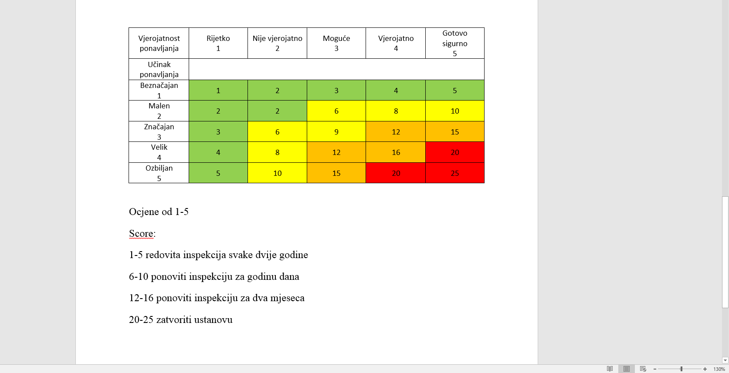
Risk assessment - BTC

Slide 10
Thank you!

