Slide 1



The EPSO-Balkan Working Group second meeting Portugal 2019
Ministria e Shendetësisë
Republika e Kosovës
Ardita Baraku
Health Inspectorate
Ministry of Health, Kosova

Slide 2
Content
The establishment of EPSO Balkan group
The initial aims and expectations
Members
Difficulties so far
Attraction of new members

Slide 3
The establishment of the EPSO BWG
January 2018 EPSO Board decided to establish the EPSO Balkan Working Group (BWG)
Chaired by Ardita (Kosova), Deputy Chair Alexandrina (Bulgaria), supported by Jooske and Mari (the Netherlands)
First meeting of the group held during EPSO Conference in Bulgaria, October 2018

Slide 4
The initial aims and expectations
Information – Empowerment
  Focused exchange of ideas, experiences, learning, new ideas, cooperation, peer support, etc.
Professional/operational cooperation
  i.e. Identifying and breaching cross country illegal activities in health area.
Keep the communication at professional level
All countries within/outside Balkan geographical area are wellcome to join.

Slide 5
Members
Phone calls, emails, visits to the designated 13 countries
Out of 13 countries, official members in 2019 are:
  Kosovo
  Montenegro
  Turkey
  Albania
Bulgaria?- being reorganised
Croatia?- to be decided

Slide 6
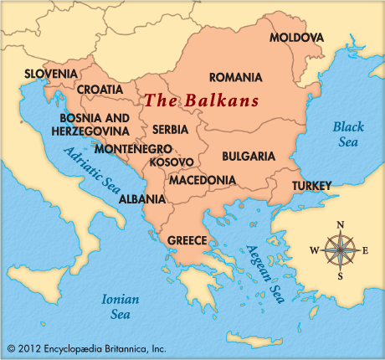
The
Balkan
peninsula

Slide 7

Difficulties so far
As far as the invitees:
  Mostly one sided comunication
  Knowledge of the English Language
  Administrative procedures of the countries
  Political background
As far as the group management:
  Coordination and timing

Slide 8
Attraction of new members
Regional Meetings
Teleconference
Cooperation for training
Joint funding programe
Discussion:
What can be done to attract new members?

Slide 9

Faleminderit
Ευχαριστώ
Благодаря
Hvala
teşekkür
Mulțumesc

