Slide 1
Ethical questions of relevance for supervision in health care?
24 September EPSO Conference, Malmö Sweden
Lotta Eriksson, Head of secreteriat
Notes:
I’m Lotta Eriksson, I have been working with bioethical issues for 17 years, for the Swedish Counciol on medical Ethics. Today I’m going to give a brief presentation about current ethical questions of relevance for supervision in health care with examples from our work in the Ethics council.

Slide 2


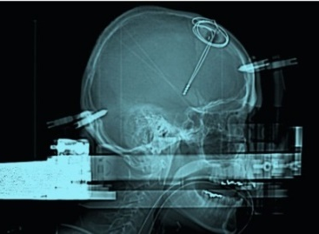
Statens medicinsk-etiska råd (Smer)
Is an advisory body to the government and parliament
Main tasks (since 1985):
identify and explore ethical issues raised by scientific and technological advances in biomedicine from a societal perspective
to serve as a body for exchange of knowledge and opinions on bioethics and serve as a link between science, citizens and policy makers
to stimulate public debate on bioethics
Notes:
The swedish ethical council on medical ethics is an advisory board mainly to the Swedish government and parilament.
The main tasks has remain the same since the start in 1985: To identify and explore ethical issues raised by scientific and technological advances in biomedicine from a societal perspective
to serve as a body for exchange of knowledge and opinions on bioethics and serve as a link between science, citizens and policy makers
to stimulate public debate on bioethics

Slide 3

Composition – unique compare to other countries
Notes:
Smer consists of a Chair and eight representatives from the political parties in the Swedish Parliament
Ten experts representing academic expertise in medical ethics, professional and patient organisations, health care providers, the National Board of Health and Welfare and the Ministry of Health and Social Affairs
The secretariat is the executive organ of the Council. Four persons + administrative support from the Ministry of Health and Social affairs.

Slide 4
Examples of National Ethics Councils
Comité consultatif national d'éthique (France)
Deutsche Ethikrat (Germany)
Nuffield Council on Bioethics (UK)
Det Etiske Råd (Denmark)
ETENE (Finland)

Slide 5
International Ethics Councils
European/International
European Commission: The European Group on Ethics in Science and New Technologies (EGE)
Council of Europe (DH/BIO)
UNESCO (IBC)

Slide 6



NETWORKING with other national ethics committes
Participation in current networks for ethics (NEC-FORUM , IDB/EC, WHO Global Summit)
Visiting experts from ethics councils in other countries

Slide 7
Ethical questions with relevance for supervision?
Questions I’m curious about:
How do you use ethical analysis in your supervisory work?
What kind of ethical questions (dilemmas) are you facing in your work?
Does the staff in your supervisory body’s have ethical competence?
Do you think ethics and ethical analysis is a valuable tool in health care and quality improvement?

Slide 8

Ethics and ethical analysis?
Conflicting principles and values on different levels

Slide 9

Values and value conflicts
Between ethical values
Between ethical and economical interests
Between ethical and medical values

Slide 10
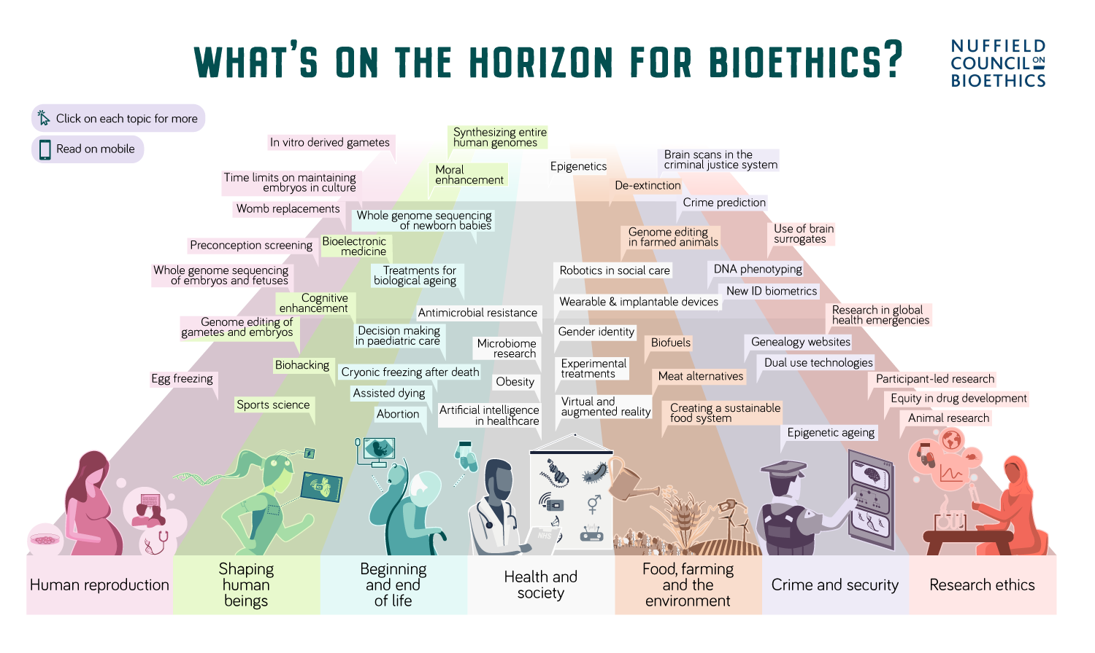

Slide 11
Topics on the council’s agenda at the moment
Children in need of a heart transplants (asylum seekers) – ethical dilemmas
  Conflicting legislations
  Prioritizing dilemmas
Ethical aspect of treatment of children with gender dysphoria

Slide 12
Current topics
Digitalisation (eHealth/mHealth)
  Artificiell Intelligens (forthcoming briefing note)
  Health data
  Welfare Technologies (robotics, health apps, wearbles/internables etc)
Genomics
  Genediting, gentic testing (direct-to – consumer)

Slide 13
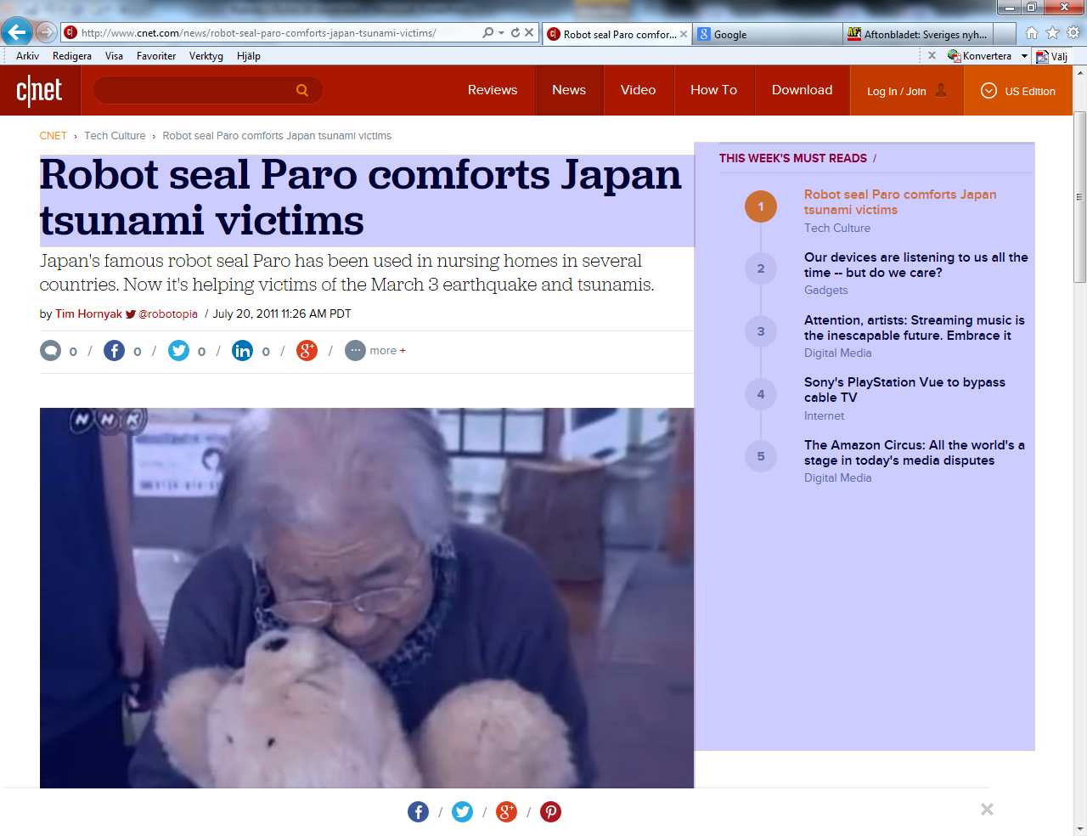
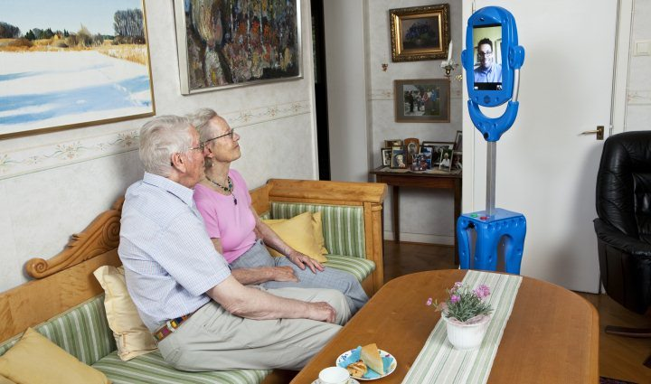
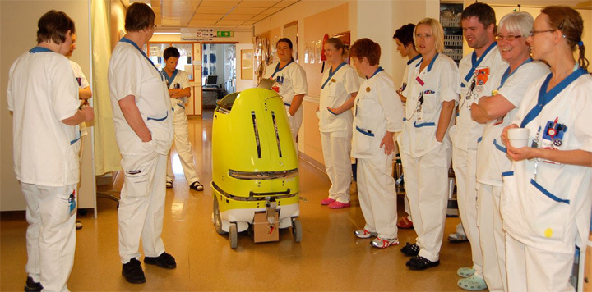
Examples of recent work:
Robotics in elderly care, report 2015

Slide 14
Robotics and surveillance in the care of elderly people
  When introducing Health care robots there could be a conflict between
on the one hand
strengthening patient integrity and efficiency in health care,
and on the other
the consequences can be lack of human contact.
Notes:
Report from the Swedish National Council on Medical Ethics in 2015.
What consequences be for the individual and for society in a larger perspective?
Focus on human robot interaction. For example the use of the ”Giraff” in elderly care, but also robots like eating-help, training and rehabilitation.

Slide 15
  Examples of conclusions in Smer’s report:
  The need for more research in Sweden concerning ethical aspects and consequences of the use of robotics in elderly health care.
  The importance of ethics research/ ethicists included within robotics research when developing health care robots.
  An ethical assessment from an individual as well as societal point of view should be conducted prior to the introduction of a health care robot

Slide 16
Robotics and surveillance in the care of elderly people
  A patient-centered individual approach
    Risk, benefit analysis
    What is the opinion of the individual?
      If the person declines, she should be given an alternative.
    Integrity concerns
      (robots can collect large extent of data concering the patient)

Slide 17

Novel medical treatments
Smer report November 2016:
Ethical considerations in the borderzone between clinical research and healthcare
English summary available.

Slide 18
Key concept: VBE
Vetenskap och beprövad erfarenhet
Science and proven experience
Legal foundation for every action taken in Swedish health care (Patient Act 2014:821)

Slide 19
Primary questions
Should it be permissible at all to use new and untested methods outside research projects?
If so, does a special ethical assessment need to be carried out in these cases ?
How should the risk-benefit assessment be done before using the innovative treatment
How can infomed consent be obtained from the patient?

Slide 20
Smer’s positions
Principle rule: Unproven methods should be developed and implemented as research projects
Unproven methods may, however, be offered outside a research project under some strictly defined preconditions. The aim should be to help an individual patient

Slide 21
Governance and ethics in health care
  New report april 2019:
  Governance models in Health care – draft of a model for ethical analysis

Slide 22
Governance and ethics in health care
The council is of the opinion that:
Ethical analysis is a tool that should be used at different levels
Ethical competence among decisionmakers is essential
New models should be developed and improved in collaboration between professionals and decision-makers, taking value questions and ethical issues as a starting point.

Slide 23
Tool for ethical analysis
The model is based on four basic concepts:
The current situation
Goals and objectives
Barriers and
Strategies
The report can be found in English on www.smer.se later this week.

Slide 24
Thanks! www.smer.se
Cut of photograph of artwork by Göran Hermerén
Cut of artwork by Göran Hermerén, Lund, Sweden

Slide 25
Preconditions - general
    Exceptional cases for single patients
    Severe suffering or extensive impairment of quality of life
    Effective conventional methods lacking or conventional treatment options depleted
    Potentially effective based on theoretical scientific reasoning
    Animal studies and/or human studies (e g in other disorders)
    Expected benefits in reasonable proportion to possible risks

Slide 26
Preconditions - practical
    Informed consent
    Decision by Head of Department
    Written plan
    External ethical assessment
      ethical, legal and medical expertise
    In acute situations
      written plan, post hoc assessment
    All results reported nationally

Slide 27
The quantified human.
Ethical aspects on Self-monitoring using wearbles and health apps. Report 2017.

